Slide 1
Informational Hearing on CHSRA Proposed Draft Business Plan
Senate Transportation Committee
& Budget Subcomittee 5
March 16, 2021

Slide 2
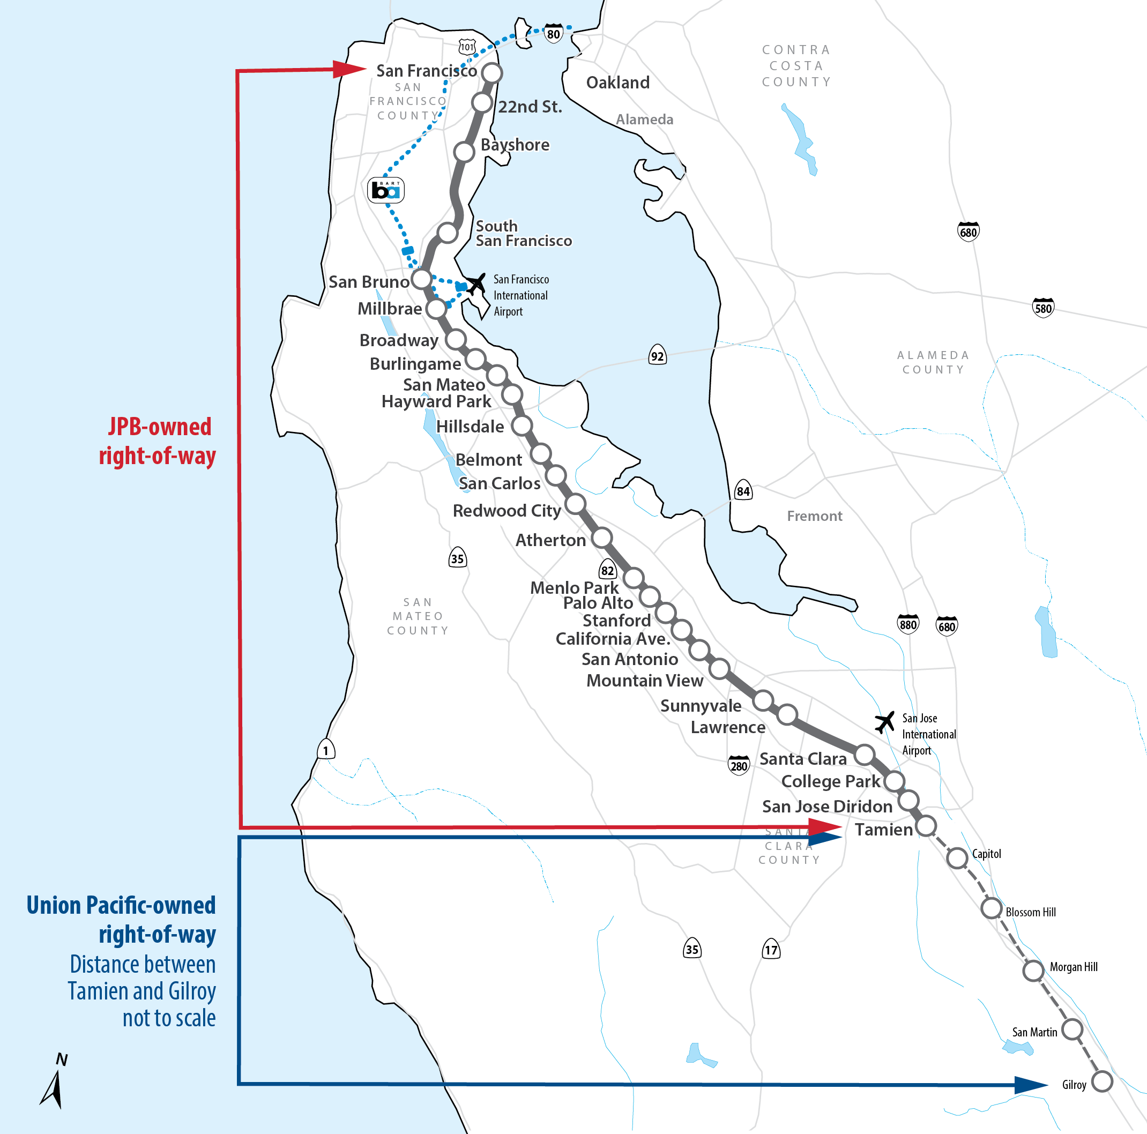
Caltrain System
77 Miles
31 Stations: San Francisco to Gilroy
92 Weekday Trains*
7th Largest Commuter Railroad in Nation*
  65,000 daily riders
  Carries equivalent 4 lanes on US 101
One of highest farebox recovery in nation
Bi-directional commute
Key economic hubs throughout corridor
Major transit system on western half of bay, connecting to BART, ACE, CC, MUNI, VTA, and SamTrans
*pre-covid

Slide 3
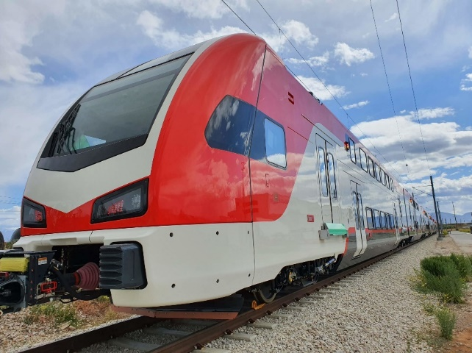

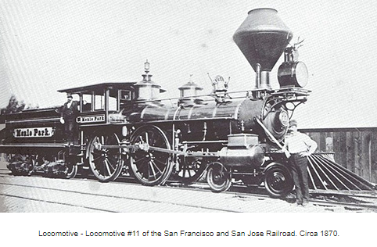
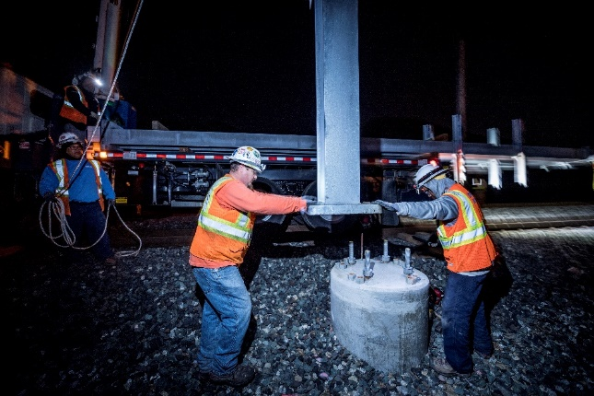
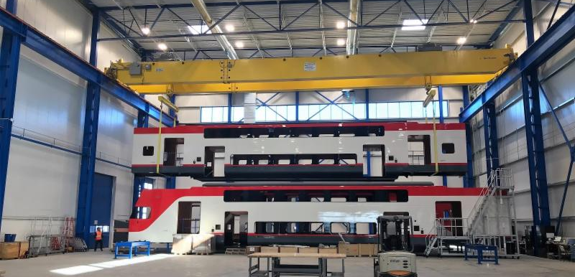
Caltrain Electrification
  Modernizing a 150 year old railroad, compatible with future HSR

Slide 4
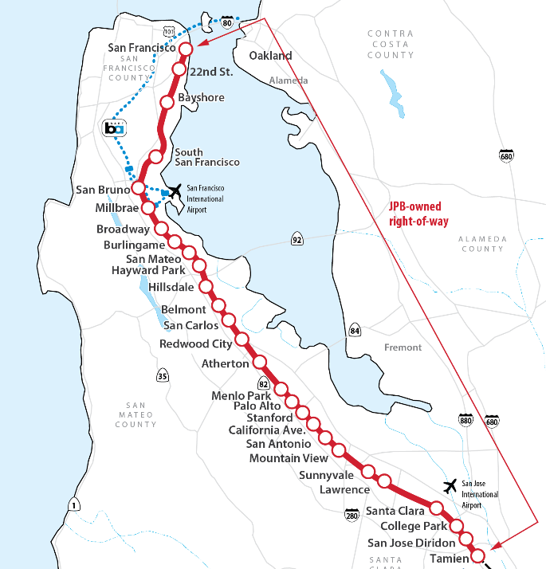





Caltrain Electrification
Project Area
Project Elements
Project Benefits
Improved Train Performance, Increased Service and Greater Capacity
Improved Regional Air Quality and Reduced Greenhouse Gas Emissions
Reduced Engine Noise Emanating from Trains
Electrification
Overhead Contact System (OCS)
Traction Power Facilities
Electric Trains*
19 7-car train sets
133 electric cars
*Includes 2018 State TIRCP Funding
Increased Revenue and Reduced Fuel Cost
51 miles
San Francisco to San Jose
(Tamien Station)
Positive Economic Benefits for the Region
CalMod.org

Slide 5
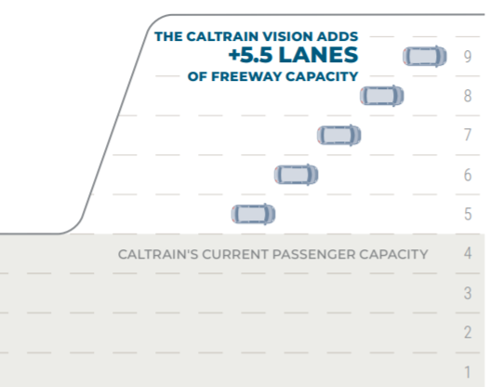
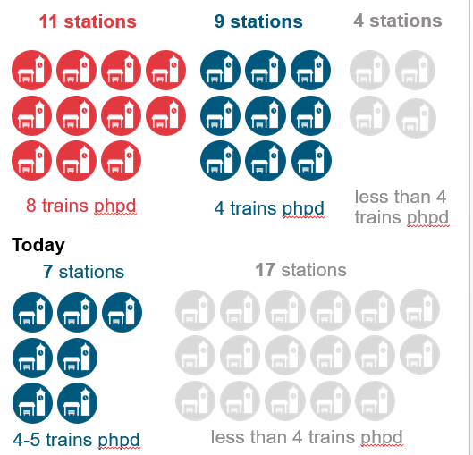
2040 Vision - Board Adopted
2040, unconstrained demand 240,000 daily riders
By 2040, 1.2 million new people w/in 2 miles Caltrain Corridor (40% increase)
Vision: 8 trains per hour, per direction
Trains vs. Lanes: capacity equivalent 5.5 additional freeways lanes
More Service at More Stations: 20 stations, train at least every 15 minutes

Slide 6
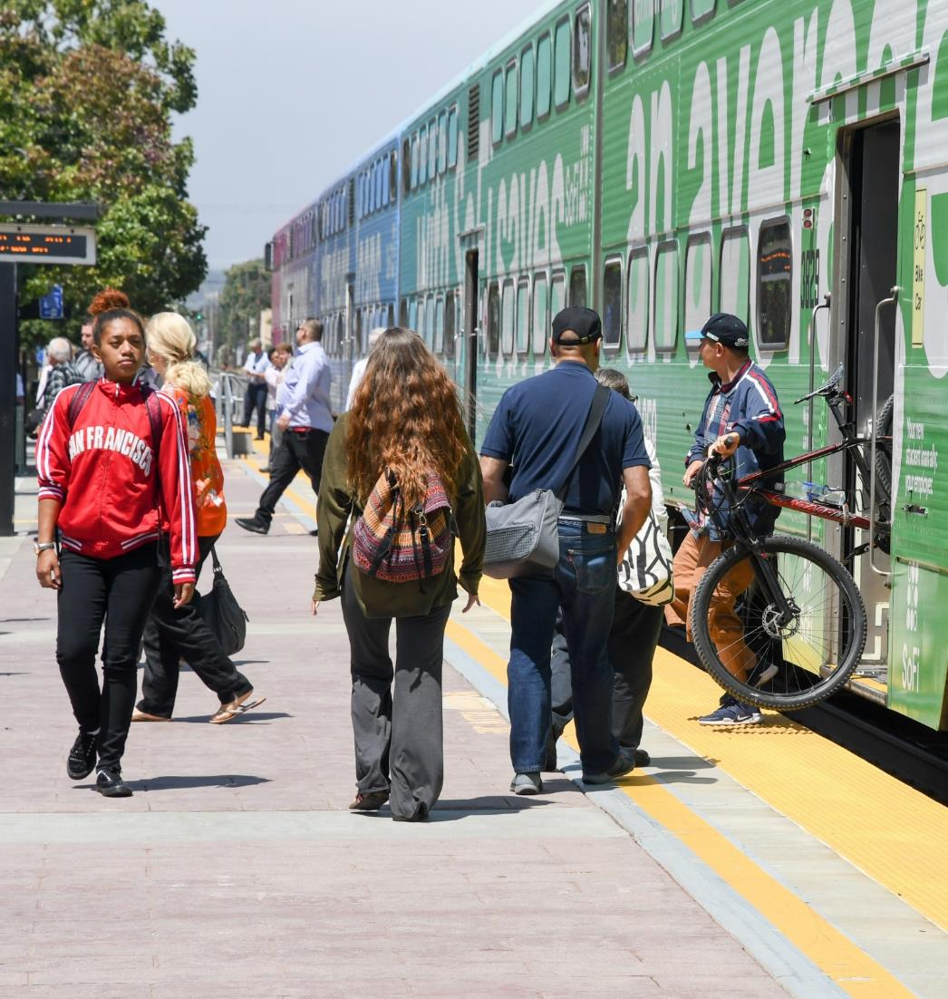
Equity Policy – Board Adopted
Purpose:
Provides guidance to help the railroad navigate implement needed changes and guide near- and mid-range planning
Addresses pressing equity and connectivity concerns
Policy Focuses on:
Equity in service, fares, customer interactions, organizational accountability
Operating a clock face schedule
Prioritizing transfer point in service planning
Working toward regionally coordinated fares and transfers

Slide 7
Contact Information
Website: www.Caltrain.com
Electrification: CalMod.org
Business Plan: Caltrain2040.org
Twitter: @Caltrain, @GoCaltrain

