Slide 1
senate joint hearing Revised Draft 2020 Business plan
Brian Kelly
Chief Executive Officer
March 16, 2021

Slide 2
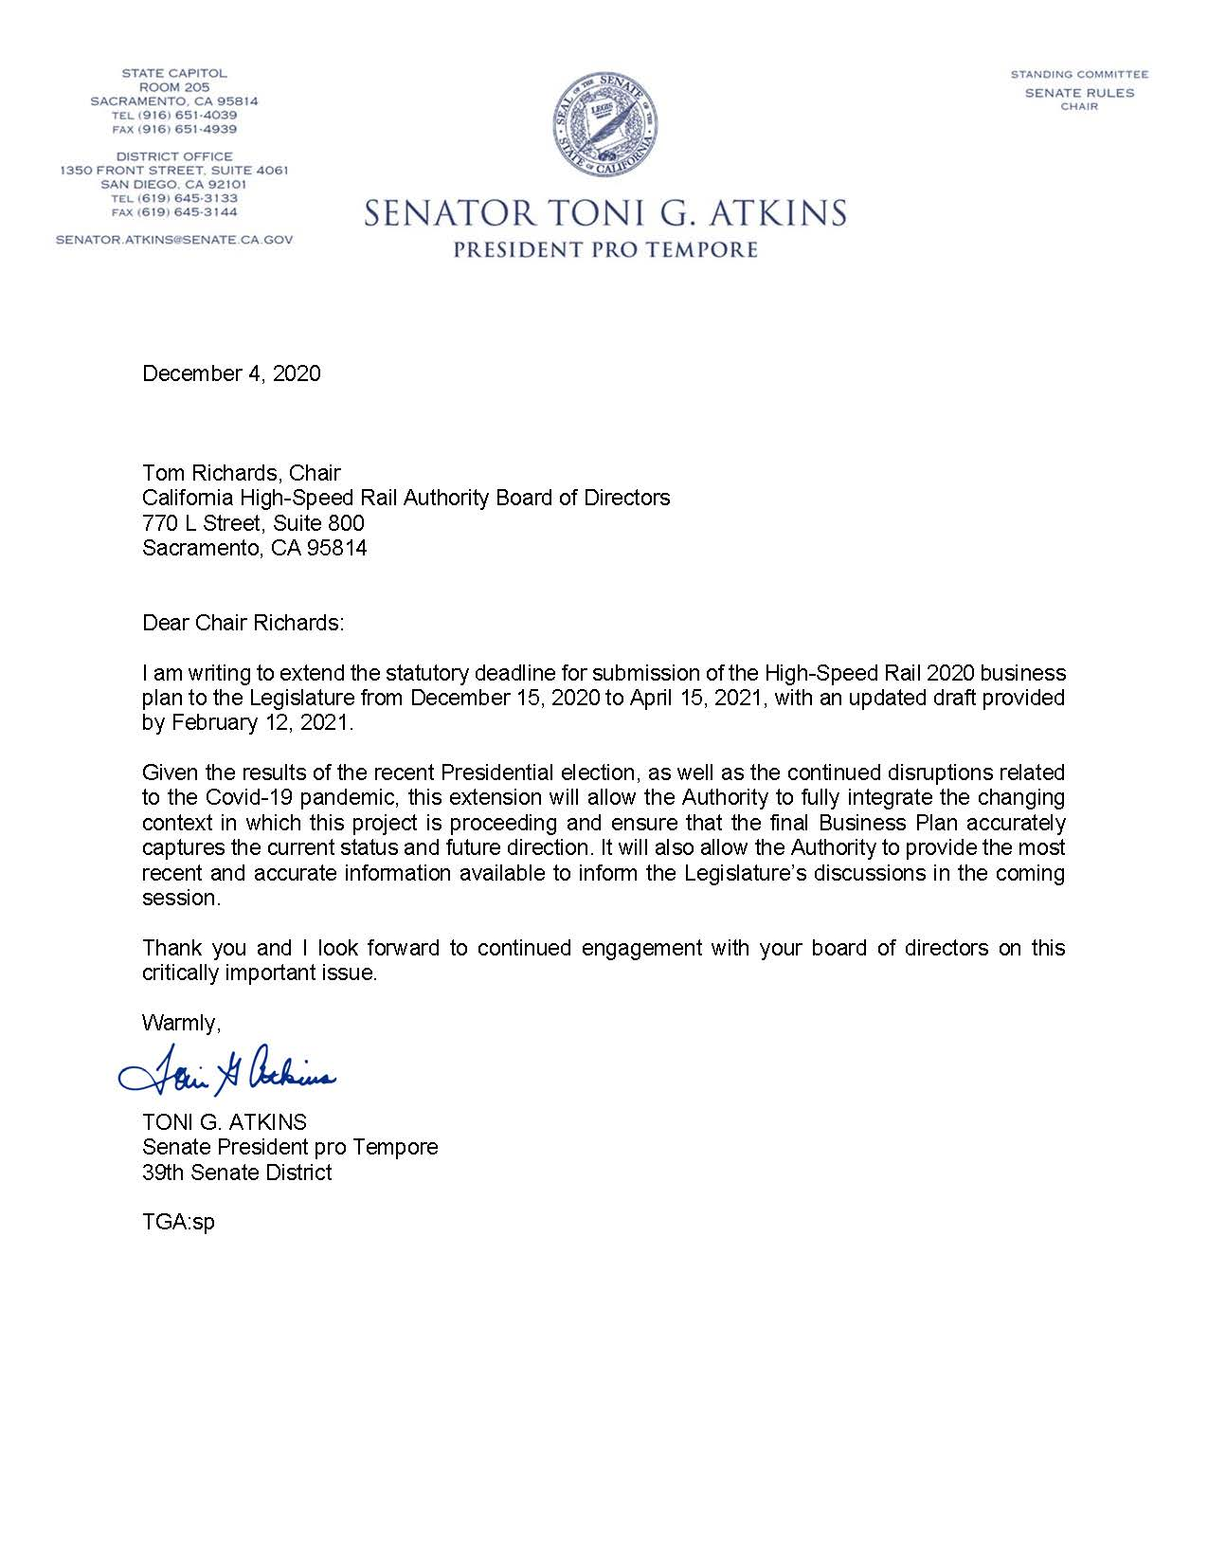
Revised Draft 2020 business plan
CALIFORNIA HIGH-SPEED RAIL
Revised Draft Plan released on February 9, 2021
30-day public review through March 12, 2021
Final Business Plan to Legislature by April 15, 2021
December 4, 2020
Tom Richards, Chair
California High-Speed Rail Authority Board of Directors
770 L Street, Suite 800
Sacramento, CA 95814
Dear Chair Richards:
I am writing to extend the statutory deadline for submission of the High-Speed Rail 2020 business
plan to the Legislature from December 15, 2020 to April 15, 2021, with an updated draft provided
by February 12, 2021.
Given the results of the recent Presidential election, as well as the continued disruptions related
to the Covid-19 pandemic, this extension will allow the Authority to fully integrate the changing
context in which this project is proceeding and ensure that the final Business Plan accurately
captures the current status and future direction. It will also allow the Authority to provide the most
recent and accurate information available to inform the Legislature’s discussions in the coming
session.
Thank you and I look forward to continued engagement with your board of directors on this
critically important issue.
Warmly,
TONI G. ATKINS
Senate President pro Tempore
39th Senate District
TGA:sp
2

Slide 3
Revised Draft 2020 Business Plan
CALIFORNIA HIGH-SPEED RAIL
2020 COVID-19 Impacts to High-Speed Rail:
244 workers quarantined;
$288 million in lost Cap and Trade revenue;
Environmental schedules extended for 4 project sections;
Track and Systems procurement delayed until Q3 2021;
Right of Way acquisition affected by court delays
3

Slide 4
Revised draft 2020 Business Plan
Schedule Updates
We anticipate needing more time to complete Central Valley Segment construction
Construction Elements | Projected Completion
Construction Package 1 | December 2023
Construction Package 2-3 | December 2023
Construction Package 4 | April 2022
Track and Systems Contract Award | Q3 2021
4

Slide 5
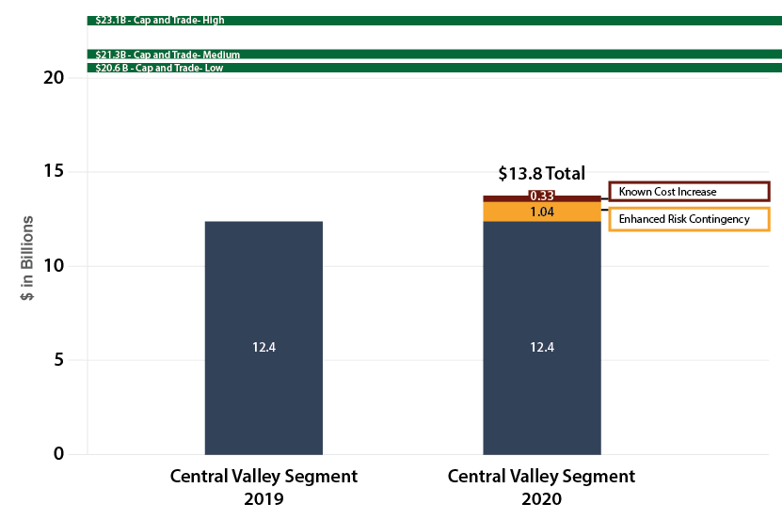
Revised draft 2020 Business Plan
Central Valley Segment Cost Updates
Construction costs have increased by $330 million
Remaining construction still has risk and impacts due to the pandemic.
Recommend adding approximately $1.0 billion to contingency
Estimate includes phased track implementation (single track for system testing)
5

Slide 6
Revised draft 2020 business plan
SCHEDULE UPDATES FOR RECORDS OF DECISION
Project Section | Draft EIR/EIS | Projected ROD Date
Bakersfield to Palmdale | Complete (February 2020) | Q2 2021
Burbank to Los Angeles | Complete (May 2020) | Q4 2021
San José to Merced | Complete (April 2020) | Q1 2022
San Francisco to San José | Complete (July 2020) | Q2 2022
Palmdale to Burbank | Q3 2021 | Q4 2022
Los Angeles to Anaheim | Q4 2021 to Q1 2022 | Q4 2022 to Q2 2023
6

Slide 7
Why Extend to Bakersfield and Merced
171-MILE INTERIM SERVICE
It reduces travel time by 90-100 minutes
It provides a valuable state asset and more than doubles service through the Central Valley from – 7 daily trips to 18
It connects three of the fastest growing cities of the state
It produces the greatest ridership increase and farebox benefit for the smallest investment compared to other corridors
Provides for interim connection to parts north via the San Joaquin service (into Bay Area and Sacramento) and bus connection in the south to the LA Basin
Implementation for 171-mile segment is expected to generate 203k job years and $40B in economic activity
Bakersfield Station Artist Concept
7

Slide 8
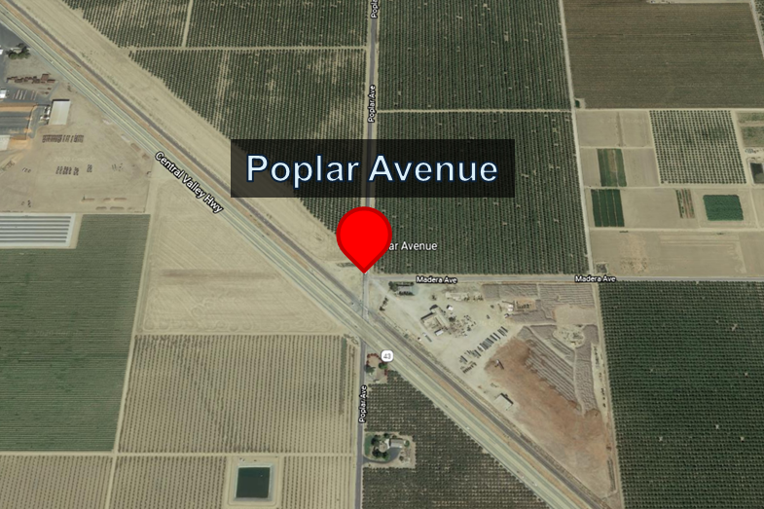
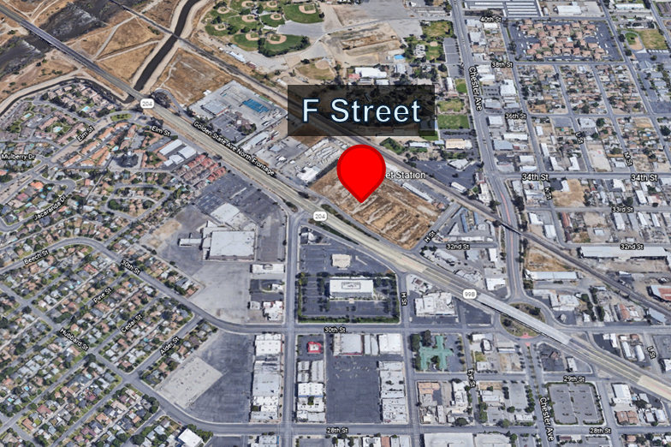
Revised Draft 2020 Business Plan
Southern Terminus Options
SHAFTER – Poplar Avenue
Southern terminus of 119-mile first construction segment
BAKERSFIELD – F Street
Southern terminus of Newsom Administration’s first high-speed operating segment (171 miles)
8

Slide 9
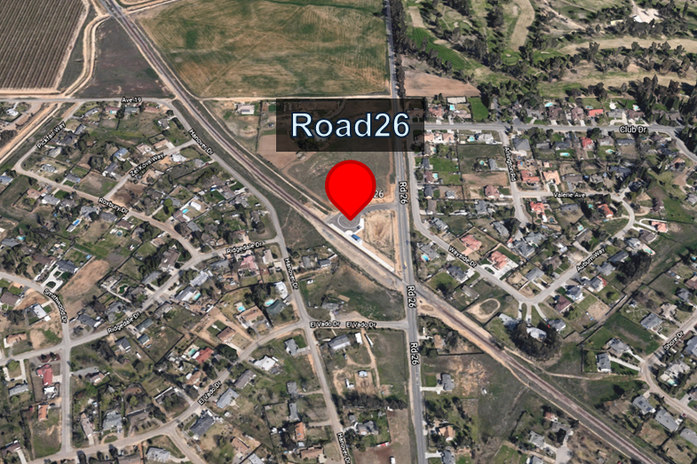
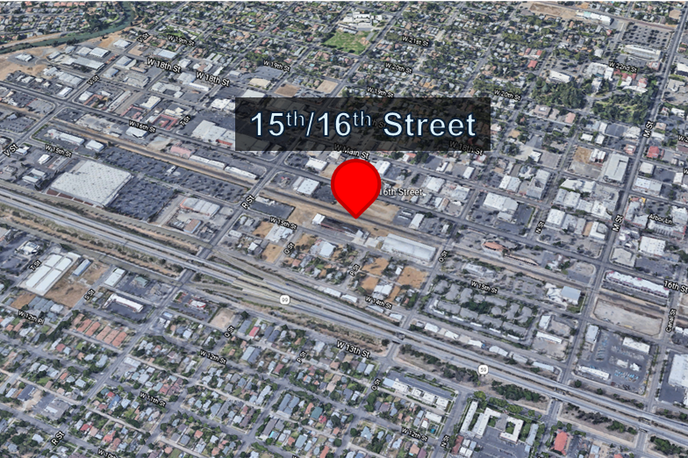
Revised Draft 2020 Business Plan
Northern Terminus Options
MADERA – Road 26
Northern terminus of 119-mile FRA-funded first construction segment (current Amtrak station)
MERCED – W 15th/W 16th St
Northern terminus of Newsom Administration’s first high-speed operating segment (proposed station where HSR, ACE and San Joaquin service will connect)
9

Slide 10
Revised Draft 2020 Business Plan
Addressing Comments on Interim Service: Merced to Bakersfield
We evaluated questions raised by Legislature and Peer Review Group:
Independent peer review of ridership forecasts
Memorandum of Understanding with CalSTA and San Joaquin Joint Powers Authority for interim service roles and responsibilities
10

Slide 11
Revised draft 2020 Business Plan
Peer Review of Ridership Projections
Further analysis conducted to address questions on ridership estimates:
Peer Review Group helped define the scope of independent review
Resource Systems Group – a third party transportation research and analytics firm – assessed whether assumptions and results were reasonable
Resource Systems Group review concluded:
“No fatal flaws” with the work performed by the Early Train Operator
Ridership estimates are within expected “ranges for travel time and frequency”
Merced to Bakersfield initial operating segment “Obtains the highest forecast gain in ridership and does so at the lowest increase in cost” compared to the Burbank-Anaheim and San José-Gilroy corridors
11

Slide 12
Revised draft 2020 Business Plan
Merced and Bakersfield extensions
These studies and efforts reaffirm value in the Merced to Bakersfield interim service:
The Merced and Bakersfield extensions are environmentally cleared
We recommend advancing design which will include engineering and:
Right-of-way mapping
Identifying utility relocations
Third-party agreements
Establishing the project footprint (project configuration)
This will refine our cost estimates and prepare these extensions for pre-construction activities
12

Slide 13
Revised draft 2020 Business Plan
Current Funding
Funding:
Business Plan updates funding forecast through 2030 as a range based on Cap-and-Trade projections
Total funding range is $20.6 billion to $23.1 billion
Cost estimate to complete Merced to Bakersfield Line ranges from $21.3 billion to $22.8 billion (base cost estimate is $22.2 billion)
Funding Plan to seek appropriation of remaining Proposition 1A funds as part of the 2021 Budget Act to complete construction currently underway
13

Slide 14
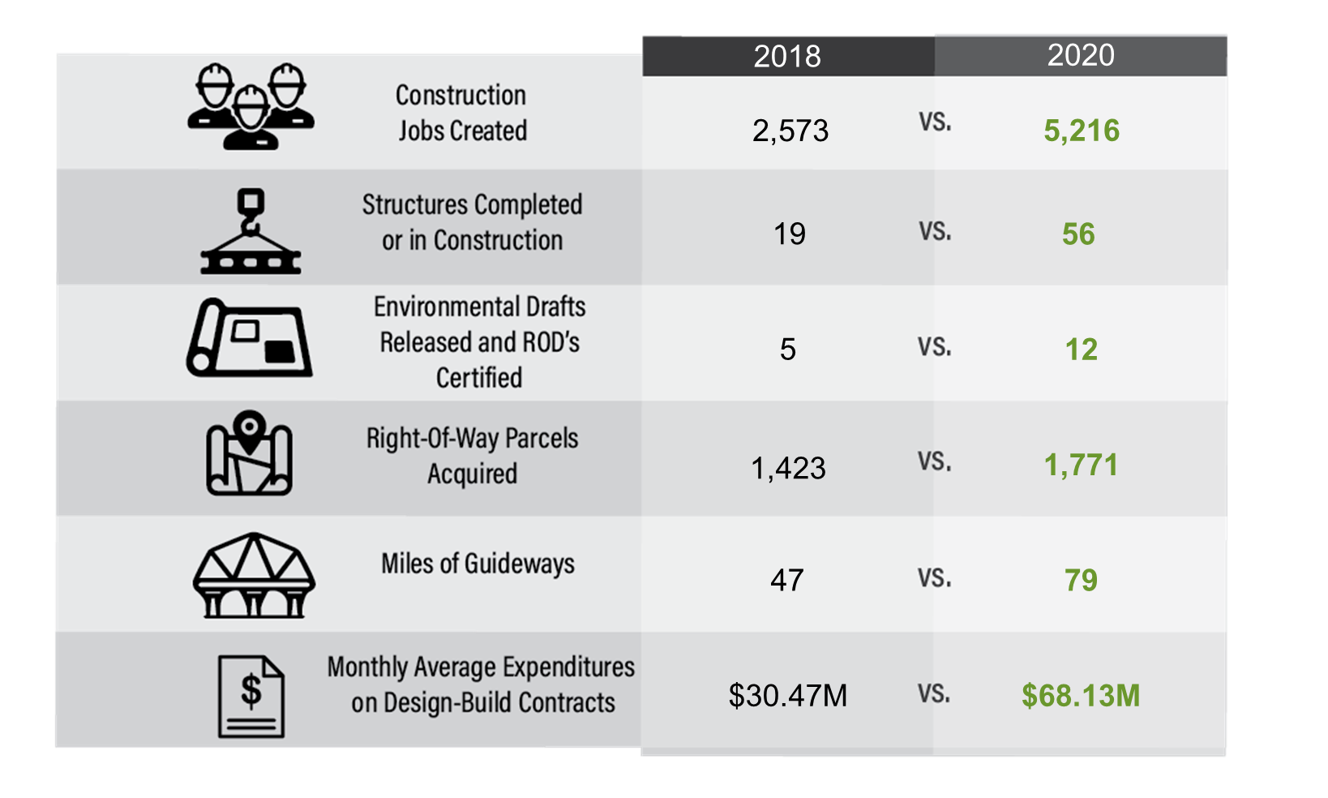
Revised draft 2020 business plan
Progress – 2018 to 2020
14

Slide 15
Revised draft 2020 Business Plan
2021 Milestones
Over the next 12-15 months:
100% of ARRA state match will be completed in Q1 2021 – 22 months ahead of December 2022 deadline
Substantial completion of Construction Package 4
Environmental clearance of first two segments in Los Angeles County
Bakersfield to Palmdale
Burbank to Los Angeles
Award Track and Systems contract, commence work in 2022
Begin advance design work on Merced and Bakersfield extensions
Construction completed or underway on
83 of 93 structures
106 of 119 miles of guideway
15

Slide 16
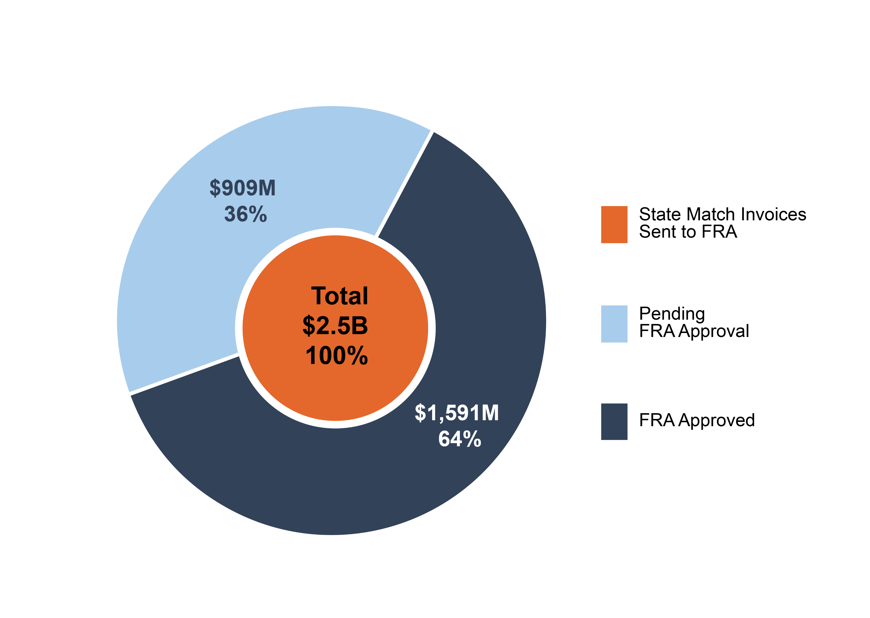
Revised draft 2020 Business Plan
Fulfilling our arra grant commitments
ARRA matching funds:
16
Notes:
Highly-structured capital project development and approval process
Enhanced risk reviews will strengthen risk management
“Gates” are major project milestones marked by significant reviews and approvals before advancing into the next stage
Addresses lessons learned from starting construction before pre-construction activities are completed, including:
Completing preliminary engineering
Third-party agreements – railroads, utilities, local jurisdictions
Right-of-way acquisition
Risk reviews and Monte Carlo analysis built into each stage

Slide 17
Revised draft 2020 Business Plan
A New Federal Partnership
The Biden administration presents an opportunity to re-establish our federal partnership:
The Authority is engaging with new administration on:
Restoration of Federal Partnership
Settling litigation to restore FY/10 grant funding de-obligated by the Trump Administration
Program delivery schedule flexibility
New administration and Congress create opportunity for increased federal investment in electrified high-speed rail
California is well-prepared to benefit (i.e., SB 1, Cap and Trade $, commitment to cleaner transportation future)
17

Slide 18
Revised draft 2020 Business Plan
CALIFORNIA HIGH-SPEED RAIL
“It always seems impossible until it is done”
Nelson Mandela
18

Slide 19
Revised draft 2020 business plan
CALIFORNIA HIGH-SPEED RAIL

