Slide 1
Summer 2015

Slide 2
Summer 2016

Slide 3
August 2015

Slide 4
February 2016

Slide 5
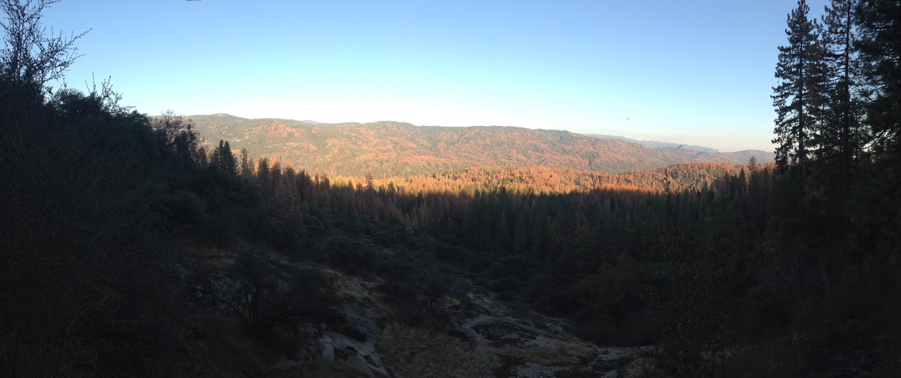

Slide 6
August 2016

Slide 9
Rim Fire 50 miles away

Slide 12
Prescribed burn 1 mile away

Slide 15
