Slide 1
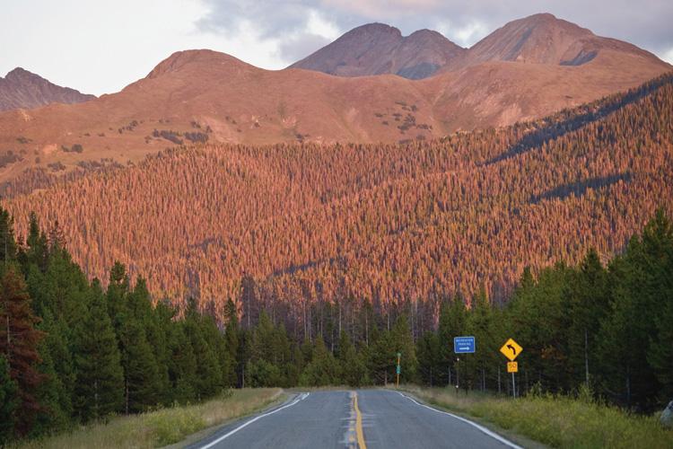
Restoring California’s Forest Health:
Time for a new approach!
Notes:
Thank you, Chairman Hertzberg, Chair Garcia , for the opportunity to testify in front of this Committee

Slide 2
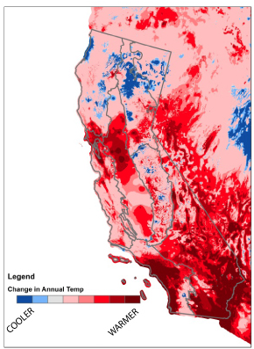
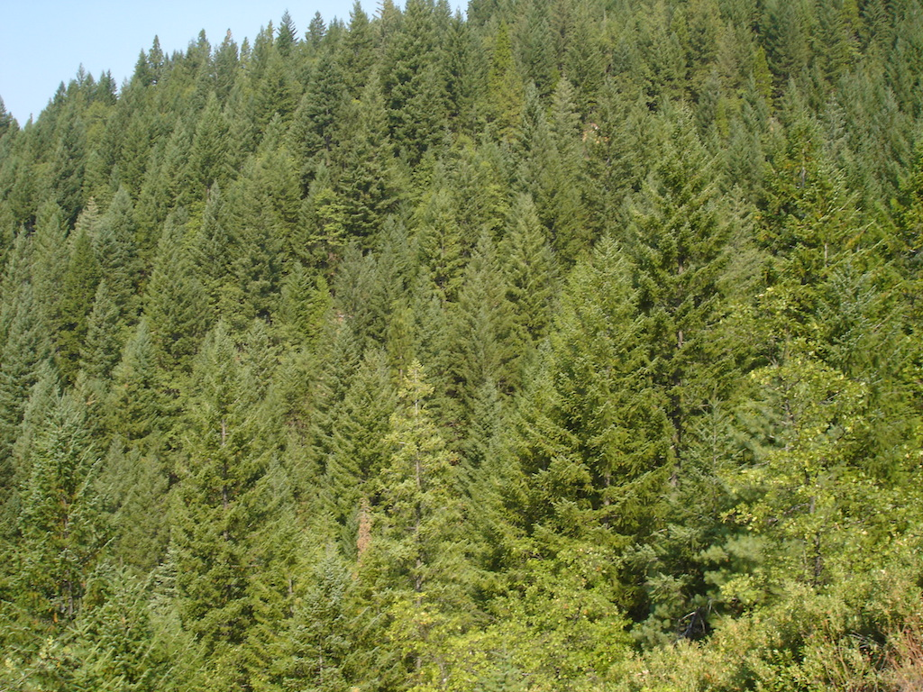
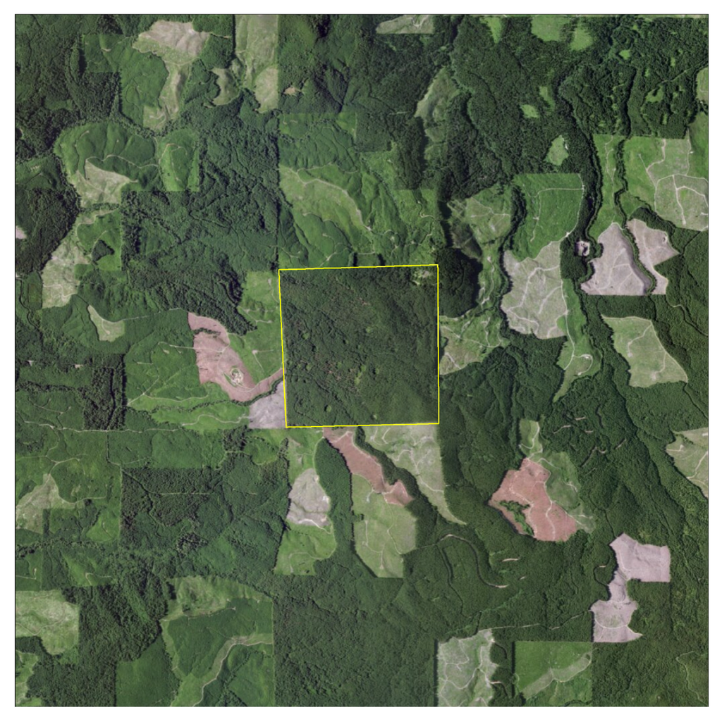
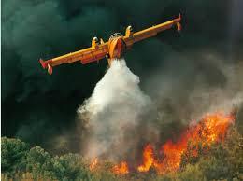
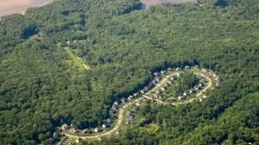
Confluence of factors
* Young, simplified forests
* Fragmentation
Development
Fire suppression
Climate change
Notes:
Pat management focused on producing these Overly dense, young, simplified forests : not disease or pest resistant as our native diverse forests are. No real bark, too thirsty
Not good for fire or water and limited for habitat
Multi story canopy with large trees can increase effective precipitation 10-25% (redwoods)
Attracts and retains more moisture longer
Also can reduce fire impacts
Sprawl force fire fighters to go in where maybe they shouldn’t
Hotter and drier and longer summers

Slide 3
Multiple forest benefits:
Notes:
Overly dense forests.
They prevent rain and snow from penetrating to the ground. Some 70% of Snow on these can be lost to evaporation
Multi story canopy with large trees can increase effective precipitation 10-25% (redwoods)
Attracts and retains more moisture longer
Also can reduce fire impacts

Slide 4
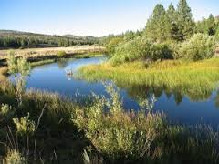
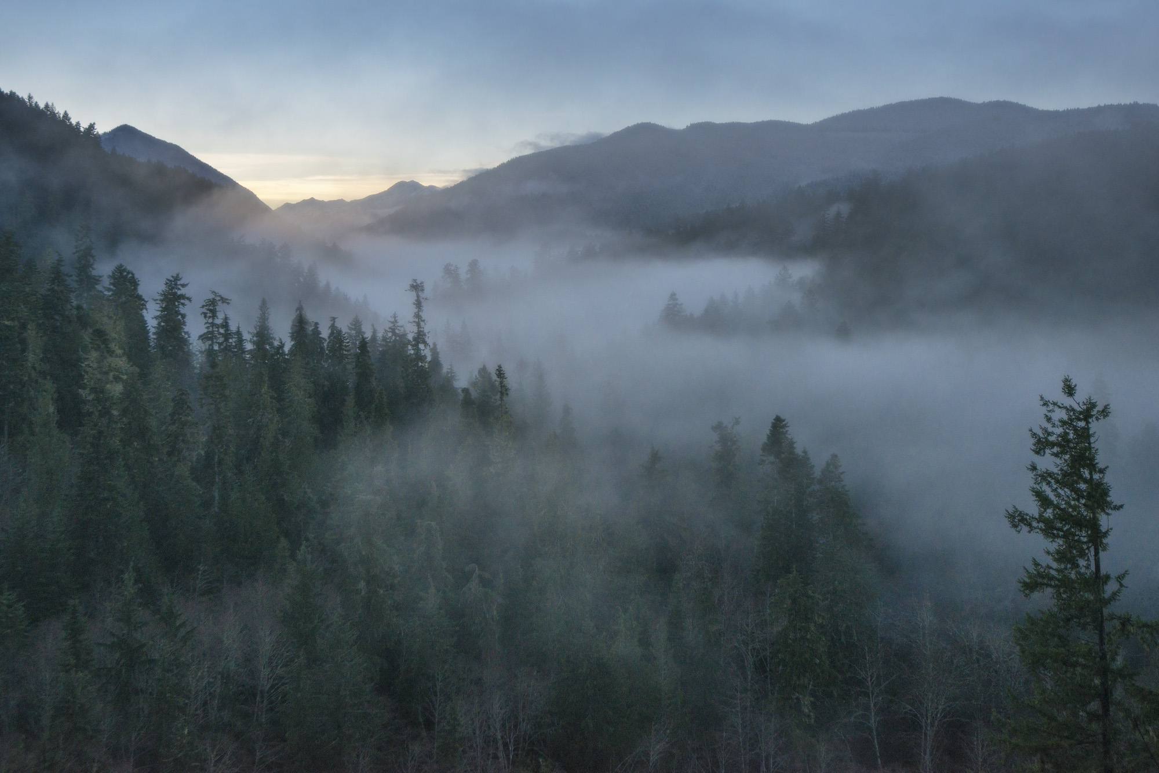
How do we restore healthy function?
Notes:
Overly dense forests.
They prevent rain and snow from penetrating to the ground. Some 70% of Snow on these can be lost to evaporation
Multi story canopy with large trees can increase effective precipitation 10-25% (redwoods)
Attracts and retains more moisture longer
Also can reduce fire impacts

Slide 5
Change our management approach: more than one tool!
Notes:
Overly dense forests.
They prevent rain and snow from penetrating to the ground. Some 70% of Snow on these can be lost to evaporation
Multi story canopy with large trees can increase effective precipitation 10-25% (redwoods)
Attracts and retains more moisture longer
Also can reduce fire impacts

Slide 6
Recommendations
Holistic integrated investments
Restore natural forest features & functions
Match solutions to ownership types
More than crisis reaction: work, time & money

Slide 7
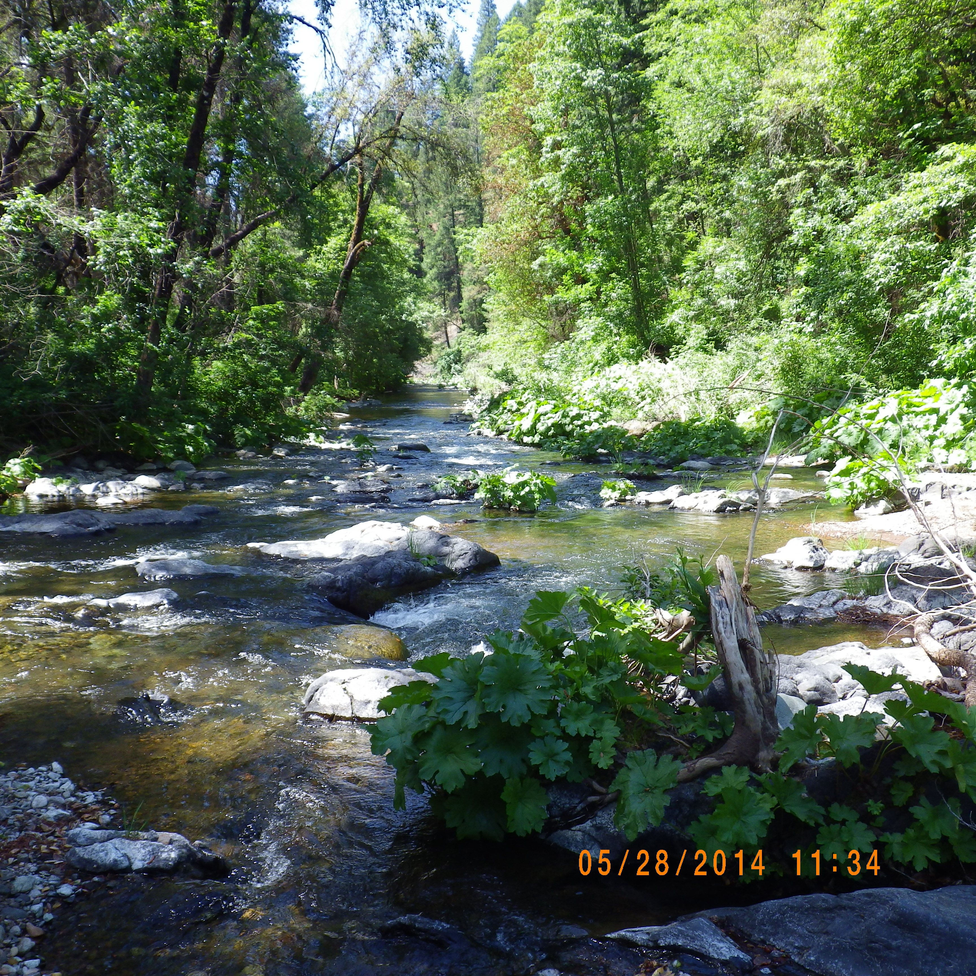
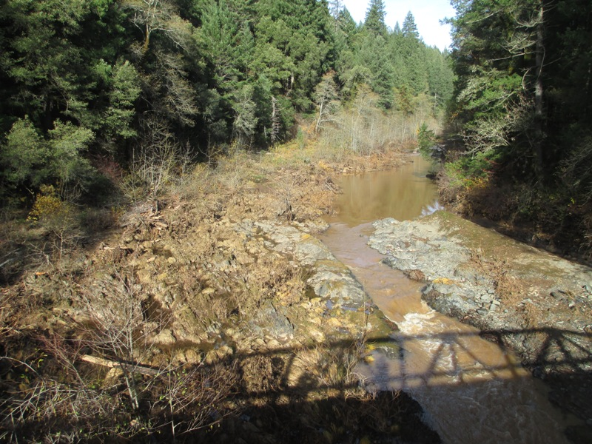
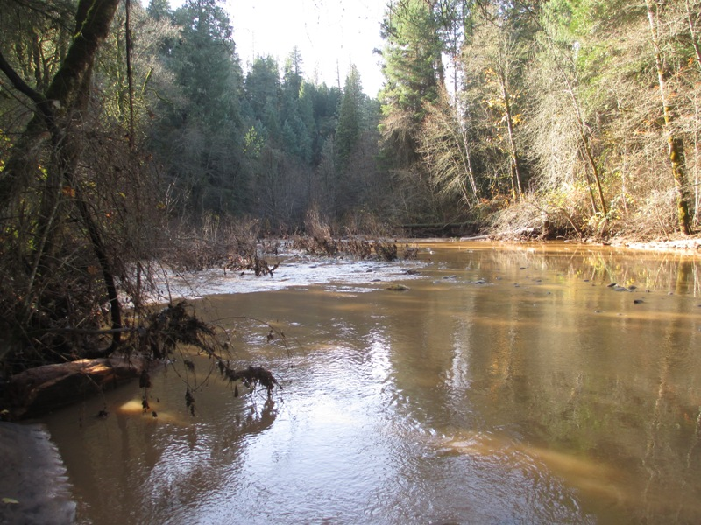
Promote Resiliency
Spring 2013
Squaw Creek May 2014
Notes:
These conditions will persist, threats will persist and Net net we need to restore resiliency and the ability of forests to sustain and recover from stress---be resilient. As climate change advances, essential. Fire in Mc Cloud watershed 2012, followed by floods 2013 Squaw Creek McCloud River watershed and 1 year later.
Shortly after the fire much of the sediment has moved Squaw Creek and water quality has improved.
Squaw Creek, in McCloud watershed where thinning had been implemented to reduce small diameter trees, enhance stand complexity.

Slide 8
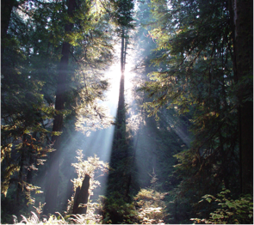
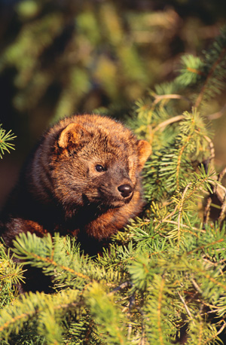
Thank You!
For further info: Laurie Wayburn: lwayburn@pacificforest.org

