Slide 1
The Future of Kern County
An EJ Perspective on Transitioning Workforce, Environment & Economy

Slide 2
Goals for Future Kern County
Thriving and prosperous local economy
Good, well-paying, safe jobs
Healthy places to live, work, play and pray
Increased investment in Kern County, prioritizing areas that have historically been harmed by environmental hazards

Slide 3
Local Economy – Current Status
Non-diverse
High unemployment (Kern – 6.4%; CA – 3.7%)
High rates of poverty (Kern – 22.6%; CA – 15.1%)
Highly dependent on a naturally declining oil and gas industry

Slide 4
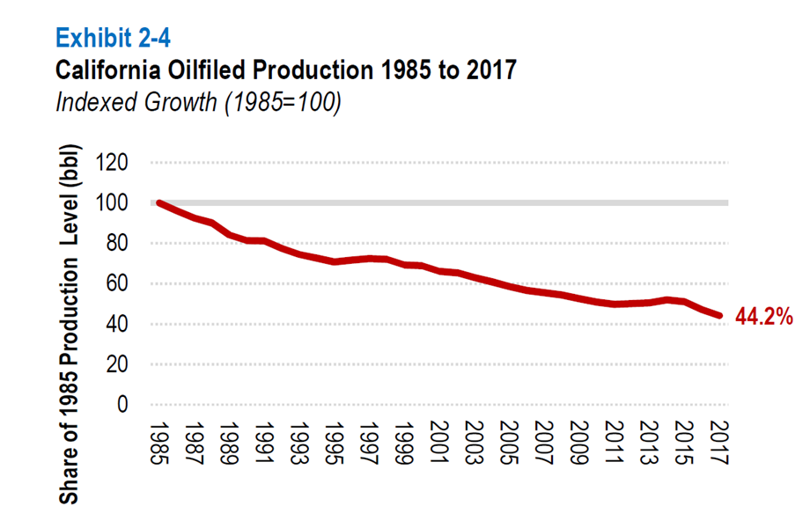
Oilfield Production in California

Slide 5
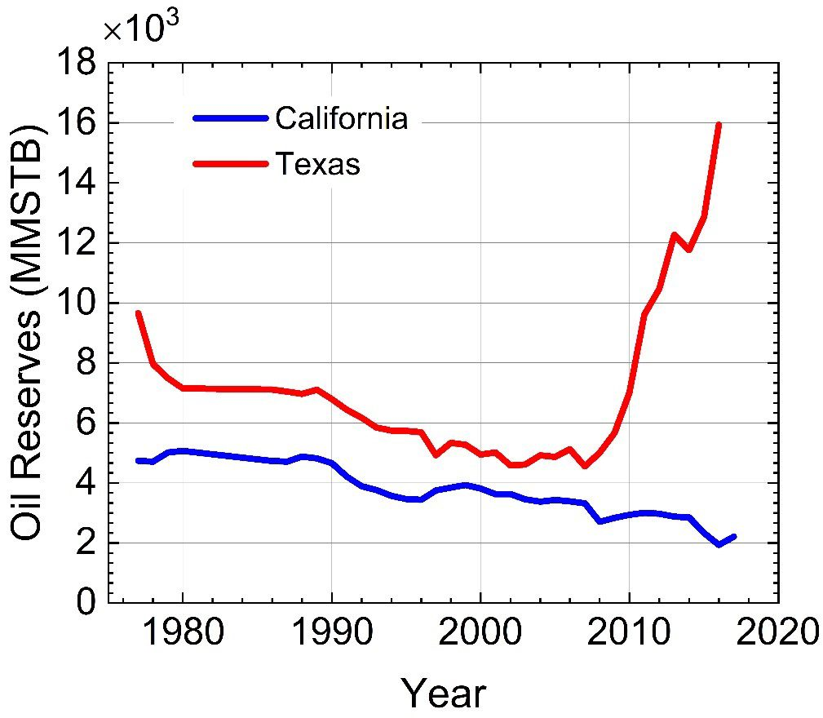
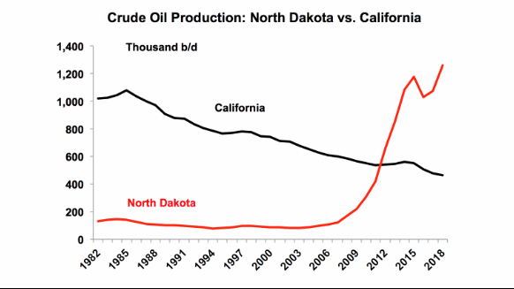
Why the Decline?

Slide 6
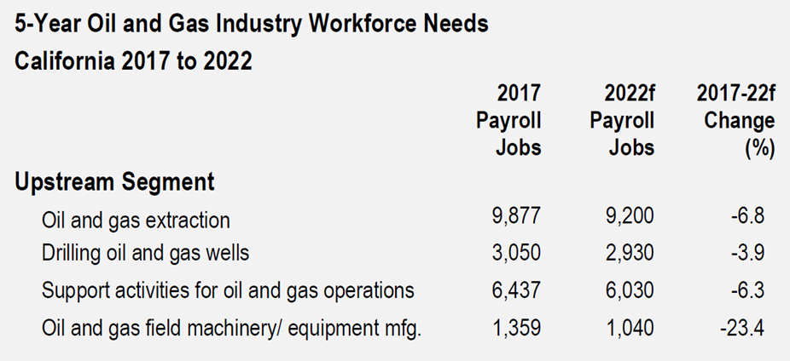
Workforce Trajectory

Slide 7
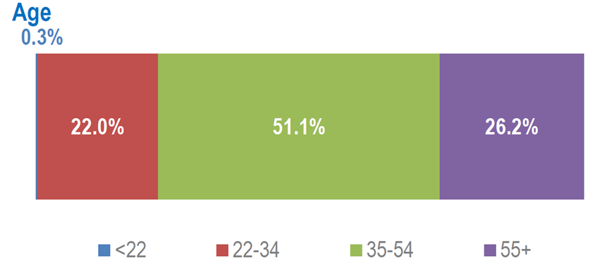
Workforce Composition

Slide 8
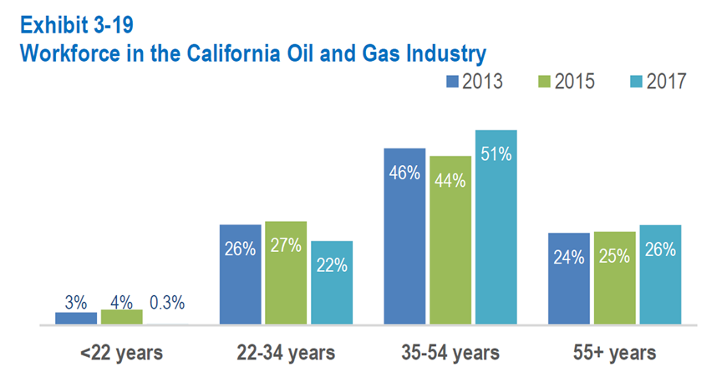
Workforce Composition Trajectory

Slide 9
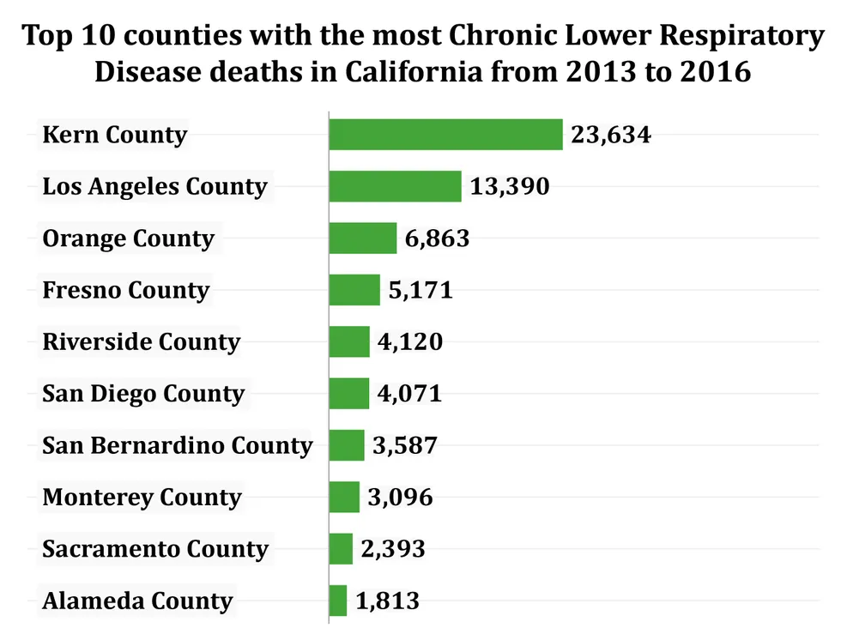
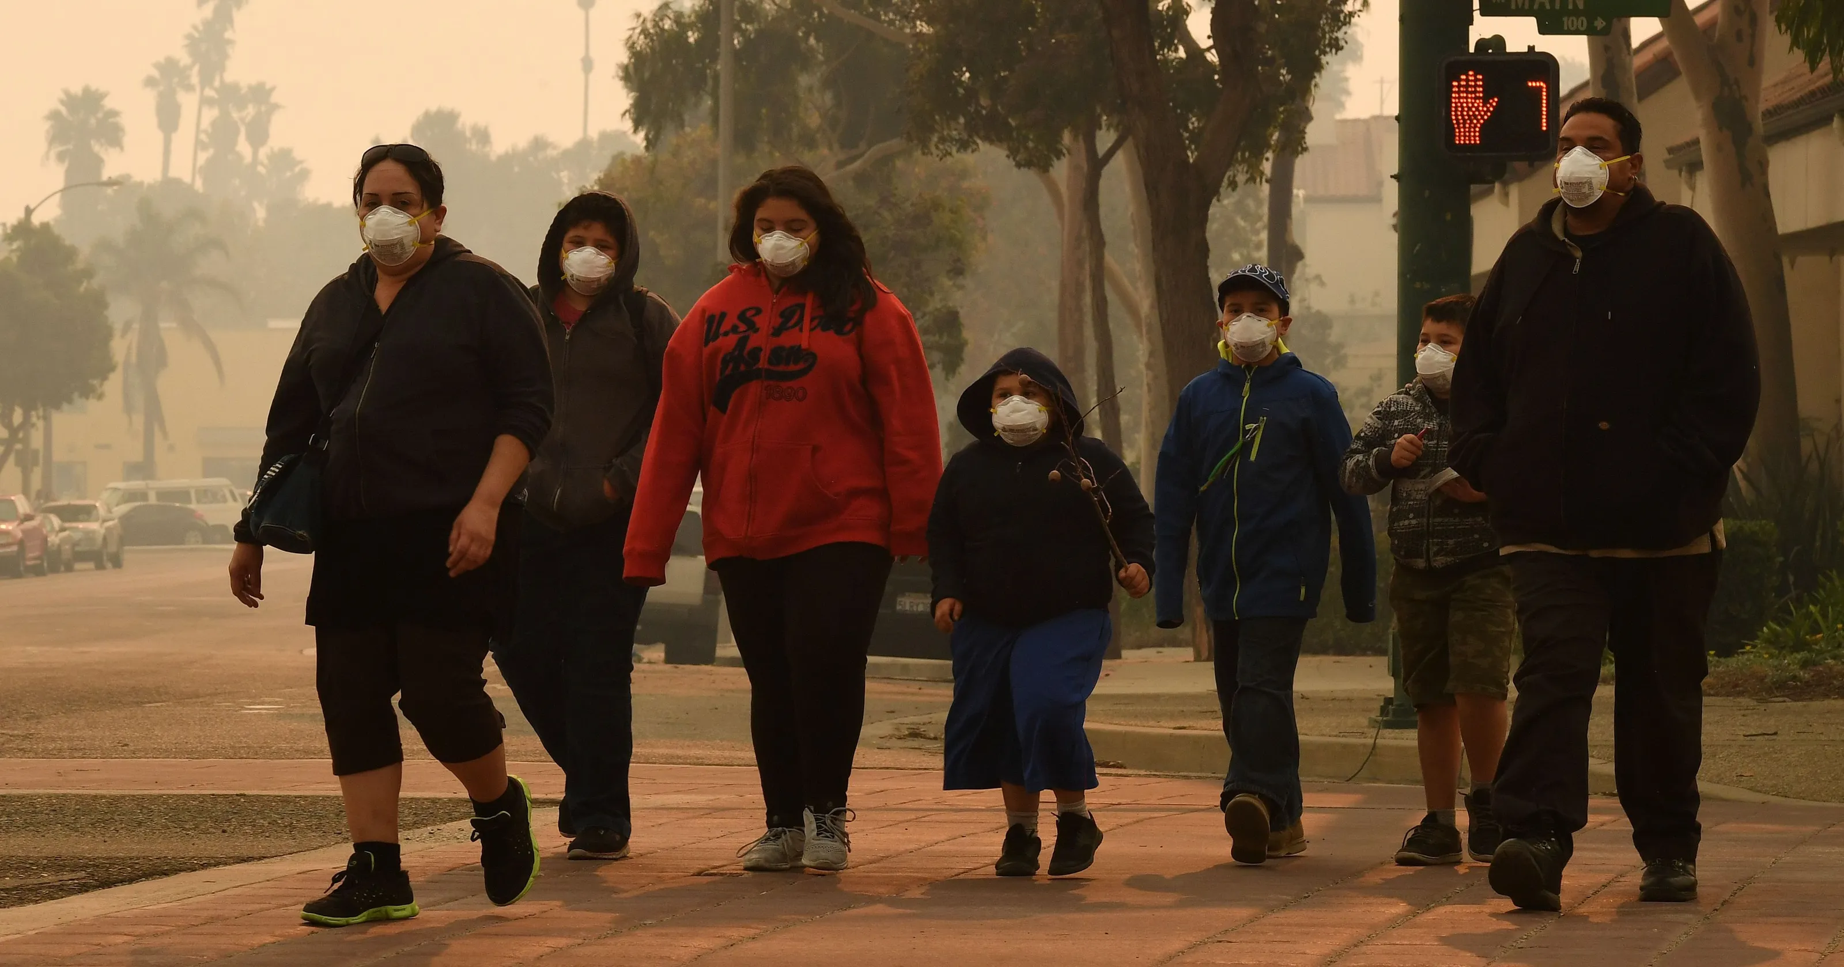
Health Costs of Oil/Gas Production

Slide 10
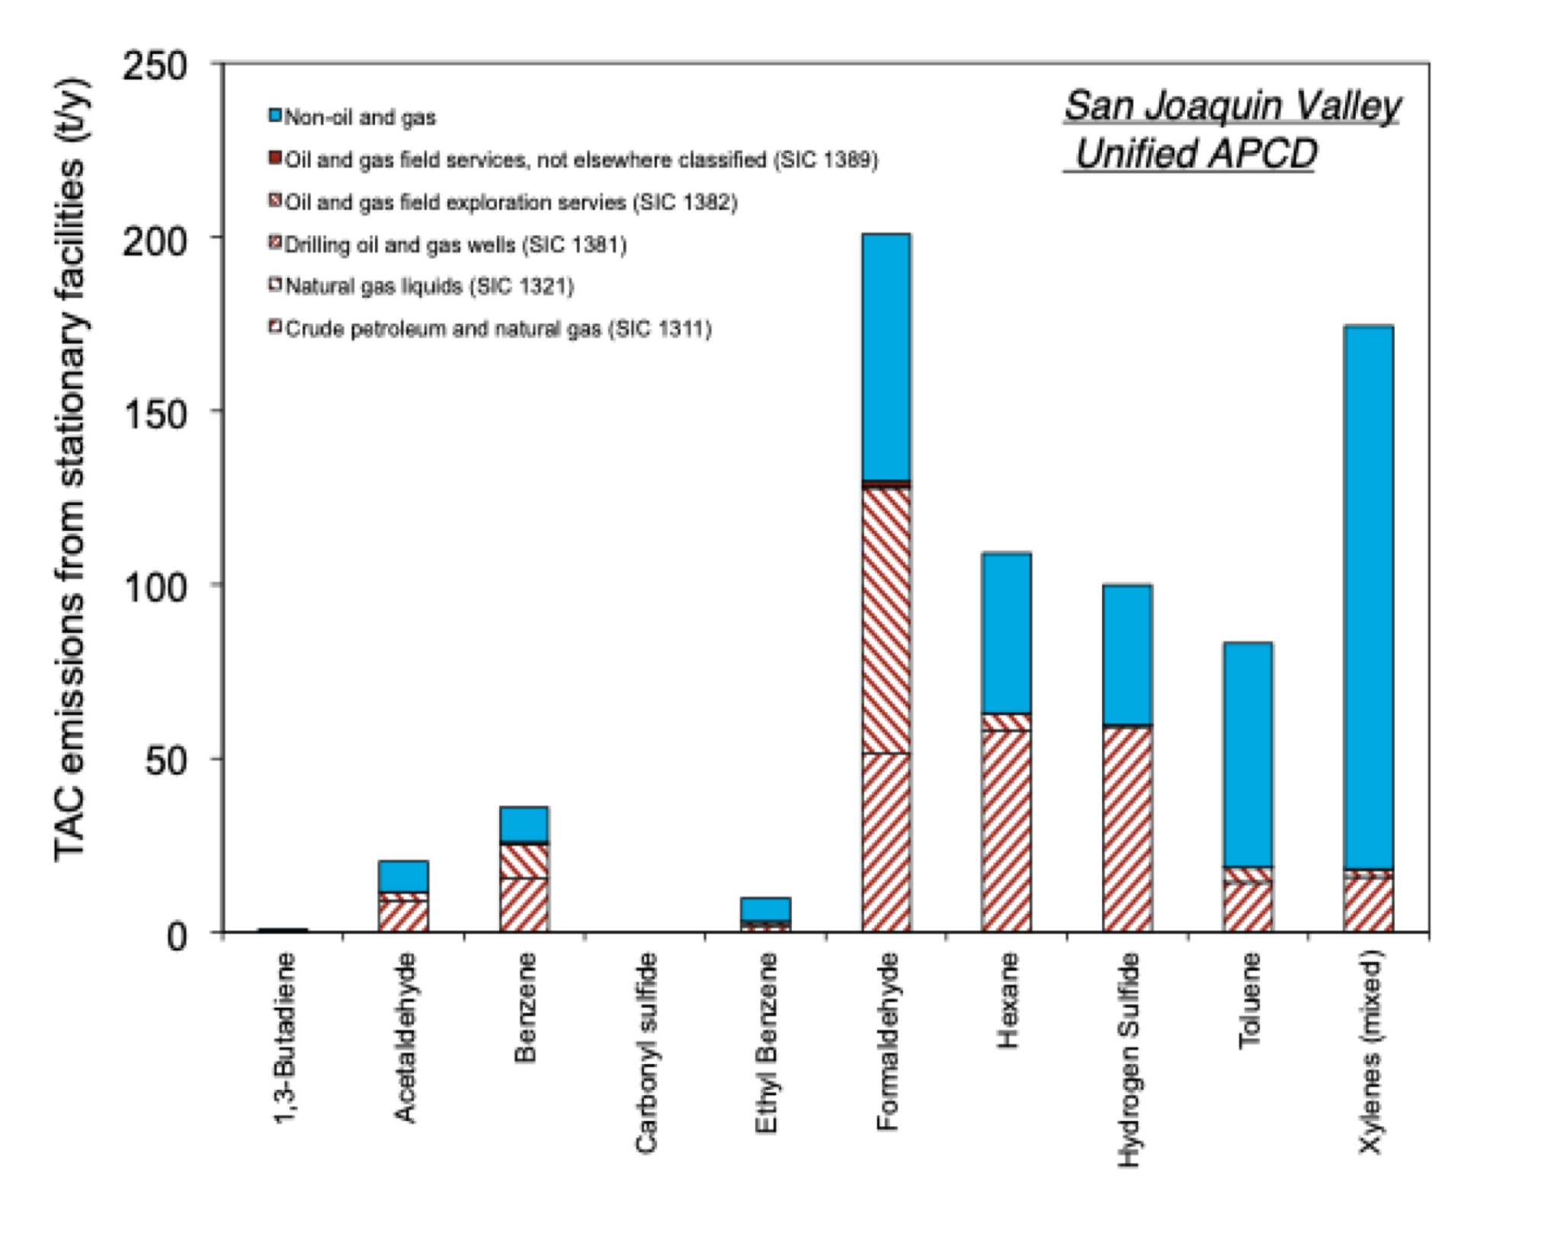
Local Air Pollution

Slide 11
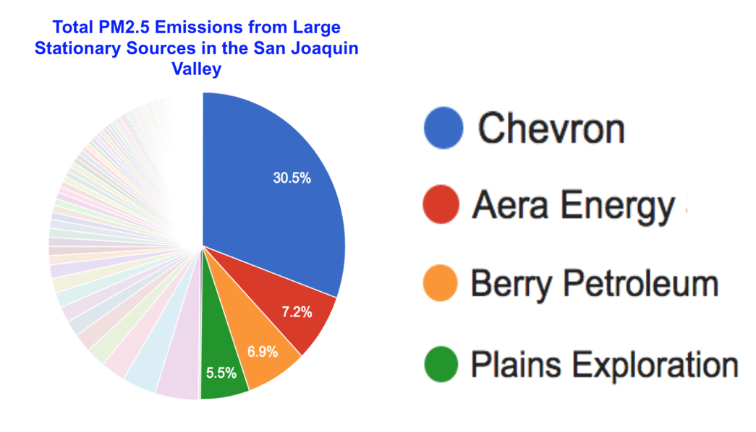
Regional Air Pollution

Slide 12
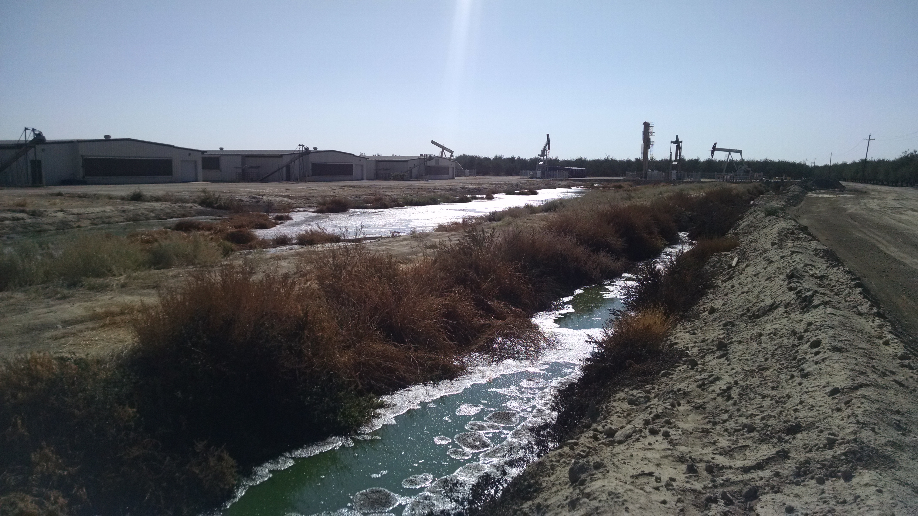
Water

Slide 13
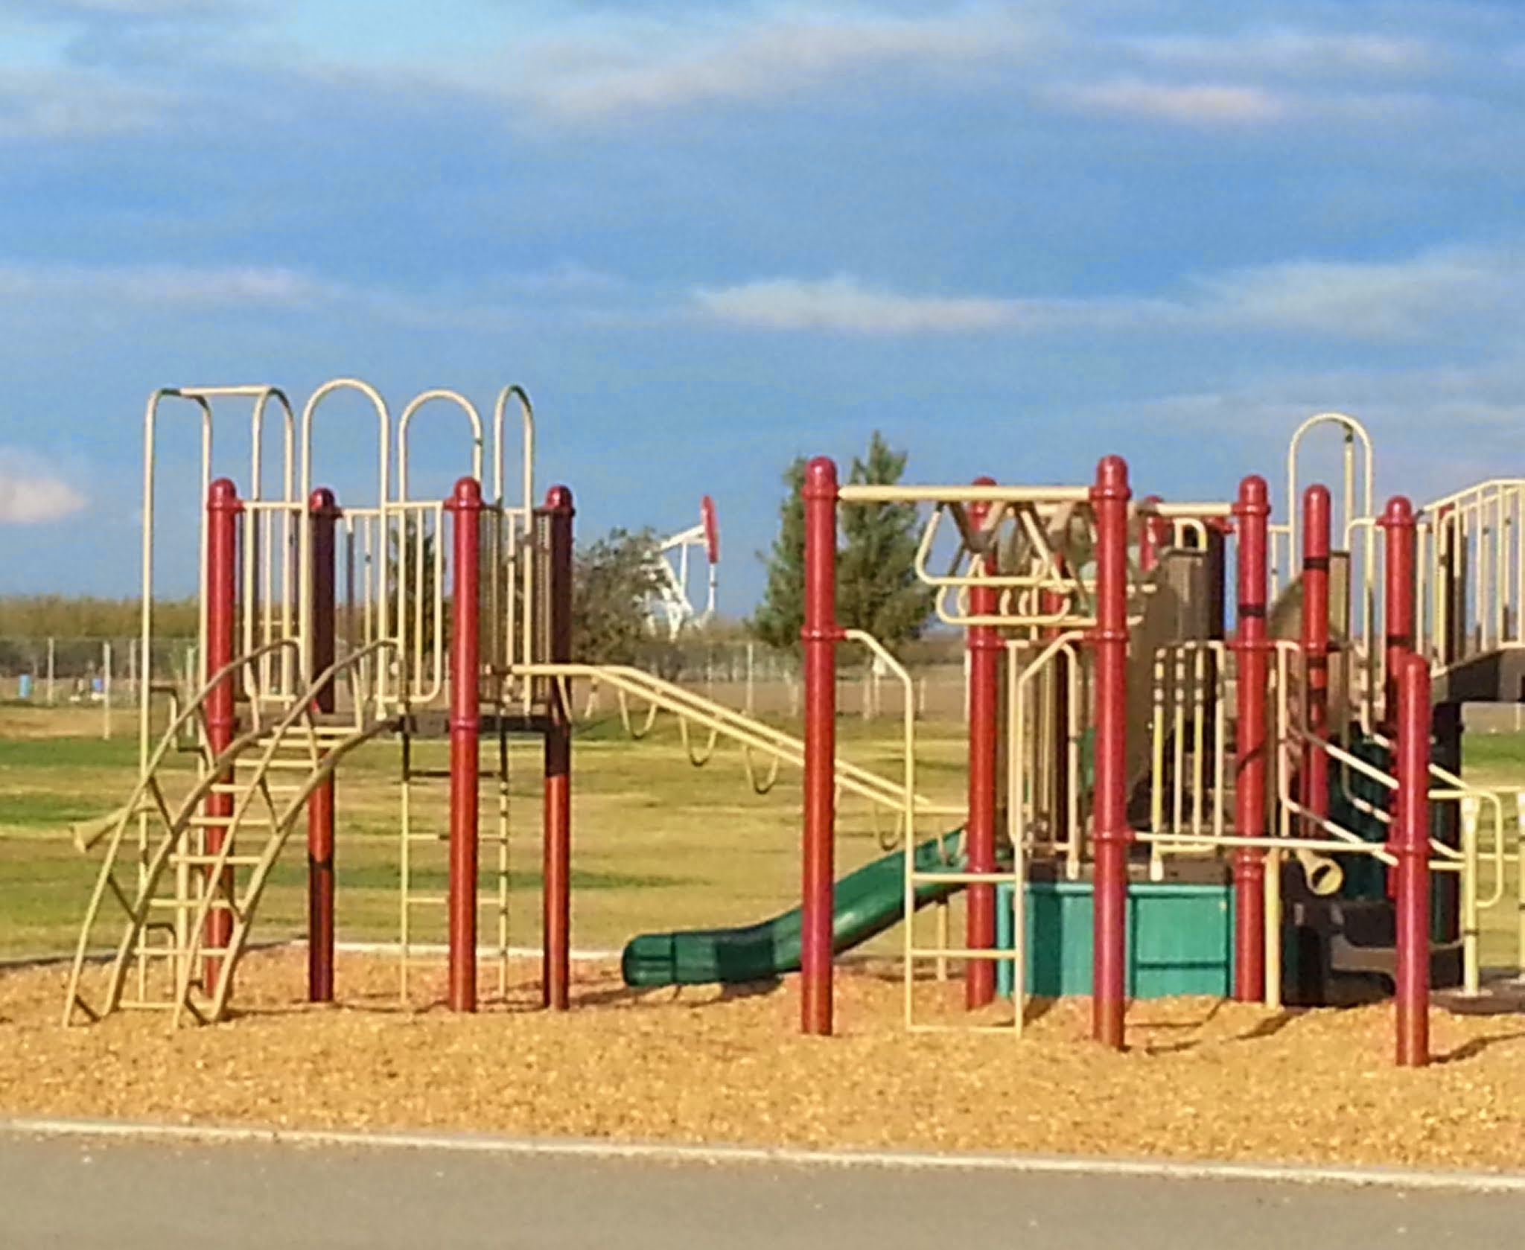
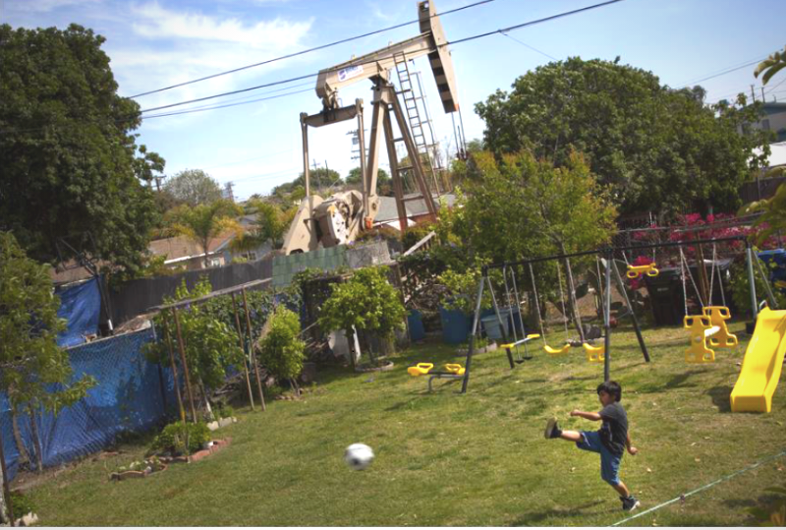
Incompatible land uses

Slide 14
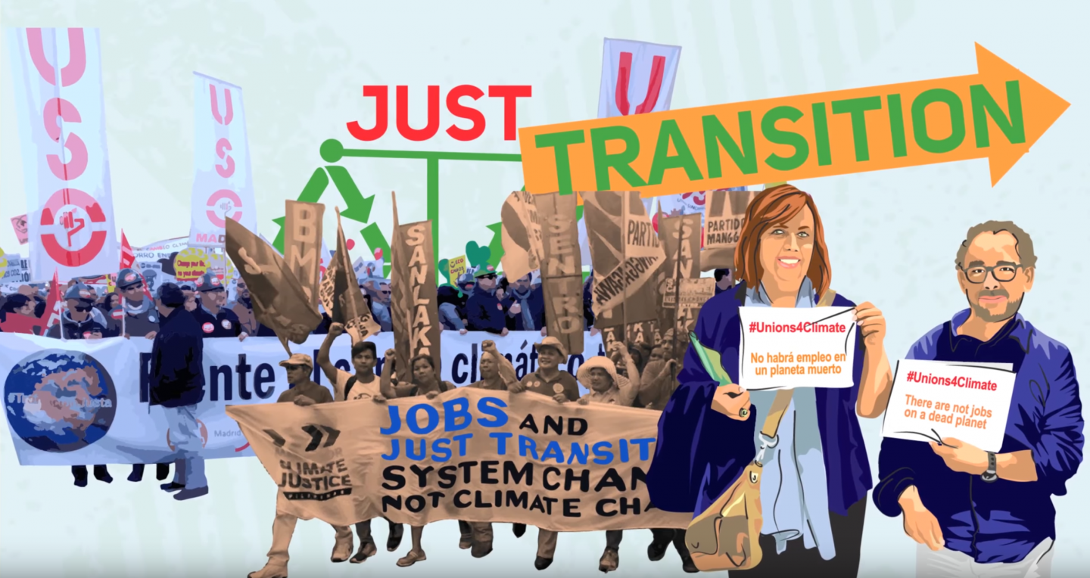

Slide 15
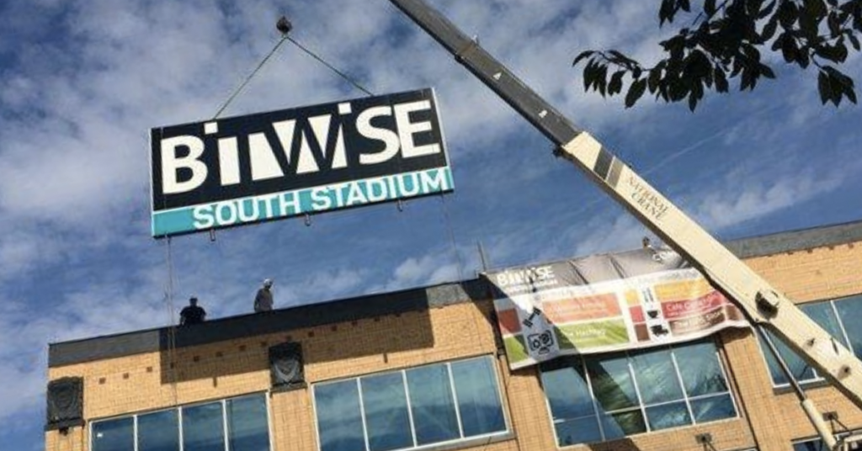
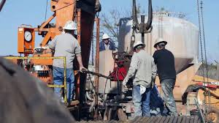
Future Opportunities for Kern

Slide 16
Recommended Next Steps
Create a Plan for a Just Transition in Kern County including stakeholders from the energy sector, labor, community groups, health groups, and local governments.
Dedicate significant state funds for the transition- helping residents, business, and communities take advantage of emerging opportunities.
Undertake an analysis of Kern County assets and opportunities to diversify the economic base of the county while creating safe and environmental healthy opportunities for Kern workers and residents.

Slide 17
Conclusion
Transition away from oil/gas is inevitable. Our choice is whether to plan for a managed decline or be caught off-guard.
Kern County has an opportunity for significant state investment if it comes to the table with an open mind and collaborative spirit.

