Slide 1
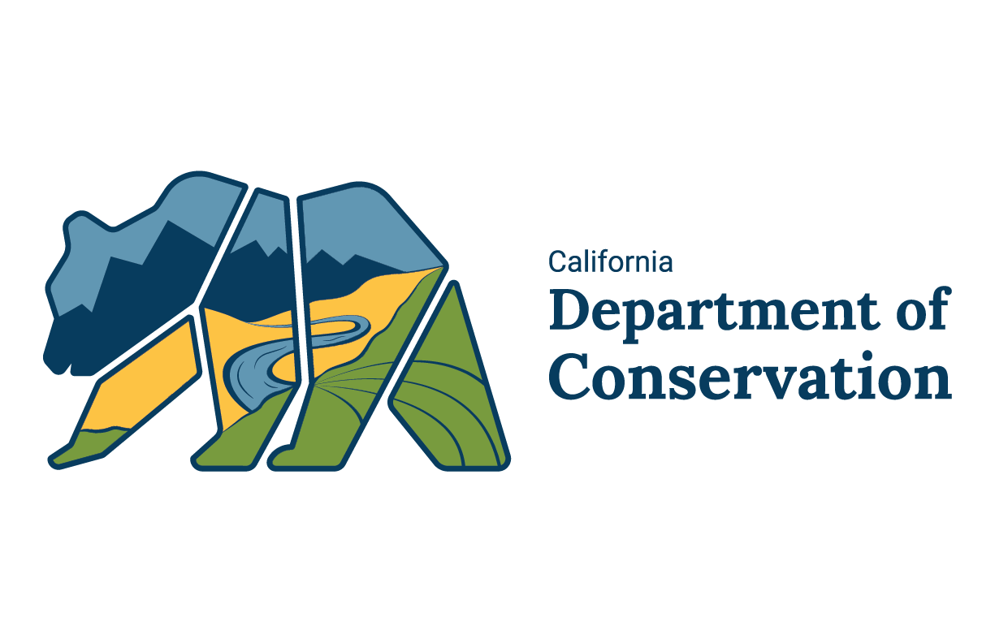
Division Name
  Aliso Canyon
  Jason Marshall
  Chief Deputy Director
  Acting State Oil and Gas Supervisor
  Jason.Marshall@conservation.ca.gov

Slide 2
Comprehensive Safety Review
New operating requirements
Regulations effective October 1, 2018
Plans for subsequent regulations

Slide 3
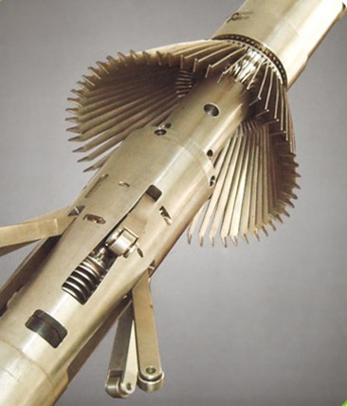
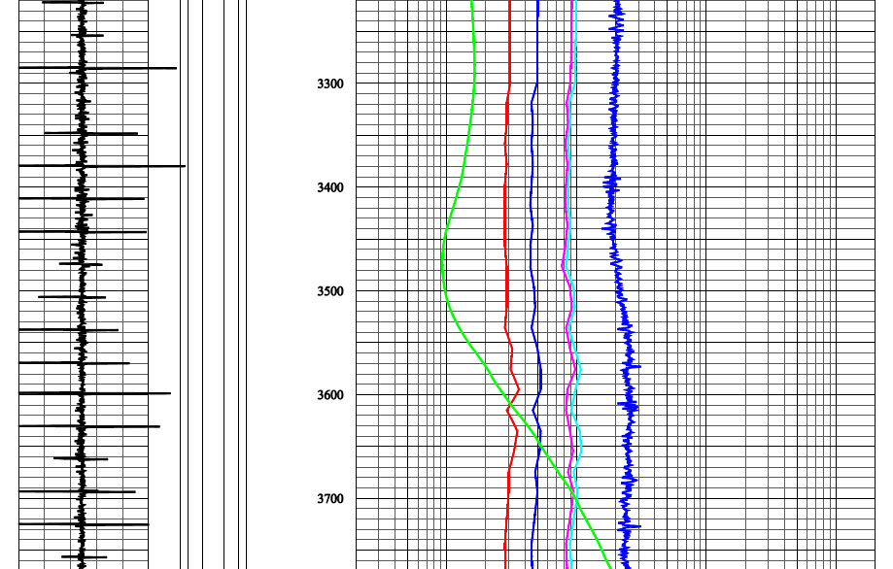
Comprehensive Safety Review
Testing Requirements for Wells Returning to Service
Battery One
Battery Two
Noise log
Temperature log
Cement bond log
Multi-arm caliper log
Ultrasonic casing inspection log
Magnetic flux casing inspection log
Pressure test of production casing, tubing and packer

Slide 4
Comprehensive Safety Review
Current Well Status
66 wells have passed all tests and are approved for service
43 wells have been taken out of service, plugged with cement; surface restoration not yet complete
1 well is isolated from the formation and plugging operations are near complete
4 wells have been plugged with full surface restoration

Slide 5
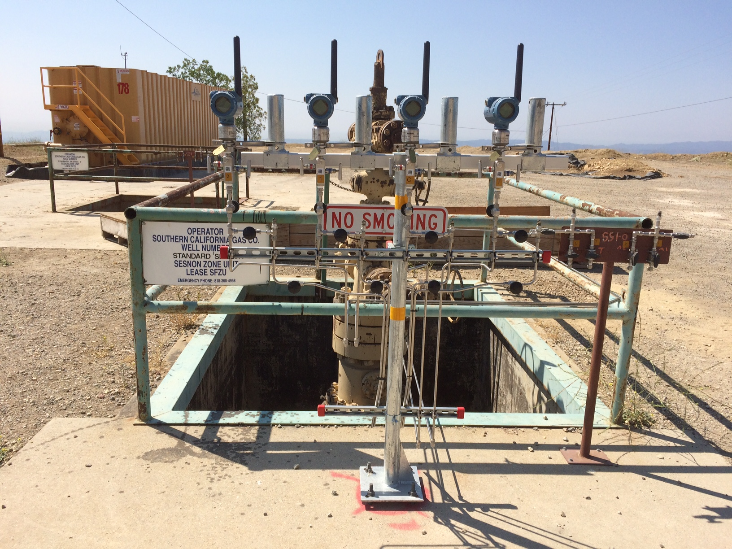
Ongoing Operating Requirements
Maximum reservoir pressure is being held to 2,926 psi, significantly lower than the 3,595 psi requested by SoCalGas
Continuous pressure monitoring of tubing and annulus on all storage wells
Fence line air monitoring for methane
Daily FLIR camera for gas imaging inspection of all well sites

Slide 6
Regulations Effective October 1, 2018
Well Construction
Ensure that a
single point of failure
does not pose an immediate threat of loss of control of fluids
Design casing to ensure that integrity will be maintained and to be compatible with fluid chemical composition
Casing as secondary barrier
Tubing as primary barrier
Flow ONLY through the tubing

Slide 7
Regulations Effective October 1, 2018
Risk Management Plan
Identification of potential threats and hazards including corrosion
Quantitative risk assessment of the probability of threats and hazards and their consequences
Selection and implementation of prevention and mitigation protocols
Well by well risk assessment
Periodic assessment of Risk Management Plans
Regular mechanical integrity testing
Casing corrosion monitoring, evaluation, and mitigation
Monitoring protocols
Emergency Response Plan

Slide 8
Regulations Effective October 1, 2018
Monitoring Requirements
Real-time data gathering system including pressure sensors for every casing annulus and tubing
Alarms for annulus pressure changes
Testing of safety valves every 6 months
Monitoring of storage reservoir material balance and reservoir integrity
Immediate reporting of any unintended gas release
Chemical fingerprinting of gas released
Gas detection logs

Slide 9
Root Cause Analyses
Blade Energy Partners
Department of Conservation, DOGGR
Jointly directed by CPUC and DOGGR
Focused on technical failures and technical cause of leak
Casing pulled and tested
Sophisticated geophysical logging run to analyze the wellbore
Final report with supplements issued May 2019
DOGGR investigation team operating independently of management and local districts
Focused on compliance with DOGGR statutes and regulations
Focused on mechanical and operational condition of the well
Review of project data from initial drill to well failure
Final report in progress

Slide 10
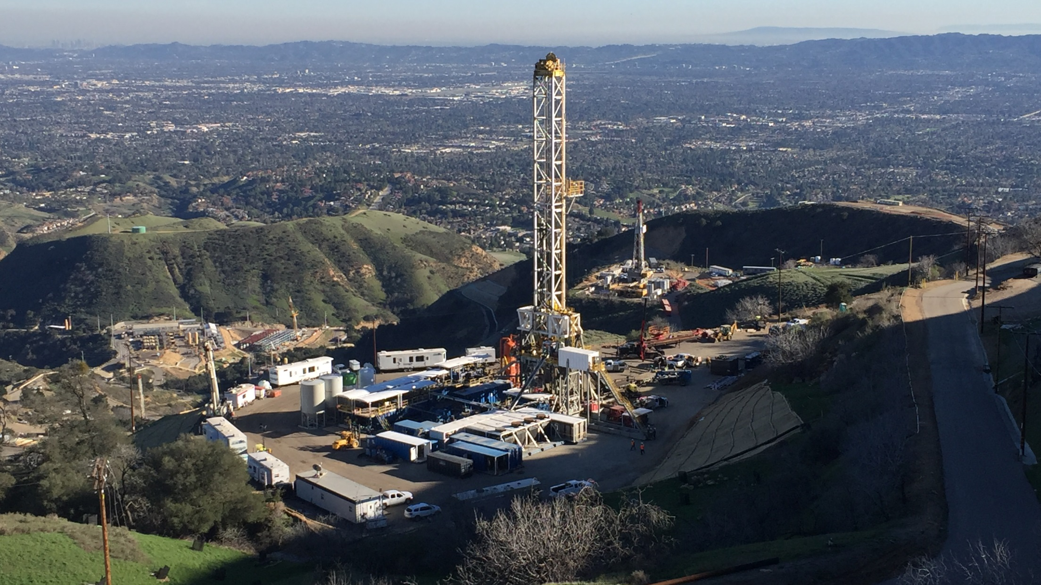
Regulations Update Planned 2019-2021
Consult with a cathodic protection subject matter expert on surface casing
Prepare and maintain individual well control plans
Evaluation of casing failures and near misses
Chemical inventory reporting (SB 463)

Slide 11
THANK YOU
Questions?

Slide 12
