Slide 1
Report from the California Actuarial Advisory Panel on the State Actuarial Valuation Joint Information Hearing on California Public Retirement Systems March 9, 2022
David Lamoureux
Member of the California Actuarial Advisory Panel
Deputy System Actuary, CalSTRS

Slide 2
California Actuarial Advisory Panel (CAAP)
Established in 2008 (SB 1123)
8-member panel
Housed in the State Controller’s Office
Pursuant to Government Code section 7507.2(a):
…the panel shall provide impartial and independent information on pensions, other postemployment benefits, and best practices to public agencies…

Slide 3
Appointing Entities
Governor
(2)
CalSTRS
CalPERS
UC Board of Regent
Senate Committee on Rules
Speaker of the Assembly
State Association of County Retirement Systems
SCO | California Actuarial Advisory Panel Members

Slide 4
CAAP Issued Guidance
Guidance on Funding Policies for Pension Plans and OPEB
Guidance on Disclosure Elements for Valuation Reports
Guidance on Funding Policies for Benefit Changes
Guidance on Evaluating Public Sector Actuarial Services

Slide 5
Government Code §20229
Requires CalPERS to annually provide certain information related to pension cost for State employees:
Liabilities and contribution rates using an investment return assumption that is 2% higher and 2% lower than assumed
Contribution rates calculated by paying down unfunded liability over the average remaining service period of State employees

Slide 6
Government Code §20229
Requires a representative from the CAAP present information to this joint legislative hearing:
Explain the role played by the investment return assumption and amortization period in the calculation of contribution rates.
Describe the consequences to future State budgets if the investment return assumption is not realized.
Report whether the Board’s amortization period exceeds the average remaining service periods of employees covered by the contributions.

Slide 7
Role Played By Investment Return
Investment Returns
Benefits and Expenses
Contributions

Slide 8
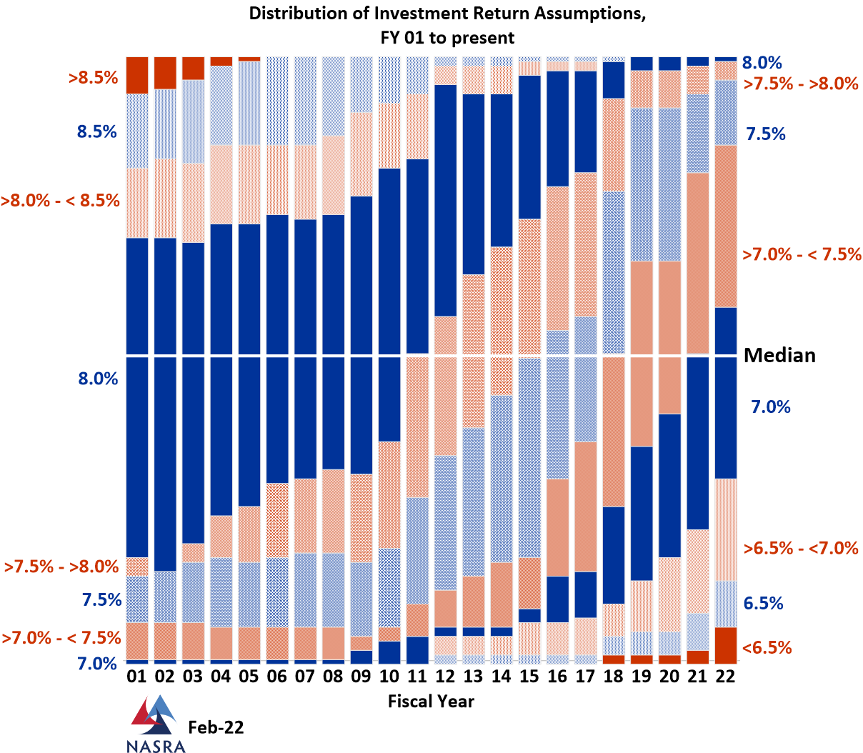

Slide 9
Role Played By Investment Return
In November 2021, CalPERS board lowered the assumed investment return assumption from 7% to 6.8%
Future Returns < 6.8% Future Contributions
Future Returns > 6.8% Future Contributions

Slide 10
Role Played by the Amortization Period
CalPERS uses a 20—year amortization period for “new” unfunded liability
Change became effective in 2020-21
Old method was a 30-year amortization period
Shorter period
Higher contribution rates but lower total costs long-term
Current tax-payers pay more toward current unfunded liability
Longer period
Lower contribution rates but higher total costs long-term
Future tax-payers pay more toward current unfunded liability

Slide 11
Role Played by the Amortization Period
Government Code §20229
CAAP representative must report if the CalPERS amortization period exceeds the average remaining service periods of employees covered by the contributions.
Average remaining service period for state plans is between 11 and 12 years.
Current amortization period exceeds the average remaining service period for all state plans.
CAAP guidance on Funding Policies: 15-20 years is model practice

Slide 12
Most Recent CalPERS Valuation Report
State Actuarial Valuation as of June 30, 2020
Based on a 7% investment return assumption
See pages 46-56
Report covers five different retirement plans:
State Miscellaneous (Tier 1 and Tier 2)
State Industrial
State Safety
State Peace Officers and Firefighters
California Highway patrol

Slide 13
Questions?

