Slide 1
Presentation for Senate Committee on Energy, Utilities and Communications Hearing on Proposal to Extend Operations of the Diablo Canyon Nuclear Power Plant August 25, 2022

Slide 2
September peak day conditions: 2022- 2025
Gap of ~1800 MW results in need for incremental procurement by Summer 2025
~1700 MWs of contingency measures to meet planning standards in 2022
Notes:
Most rigorous analysis – combine 1-in-10 analysis with extremes
Assumes best case build out
Lag in authorized procurement to meet 1-in-10 ~ 1800 MWS in 2022 and 2025. minor gaps in 2023 and 2024

Slide 3
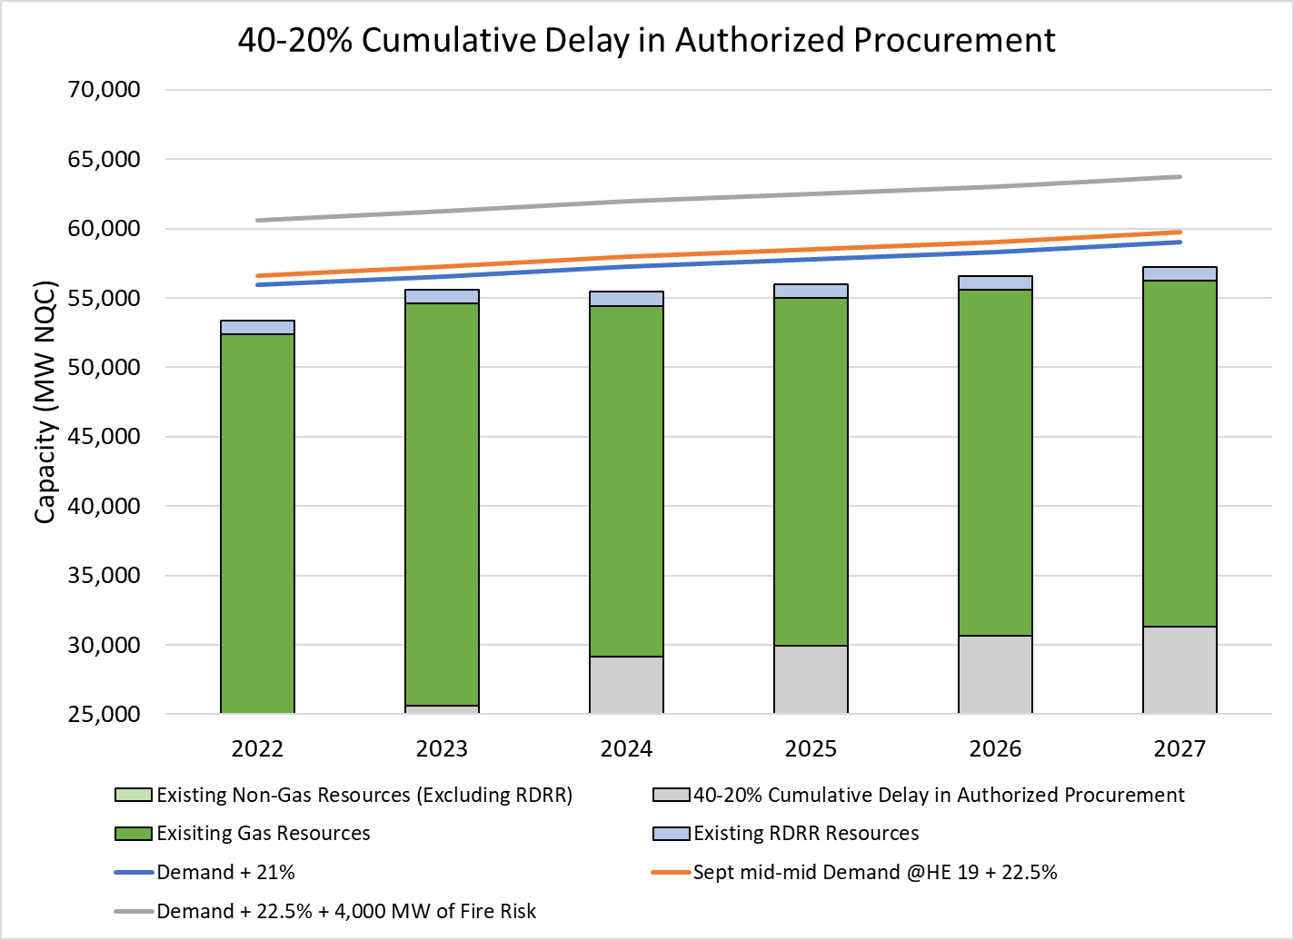
Midterm: Significant Procurement Underway, but Challenges Undermine Reliability
11,500 MW NQC New Procurement
Challenges:
Procurement delays
Load growth uncertainty
Climate-driven extreme weather events
Net Qualifying Capacity (NQC) is the total capacity contribution of a resource that counts towards meeting resource adequacy obligations.
Notes:
Strategic reserve is filling the gap between grey and orange
When CEC constructed the stack with a year ahead look out, based on the info available the build was expected to be over 4000 MWs to support summer 2022. In reality, we have approximately 2500 MWs – this represents a drop of nearly 40% delay
Now we look at the case of delayed development 40/40/20/20 cumulative delays in 2023, 2024, 2025, 2026
When you apply delays, you also see shortfall in meeting 1-in-10 in 2023 and 2024
Demand growth of approximately 1000 MWs year after year – this grows to 1500 MWs in 2028 and beyond as we anticipate TE
Load growth – coastal AC

Slide 4
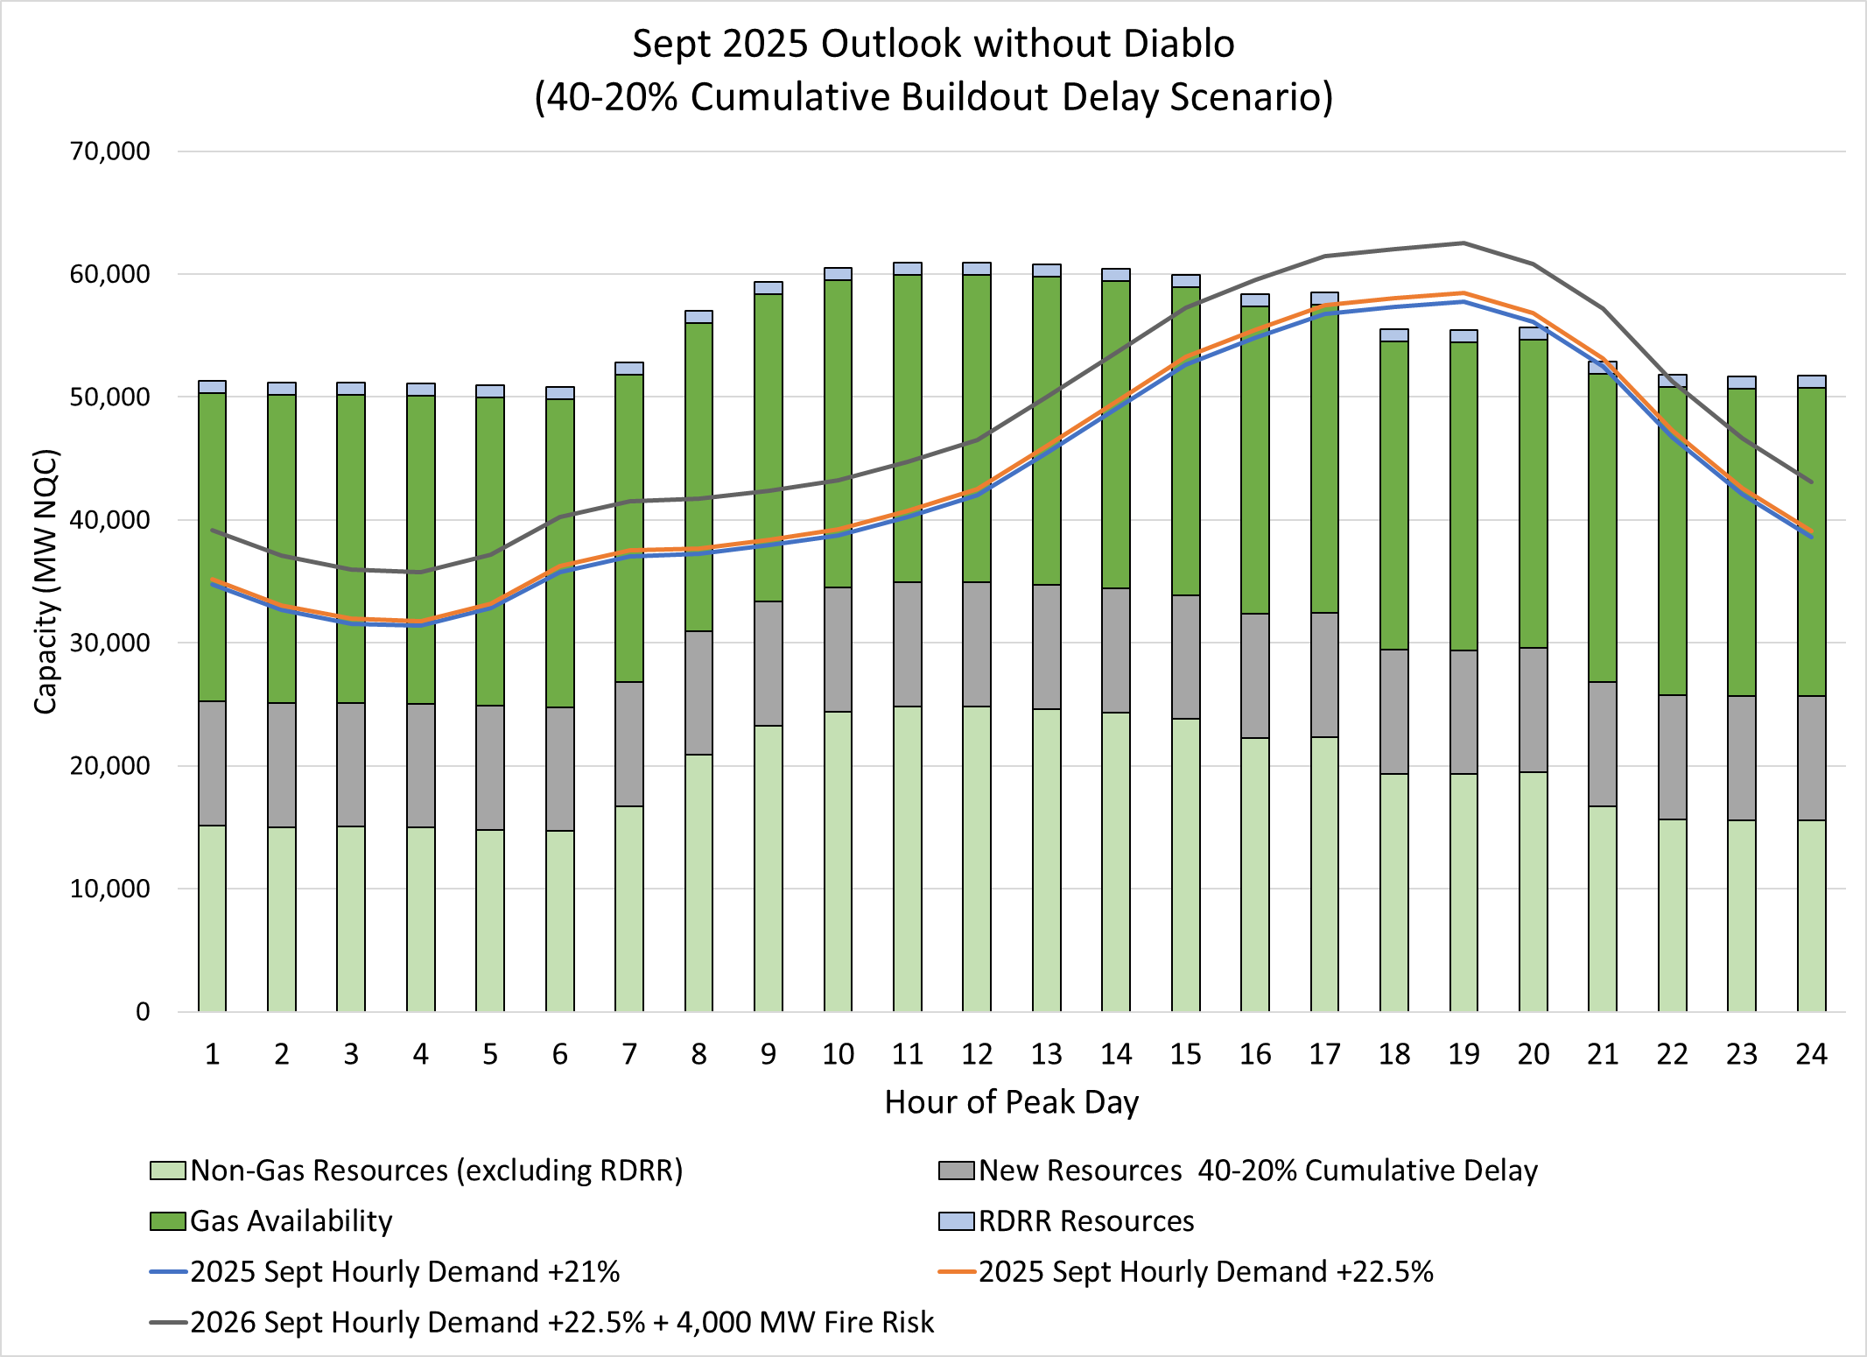
Need for Peak Capacity in 2025
Notes:
Hourly scenario 2025

Slide 5
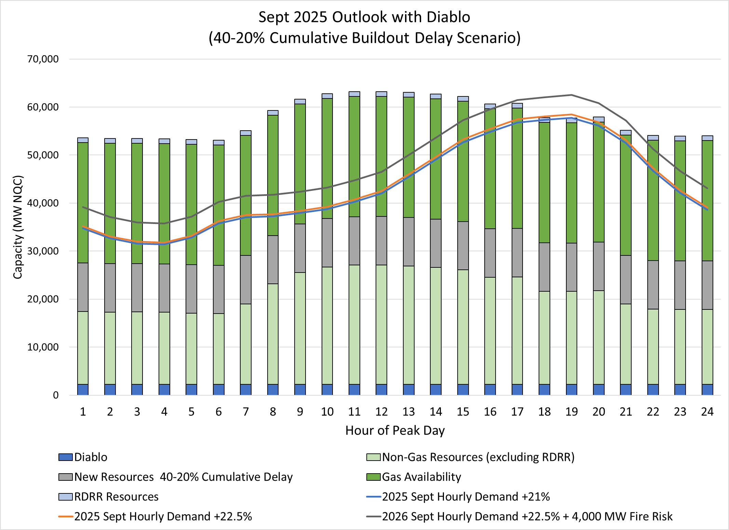
Diablo Canyon Can Fill Capacity Need and Displace Gas Generation
Notes:
Diablo helps fill the energy shortfalls
Reduces reliance on gas

