Slide 1
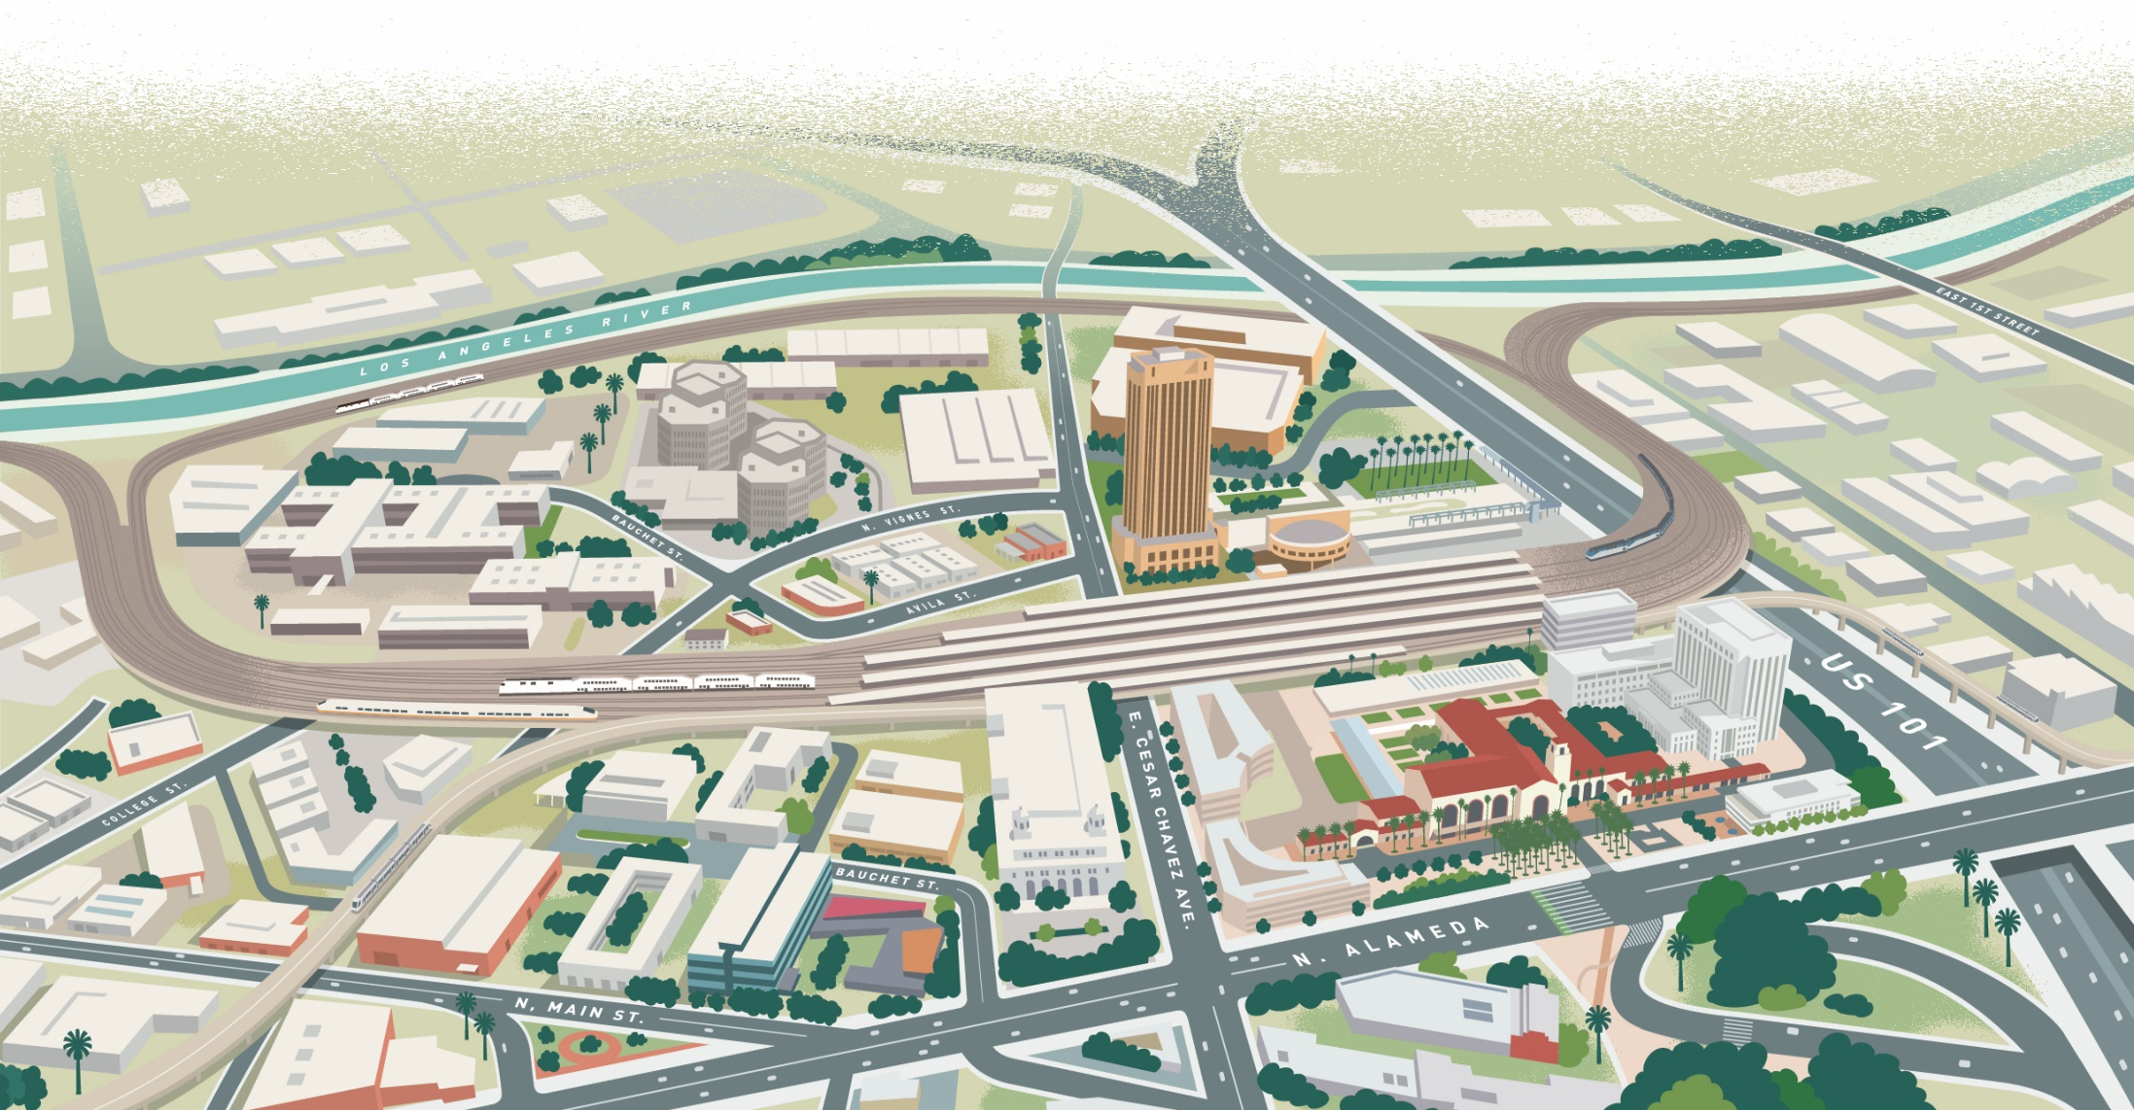
Link Union Station (Link US) Project
SENATE TRANSPORTATION COMMITTEE
& SENATE BUDGET SUB-COMMITTEE #2
March 26, 2019

Slide 2
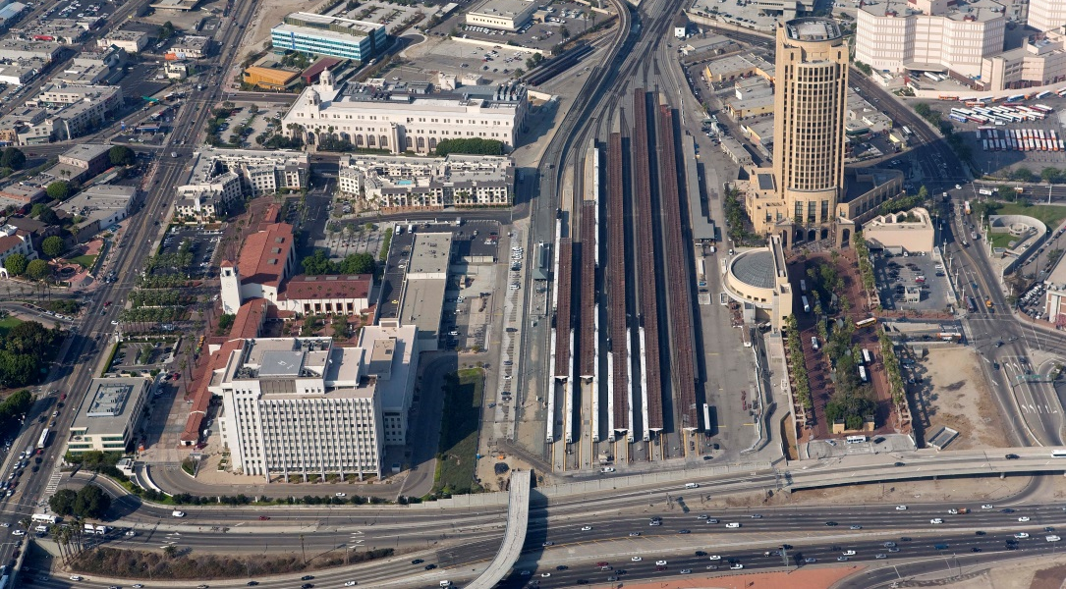
Los Angeles Union Station – Today
Aerial view from the US 101 Freeway
2

Slide 3
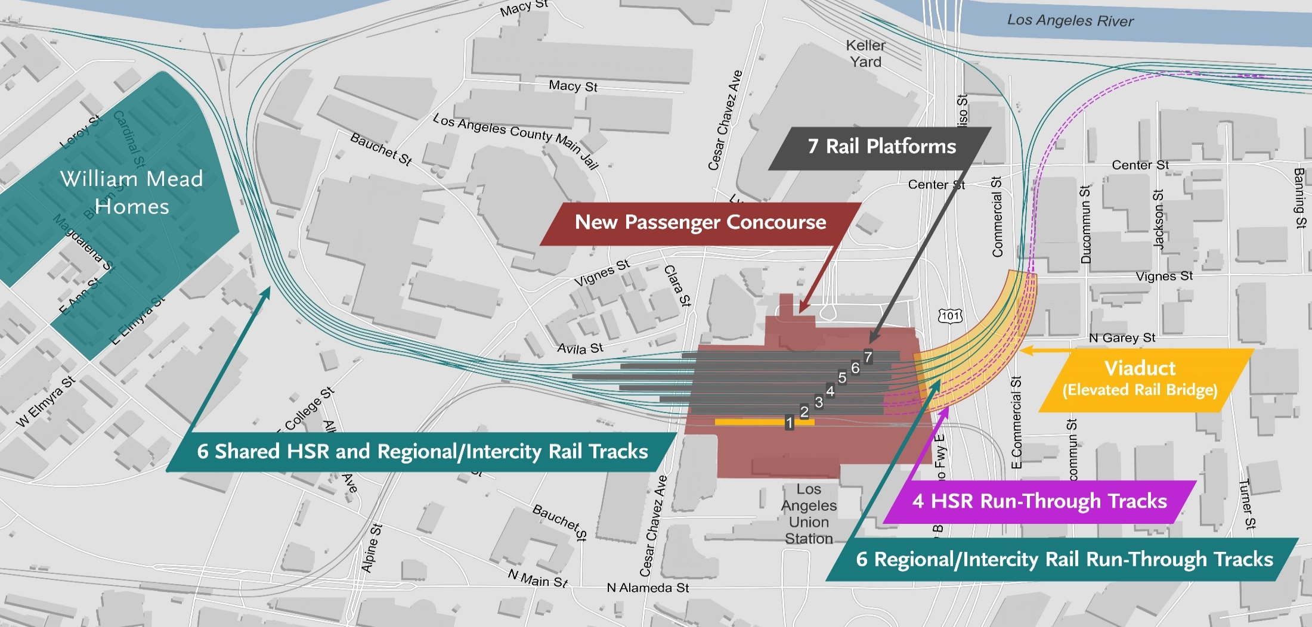

Proposed Project
Up to 10 New Run-Through Tracks with Shared Lead Tracks
Project Components
New rail communication, signals and tracks
New run-through tracks over US-101 and a new loop track
New expanded passenger concourse, platforms, escalators and elevators
Accommodation of High-Speed Rail with a new lead track, optimized throat and rail yard
3

Slide 4
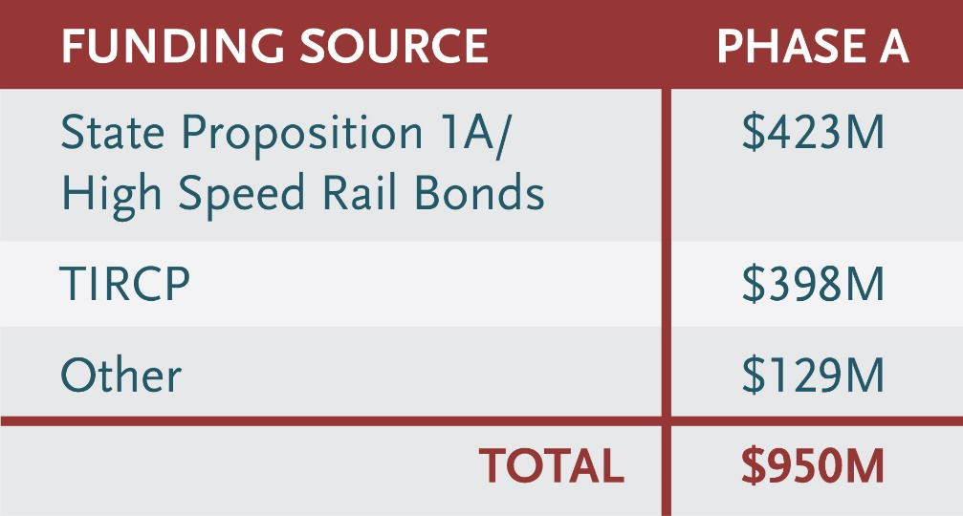
LINK US Funding Plan
*Preliminary estimates, subject to change
LINK US has 2 Phases :
Phase A – Run-through tracks and rail communication and signals that will enable commuter and intercity rail trains (Metrolink and Amtrak) to realize early benefits with an interim two-track run-through configuration at LAUS.
Phase B- New lead tracks, new passenger concourse, raising of the train yard, new platforms with up to 8 run-through tracks including accommodating HSR with 1 platform and 2 tracks.
California High-Speed Rail Authority
2018 Business Plan includes $423 million for Link US.
As part of the 2018 Transit and Intercity Rail Capital Program under Metrolink’s SCORE program, Link US was awarded $398 million.
Phase B component is currently unfunded with 2 options:
Option 1- $1.15 Billion (above-grade option)
Option 2 - $1.65 Billion (at-grade option)
4

Slide 5
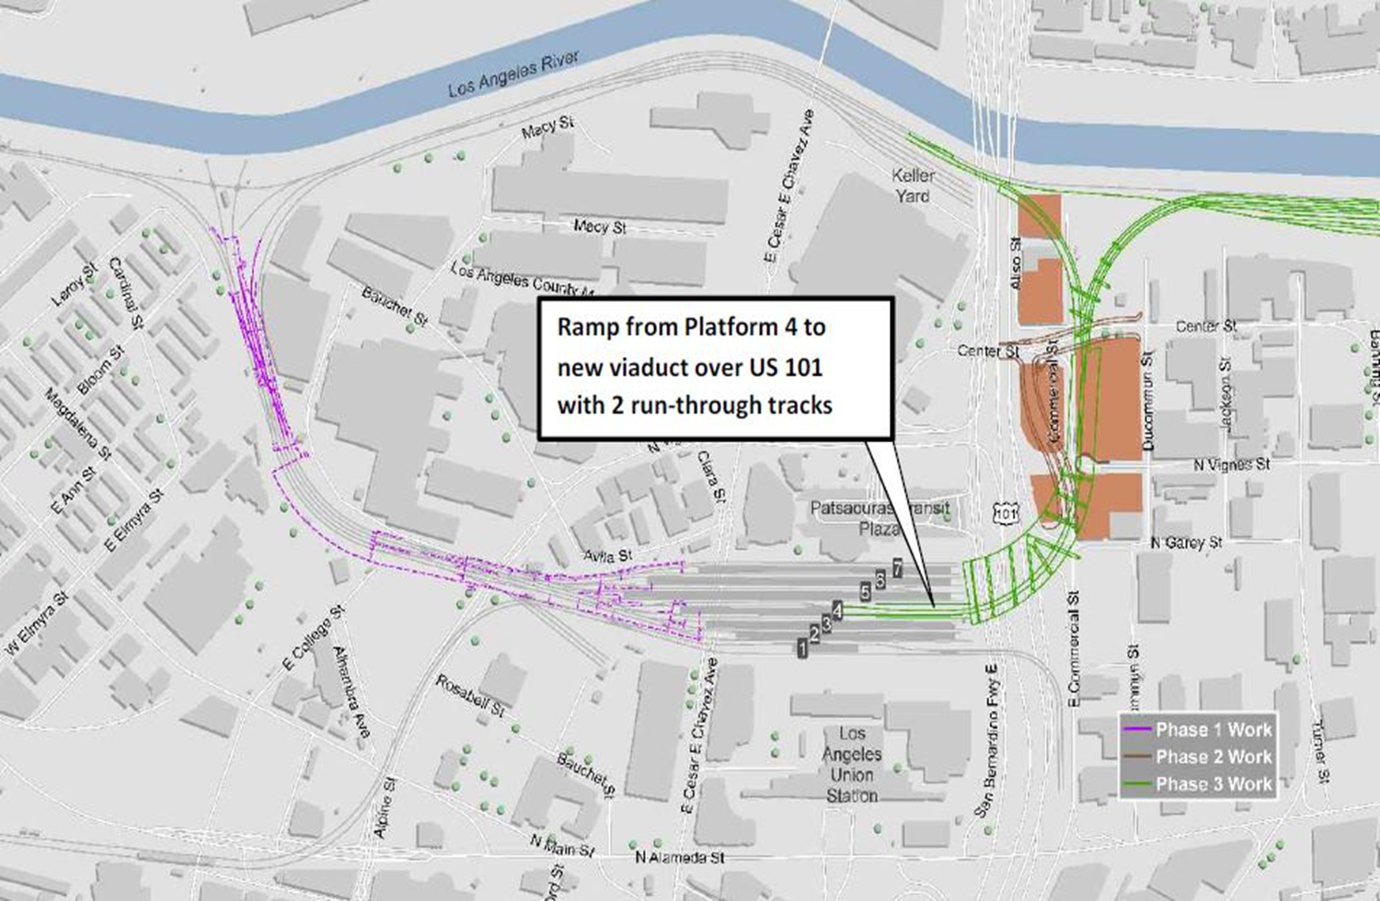
Phase A: Interim Condition with 2 run-through tracks
Segment 2: Commercial and Center St Realignment/Utility Relocation/ROW
Segment 3 – Viaduct and Run-Through
Segment 1: Early Track Construction, Signal and Communication work consisting of reconstructing Control Points at Mission and Terminal
Segment 3: Run-Through Track Viaduct
5

Slide 6
Project Status and Schedule
We Are Here
Early Planning
Completed spring 2016
*Environmental STUDIES & CONCEPTUAL ENGINEERING
Spring 2016 –
summer 2019
FINAL
CEQA ENVIRONMENTAL
CLEARANCE
Complete June 2019
FINAL DESIGN
SPRING 2019 – SUMMER 2020
CONSTRUCTION
SUMMER 2020 – SPRING 2026
Ongoing Public Involvement within each Project Development Phase
*Draft EIR released for public comment period on January 17, 2019 and ended on March 4, 2019
6

Slide 7
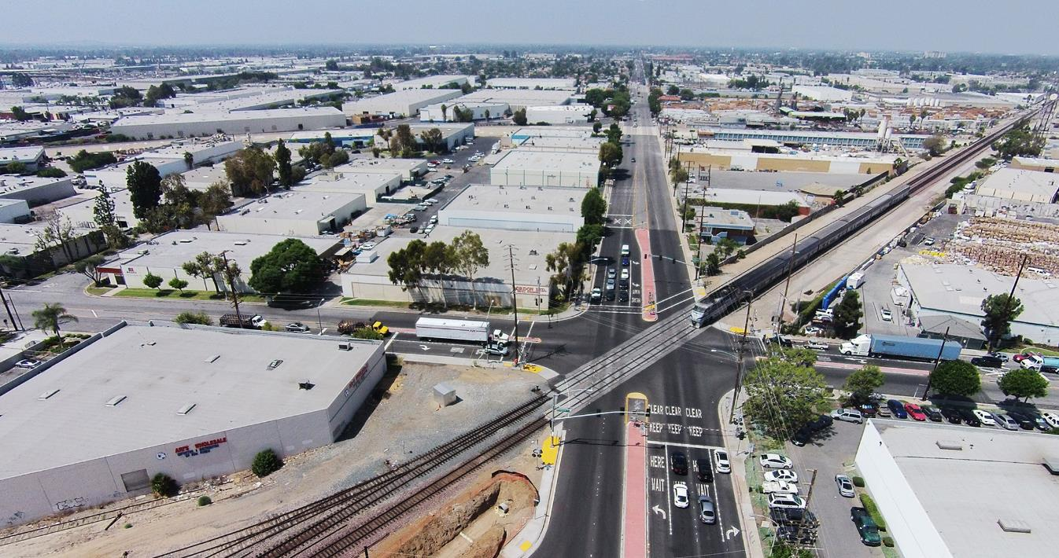
Rosecrans Marquardt Grade Separation Project
EXISTING CONDITIONS
Located om the City of Santa Fe Springs, Rosecrans Ave & Marquardt Ave is a diagonal rail crossing at the intersection
Most hazardous grade crossing in California by the CPUC in 2016 with over 112 trains and 45,000 vehicles use this crossing daily
  Trains cross the intersection about every ten minutes
  Each week the crossing arms are down for combined 21 hours
7
7

Slide 8
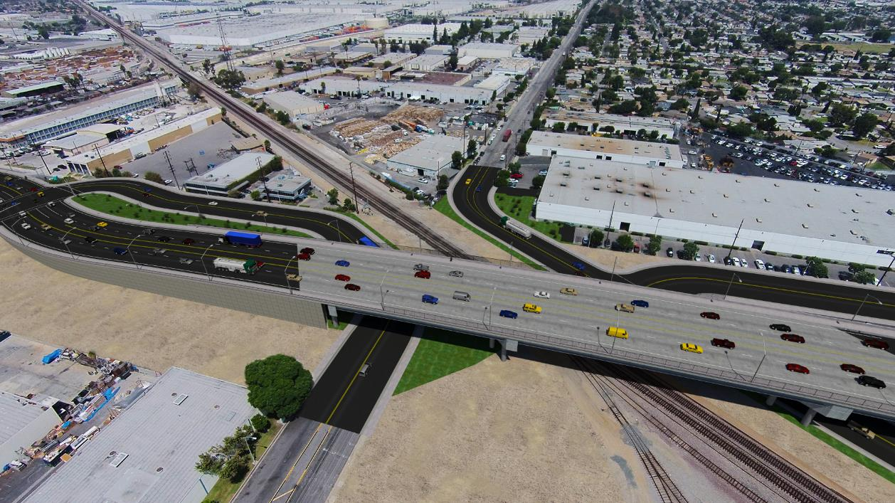
Rosecrans Marquardt Grade Separation Project
PROPOSED CONDITIONS
PROJECT BENEFITS:
Significantly Improve safety by separating pedestrians and vehicles from trains at the railroad crossing AND Reduce Traffic Congestion & eliminating Delays
Supports BNSF 3rd mainline track that provides 32 additional passenger train time slots for Metrolink and Amtrak trains.
Accommodates future HSR tracks.
8
8

Slide 9
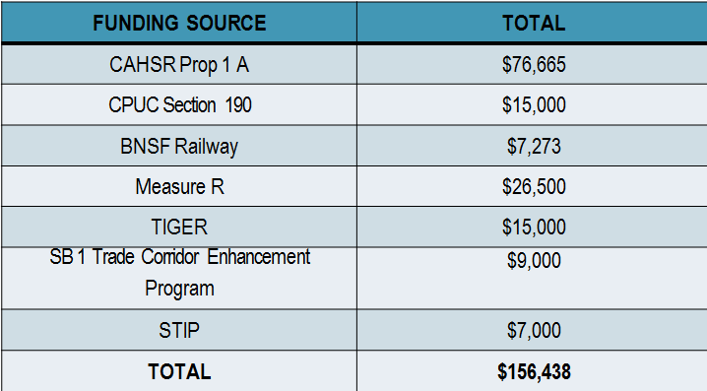
Rosecrans Marquardt Grade Separation Project
FUNDING PLAN
HSR provided 50% of the funding for the 1st bookend project in Southern California.
SCHEDULE:
FINAL Design and ROW Acquisition in process.
Construction IFB award by December 2020 and Construction to begin 1st quarter 2021
9
9

Slide 10
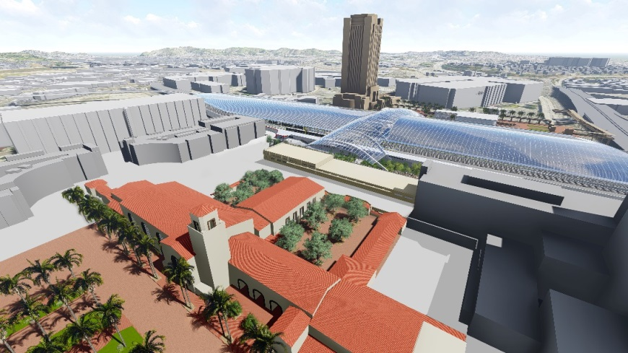
LA Union Station Concept Video
The following video is meant to inspire a creative vision for a world class transit station at Union Station
Proposed buildings shown are NOT part of the Link US project. Future development shown will be in later phases.
Visual representation of the passenger concourse and other elements are conceptual renderings that are not funded and subject to change through future design and preliminary engineering.
Link US Concept Video
10
10

Slide 11
Rosecrans Marquardt Video
Visual representation of the grade separation subject to change during final design engineering and construction.
Rosecrans Video
11
11

