Slide 1
SS-25 Root Cause Analysis
California Joint Legislative Oversight Hearing
August 6, 2019

Slide 2
ACKNOWLEDGEMENTS
CPUC
DOGGR
SOCALGAS
Service Companies

Slide 3
Phases
Root cause:
  Systematic process for identifying the root causes of problems or events and determining methods for responding to and preventing them
Phase 0: Data collection, collation and analyses
Phase 1: Site Evidence collection and documentation
Phase 2: Site restoration to rig readiness
Phase 3: Tubing, casing, and wellhead extraction
Phase 4: Non-destructive evaluation and metallurgical examination
Phase 5: Integration, interpretation, and final report

Slide 4
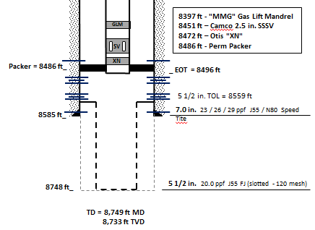
SS-25 Wellbore for Gas Storage
Injection and withdrawal through the tubing and casing
Casing flow was through open ports in the annular flow safety system above the packer
11 ¾ in. cementing problems
No leaks or failures in SS-25 until October 23, 2015

Slide 5
SS-25 Failure
SS-25 Root Cause Analysis

Slide 6
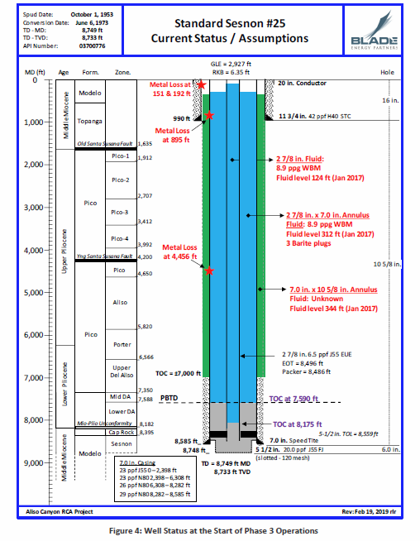
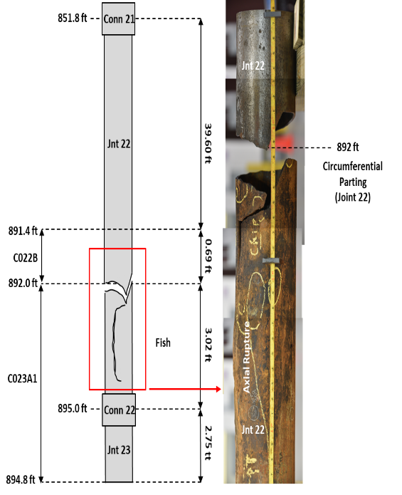
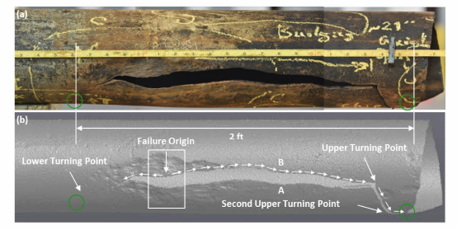

Slide 7
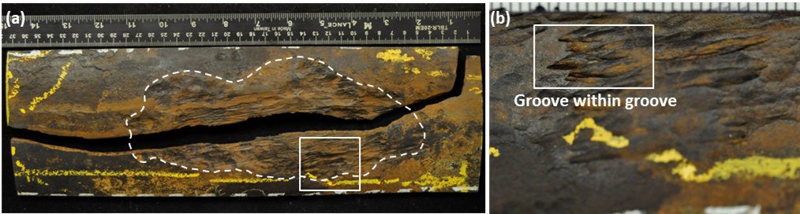
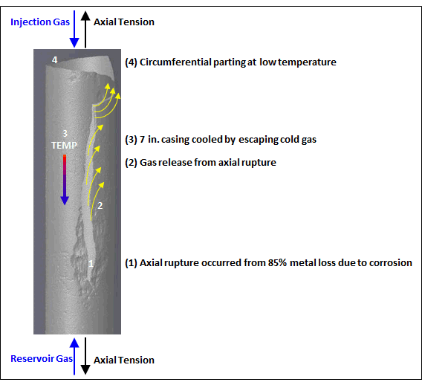
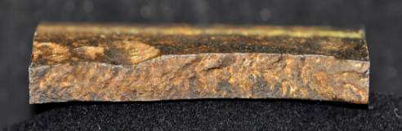
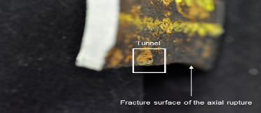
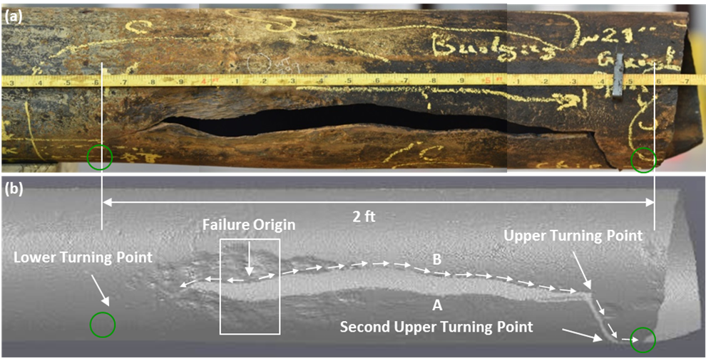
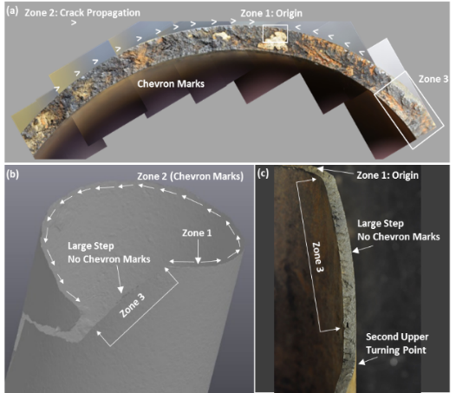
7 in. Casing Failure Sequence
External corrosion with 85% wall reduction
Corrosion caused by microbes resulting in grooves
Notch acted like a stress concentrator
Large patch of corrosion
Axial rupture
Cooled (-76ºF to -38ºF) and then circumferential parting
Two separate events-failure sequence

Slide 8
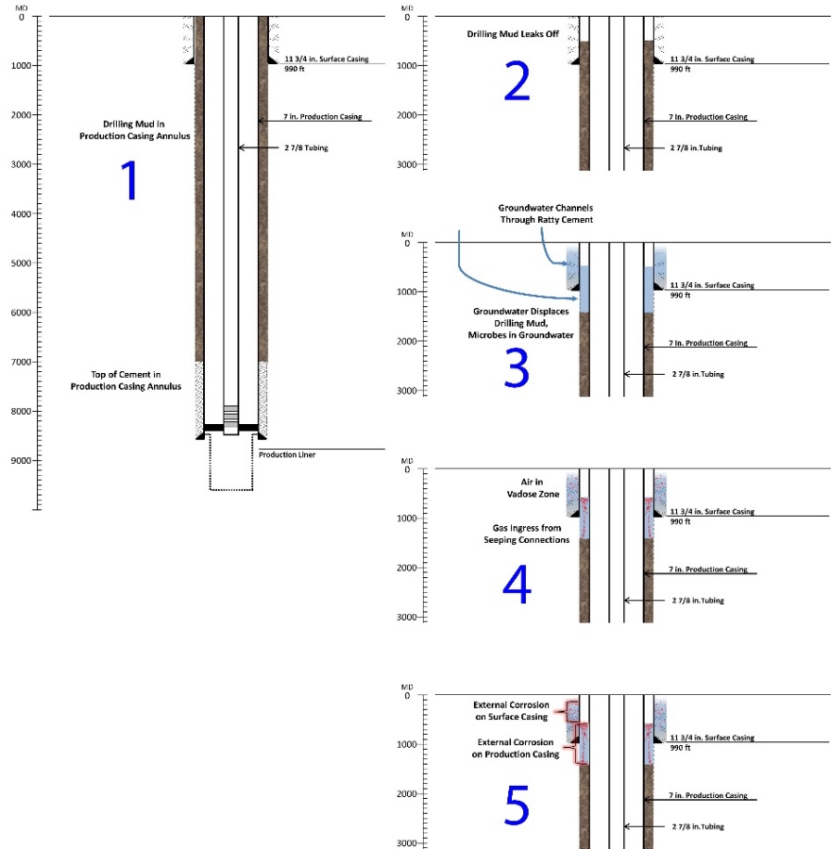
7 in. Corrosion
Annulus groundwater ingress and egress
Dry and wet seasons
External corrosion due to microbes

Slide 9
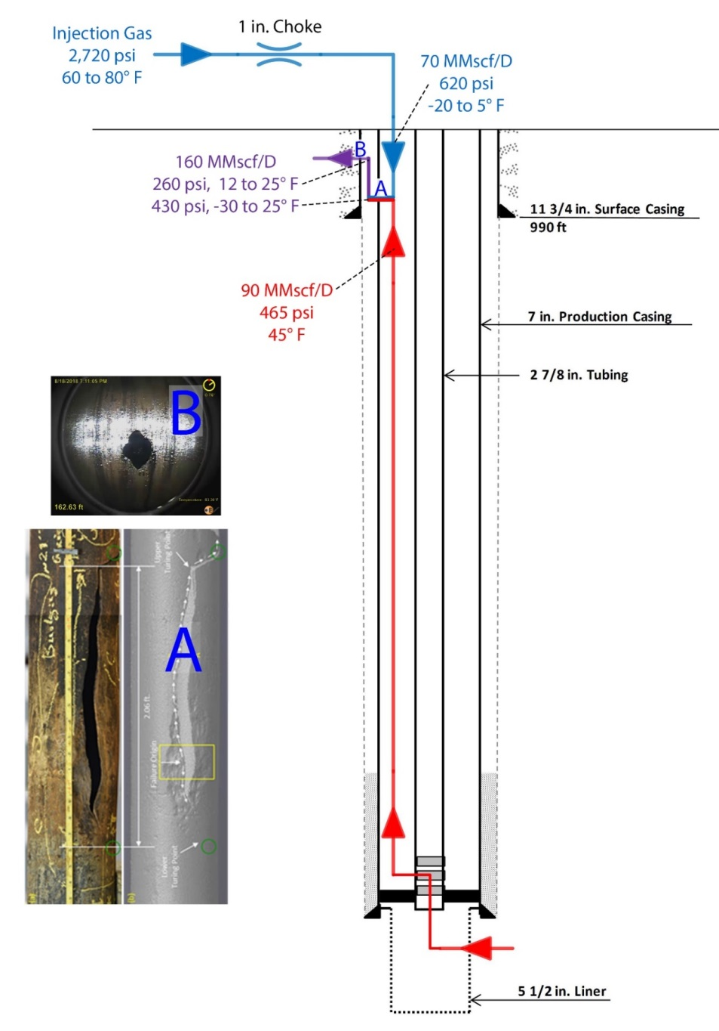
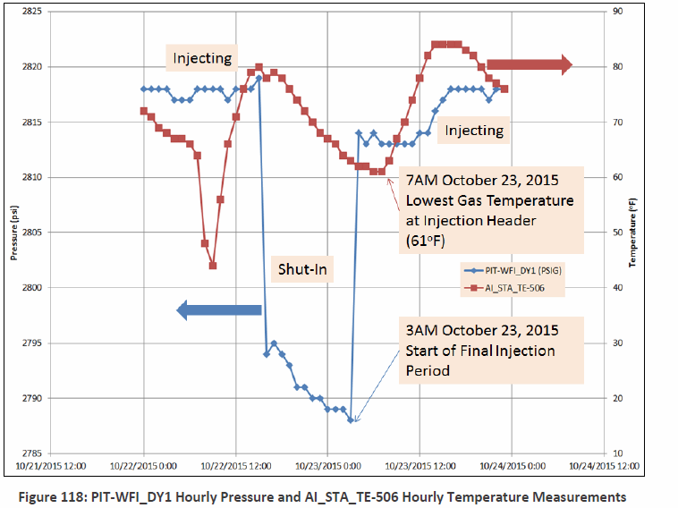
7 in. Casing Failure Timeline on Oct. 23
October 23, 2015
  Well opened for injection between 3 and 4 AM
  Axial rupture happened first
  Gas flow increased to a total of 160 mmscf/D
  Metal cooling resulted in brittleness and circumferential parting within hours of axial rupture
  All failures same day

Slide 10
Post Leak Events
SS-25 Root Cause Analysis

Slide 11
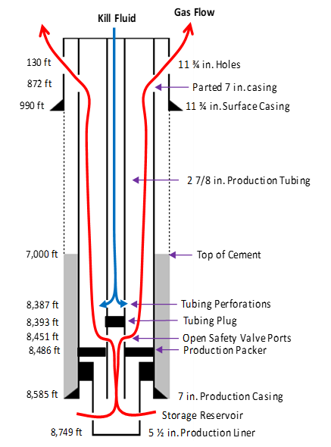
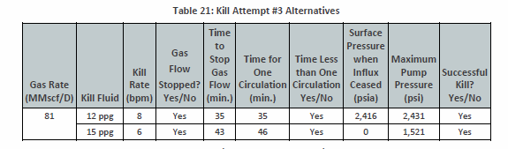
Flow Rate / Kill Modeling
Modeling and Assessment predicts that kill could have been successful with heaver fluids at a higher pump rate

Slide 12
Aliso Canyon Casing Integrity
SS-25 Root Cause Analysis

Slide 13
Aliso Canyon Casing Integrity
Historical Casing Failures
  Mitigated immediately
  No failure analyses or further investigation
1988 Memo on Casing Inspection
  7 out of 20 logged (5 had external corrosion)
GRC 2016-Testimony in 2014
  Risk Assessment as part of SIMP
Pre-2015 Approach more Reactive rather than Proactive

Slide 14
Root Cause Analysis
SS-25 Root Cause Analysis

Slide 15
Causes
Direct
  Axial rupture due to microbial corrosion on the OD of the 7 in. casing
  Unsuccessful top kills because of insufficient fluid density and pump rates
Root Causes Identified

Slide 16
Root Cause Solutions
The RCA identified solutions that would have prevented the primary effect
Nearly all have been implemented to meet SoCalGas current practices and DOGGR regulations updated after 2015
Solutions:
  Risk based well integrity management system
  Casing wall thickness inspections
  Tubing-packer completions – dual barrier system
  Real-time well surveillance of surface pressures (tubing and annuli)
  Detailed well-specific well control plans
  Casing corrosion study
Additional proposed solutions:
  Conduct casing failure analyses
  Cement surface and production casings to surface for new wells
  Implement cathodic protection when appropriate

Slide 17
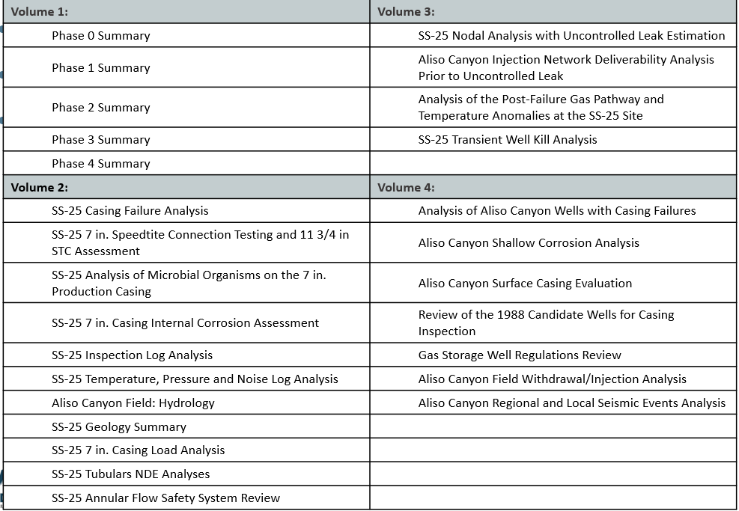
Phase 5: Integration, Interpretation, and Final Report
Main report released May 16, 2019
27 Supplementary reports released May 31, 2019
Report links on CPUC website

Slide 18
Questions?
SS-25 Root Cause Analysis

