Slide 1
COVID-19 and Food Insecurity in California
Diane Whitmore Schanzenbach
Director, Institute for Policy Research
Northwestern University

Slide 2
Food insecurity is very high during covid-19

Slide 3
Overall Food Hardship in California, by Time Period

Slide 4
Food Hardship in California, by Group (Sept-Oct 2020)

Slide 5
Food Hardship in California, All Adults by Race/Ethnicity (Sept-Oct 2020)

Slide 6
Food Hardship in California, Adults with Children by Race/Ethnicity (Sept-Oct 2020)

Slide 7
Food Hardship in California, Elderly (60+) Adults by Race/Ethnicity (Sept-Oct 2020)

Slide 8
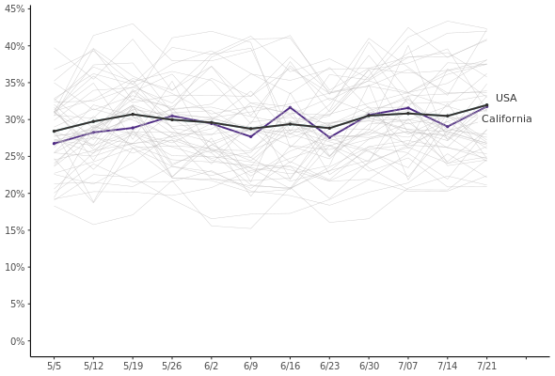
Food insecurity for California tracks the national average closely
Food Insecurity Among Households with Children, May-July 2020
COVID-19: Census Pulse Survey, food insufficiency in last 7 days, mapped onto food insecurity
Notes:
Despite these payments, measures of distress are elevated.
Here we monitor food insecurity, which is a survey measure designed to assess whether families have enough $ to support adequate food consumption. In normal times, it is measured with a battery of questions asking respondents to what extent they agree with statements such as: our food just didn’t last, and we didn’t have enough money to get more; or reported that adults or children in the family cut the size of meals, skipped meals or went for a day without eating specifically because there wasn’t enough money for food.
Subsets of these questions have been asked in both the Census Household Pulse survey and the COVID Impact Survey;
In companion work described in the paper we assess how to make the old and new surveys as comparable as possible; you see our preferred method here.
In general in the annual time series, see in two downward sloping lines that hover around 10% (orange for hh w/kids; blue overall):
FI is an economic measure, varies with the unemp rate. Using that relationship, we can project food insecurity out to Feb 2020 at the economy’s peak, shown with the square markers. 8.5% overall; 9.4% w/kids.
During COVID-19, surveys indicate that FI has doubled overall (to 23%). Almost all of this increase can be explained by the increase in UR (adjusting for misclassification).
Tripled for families w/children; hit harder on many dimensions including loss of school meals.

Slide 9
Strong reliance on free meals

Slide 10
1 in 8 report receipt of free meal in past week
Sept-Oct 2020
April-July 2020

Slide 11
Receipt of free meals in past week, by source (Sept-Oct 2020)

Slide 12
Source of free meals in past week, by race/ethnicity (Sept-Oct 2020)
*Meals from school for households w/children only.

Slide 13
Other measures of hardship

Slide 14
Many CA Families Lack Confidence in Ability to Finance Consumption in Next Month

Slide 15
Many CA Families Report Being Behind on Housing Payments (Sept-Oct 2020)

Slide 16
Relief payments have helped

Slide 17
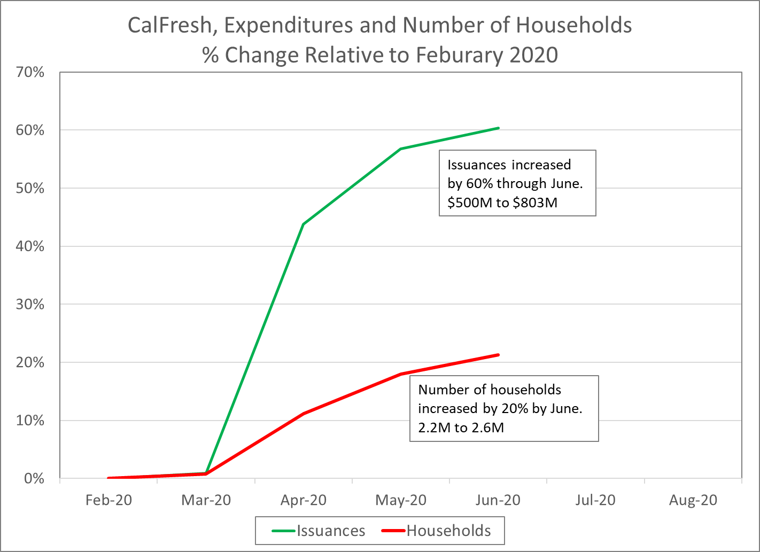
California CalFresh response has been strong
SNAP participation declined modestly June – Sept
Still up 16% since February
Source: Bitler, Hoynes and Schanzenbach, BPEA forthcoming
Notes:
Second, we must praise Congress for taking action to quickly disburse increased money through SNAP – this has happened much faster as measured by months since business cycle peak during COVID (as illustrated by the solid lines) than the great recession (illustrated by the dotted lines).
These benefits are relatively modest, though, at about $40/week, and only went to a subset of participants that were already relatively better off.

Slide 18
Pandemic EBT payments help families, bring $ to state

Slide 19
WIC Caseloads Rebounding, Up 11% in CA Feb-Apr

Slide 20
What to expect

Slide 21
Expecting Prolonged Economic Slowdown
Much higher rates than during Great Recession
History: Unemp rates higher, recovery slower for Black, Hispanic & low-education groups
-> Increased need will be sustained for a long time
-> even without other factors

