Slide 1
Senate Health Informational Hearing: California’s Public Health Infrastructure and Capacity - STDs
Anissa Davis, MD, MPH
City of Long Beach Health Officer
March 6, 2019

Slide 2
Number of Reported Cases of STDs in California
California STDs
2013 - 2017
45% increase
Notes:
Good afternoon chair and members.
Sexually Transmitted Diseases or STDs has become a state and national emergency, increasing to unprecedented levels, and greatly taxing an already strained public health infrastructure. Sustained funding is crucial to adequately address this issue.
The number of reported STD cases in California has reached record highs. More than 300,000 cases of chlamydia, gonorrhea and syphilis were reported in California in 2017, a 45% increase from 5 years ago. If left untreated, gonorrhea and chlamydia can lead to infertility, chronic pelvic pain, and ectopic pregnancy and can cause pneumonia and eye infections in newborns.

Slide 3
Congenital Syphilis on the Rise
The number of infants born with
congenital syphilis
increased for the 5th year in a row.
71 of those infants were stillbirths, with 30 stillbirths in 2017 alone.
Notes:
Syphilis is of particular concern. Syphilis can be passed from a pregnant mother to her unborn baby, causing congenital syphilis, and the effects to the baby are devastating. Congenital syphilis can cause preterm birth, low birth weight, birth defects, blindness, hearing loss and even death.
In 2017, 283 babies born with congenital syphilis were reported in California, which accounts for one third of all cases nationally. 2017 was the 5th consecutive year of increases in California. This burden of disease hasn’t been seen since 1995. Congenital syphilis is completely preventable with timely testing and treatment. In the City of Long Beach, where I’m Health Officer and STD Controller, we have the 2nd highest rates of chlamydia and gonorrhea and the 3rd highest rates of syphilis reported in the state.

Slide 4
Health Jurisdiction Roles and Challenges
Roles
Challenges
Adequately treated
Sexual partners are tested and treated
Train and support healthcare providers
People experiencing homelessness
Substance use
Mental health
Notes:
Local health departments play a crucial role in addressing this epidemic. We have the unique function of ensuring that patients are appropriately treated, that their partners are tested, and that healthcare providers have the training and the support they need to provide good care.
This is easier said than done. Preventing one case of congenital syphilis requires boots on the ground work. Homelessness, substance use, and mental health conditions are significant barriers for many women with syphilis. In Long Beach, we’ve had women diagnosed with syphilis in the emergency room who left before they could be treated. We search for them, contacting the police and homeless service providers, checking DMV and Medi-Cal records, and even going door to door and to homeless encampments to try to locate them.
Beyond case investigations, local health departments must educate community members and healthcare providers about the magnitude of the issue and how to respond. This work is labor intensive as well. Many healthcare clinicians have never seen syphilis and are unclear on the complexities of diagnosis and treatment. In Long Beach many patients who have a positive syphilis test are referred to our health department to be properly diagnosed and treated. In the many California jurisdictions without STD clinics, this is not even an option. STDs disproportionately affect youth, people of color, and men who have sex with men.

Slide 5
STDs vs Funding
STDs
Funding
Notes:
We do all this with very little staff, and we’ve had to make some hard choices. Federal funding for STD Control efforts decreased by $21million dollars between 2003 and 2016. This equates to a 40% reduction in purchasing power when adjusted for inflation. So while rates are reaching all time highs, funding is reaching all time lows. In Long Beach, although we have some of the highest rates in the state, we only have enough funding for one person dedicated to syphilis investigation.
In Long Beach as well as throughout the state, health departments have had to focus their attention and resources on preventing congenital syphilis and it’s still not enough. Investigating syphilis cases in heterosexual men and men who have sex with men has suffered. We’ve had to redirect staff who were working on other priorities to just stay barely ahead of the most important cases, not really making a dent in the overall level of disease.

Slide 6
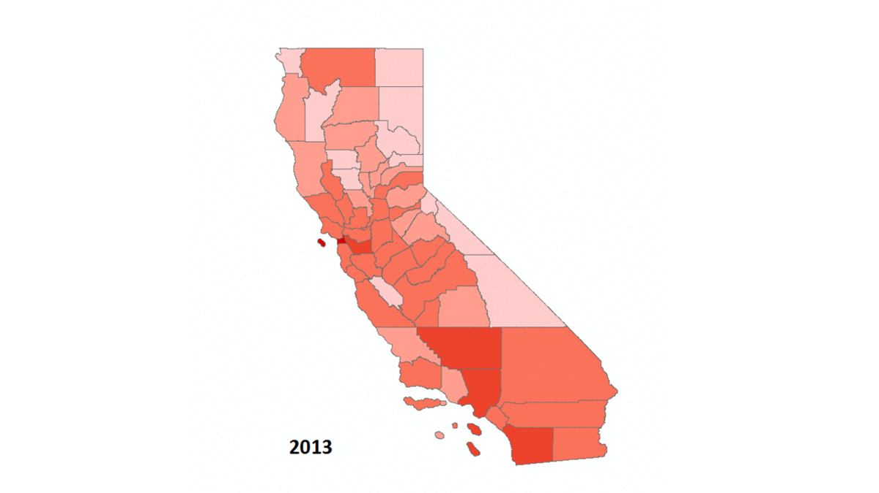
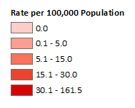
Increase of total early syphilis over time
Notes:
Getting a head of this unprecedented increase will require sustained, ongoing funding in order to staff, train and retain a dedicated and experienced workforce. Without funding to respond to this urgent epidemic, babies will continue to be born with devastating birth defects under our watch, and STDs will continue to spread at increasing rates across the state. We are doing everything we can, but it simply is not enough.

Slide 7
Thank you
Anissa Davis, MD, MPH
Long Beach City Health Officer
anissa.davis@longbeach.gov
562.570.4047
Notes:
Thank you for your time and I’m happy to answer questions.

