Slide 1
Overview of the Substance Use Disorder Treatment System in California
Darren Urada, Ph.D.
UCLA Integrated Substance Abuse Programs
January 31, 2018
Senate Health Committee
Sacramento, CA
All views expressed are my own,
and do not necessarily reflect those of UCLA or my funders (DHCS, Kern County).

Slide 2
Today’s (brief) talk
Does treatment work?
SUD Treatment in California
Terminology
Illustration in 2 graphs
Drug Medi-Cal Organized Delivery System
Levels of care
Summary & Conclusions

Slide 3
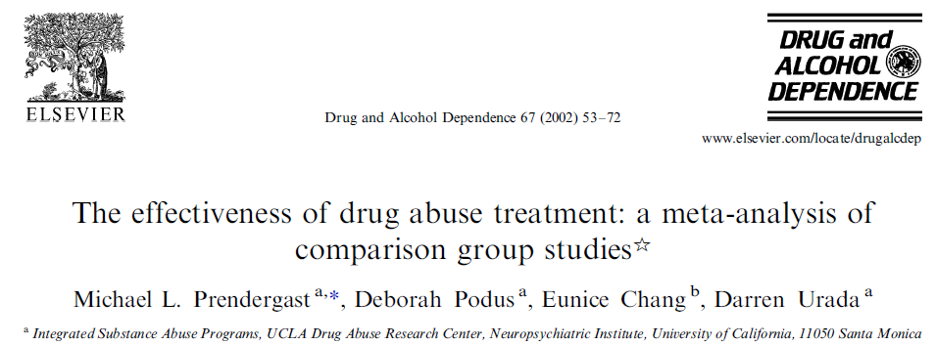
Does treatment work?
YES!
“drug abuse treatment has both a statistically significant and a clinically meaningful effect in reducing drug use and crime”
Notes:
Analysis of 78 rigorous studies conducted over more than 30 years

Slide 4
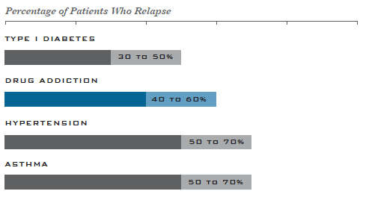
People do relapse, but at rates similar to other health conditions.
Source: National Institute on Drug Abuse
https://www.drugabuse.gov/publications/principles-drug-addiction-treatment-research-based-guide-third-edition/frequently-asked-questions/how-effective-drug-addiction-treatment

Slide 5
“Drug dependence generally has been treated as if it were an acute illness . . . long-term care strategies of medication management and continued monitoring produce lasting benefits. Drug dependence should be insured, treated, and evaluated like other chronic illnesses.“

Slide 6
Substance Use Disorder Treatment in California

Slide 7
Terminology
“Rehab” is not a specific service.

Slide 8
Residential
time in
treatment has
historically
been driven
By program,
funding.

Slide 9
Treatment based
on patient needs
IS possible.

Slide 10
How do we get there?

Slide 11
Drug Medi-Cal Organized Delivery System Waiver (Part of Medi-Cal 2020)
Covers 97.5% of the state’s population (40/58 counties)
Partly inspired by Santa Clara’s system
Level of care determined by ASAM criteria assessment
Continuum of care based on ASAM Criteria
Increased local control and accountability
Provisions for program integrity and beneficiary protections
Utilization tools to improve care and manage resources
Evidence-based practices
Coordination with other systems of care
DMC-ODS is just getting started. Evaluation underway (data needed)
Notes:
Partly inspired by Santa Clara’s system.

Slide 12
American Society of Addiction Medicine Levels of Care
0.5 Early Intervention
1 Outpatient
2.1 Intensive Outpatient
2.5 Partial Hospitalization
3.1 Clinically Managed Low-Intensity Residential
3.3 Clinically Managed Population Specific High-Intensity Residential
3.5 Clinically Managed High-Intensity Residential
3.7 Medically Monitored Intensive Inpatient
Medically Managed Intensive Inpatient
Opiate Treatment Program / Narcotic Treatment Program

Slide 13
Summary and Conclusions
Treatment works.
Sober living environments and counselor certification are not currently overseen by the state.
Need to balance “clamping down” with encouraging capacity expansion
A major effort to transform the Medi-Cal funded treatment system is underway.
Drugs affect crime, employment, child welfare, etc. Data from multiple departments is needed to provide policymakers with the full picture, but often isn’t available. Legislation would help.

Slide 14
Questions? Comments?
Darren Urada, Ph.D.
durada@mednet.ucla.edu

