Slide 1
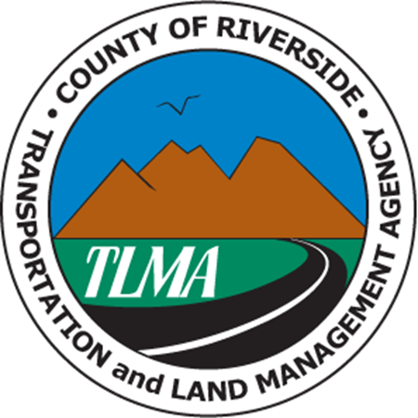
Local Government Impact Fees
Riverside County’s Perspective
Juan C. Perez
Assistant CE0
February 26, 2020

Slide 2
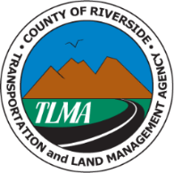
Riverside County’s Innovative Mitigation Fee Programs
Riverside County has 2 regional Transportation Uniform Mitigation Fee (TUMF) Programs:
Coachella Valley (1999) & Western County (2003)
Two regional Open Space fee programs:
Western County (2004) & Coachella Valley (2008)
County has a separate DIF program customized for 20 Area Plans
These programs have been a contributor, not an impediment, to Riverside County being the fastest growing County in California in the last 20 years

Slide 3
Riverside County Population (Millions)
1 Million New Residents
60% Growth
Western County TUMF & Riv. County DIF
Open Space (Western County)
Coachella Valley TUMF
Open Space (Coachella Valley)

Slide 4
Fee Programs Have Supported Population Growth
Provides for fair-share contributions to infrastructure – rather than first-in facing an insurmountable cost to develop
Provided CEQA cumulative mitigation – reduce legal challenges to housing growth
Leverage and match Federal and State dollars for both infrastructure and open space
Mitigation for Federal environmental permits – Endangered Species Act, Clean Water Act

Slide 5
Fee Programs Have Supported Population Growth
Over $1 Billion invested to directly deliver infrastructure that supports growth – expand freeways, highways, interchanges, bridges
Over 155,000 acres of open space preserved for over 150 protected species
Results:
Provide means to build infrastructure
Protect open space
Reduce public pressures against growth

Slide 6
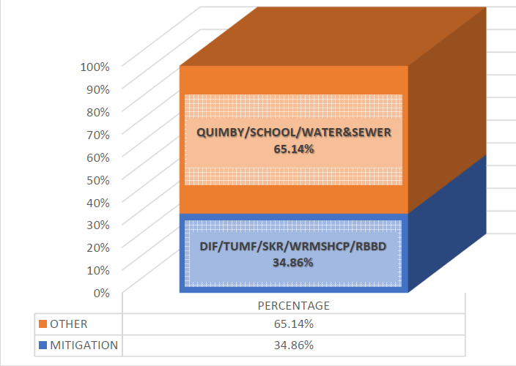
Local Mitigation Fees Are Only Part of the Picture

Slide 7
How Do We Provide for Housing Growth into the Future?
Mitigation fees provide a needed way to build infrastructure and open space– part of the funding and investment picture
Mitigation Fees provide CEQA and Federal permitting mitigation – what is the alternative?
Leads to more equitable cost sharing

Slide 8
How Do We Provide for Housing Growth into the Future?
Need for greater direct State investment in infrastructure
Align State funding programs with RHNA numbers – Target Investment
Explore innovative ways to combine CEQA reform, review State regulations for consistency with housing policy
Involvement of local agencies and regional bodies to move the needle in a collaborative way that lessens growth impacts and reduces costs

