Slide 1
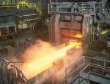
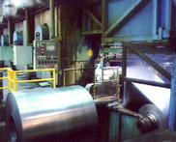
An Advanced Manufacturer in Steel
California Steel Industries, Inc.
Fontana, CA
March 21, 2012

Slide 2
Supposition: California’s Basic Industry Companies Are “Best in Class” and Support “Advanced” Technologies
California’s basic industrial companies are among the world’s most efficient
We are large consumers of advanced technology
Other states treat all manufacturing investments equally
“Advanced Technology” providers depend upon a broad-based manufacturing sector as customers

Slide 3
California Steel Industries (CSI) Snapshot
Single site, in Fontana, CA
Produce carbon steel sheet and tubular products
Largest steel company in Western U.S.
200-plus active steel customers, majority in California
More than $900 million in capital investment since 1984
About 1,000 employees and onsite contractors
Average pay $60,000 with strong benefits and profit sharing
27 years with no layoffs – AND WE ARE HIRING
During recession, loaned employees to community projects
An industry leader in employee safety, operational efficiency, and environmental excellence

Slide 4
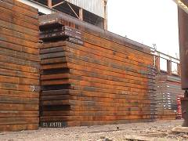
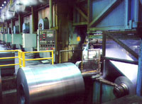
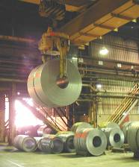
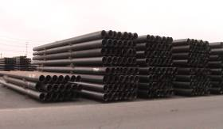
Business Model: CSI Does Not Make Steel; Purchased Slabs Are Converted to Coil Sheet & Pipe
Slabs
Converted to:
Hot Rolled Coil Sheet
Cold Rolled Coil Sheet
Galvanized Coil Sheet
Hot Rolled coil formed into
Electric Resistance Welded Pipe

Slide 5
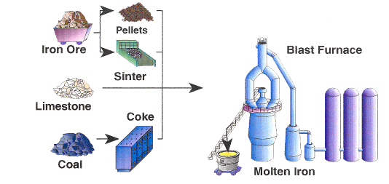
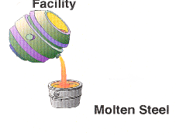
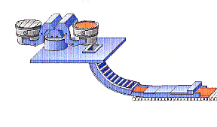
Integrated Steel Mill vs CSI
90% of the Greenhouse Gases from producing a hot rolled steel coil are generated in the steelmaking process, NOT by CSI
Pellets
Steelmaking
Facility
Iron Ore
Blast Furnace
Slab Caster
Sinter
Caster
Limestone
Coke
Molten
Steel
Coal
Molten Iron
Slabs
Hot Strip Rolling
Reheat Furnace
CSI slab rolling process produces just 10% of the GHG for coiled steel

Slide 6
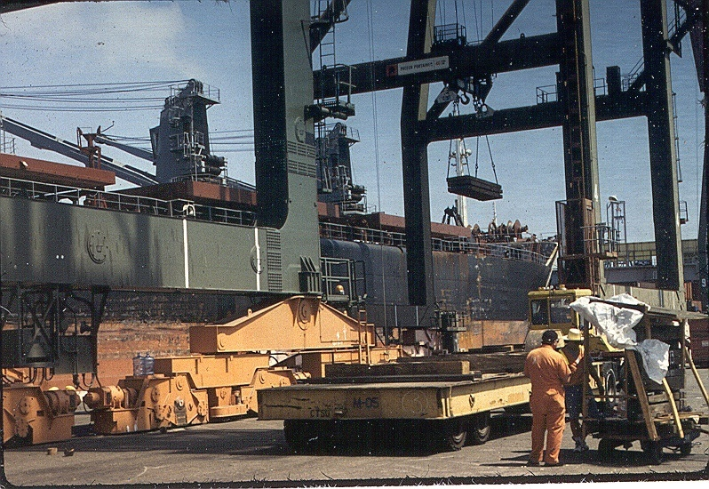
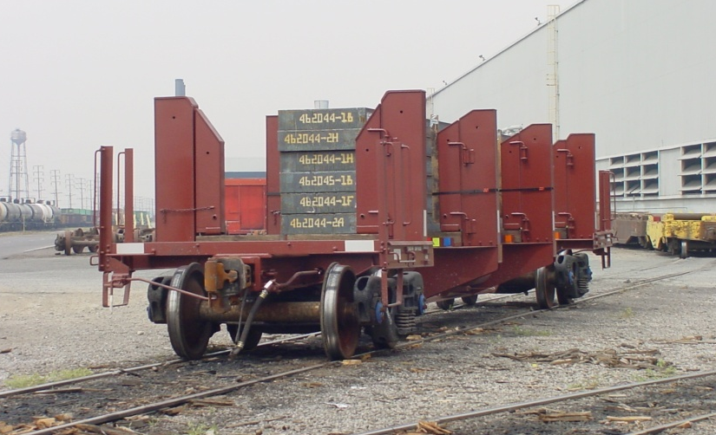
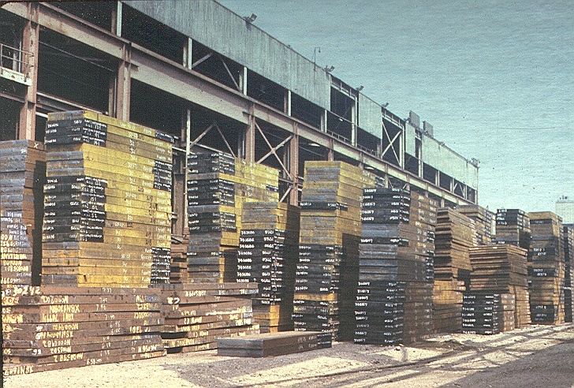
CSI Is a Major Customer of the Port of Los Angeles
All steel slab, whether coming through the Port or from domestic steel locations, arrives by at CSI by rail
More than one million tons of imported steel slab are received at the Port of Los Angeles annually

Slide 7
End Uses of CSI Products

Slide 8
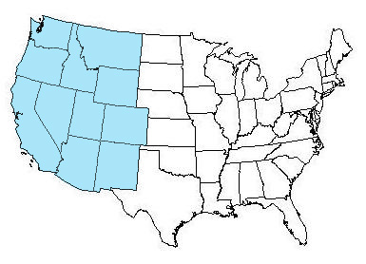
CSI’s Success is Based Primarily on Sales Within 11 Western States
CSI Target Market
CSI
Eastern U.S. Integrated Steel Mills

Slide 9
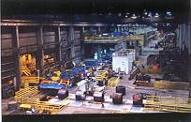
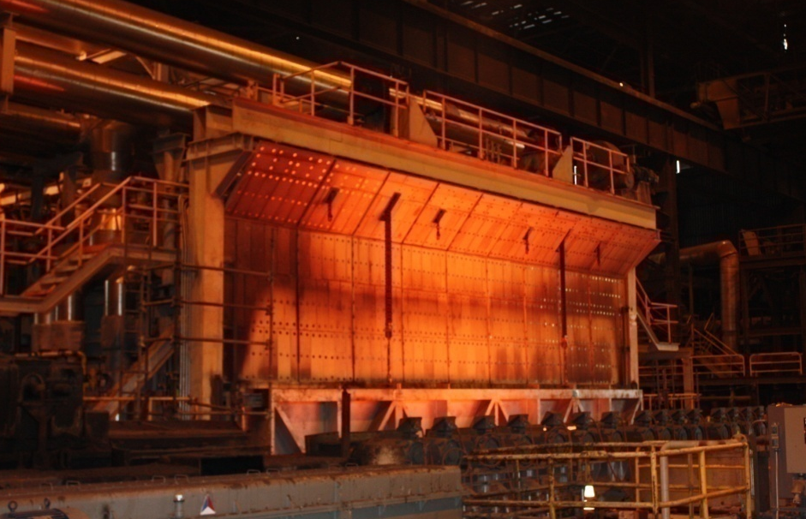
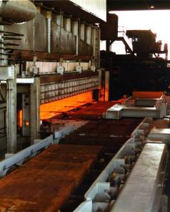
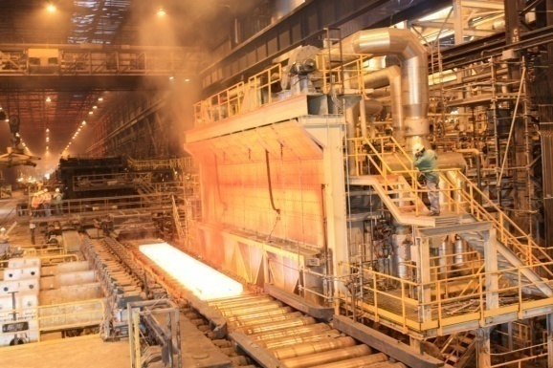
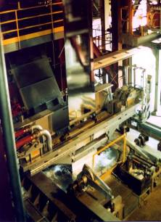
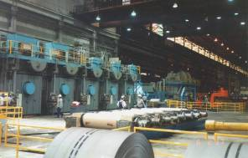
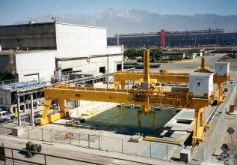
Major Modernization Projects at CSI
#5 Hot Strip Mill Reheat Furnace
2010
$71 million
62” Continuous Pickle Line
1994
$68 million
#4 Hot Strip Mill Reheat Furnace
1997
$25.5 million
Cooling Pond
1999
$13.2 million
#2 Continuous Galvanizing Line
1998
$73 million
Five Stand Cold Reduction Mill
1997
$64.3 million

Slide 10
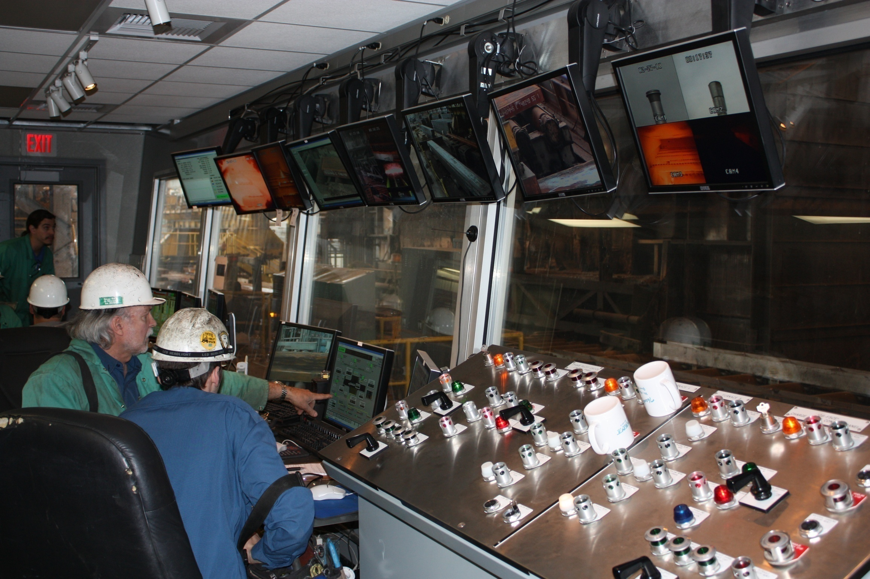
CSI is Heavily Dependent upon Process Control Technology

Slide 11
Future Growth and Innovation: CSI’s Leap of Faith
State-of-the-art slab Reheat Furnace installed 2010
$71 million investment at height of recession
Increases CSI capacity 50% with lower emissions
Latest burner technology
Waste heat produces steam, replaces boilers
GHG emissions reduced by approx. 20%
NOx emissions reduced by 50% – 67%
(Selective Catalytic Reduction technology)
PM-10 emissions reduced by approx. 20%

Slide 12
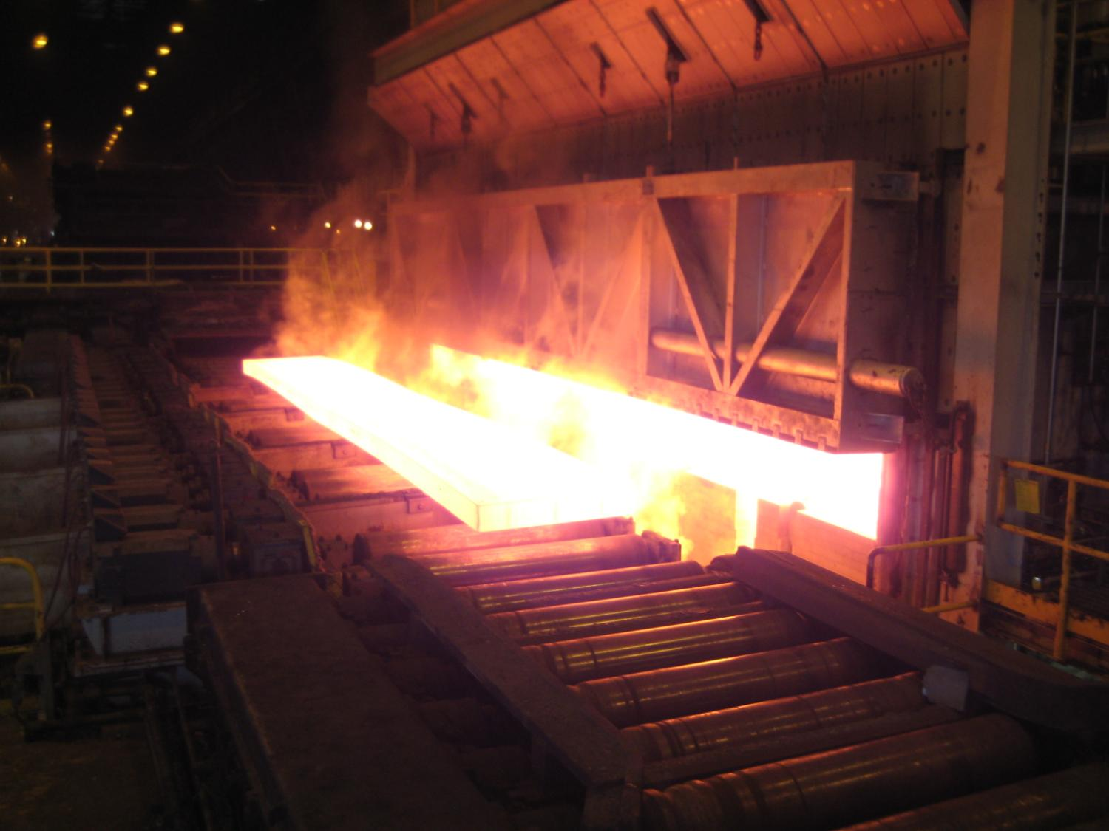
Production slab from new CSI Reheat Furnace

Slide 13
Since 1990, CSI Steel Production Has Risen While CO₂ Emissions Remained Relatively Flat

Slide 14
Why Investment in Steel is Important
For every job formed in the steel industry, seven additional HIGH VALUE jobs are created in other economic sectors, such as:
Raw materials and Transportation
Electronics
Computers and related technical services
Today’s steel industry is characterized by
Massive capital investments
World-class efficiencies
Heavy reliance on computer controls and robotics
Steel is the most recycled material on the planet

