Slide 1
Youth Civic Engagement
Mindy Romero, Ph.D.
Director

Slide 2
Types of Civic Engagement
Definition: Any effort by people to improve the quality of life in their communities
Typology:
Formal political participation
Participation in civic/community organizations, clubs, boards
Everyday civic engagement

Slide 3
Non-Traditional Forms of C.E.
Underrepresented communities often have few traditional pathways to engagement
Or the culturally relevant expressions of C.E.
We aren’t measuring the full level of C.E.
Power pathways are less accessible

Slide 4
The State of the Vote

Slide 5
Youth Eligible Voter Turnout in 2016?

Slide 7
Eligible Youth Voter Turnout
36.1%

Slide 8
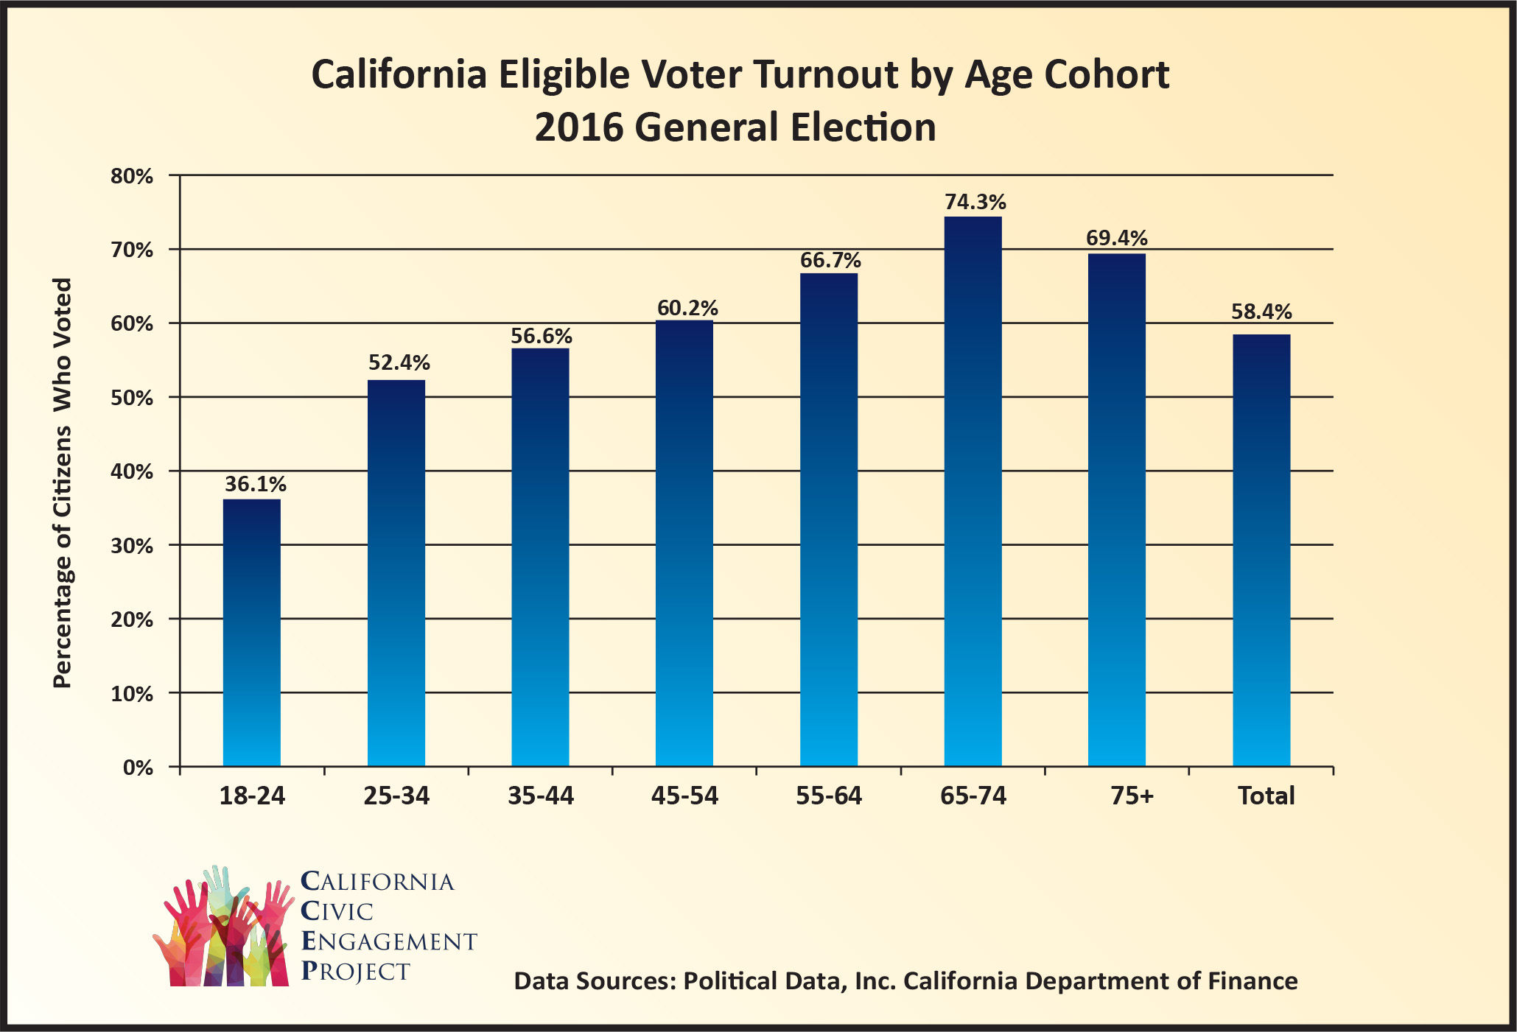
California’s Youth Turnout

Slide 9
Consequences of Disparities in Voter Turnout

Slide 10
Why Does Youth Voting Matter?
Youth play important role in democratic process
Strong youth vote has policy consequences
Increasing youth turnout is critical to a representative electorate
Look at the 2016 election!

Slide 11
How can we improve youth voter turnout?

Slide 12
How to increase youth engagement?
Make it Easier for Youth to Vote
Make Them Want to Vote

Slide 13
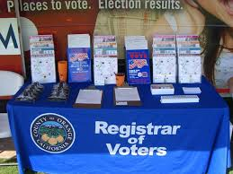
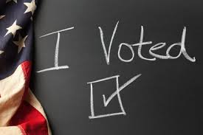
Making it Easier to Vote
Electoral system
Outreach
Civics education – high schools
Peer power!
= not apathy?

Slide 14
How Can We Make Youth Want to Vote?

Slide 15
Thank you!
Mindy Romero, Ph.D.
Director, California Civic Engagement Project
UC Davis
msromero@ucdavis.edu
@mindysromero
View my Tedx Talk on the Power of the Youth Vote!

