Slide 1
Considerations for Future Fuels
Dawn Manley, PhD
Sandia National Laboratories
Meeting the Goals of AB 32: Fuels of the Future
Informational Hearing of the
Senate Transportation and Housing Committee
October 24, 2011

Slide 2
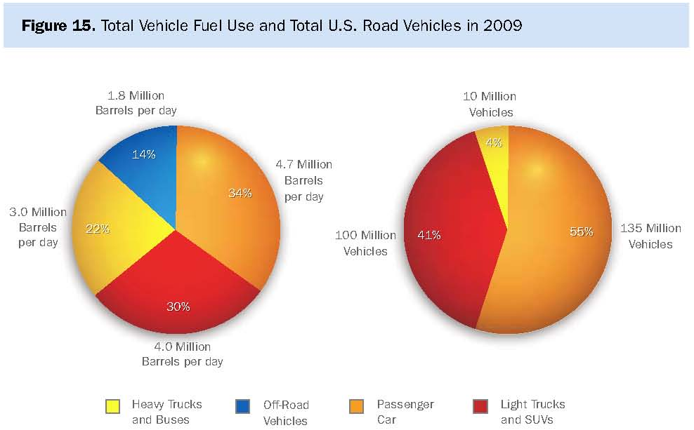
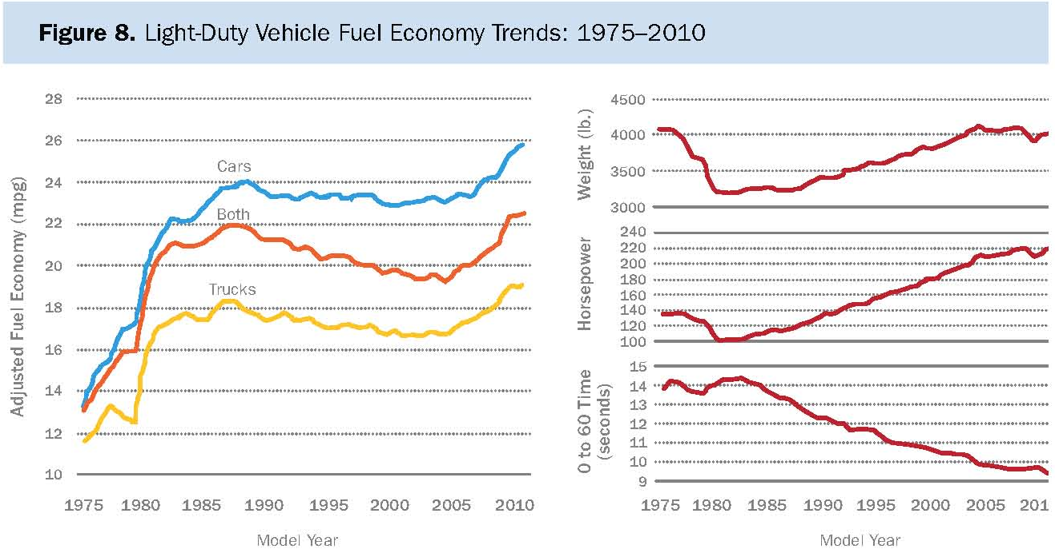
Current vehicle, fuel, and infrastructure mix reflects a history of (mostly) inexpensive petroleum
DOE, Report on the First Quadrennial Technology Review, 2011
97% of transportation fuels are derived from petroleum
Innovation in vehicles has been applied to efficiency improvements, emissions reduction, and performance
  Consumers have purchased larger, higher performance vehicles

Slide 3
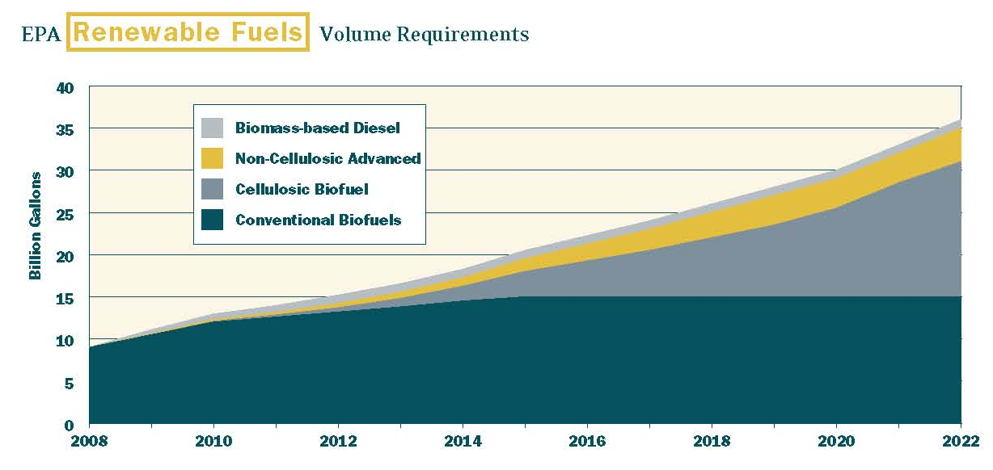
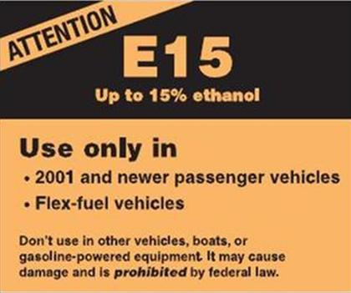
Aggressive state and federal targets specify technologies or performance standards
From D.L. Greene and S.E. Plotkin, Reducing Greenhouse Gas Emissions from U.S. Transportation, 2011
AB32 – GHG emissions reduced to 1990 levels by 2020
RFS2 – Specifies quantities of renewable biofuels by carbon intensity and feedstock type
Obama Administration targets – 1 million EVs by 2015, reduce oil imports by 1/3 by 2025

Slide 4
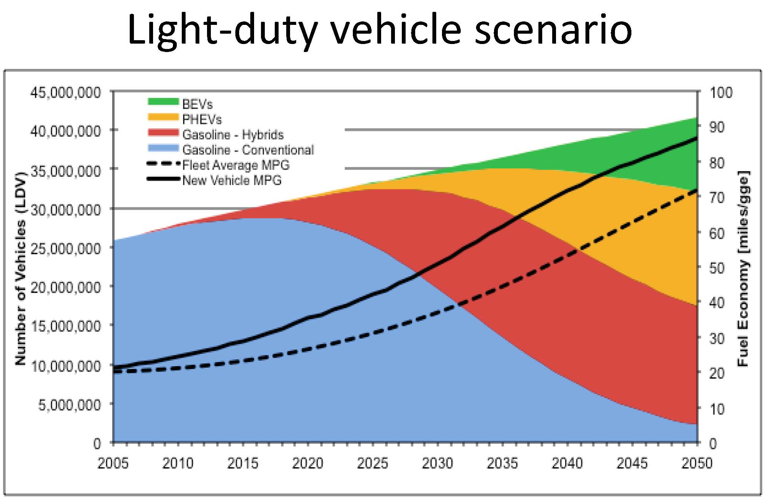
Scenario analyses explore possible futures and pathways
J.C.S. Long, Chair’s Lecture: California’s Energy Future Study Results, 2011
What mix of technologies can achieve aggressive GHG reduction or fuel economy targets?

Slide 5
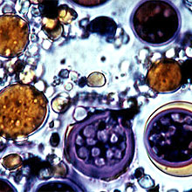
Speed, scale, standards, and segmentation matter
Speed and scale
  Target timeframes heavily influence technology options
  US car park takes 17 years to turn over
  Hybrids first commercialized in 1997 – now still make up only about 5% of US sales
Standards
  Are today’s specifications robust?
Segmentation
  Increasing divergence and fragmentation
  Interdependencies of seemingly parallel technologies
  How will regional issues and local consumer preferences influence the evolution of technology options?
Next Generation Biofuels & Advanced Engines – November 2009
Transitioning the Transportation Sector: Exploring the Intersection of Biofuels and Electric Vehicles – October 2010
www.sandia.gov/news/publications/white-papers/

