Slide 1
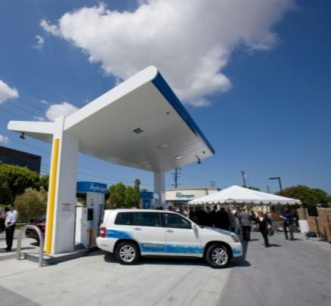
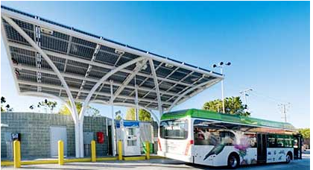
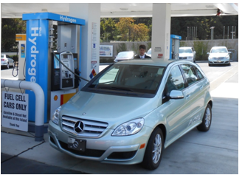
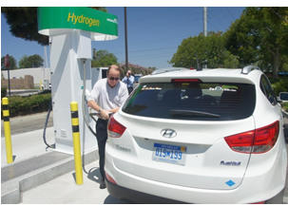
Real and ready for market launch
Notes:
Hydrogen fuel cell electric vehicles (FCEVs) are real and ready for market launch in California. Customers are driving FCEVs today and fueling at public hydrogen stations in California. These are full-size, all-electric drive vehicles that have zero tailpipe emissions and go 200-400 miles before refueling in less than 5 minutes. Fuel cell electric buses operate in regular transit service carrying passengers in the Bay Area and Palm Springs every day. Customers love these clean, quiet, high-performance vehicles. FCEVs are “no-compromise” vehicles that are essential to meeting California’s goals for air quality, energy security and climate protection.

Slide 2
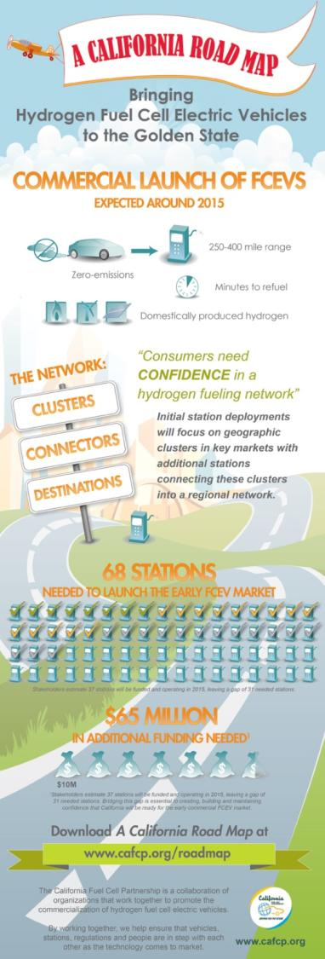
A California Road Map
Develop station network
68 stations to launch
100 stations to self-sustaining
Accelerate station implementation
Timeliness, performance, path to profitability
Promote hydrogen readiness
Communities, businesses, consumers
www.cafcp.org/roadmap
Notes:
Unlike some fuels that can be provided “one car at a time” or that are primarily used in fleets, customers must know that hydrogen will be available at retail stations before they will purchase or lease a fuel cell electric vehicle. Rather than build stations across the state, the California Fuel Cell Partnership Roadmap identifies a minimum number of hydrogen stations needed to give FCEV customers confidence they can fuel their cars as conveniently as they do today while minimizing the up-front investment needed to launch the market.

Slide 3
Station photos
Notes:
A station operator recently told me “We are done building demonstration stations. We have learned what we need to know, and we will now build retail stations.” As with other alternative fuels, State of California incentives for hydrogen are helping launch a new market. Hydrogen is an established product in many commercial and industrial applications today, but as a vehicle fuel it is still new. Businesses that sell fuel are eager to offer what their customers need, and independent analysis shows hydrogen can be a profitable business. State of California incentives bridge the gap between demonstrations and a self-sustaining market.

