Slide 1
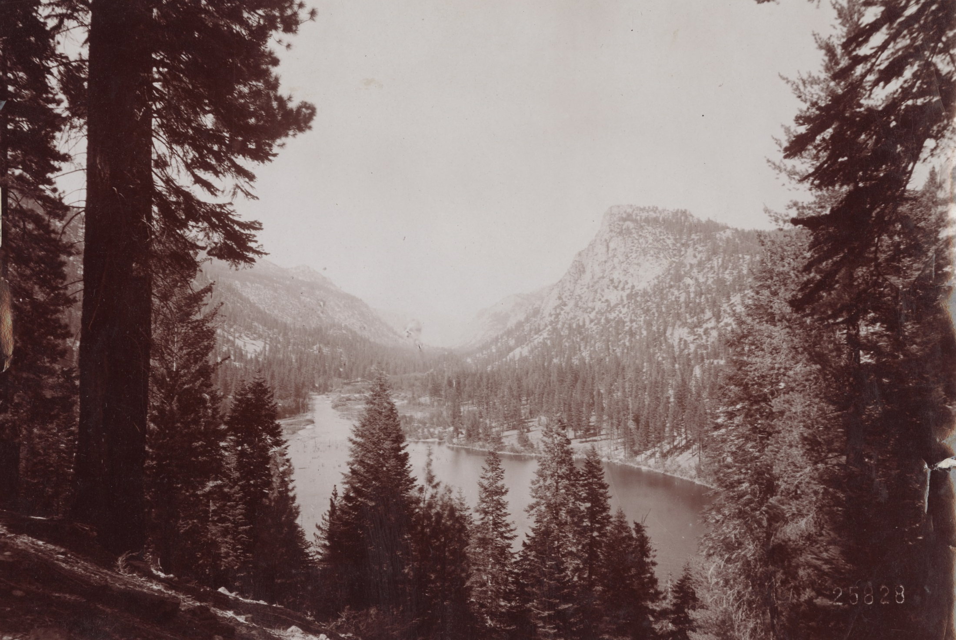
Fire deficit in Sierra Nevada forests: how the lack of fire contributed to the current calamity

Slide 2
Reconstructed historical climate and fire
Marlon et al. 2012 Proc. Nat. Acad. Sci.

Slide 3
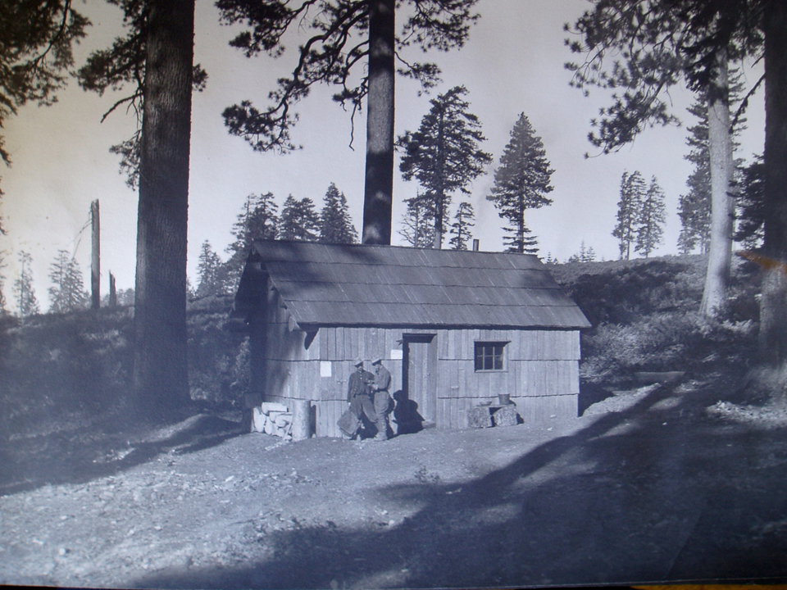
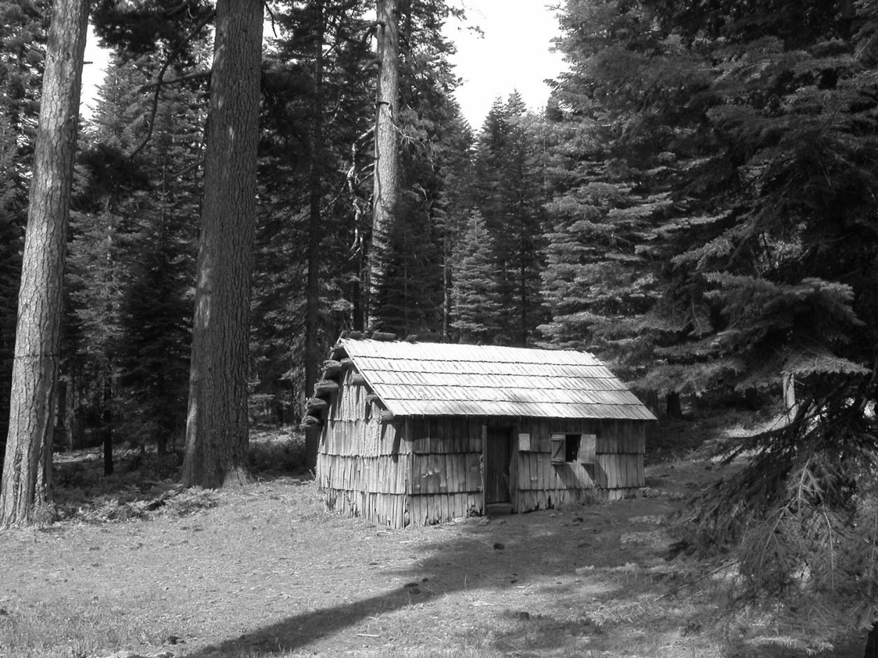
~1915
2005
Guard Station, Plumas National Forest (near UC Forestry Camp)

Slide 4
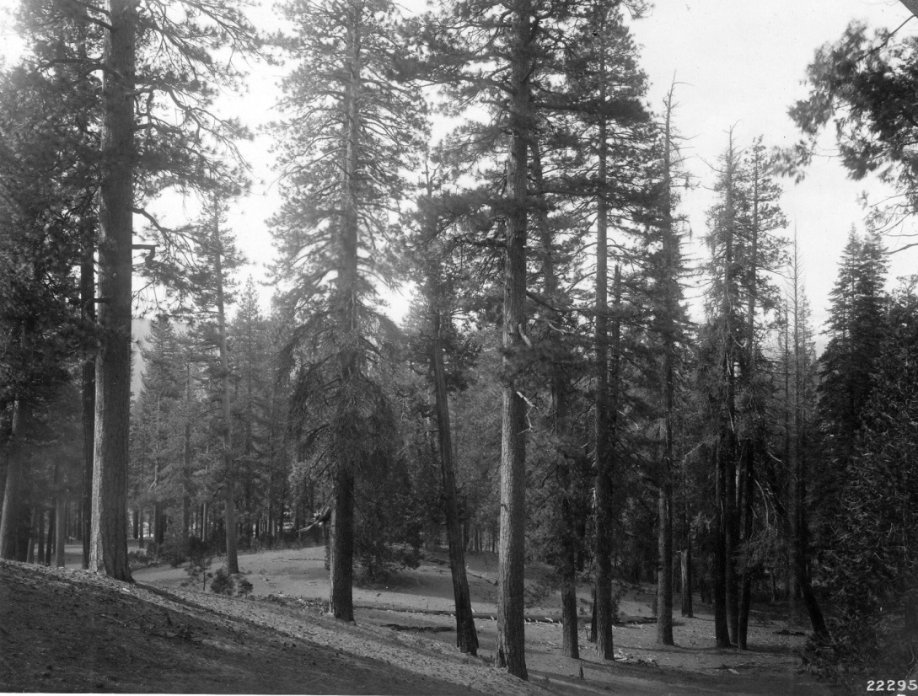
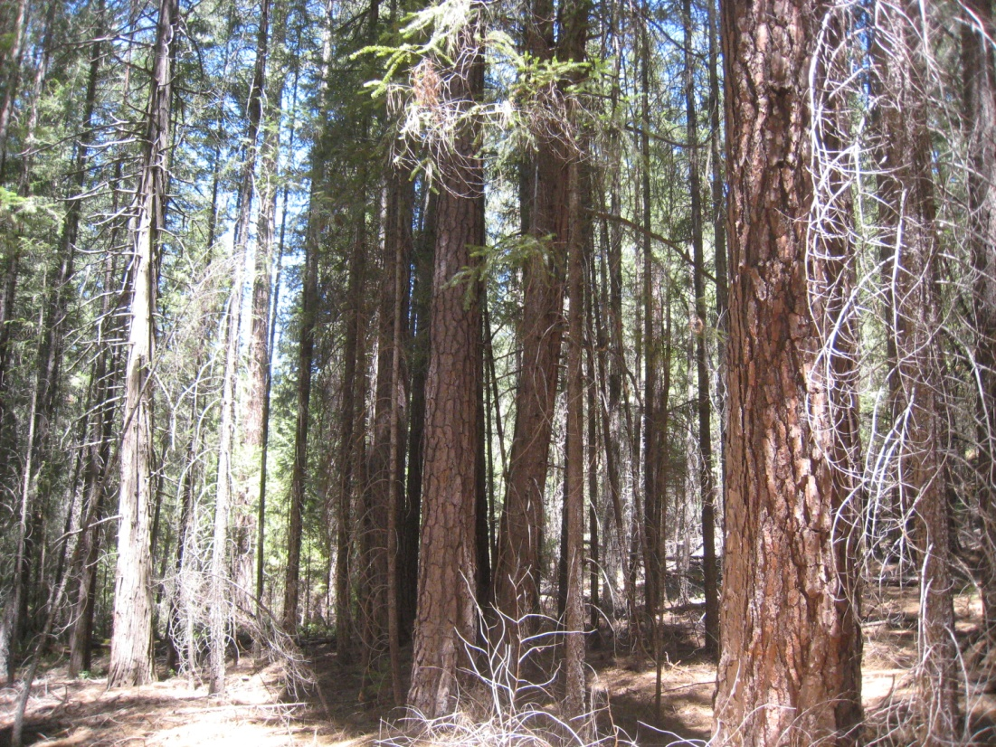
Historical vs. current forest conditions:
re-measurement of early forest surveys
Year | Basal area (ft² ac⁻¹) | Tree density (ac⁻¹; >6 in.) | Pine proportion | Shrub cover (%)
1911 | 87 | 22 | 0.56 | 28
2013 | 173 | 101 | 0.45 | 14

Slide 5
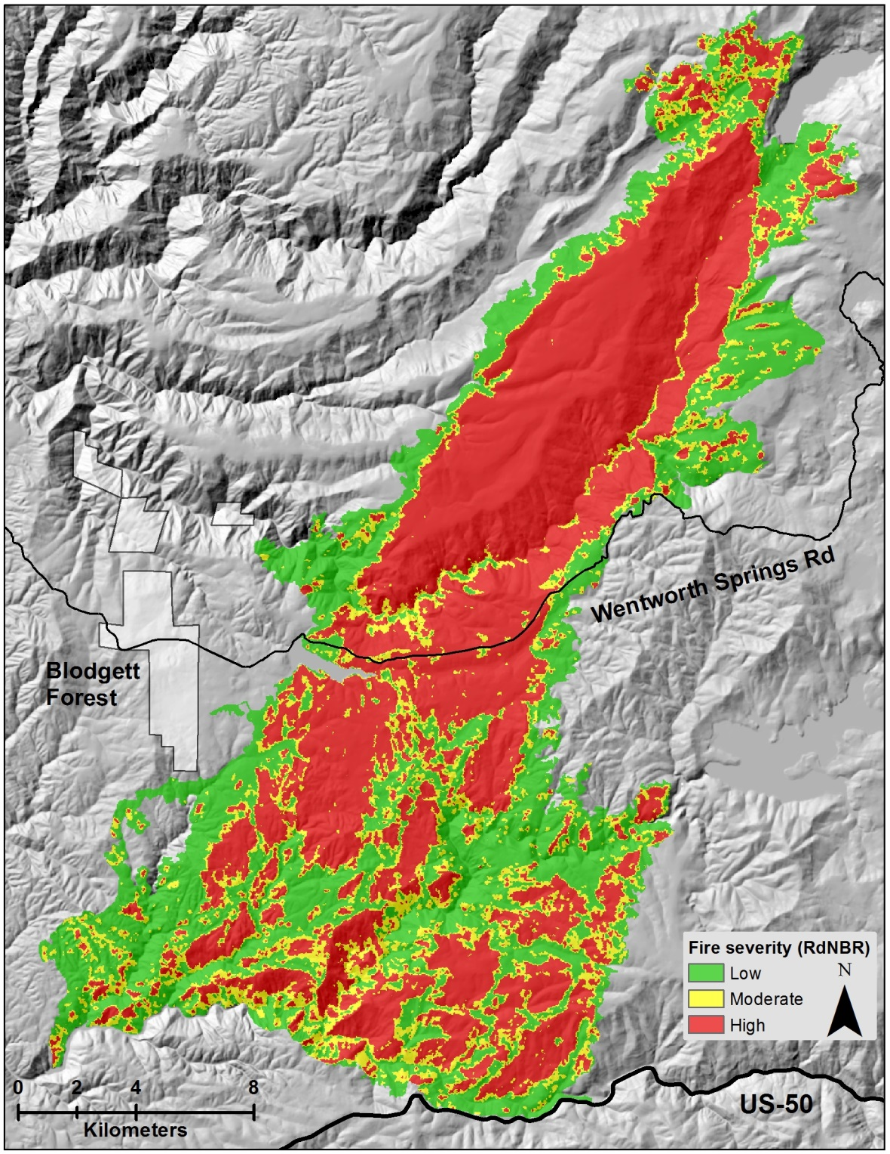
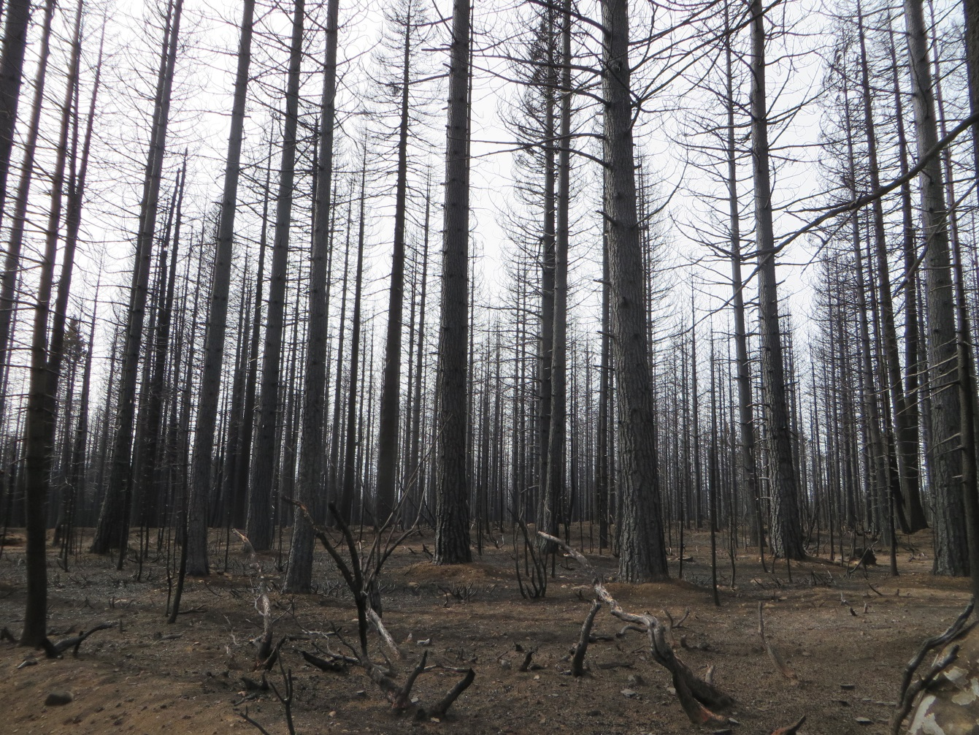
Contemporary forests: highly vulnerable to
severe fire effects, e.g., King Fire (2014)

Slide 6
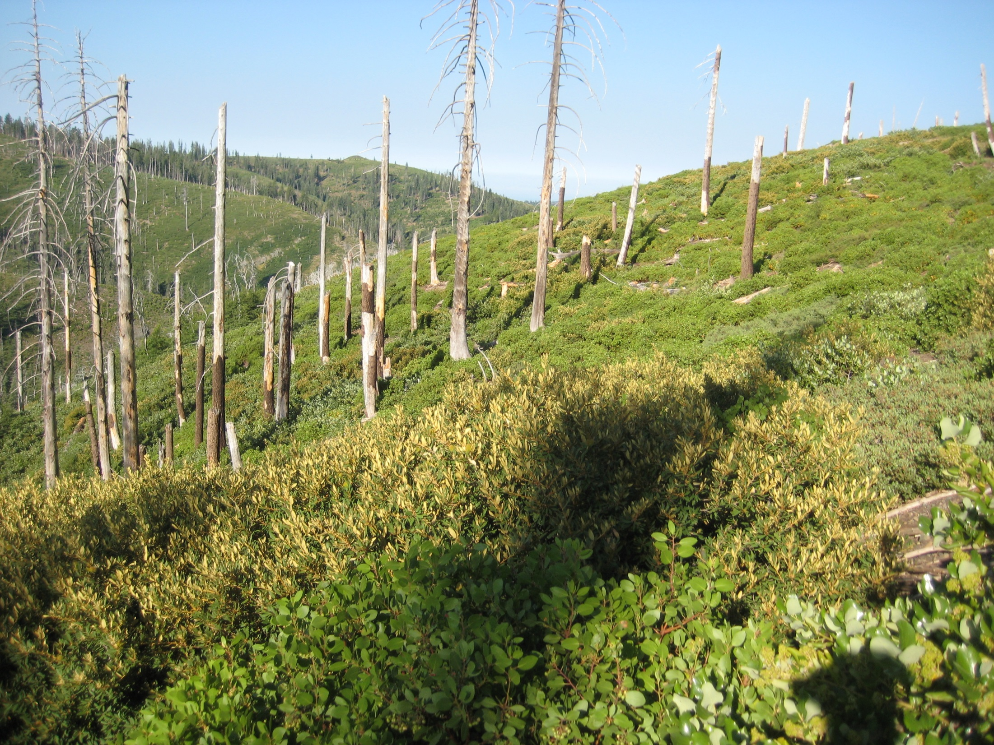
Ten years after high severity fire: Plumas NF

Slide 7
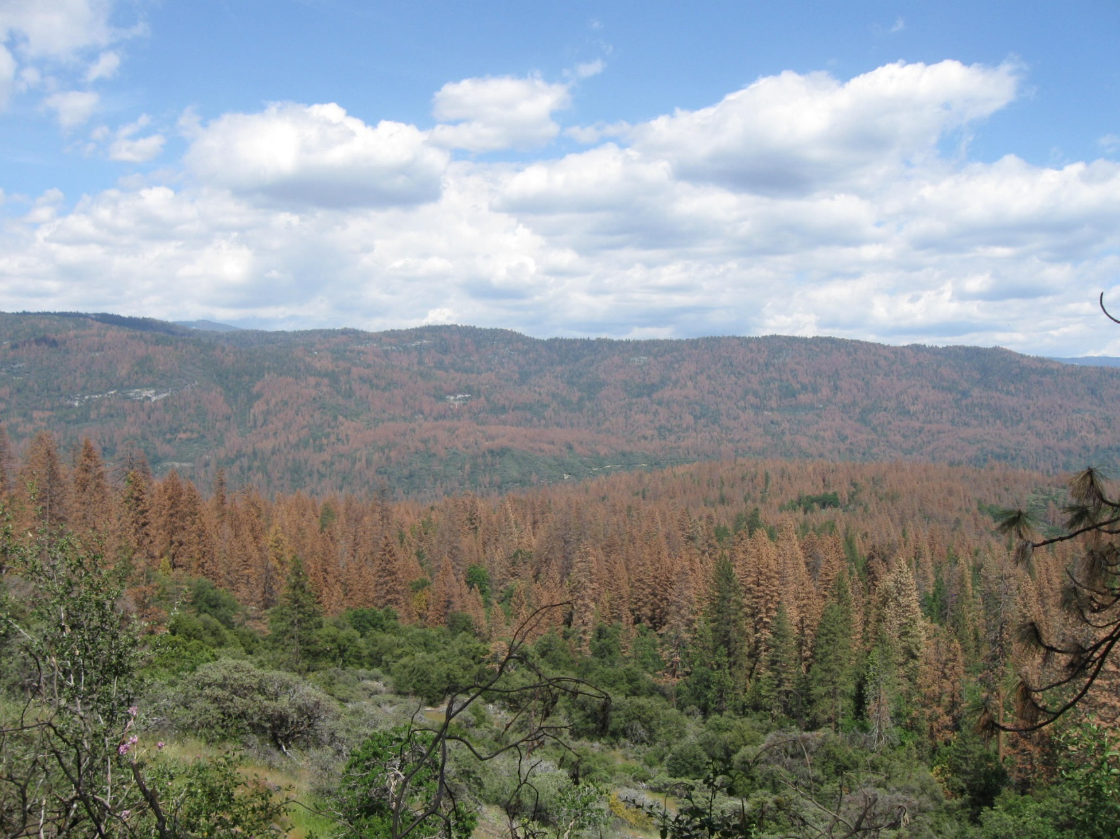
Contemporary forests: less resilient drought
Higher tree density = more drought stress
Mortality disproportionately affecting large trees

Slide 8
Contemporary vs. historical “treatment”
Forest type group
Acres
North et al. 2012 J. Forestry

Slide 9
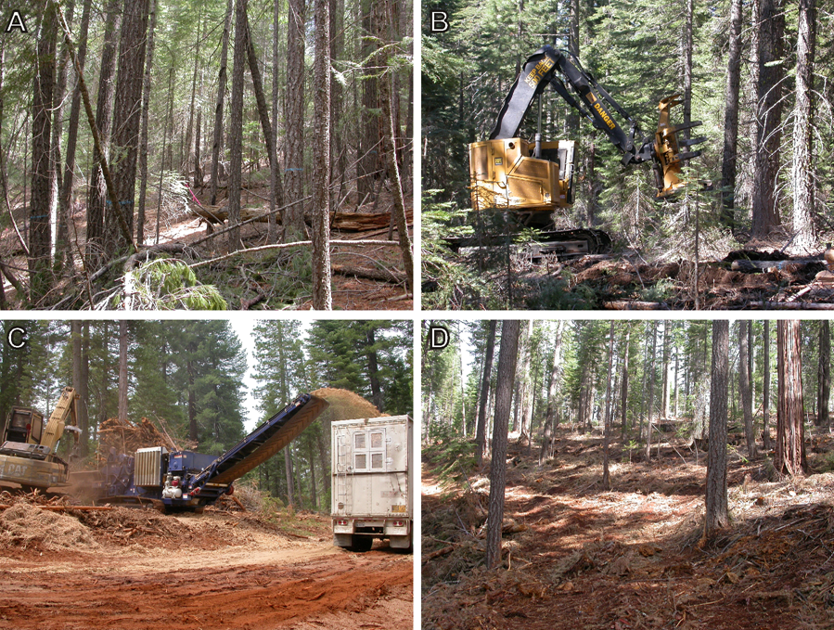
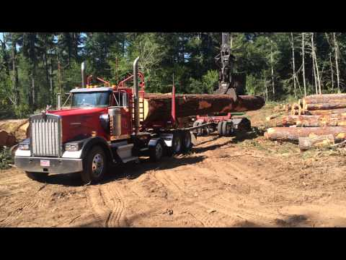
Restoration treatments: Thinning
D

Slide 10
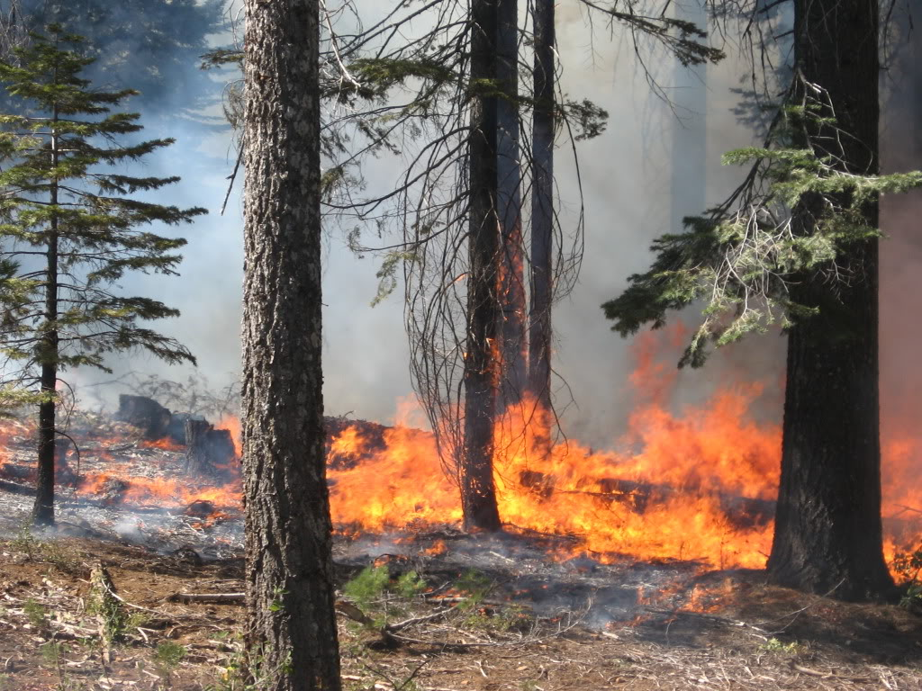
Restoration treatments: Prescribed fire

Slide 11
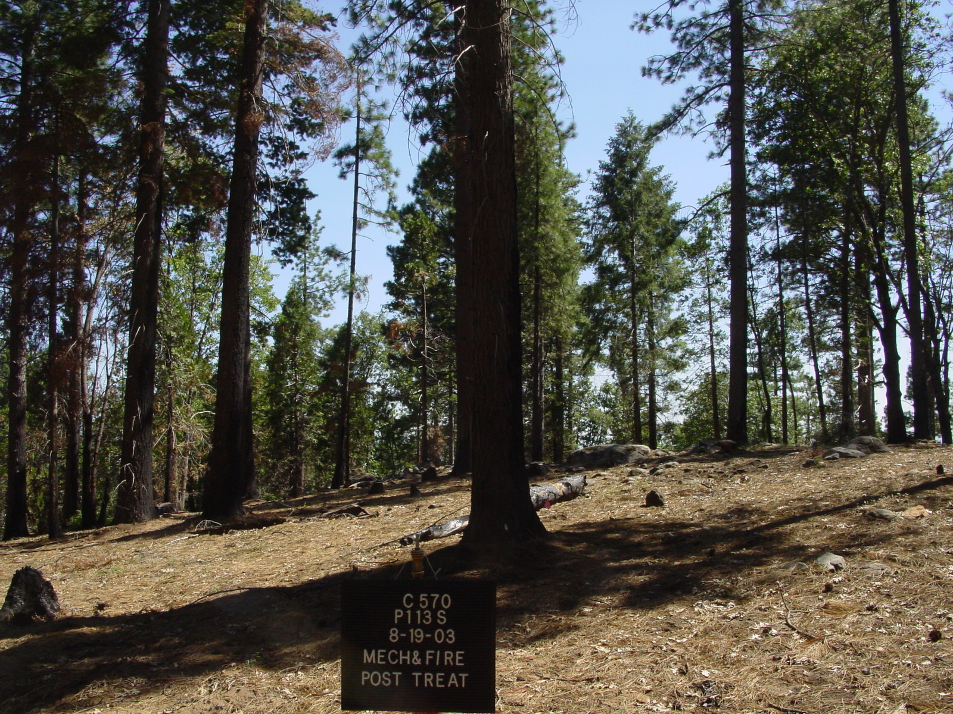
Blodgett Forest: thinning + Rx fire

Slide 12
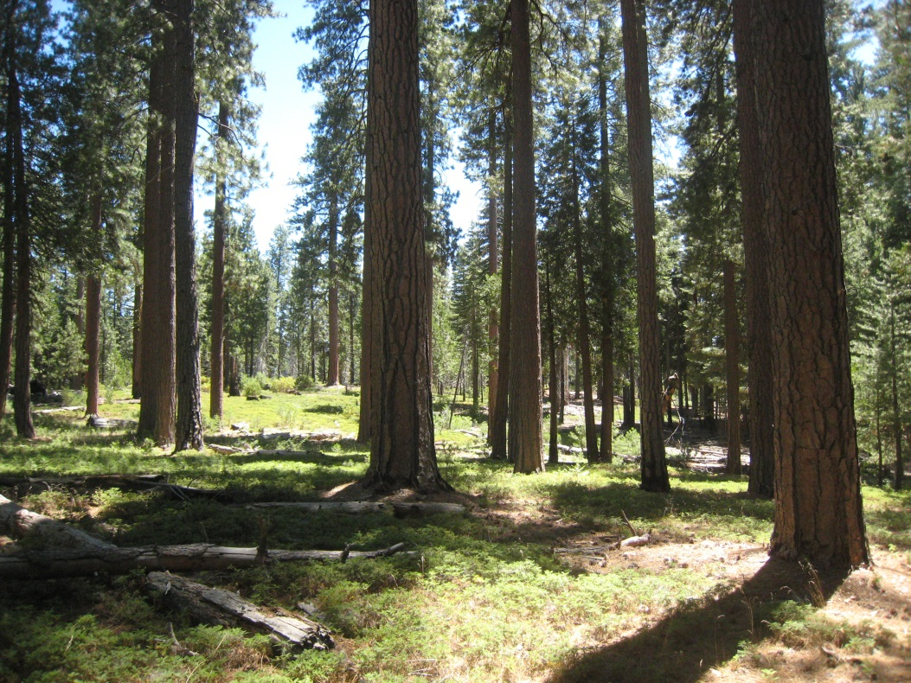
Yosemite National Park: multiple Rx fires

Slide 13
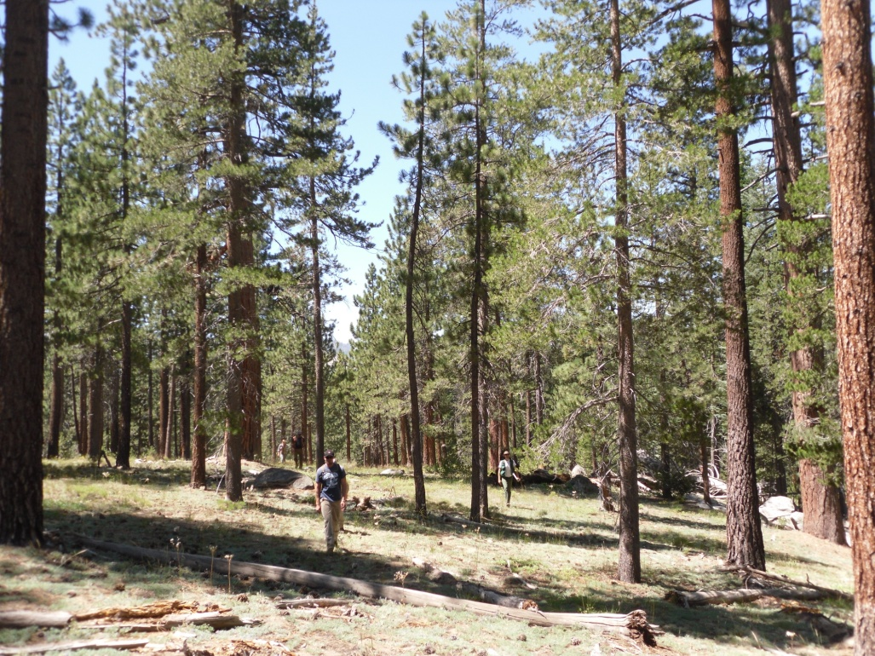
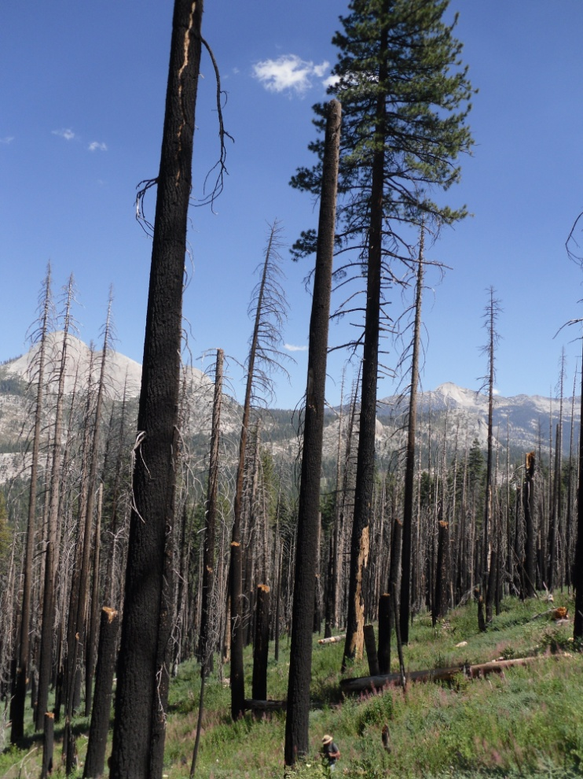
Forest management implications:
Current forests are substantially altered from historical conditions
  Greater tree density (small trees)
  More fuels
  Lower variability
Contemporary high severity fire EXCEEDS historical levels, and likely increasing
Large-scale restoration strategies are needed
  Balance treatment impacts vs. fire impacts to wildlife
  Introduce more variability
  More beneficial fire

