Slide 1
Community Choice Aggregation
Edward Randolph
Director
Energy Division
California Public Utilities Commission
August 23, 2017

Slide 2
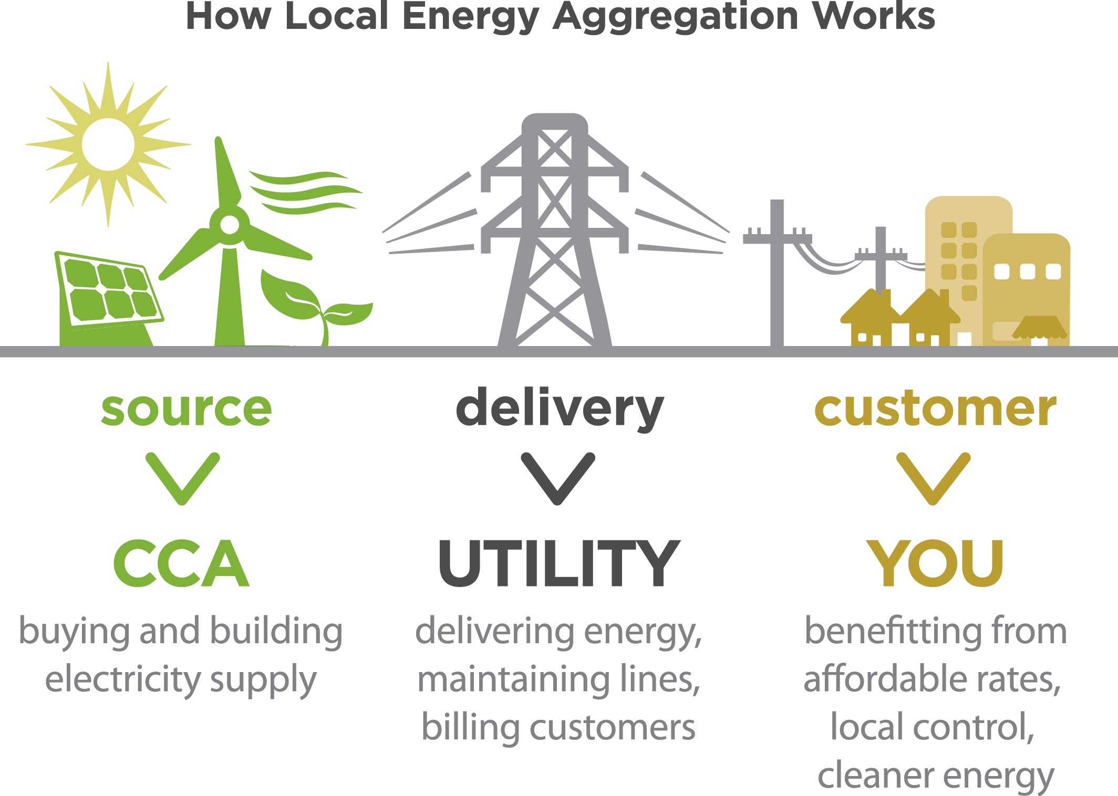
What is Community Choice Aggregation?
Community Choice Aggregators (CCAs) are local government agencies that purchase and may develop power on behalf of residents, businesses, and municipal facilities within a local or sub-regional area.
*Image from LEAN Energy: http://www.leanenergyus.org/what-is-cca/

Slide 3
CCA History
Authorized by AB 117 (Migden) (2002)
Expanded by SB 790 (Leno) (2011)
Required the CPUC to open a Rulemaking and create a Code of Conduct (D. 12-12-036)
Marin Clean Energy (MCE) begins serving customers (2010)

Slide 4
Operational CCAs
Marin Clean Energy
In July 2017, Board Approved expansion
Sonoma Clean Power
Clean Power SF
Lancaster Choice Energy
Peninsula Clean Energy
Silicon Valley Clean Energy
Apple Valley Choice Energy
Redwood Coast Energy
Pico Rivera (September 2017)
Notes:
MCE: Counties of Marin and Napa, and the Cities of Richmond, Benicia, El Cerrito, San Pablo, Walnut Creek, and Lafayette.
The Board approved to expand to serve: Concord, Danville, Martinez, Moraga, Oakley, Pinole, Pittsburg, San Ramon, and unincorporated Contra Costa County.
Sonoma Clean Power : Cities of Cloverdale, Cotati, Fort Bragg, Petaluma, Point Arena, Rohnert Park, Santa Rosa, Sebastopol, Sonoma, Willits, Windsor, and the Counties of Sonoma and Mendocino.
CleanPowerSF: Parts of San Francisco. Concentrated in Districts 5, 8, and 10. They have enrolled most residential and commercial customers in Districts 5 and 8, small and medium commercial customers in District 10, and as well we are serving customers who have signed up for our service from all over the City.
Lancaster Choice Energy: The City of Lancaster. [Edison Territory]
Peninsula Clean Energy: Cities of Millbrae, Pacifica, Portola Valley, Redwood City, San Bruno, San Carlos, San Mateo, South San Francisco, Belmont, Brisbane, Burlingame, Daly City, East Palo Alto, Foster City, Half Moon Bay, Menlo Park, Towns of Atherton, Colma, Hillsborough, Woodside, and Unincorporated San Mateo County.
Silicon Valley Clean Energy:Cities of Campbell, Cupertino, Gilroy, Los Altos, Monte Sereno, Morgan Hill, Mountian View, Saratoga, Sunnyvale, Town of Los Altos Hill,s Town of Los Gatos, County of Santa Clara (unincorporated areas).
Apple Valley Town of Apple Valley [Edison territory]
Redwood Coast Energy: City of Arcata, City of Blue Lake, City of Eureka, City of Fortuna, City of Trinidad, City of Rio Dell , the County of Humboldt, and the Humboldt Bay Municipal Water District.

Slide 5
Soon-to-be Operational and Potential Future CCAs
Soon-to-be Operational:
City of Pico Rivera
City of San Jacinto
Recently Filed Implementation Plans:
East Bay Community Energy
Los Angeles County
Placer County
Prospective
Hermosa Beach
Western Riverside Council of Governments
Santa Barbara
San Jose
Exploring / Program Evaluation:
Monterey
Long Beach
Lake County
Salinas
San Diego

Slide 6
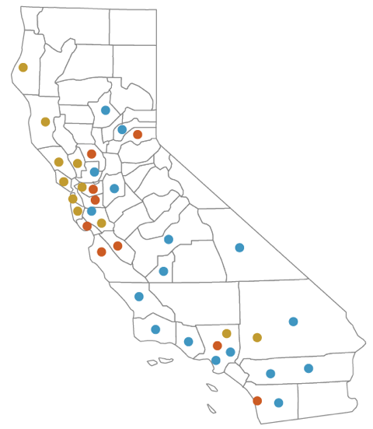
Statewide CCA Activities
Operational CCAs
MCE (includes Marin and Napa Counties, parts of Contra Costa and Solano Counties)
Sonoma Clean Power (Includes Mendocino County)
Lancaster Choice Energy
Peninsula Clean Energy (San Mateo County)
Silicon Valley Clean Energy (Santa Clara County)
Redwood Coast Energy Authority (Humboldt County)
Town of Apple Valley
City of Pico Rivera
CCAs that Submitted Implementation Plans but are Delayed or on Hold
City of Hermosa Beach (May join LACCE)
City of San Jacinto
In progress / Exploring
Sierra Valley Energy Alliance (Yolo County, Cities of Davis and Woodland)
Contra Costa County (as parte of MCE)
City of Solana Beach
San Diego County
Kings County
Butte County
San Luis Obispo
Santa Barbara County
Ventura County
Existing (Currently serving customers)
Received CCA Plans/Anticipated 2018 Launch
East Bay Community Energy (Alameda County)
Los Angeles Community Choice Energy (Los Angeles County)
Monterey Bay Community Power (Monterey, Santa Cruz, and San Benito Counties)
Pioneer Energy (Placer County)
(http://www.leanenergyus.org/cca-by-state/california/)
4

Slide 7
Community Choice Aggregate Load Information filed in Implementation Plans
Community Choice Aggregators | Customer Accounts 2018 | Peak Load (MW) 2017 | Peak Load (MW) 2018 | Implementation Plan Filed
MCE | 257,248 | 507 | 502 | Revised Apr-16
Sonoma Clean Power | 232,518 | 537 | 538 | Revised Oct-2016
Lancaster Choice Energy * | 52,00 | 132 |  | Jun-14
Clean Power SF * | 73,000 | 93 |  | Revised Nov-12
Peninsula Clean Energy | 258,301 | 669 | 753 | Feb-16
Silicon Valley Clean Energy | 243,000 | 604 | 687 | Jul-16
Apple Valley Choice Energy | 26,109 | 83 | 83 | Sep-16
Redwood Coast Energy Authority | 60,763 | 138 | 139 | Oct-16
Pico Rivera Community Choice Aggregate | 16,380 | 56 | 56 | Dec-16
East Bay Community Energy | 49,456 |  | 831 | Aug-17
Monterey Bay Community Power | 272,584 |  | 620 | Aug-17
Pioneer Community Energy | 84,284 |  | 249 | Jul-17
Los Angeles CCE | 279,241 |  | 982 | Aug-17
San Jacinto ** | 13,446 | 58 | 58 | Dec-16
* Data reported by CalCCA
** Did not start serving load in 2017 as anticipated in implementation plans
Green rows are projected for 2018 Launch

Slide 8
The CPUC’s Roles with CCAs
Certify Implementation Plans
Review and approve the annual Joint Rate Mailer
Authorize Non-Bypassable Charges that affect CCA rates, such as Public Purpose Charges. Sets the Power Charge Indifference Adjustment (PCIA) to assure bundled customer indifference
R.17-06-026 examining the PCIA methodology
Adjudicate complaints via expedited complaint process established in the CCA Code of Conduct
Authorizes CCA energy efficiency program funding
MCE filed a Business Plan
Currently MCE is an EE Administrator
Lancaster Choice Energy submitted an Advice Letter to become an Administrator
Administers Renewables Portfolio Standard (RPS) requirements for CCAs
Oversees Time of Use pilots, which some CCAs are participating in.
Administer Resource Adequacy requirements

Slide 9
CCA Obligations Before the CPUC
Resource Adequacy (RA) requirements (PU Code Section 380)
System, Local, and Flexible RA
Annual Filings
Monthly Filings
Renewables Portfolio Standard (RPS)
CCAs are subject to the same RPS requirements as IOUs
CPUC “accepts” CCAs’ RPS plans
Integrated Resource Planning (IRP) (PU Code Section 452.52)
CCAs must submit IRP proposal for CPUC certification
Energy Storage requirements (AB 2514)
Storage projects to meet 1% of the peak load
Notes:
RPS: CCAs are required by law and CPUC regulations to procure a minimum percentage of its retail electricity sales from qualified renewable energy resources. The same standards and rules governing RPS complaint that are applicable to IOUs are applicable to CCAs.

Slide 10
CCA Obligations before the CPUC (continued)
Resource Adequacy (RA)
For the annual filings, Load Serving Entities (LSEs) are required to make an annual System, Local, and Flexible compliance showing for the coming year.
For the System showing, LSEs are required to demonstrate that they have procured 90% of their System RA obligation for the five summer months the coming compliance year.
Additionally each LSE must demonstrate that they meet 90% of its Flexible requirements and 100% of its local requirements for each month of the coming compliance year. For the monthly filings LSEs must demonstrate they have procured 100% of their monthly System and Flexible RA obligation. Additionally, on a monthly basis from July through December, LSEs must demonstrate they have met their revised (due to load migration) local and flexible obligation.

Slide 11
CCA Obligations before the CPUC (continued)
Renewables Portfolio Standard
Requires investor-owned utilities, electric service providers, and community choice aggregators to increase procurement from eligible renewable energy resources to 50% of total procurement by 2030.
Integrated Resource Planning (IRP)
PU Code Section 452.52:
(3) The plan of a community choice aggregator shall be submitted to its governing board for approval and provided to the commission for certification
The Plan shall achieve a diversified procurement portfolio and resource adequacy requirements, among other things
Energy Storage
Storage projects to meet 1% of the peak load
Contracts by 2020
In place by 2024
Notes:
RPS: CCAs are required by law and CPUC regulations to procure a minimum percentage of its retail electricity sales from qualified renewable energy resources. The same standards and rules governing RPS complaint that are applicable to IOUs are applicable to CCAs.

Slide 12
CCA Interest and Participation
in Other CPUC Programs
Energy Efficiency (EE)
MCE currently administers its own EE program
Lancaster has submitted an Advice Letter to also become an EE administrator
MCE submitted a Business Plan in R.13-11-005 proposing to take on EE programs that have been administered by PG&E
Time of Use (TOU) Rates
MCE and SCP are participating in PG&E default TOU pilot..

Slide 13
CPUC Jurisdictional Breakdown
Based on 2014 year ahead load forecasts (MWs) from the CEC
Based on 2018 initial August load forecasts (MWs) filed with the CEC in April 2017
Potential 2018 based on filed implementation plans

Slide 14
CCA Growth and Participation in the RA Program
In 2016, six CCAs filed implementation plans with the Commission. These implementation plans suggested that 1,600 MW of additional peak load would migrate to these new CCAs in 2017.
In 2017, five of the six CCAs began serving load. Their August load forecast used for RA purposes amounted to just under 1,400 MW of load.
Four of these five CCAs did not participate in the CPUC’s annual RA process.
As of August 2017, four new CCAs have filed implementation plans. These implementation plans suggest that about 2,700 MW of additional peak load will be migrating to these new CCAs in 2018.
None of these four CCAs are participating in the CPUC’s annual RA process. This means that some of the capacity costs may ultimately be stranded with remaining bundled customers.
It is also possible that other CCAs will emerge (in addition to these four) to serve load in 2018, without participating in the annual RA process.

