Slide 1
Community Choice Aggregation and Retail Choice
Potential Benefits and Challenges
James Bushnell, UC Davis
Department of Economics and Davis Energy Economics Program
DEEP.UCDAVIS.EDU

Slide 2
CCA is a form of retail choice
A very specific (and narrow) form
CCA/Retail choice can provide beneficial aspects to markets.
But also raises new challenges for regulators and operators
Specific regulatory infrastructure is necessary to support retail choice while preserving financial and physical stability of the electric system.
Regulations need to be robust to stressed market conditions
Policies for retail choice, and the incentives provided to utilities played an important role in the CA electricity crisis.

Slide 3
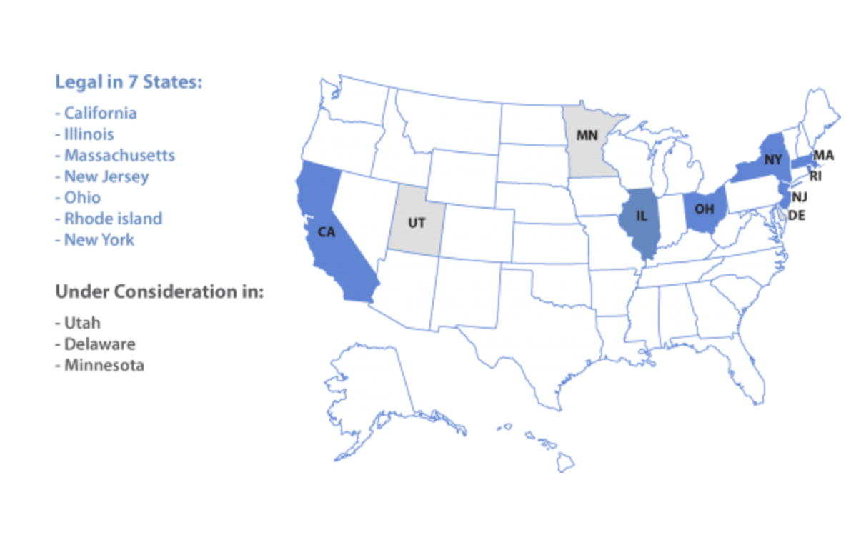
Community Aggregation Nationwide
Source: leanenergyus.org

Slide 4
Potential Benefits of CCA/Retail Choice
One approach to promoting competitive wholesale markets
Reduces the concentration of individual load serving entities
Can reduce reliance on regulatory procurement processes
Provides a benchmark with which to compare utility procurement
If regulated procurement still plays a big role, other retails provide a comparison group to judge performance.
One avenue for accommodating diverse customer preferences
More choices --> More options
Can these options be provided by a traditional utility?
More potential for innovation in retail services
How much scope for innovation in electricity retail is there?

Slide 5
Potential Issues with CCA/Retail Choice
Migration risk
How to invest and plan for customers who might leave (or come back)?
Migration is strongest in periods of market upheaval.
Stable wholesale markets require long-term investment and financial contracts.
Eastern markets have developed complex mechanisms to deal with risks of regulated providers of last resort. CA has not.
Stranded costs of incumbent utilities
Who should pay for costs of old contracts/plants?
Issue looms largest during large transitions (like 1998, and today?)
Are customers migrating primarily to avoid paying for stranded costs?
Or are they being prevented from migrating because of excessive exit fees?

Slide 6
Potential Issues with CCA/Retail Choice (2)
Environmental issues
State climate policy has several complex aspects
Renewable “buckets”, Reshuffling, Caps
Does your average electricity customer understand them?
Do we need them to?
RPS rules vs. Organic food labelling.
Is it fair to rely upon some customer’s over-compliance with carbon goals?
Coordination of planning and investment
Trade-off between integrated planning and more competition
LTTP has played a dominant role, may not in the future
Can require policies that set standards on retailers
Renewable energy policies; Resource adequacy policies; GHG import policies
Many of today’s policies in CA have not been tested under a setting with many retailers
Are these policies applied equitably to both CCA’s and utilities?
Potential loopholes that may become more of an issue with many LSEs

Slide 7
Critical Policy Issues with CCA/Retail Choice
How to manage exit and possible return of customers?
How to set exit and return charges to protect remaining customers?
CCA context is unusual in that “default” provider is not the provider of last resort.
What should happen to customers if their CCA goes bankrupt?
How to implement State policy with more and more diverse retail providers?
Renewable policy, reliability policy.
State policy coordination vs. customer choices
May need to rely more upon broadly applied, market-based instruments (e.g. cap and trade) and less upon planning.
Need to make sure those standards/caps are applied evenly to all retailers.

