Slide 1
Advanced Manufacturing
at Work in California
Senate Committee on Governance & Finance
Senate Committee on Energy, Utilities & Communications
March 21, 2012

Slide 2







K-C GLOBAL:
Company Profile
Operations: 57,000+ employees in 36 countries
Sales: $20.8 Billion Net Sales in 175+ countries in 2011
Well-known brands:
#1 or #2 market position in 80+ countries
Nearly one-quarter of the world’s population

Slide 3


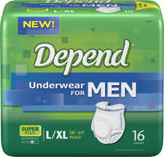
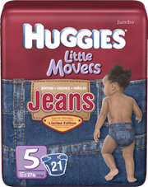
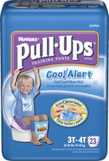
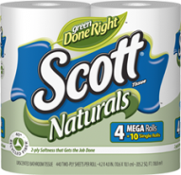


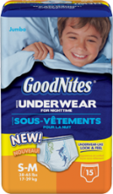
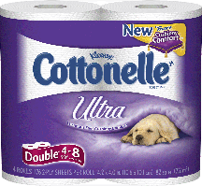
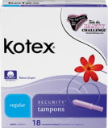
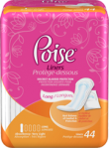

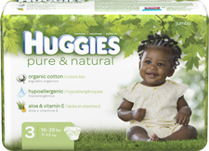


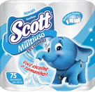
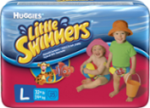
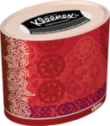

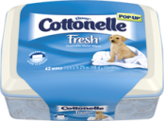
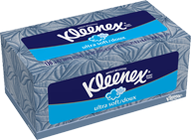
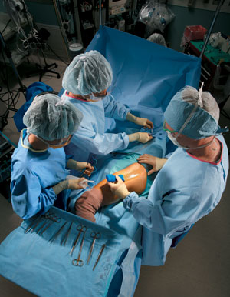
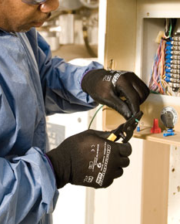

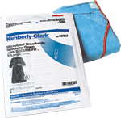
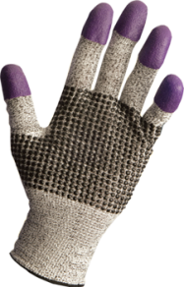
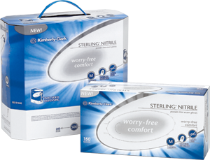
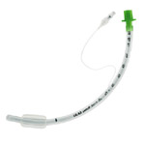
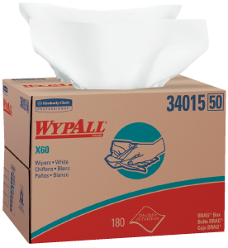
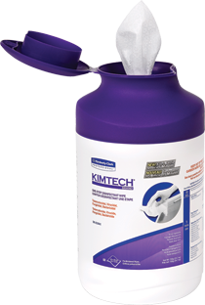
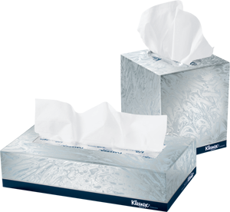
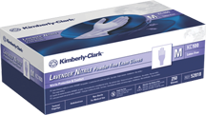
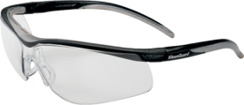

K-C GLOBAL:
Our Businesses
Personal Care
Consumer Tissue
Health Care
K-C Professional

Slide 4
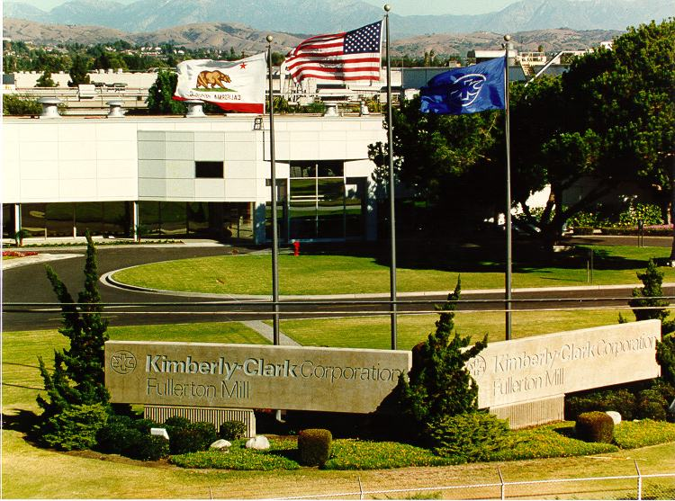
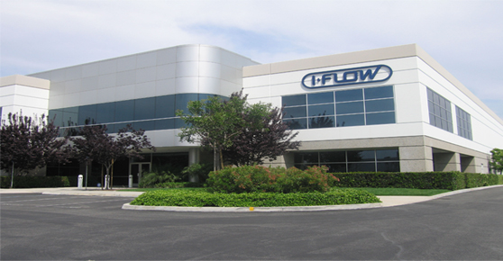
K-C CALIFORNIA:
Employment Profile
Fullerton Mill – Consumer Tissue
    Since 1955
    350 employees
Lake Forest HQ – Medical Devices
    100 employees
Pomona Plant – Welding Safety
Redlands DC
Ontario DC
Sales workforce – All K-C

Slide 5
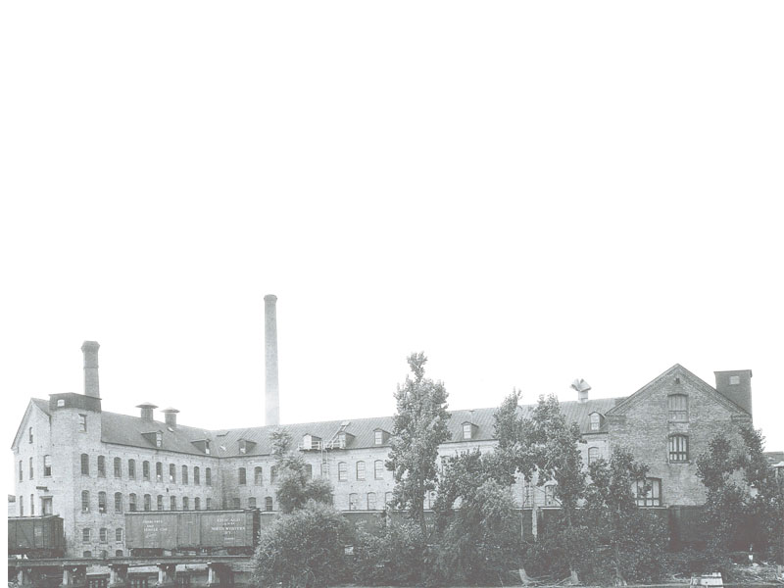
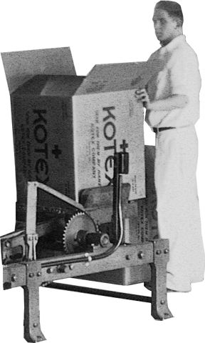
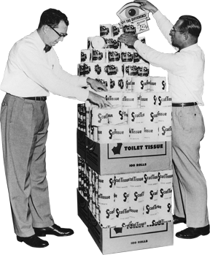
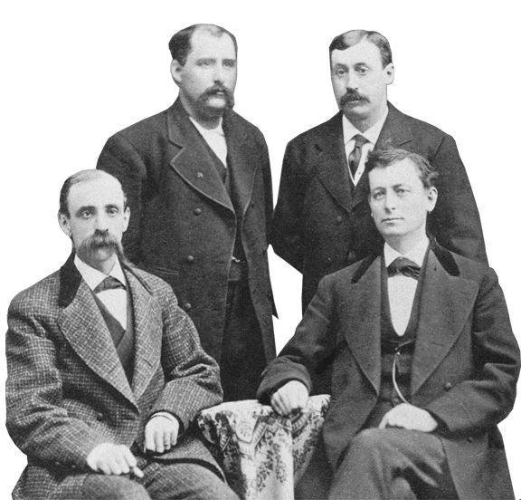
THEN:
Formed in 1872
A Paper and Newsprint Company

Slide 6
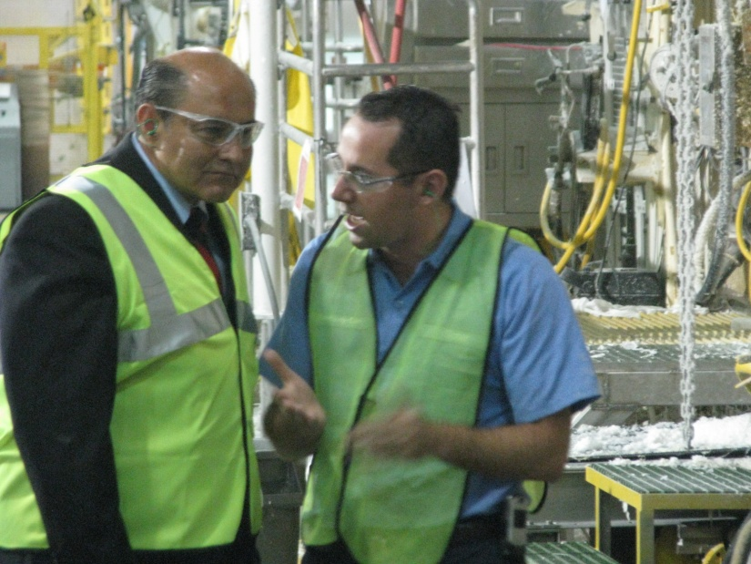
ADVANCED MANUFACTURING:
WORKFORCE & PROCESSES
Workforce
  Highly skilled, empowered
  Highly compensated
  Work-Life balance
Training
  Continual
  Employment Training Panel
Processes
  Lean business processes

Slide 7
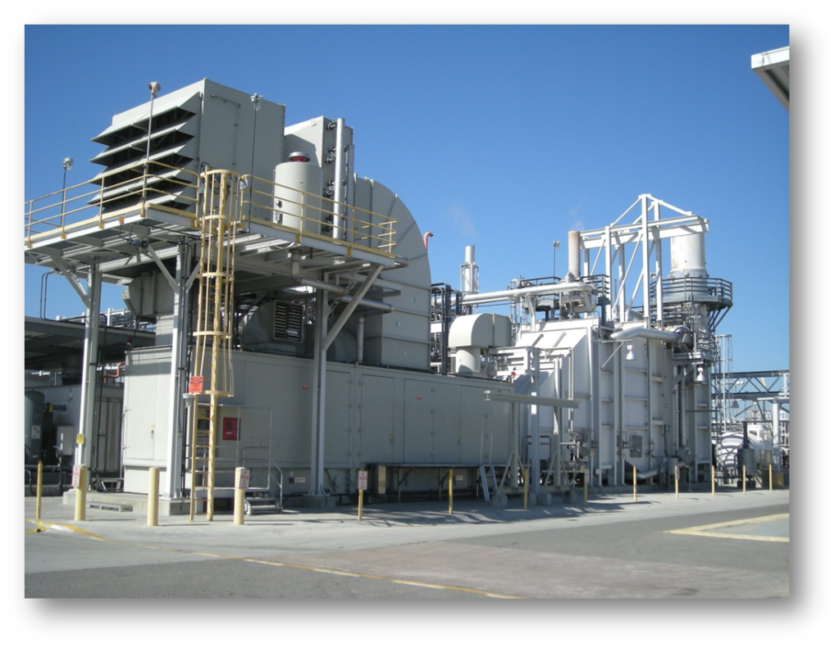
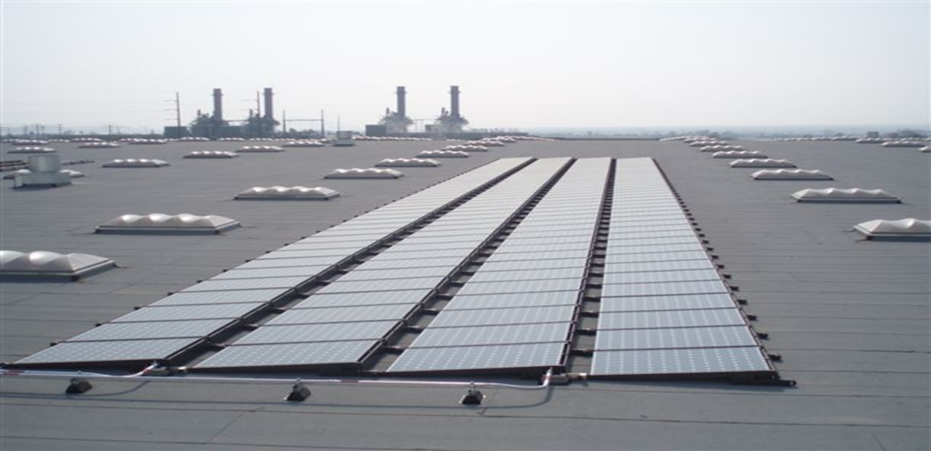
ADVANCED MANUFACTURING:
TECHNOLOGY
Production Efficiency
Process Water Recycling
Landfill Free
Energy Efficiency & Self-Sufficiency

Slide 8
ADVANCED MANUFACTURING:
CORPORATE CITIZENSHIP
Dow Jones Sustainability World Index
Ranked #1 for five consecutive years in personal products category based on the long-term economic, environmental and social performance of global companies
Ethisphere Institute’s 2012 World's Most Ethical Companies
EPA Energy Star Partner of the Year
For two years based on K-C’s comprehensive approach to energy management.

Slide 9
Manufacturing in California since 1955
Thank you for your support!

