Slide 1
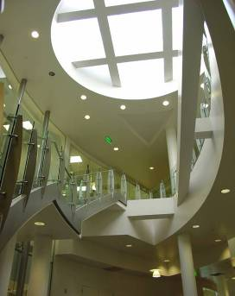
Boehringer-Ingelheim: Insight into Advanced Manufacturing
Chris Qualls
Director, Engineering & Technology
Notes:
Thank you for taking the time to discuss the capabilities of Boehringer-Ingelheim‘s Fremont California facility with us.

Slide 2
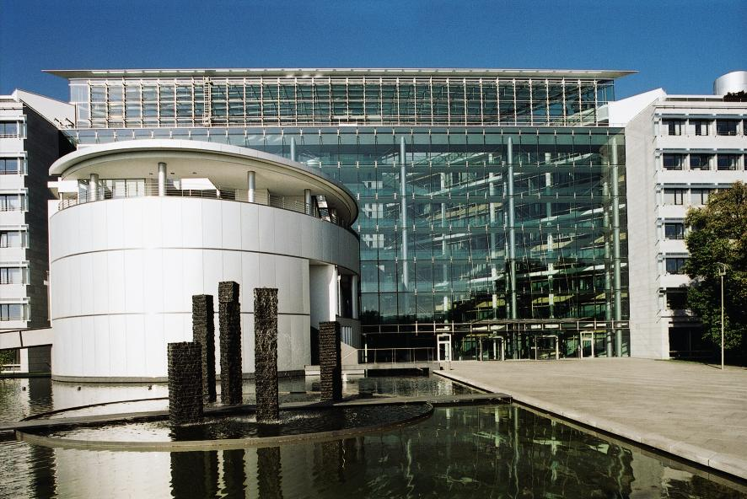
Who is Boehringer-Ingelheim?
Family-owned global corporation
Founded 1885 in Ingelheim, Germany
Prescription medicine, consumer healthcare, biopharmaceuticals, pharma chemicals & animal health
Employees worldwide: more than 42,000
20 production facilities in 13 countries
Total revenue: nearly $17 billion (2010)
Affiliated companies: 145 in 50 countries

Slide 3
Our Businesses World net sales by business segments (2010)
Total EUR 12,6 billion

Slide 4
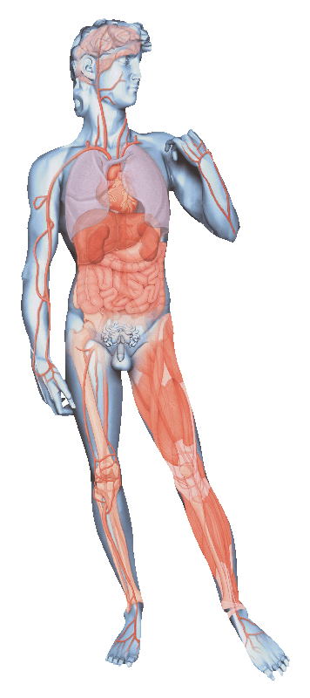
Our R&D Focus on six therapeutic areas
Research Areas | Examples of disease areas
Respiratory diseases | Asthma, COPD, Idiopathic pulmonary fibrosis
Cardiometabolic diseases | Atherosclerosis, Diabetes, Metabolic syndrome, Thrombo-embolic diseases
Oncology | Lymphomas, Leukaemias, Solid tumours
Neurological diseases | Alzheimer’s disease, Chronic pain, Migraine, Parkinson’s disease
Immunology | Multiple sclerosis, Psoriasis, Rheumatoid arthritis
Infectious diseases | Hepatitis C, HIV/AIDS

Slide 5
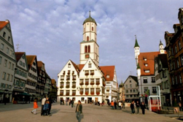
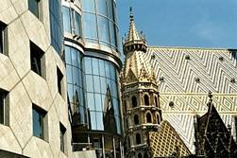
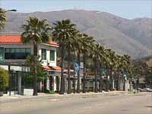
We are the Pioneer in Biopharmaceuticals
New GMP Biotech plants Biberach/Vienna
Additional new large scale plants Biberach/Vienna
Acquisition of US biopharma plant (Fremont)
1963
1984
1998
2003/5
2010
2011
Research in chicken Interferon
Strategic decision for contract manufacturing business
Establishment of global Biopharma Organisation with a global account management structure
BIBERACH
VIENNA
FREMONT
Notes:
The history of our Biotech production sites started in 1963 with research activities around chicken interferon. 1981 the first production plant was constructed in Vienna, a 3x 500 l cell culture plant for Interferon alpha and beta. The pioneering work on the interferons led to a number of growing collaborations, among them Genentech, US, with who we started a cooperation in 1982 for the use and sales of Interferon gamma, TNF-alpha and t-PA. 1984 was the year of registration of our first interferon alpha market product, under the name "Berofor". The first plant for MO fermentation was built in 1985, 3000 L, which produced TNF-alpha and Interferon gamma, which were registered in Europe in the 90s, under the names Immukin and Beromun. In the same year the large-scale biotech plant for mammalian CC fermentation was bilt in Biberach. 1995 the second Biotech plant for MO fermentation was built in Vienna with a capacity of 6000 L for the production of Betaferon. An important year for BIA as it is today was 1998 where the strategic decision was made to fill the by then surplus capacities of our state-of-the art plants with contract manufacturing for third parties.

Slide 6
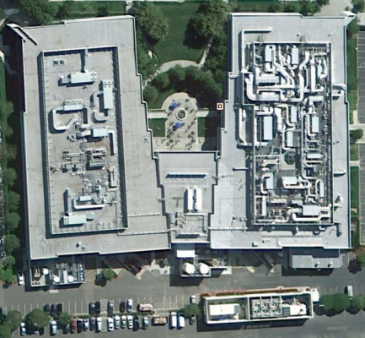
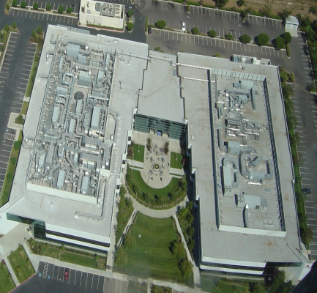
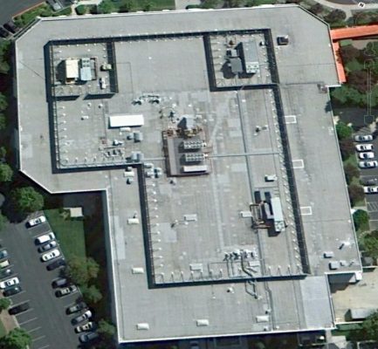
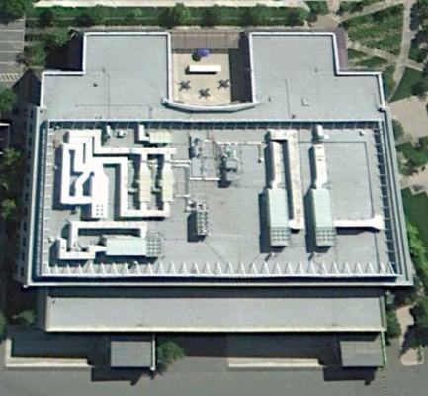
Our Fremont Facilities 200,000 sq ft of manufacturing
B 2
B 3
B 3A
B 4
Size
100,000 ft²
(9,290 m²)
Function
Offices
Process Science labs and Pilot Plant
Size
100,000 ft²
(9,290 m²)
Function
Bulk drug substance manufacturing
Drug product filling
Utilities
Size
10,000 ft²
(1,310 m²)
Function
GMP cold room
Utilities
Maintenance
Calibration
Size
100,000 ft²
(9,290 m²)
Function
GMP Warehouse
Manufacturing
Labeling, Packaging, Inspection
Quality Assurance & Records Archive
QC Laboratories

Slide 7
Our Workforce at Fremont
300 full-time employees
Average salary $90,000
Nearly 80% have college degrees
25% Masters & PhD level

Slide 8
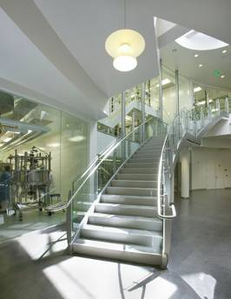
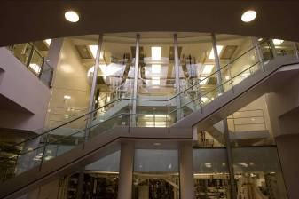
Manufacturing at Fremont
Manufacturing of clinical and commercial biopharmaceuticals
Pilot plant and process development labs
Suited for the development and commercialization of therapeutic proteins and antibodies from mammalian host systems
Utilized by regional FDA for staff training
Boehringer-Ingelheim is one of the largest contract manufacturers in the world
Notes:
We are a fully fledged biopharmaceutical manufacturing site with comprehensive capabilities to deliver development and manufacturing of pre-clinical, clinical and commercial products
Our comprehensive capability is complemented by an infrastructure which includes process development labs, a pilot plant facility and comprehensive GMP manufacturing facilities at up to 12,000L scale.
Our core focus and capability is in the area of therapeutic proteins and antibodies derived from mammalian cell host systems and our staff, facilities and capabilities are very comprehensive in this space.
We are in an ideal location in the SF bay area in the hub of biotech, and center of innovation and excellence.

Slide 9
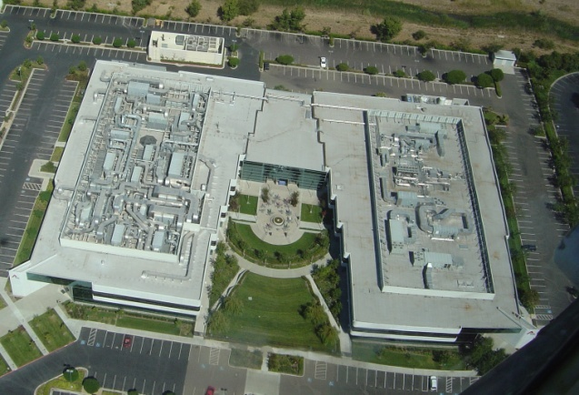
Production Capabilities Drug Substance Manufacturing Capabilities BI Fremont
Cell Culture Facility "East Train"
Cell Culture Facility "West Train"
Inoculum
1 suite
1 suite
East and West Trains are of similar design
Fermentation
1x 12 000 L
1x 12 000 L
Downstream processing
2 suites
2 suites
Formulation
1 suite
1 suite

Slide 10
Bulk Manufacturing Provides Capacity, Capability and Flexibility
WEST
EAST
Two separate bulk trains enable concurrent production at clinical or commercial scale.
e
12kl
2kl
12kl
2kl
r
u
t
l
u
C
2kl
text
2kl
l
l
e
C
Four Steps of Production Process
Cell Cultivation: Growing &expanding cells to produce product
Harvesting: Separate product from cell culture broth
Purification: Enriching specified product
Fill & Finish: Put the product into a formulation buffer & fill into vial
t
s
e
v
r
a
H
n
o
i
t
a
c
i
f
text
text
i
2
kL
r
12
kL
u
P
Notes:
Our E train is ideally suited to 2K to 6K production scale, while the W train is ideally suited to 12K scale and can accommodate high titer processes. Recognize that the E train can accommodate 12K scale processes too.
We have created connectivity between the two trains by means of transfer lines which allow any possible permutation/combination of plant utilization. For example, we can take all the cell culture capacity in both E and W trains and feed it down any one purification train. While the diagram shows a single harvest area for simplicity, we actually have 3 separate harvest areas which we can utilize.

Slide 11
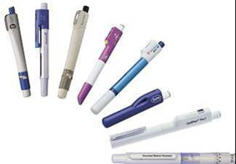
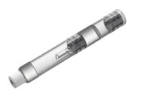
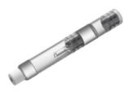
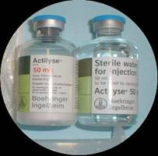
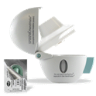
Biopharmaceuticals Our Fill & Finish Toolbox
Bags
Double Chamber Syringe
Cartridges / PENs
Vials (liquid, lyo)
Spray drying
Pre-filled Syringe

Slide 12
Product Quality: Management Employs Several Functions to Ensure Patient Safety
Quality Assurance
Performs Quality oversight for cGMP site operations, disposition, investigations, internal auditing, and management of external inspections
Quality Control
Performs cGMP testing of in-process, stability, validation, lot release, and facility support including method validation and transfer
Quality Systems
Uses a comprehensive management program to define, implement, monitor, and continuously improve
Quality Engineering
Supports continuous improvement by applying quality engineering, Six Sigma, Lean, 5S and project management tools
Validation
Ensures facilities, equipment, processes and systems are qualified and validated to current industry practice and regulatory requirements
Notes:
The Quality Site Model is consistent with what you will find at most manufacturing sites.
In addition, the Environmental Heath and Safety Organization reports into the Quality organization.

Slide 13
Enabling Advanced Manufacturing at our Fremont Facility
Planned Investment
$100 M Capital Investment of Manufacturing Machinery
$30M Capital Investment of Research and Development machinery
$10M of consumption items for Manufacturing
$1M of consumption items for R&D
Production
Technologically complex systems
Innovative products
Manufacturing with high levels of design and precision
Special Requirements
Regulated air filtration systems
Specially skilled facility cleaning
Mandated to wear special clothing, masks, etc.
Labor & Skill Set
Highly educated
Particular skills/background required

Slide 14
Sales & Use Tax
Sales & Use Tax | CA | CT | OH | NY
Rate | 8.75% | 6.35% | 6.75% | Rate avg 8%
Manufacturing Machinery & Equipment
Capital Equipment | 8,750,000 | Exempt | Exempt | Exempt
Consumption Items | 875,000 | Exempt | Exempt | Exempt
Research & Development
Capital Equipment | 2,625,000 | Exempt | Exempt | Exempt
Consumption Items | 87,500 | Exempt | 67,500 | Exempt
Total Sales & Use Tax | 12,337,500 | 0 | 67,500 | 0

Slide 15
Personal Property Tax
Personal Property Tax | CA | CT | OH | NY
Rate | 1% | Exempt | Exempt | Exempt
Manufacturing Machinery | 1,000,000 | Exempt | Exempt | Exempt
Research & Development Machinery | 10,000 | Exempt | Exempt | Exempt
Total Personal Property Tax | 1,010,000 | 0 | 0 | 0

