Slide 1
Job Creation from Proposition 39 Funding in K-12 LEAs
Sarah L. White, Ph.D.
Deputy Director, California Workforce Development Board
Senate Energy, Utilities and Communications Committee
01.20.2016

Slide 2
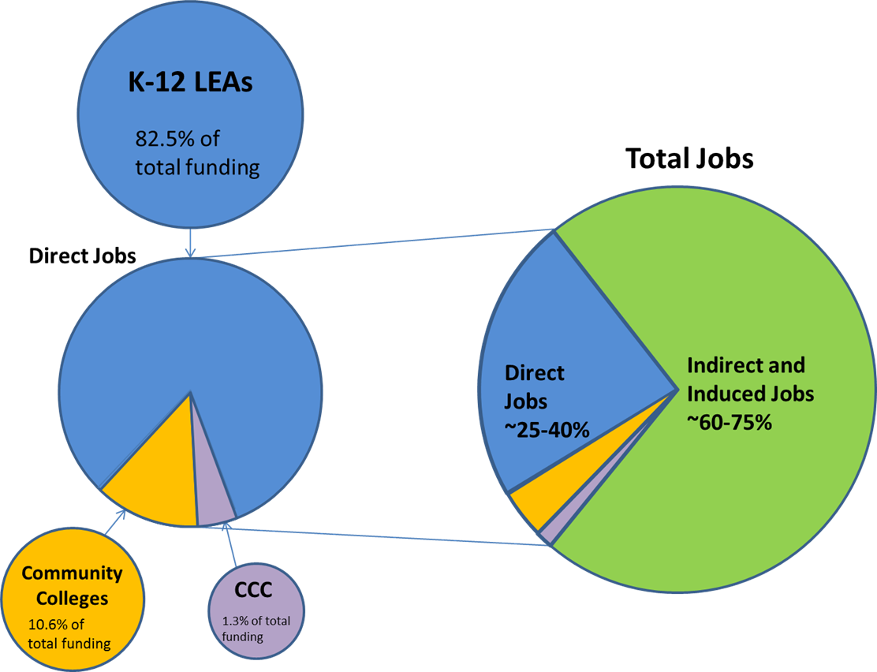
Total Job Creation from Proposition 39

Slide 3
Jobs Breakdown from K-12 LEAs

Slide 4
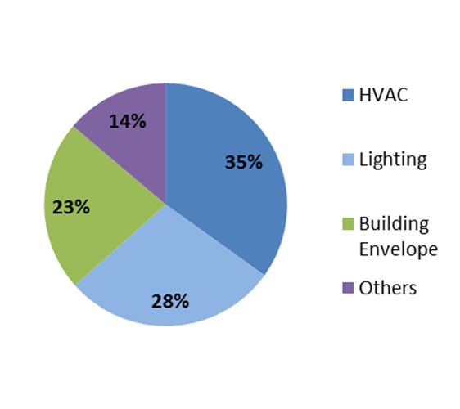
Total Hours Worked by Building System in K-12 LEAs

Slide 5
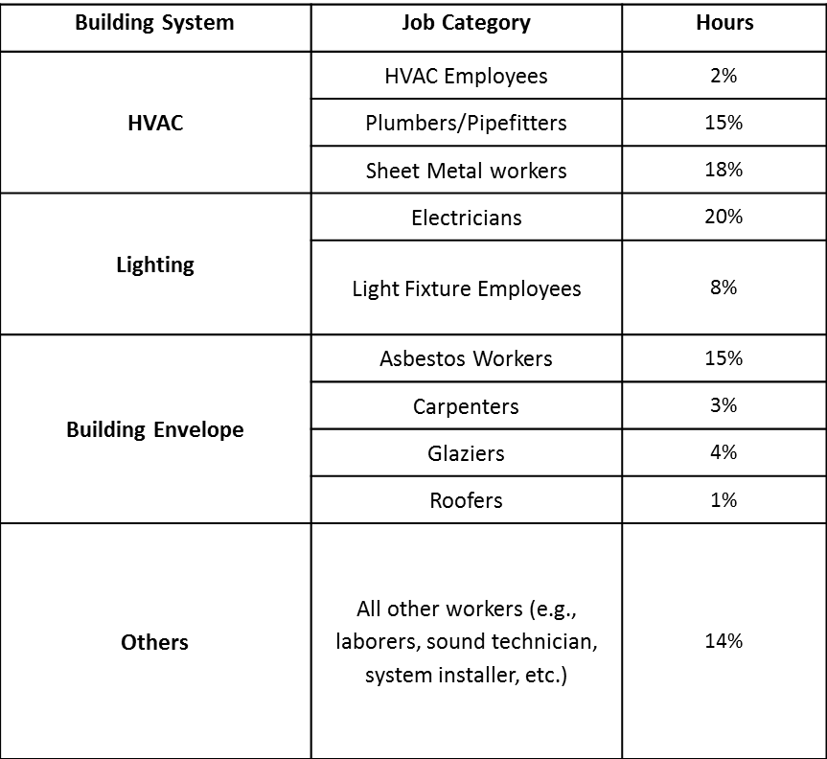
Prop 39 Work by Trade in K-12 LEAs

Slide 6
Average Hourly Wage by Trade on K-12 LEA Projects
Job Category | Apprentices | Journey-Level/ Non-Apprentices
Electricians | 30 | 53
Light Fixture Workers | - | 36
Sheet Metal Workers | 26 | 49
Plumbers/Pipefitters | 27 | 49
Carpenters | 30 | 43
Asbestos/Lead Abatement Workers | - | 30
Other | 24 | 45
Total | 28 | 44

Slide 7
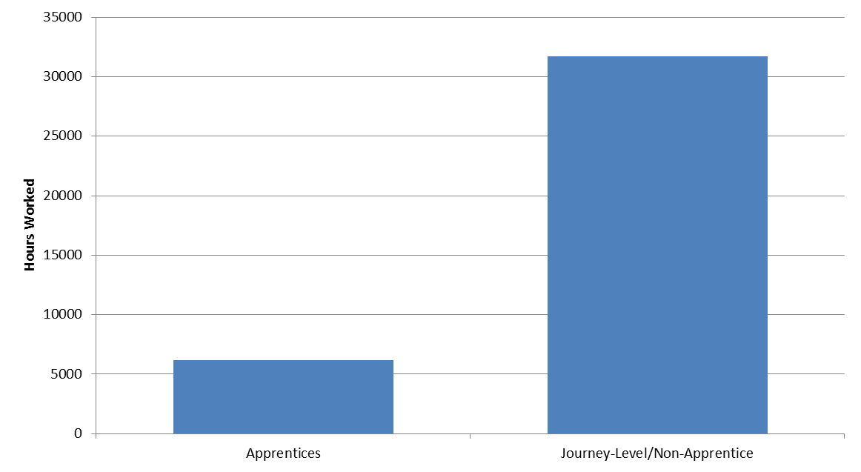
Apprentices on Prop 39 K-12 LEA Projects

Slide 8
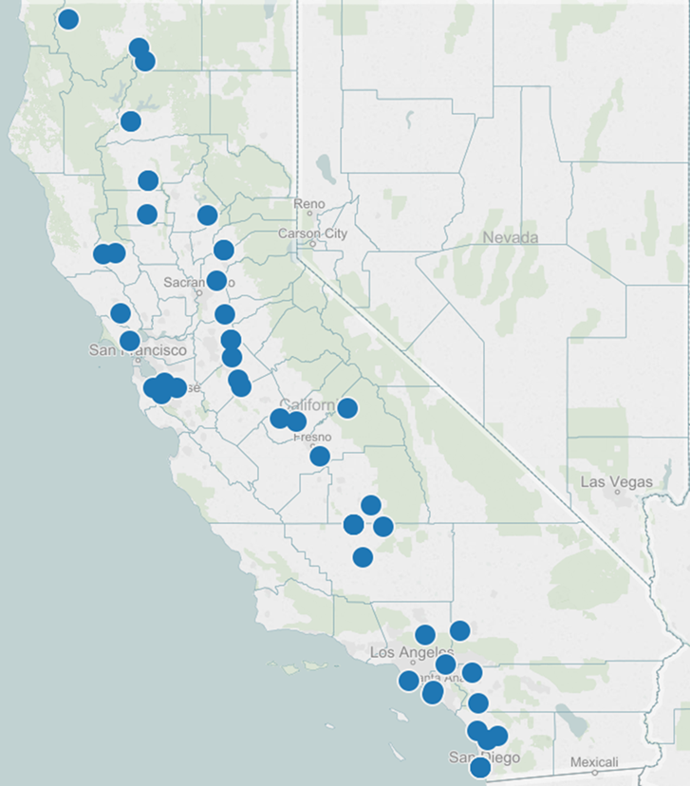
Distribution of K-12 LEA Projects Completed across the State

Slide 9
Forecasted Potential Job Creation from Proposition 39 (FY 2013-2016)
 |  | Low Estimate |  |  | DVC Jobs Forecaster |  |  | High Estimate
 | Total Allocated Funding ($M) | Jobs per Mil. | Fore-casted Direct Jobs | Total Jobs (mult. =1.5) | Jobs per Mil. | Fore-casted Direct Jobs | Total Jobs (mult. =2.3) | Jobs per Mil. | Fore-casted Direct Jobs | Total Jobs (mult. =3)
K-12 | $973.4 | 2.5 | 2,434 | 6,085 | 6.2 | 6,035 | 13,881 | 8.9 | 8,663 | 34,652
Comm. Colleges | $124.7 |  | 312 | 780 |  | 773 | 1,778 |  | 1,110 | 4,440
CCC | $15.4 |  | 39 | 98 |  | 95 | 219 |  | 137 | 548
Total | $1,113.5 |  | 2,784 | 6,963 |  | 6,903 | 15,878 |  | 9,910 | 39,640
Source: Don Vial Center on Employment in the Green Economy,
Institute for Research on Labor and Employment, University of California, Berkeley

