Slide 1
Keeping California Golden through clean, affordable Transportation
March 17, 2015
Senate Transportation and Housing Committee
Environmental Quality Committee
Simon Mui, Ph.D.
Director, California Vehicles & Fuels

Slide 2
California’s Advanced Clean Cars Program: Greater Choice of Clean, Efficient Vehicles Equals Lower Fuel Bills

Slide 3
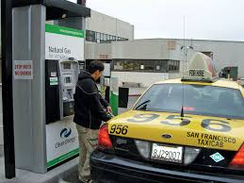
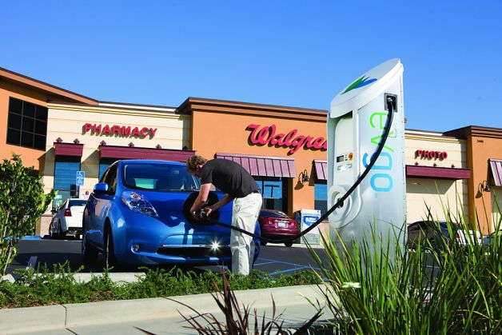
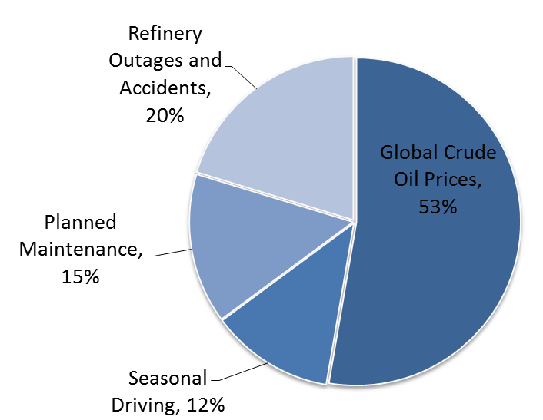
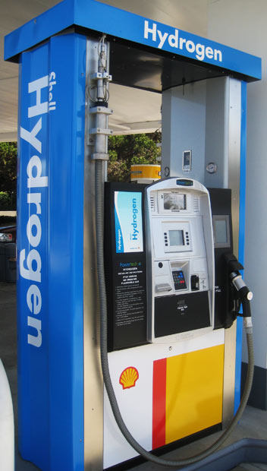
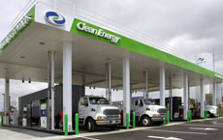
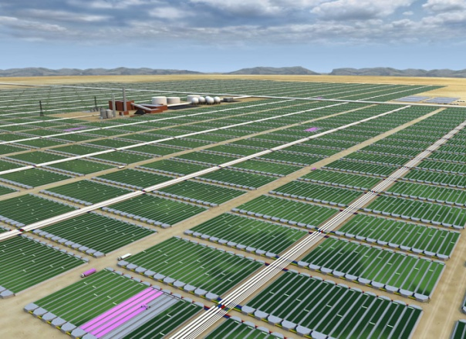
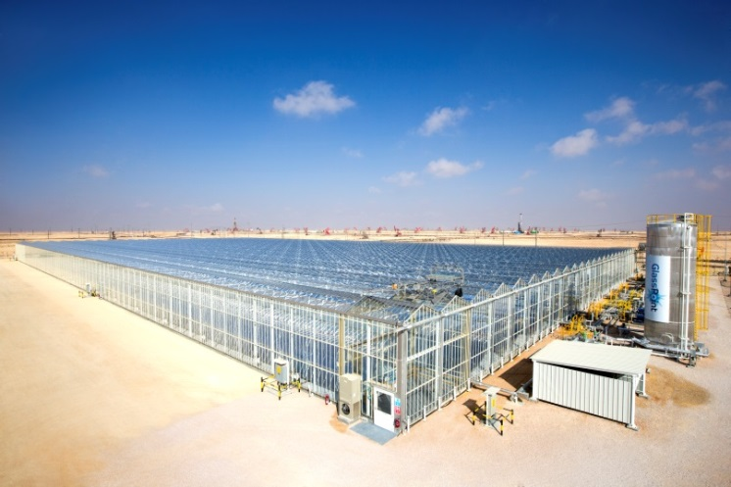
Low Carbon Fuel Standard: Increased clean fuel investments, supplies, and energy diversification
Causes of California gasoline price spikes

Slide 4
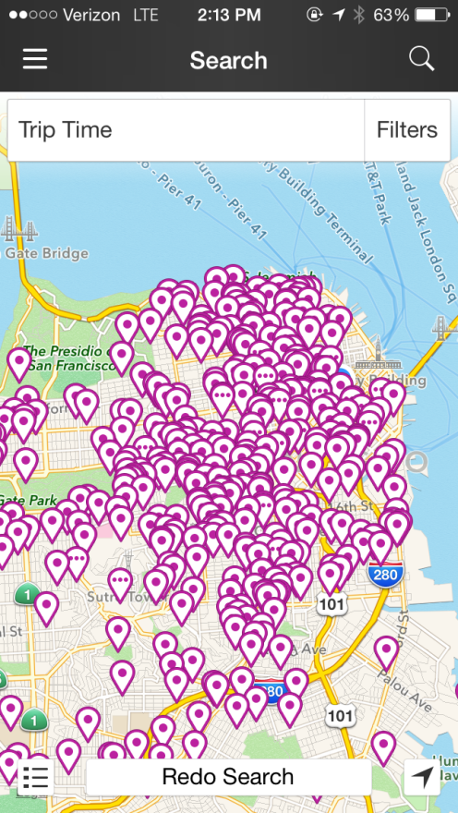
California’s Sustainable Communities Strategy (SB 375): Reduced Vehicle Miles Traveled to Meet California’s Climate Goals
“Without improved land use and transportation policy,
California will not be able to achieve the goals of AB 32.”
* Estimated from draft CTP 2040

Slide 5
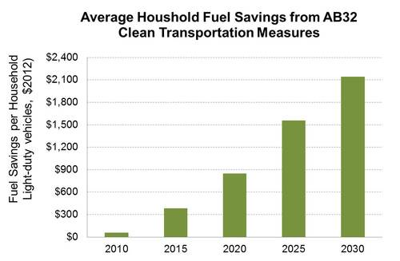
AB32 Benefits: Lower household fuel bills due to greater efficiency, more fuel choices, and less need to drive
Includes AB32 scoping plan measures versus a no policy case
Includes EIA and CEC price forecasts
Includes AB32 cap-and-trade and LCFS compliance costs and value

Slide 6
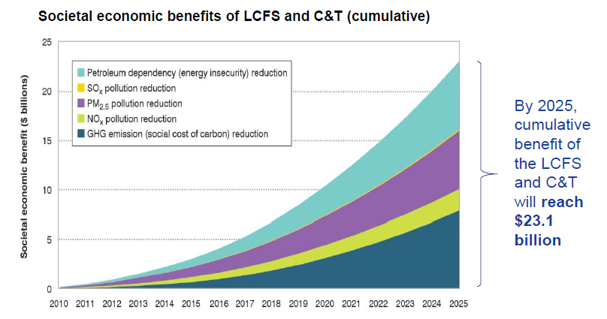
AB32 Benefits: Less Pollution, Improved Public Health, Avoided Climate Damage, Increased Energy Security
American Lung Association and EDF report: Benefits from Low Carbon Fuel Standard and Cap & Trade are greatly benefiting state residents.
Tetratech, Inc. (2014), Driving California Forward, http://www.edf.org/climate/drivingcaliforniaforward

Slide 7
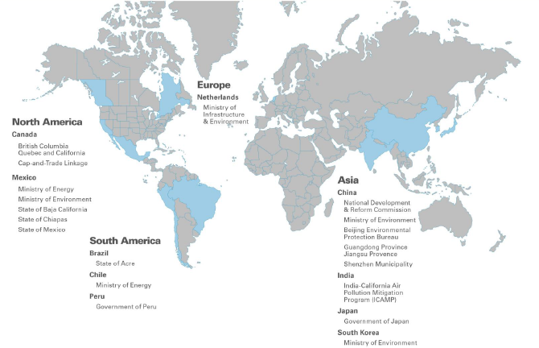
California Leadership Matters: International Partnerships
Source: ARB December Board Presentation, www.arb.ca.gov/board/books/2014/121814/14-10-3pres.pdf

Slide 8
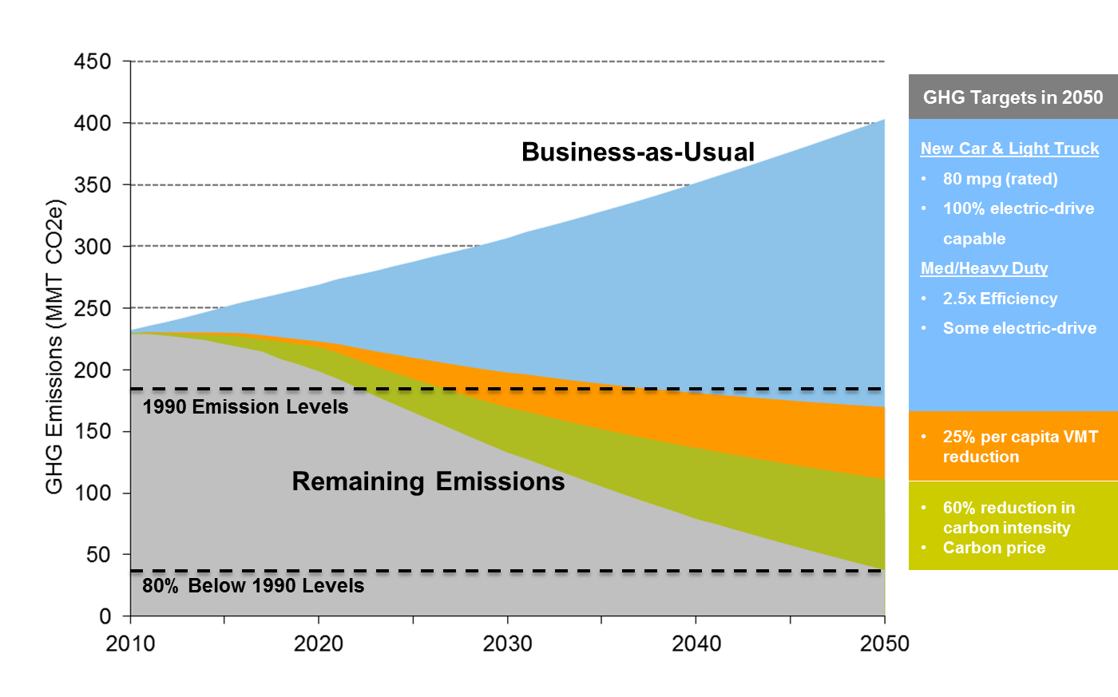
Keeping California Golden: SB350 (De León-Leno) and SB32 (Pavley)
Illustrative scenario only

