Slide 1
Assessment of Low Carbon Technologies and Potential Impact on AB 32
Blake Simmons, Ph.D.
Sandia National Laboratories, Livermore, CA
AB 32 Implementation: Light Duty Vehicles and Their Fuels
Informational Hearing of the
Senate Transportation and Housing Committee
March 19, 2013

Slide 2
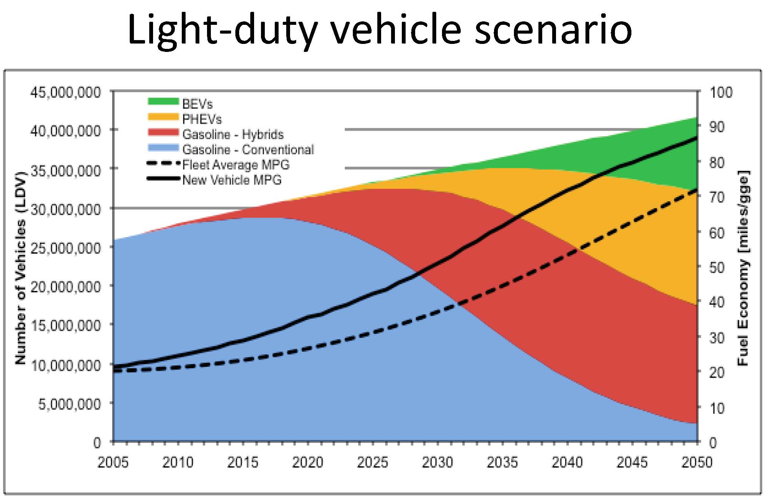
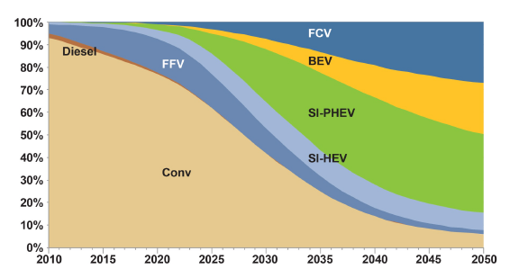
AB 32 Goals in LDV GHG Emission Reductions Rely on Significant Technology Advances
AB 32 sets GHG targets to
1990 levels by 2020
80% below 1990 levels by 2050
Goals based on advances in several major technology areas:
Renewable liquid fuels
Batteries
Fuel cells
US car park takes 17 years to turn over – challenging environment for rapid, significant change to occur.
Technology challenges exist across all sectors that must be addressed.
Sudden changes in policy increase risk of delayed technology adoption.
Several technology scenarios exist to achieve targeted GHG reductions for the state of CA.
J.C.S. Long, Chair’s Lecture: California’s Energy Future Study Results, 2011
Market %
Transportation Energy Futures, 2013, http://www.nrel.gov/docs/fy13osti/56270.pdf

Slide 3
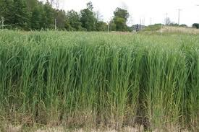
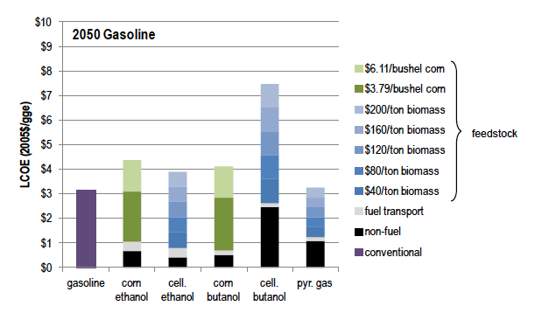
Biofuels
Industry moving beyond corn ethanol
Cellulosic feedstocks: agricultural, forestry residues, dedicated energy crops
Drop-in fuels for gasoline, jet and diesel
Waste to energy beating expectations
Advanced biofuel production lagging federal and state targets, but more capacity coming online in 2013.
Several companies currently operating advanced biofuel facilities (e.g., POET, Mascoma, INEOS, DuPont-Genencor, KiOR).
Moving beyond the first demonstration facility → potential cost reductions as a function of process engineering and technology maturation.
Advances in ICE can produce significant GHG reductions short-term, effect is magnified when coupled with advanced biofuels.
Switchgrass
Densified biomass
Ruth, M. et al., 2013 Projected Biomass Utilization for Fuels and Power in a Mature Market. Transportation Energy Futures Series. Prepared for the U.S. DOE by National Renewable Energy Laboratory, Golden, CO. DOE/GO-102013-3707. 153 pp.

Slide 4
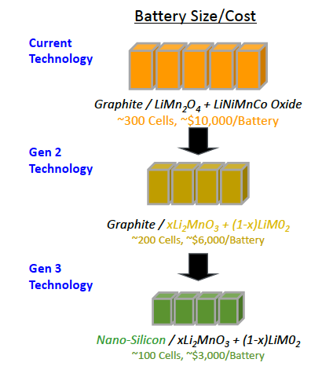
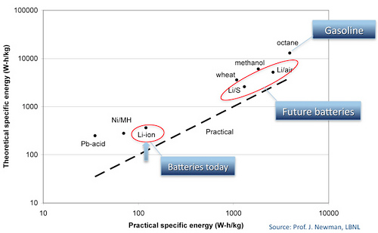
Batteries (HEV, PHEV, BEV)
Significant advances in battery technology have occurred in past decade.
Cost of ownership/operation still higher than desired.
Hybrids first commercialized in 1997 – now still make up only about 5% of US annual sales.
Sector on track to meet Obama Administration targets – 1 million EVs by 2015.
DOE-EERE 2014 goal: PHEV battery that can deliver a 40-mile all-electric range and costs $3,400 (more competitive with ICE).
DOE projects that next generation lithium-ion batteries can increase power and energy 2X while decreasing cost by 70%.
Source: EERE Vehicle Technologies Program

Slide 5
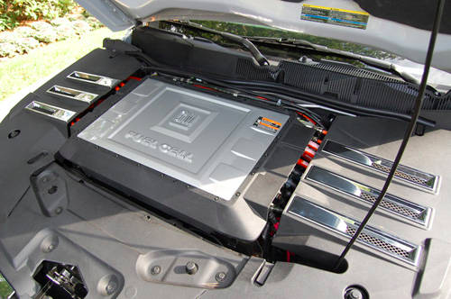
Fuel Cells (FCEV)
FCEVs are a customer-focused ZEV due to the potential for lower cost, rapid refueling, and a 300+ mile range.
Advances in HEV/PHEV/BEVs directly benefit FCEVs due to common power electronics and drive-trains.
Automotive companies are in the process of commercializing fuel cell vehicles.
Production of FCEVs already underway by some companies.
Hydrogen fuel infrastructure availability, cost and performance are the biggest challenges that can be addressed by sensible public-private partnerships (AB 118).
Continued reductions in cost of fuel cells, hydrogen storage, production, and dispensing will support market growth, but these are primarily affected by policy and not significantly constrained by technology.

Slide 6
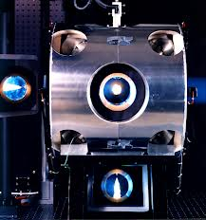
Technologies with Significant Potential Impact on AB 32
Solar Fuels
Joint Center for Artificial Photosynthesis (JCAP)
Concentrated solar power to liquid fuels
ICE Efficiency
50% better fuel economy while meeting or exceeding environmental standards
Battery Innovation
Joint Center for Energy Storage
Goal: 5 times greater energy density than today's Lithium Ion, at 1/5 the cost, achieved in 5 years
Natural Gas Conversion
Direct conversion of methane to liquid fuels (goal of ~$2-3 gge) using biology, chemistry, or hybrid conversion approaches
crf.sandia.gov
Methylocella silvestris
image courtesy JGI

Slide 7
Summary
AB 32 represents a significant policy shift with the potential of significantly reducing GHG emissions for the state.
It is important, from a technology development perspective, not to pick winners and losers a priori, but rather to establish clear performance and cost metrics that enable innovation and robust assessment in terms of cost and GHG emissions.
Policy can benefit from empirical data and validated models that are informed by the best science possible for all technology scenarios.
In order for innovation within the market to occur, there should be a level playing field for all fuel types on direct and indirect GHG effects.
LCFS models on indirect effects should be updated frequently as improvements and validated training sets become available.
Data driven, validated models should be used whenever possible.
For some fuel types with more inherent risk, such as the hydrogen infrastructure, public-private partnerships may be one approach to de-risk the technologies (e.g., AB 118) until they are economically self-sustaining.
From a technology deployment perspective, it is recommended that the AB 32 implementation plan continue, as significant and fundamental shifts in policy will increase the risk associated with deployment of new low carbon LDV technologies and decrease likelihood of achieving targeted GHG reductions.

