Slide 2
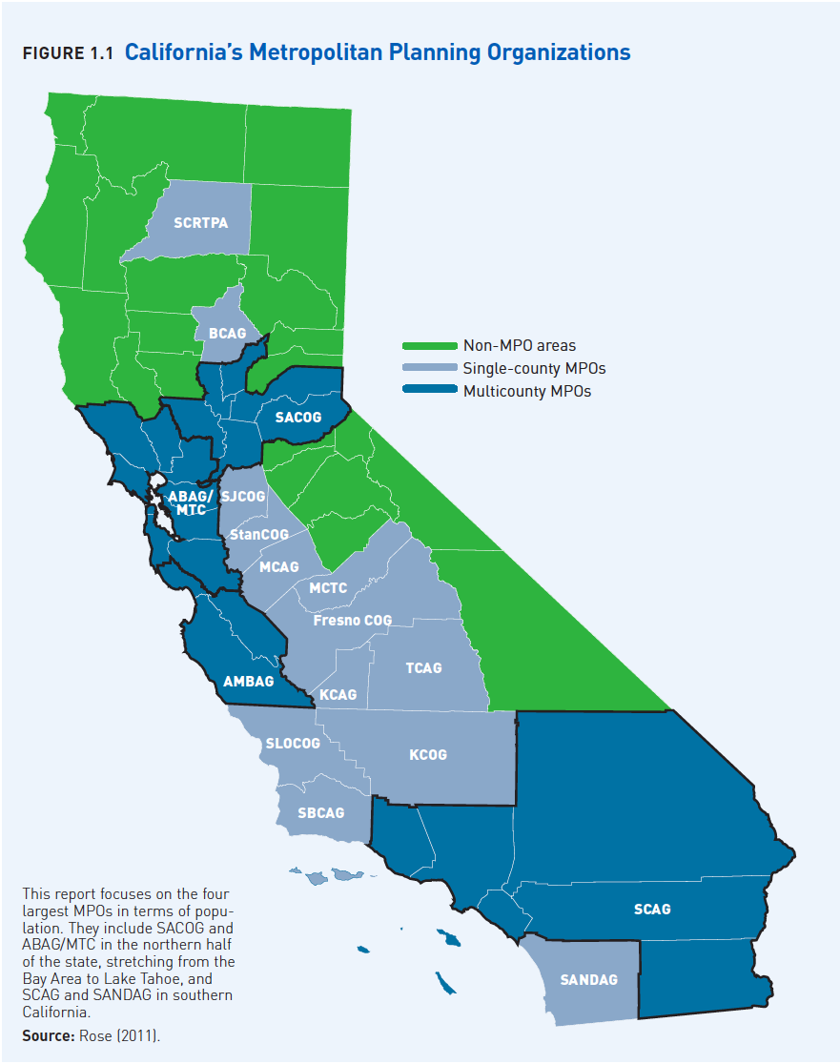

Slide 3
Drivers of Change
Demographic
Aging + Minority Growth
Economic
Stagnating real incomes; higher unemployment
Financial
Tighter money for home loans
Preference
More amenities, more options, better accessibility

Slide 4
US Starter, Mature, Downsizing Trends
HH Age | 2010 | 2030 | Change | Share
<35 | 26 | 29 | 3 | 11%
35-60 | 60 | 63 | 3 | 10%
61-74 | 18 | 29 | 11 | 43%
75+ | 12 | 21 | 9 | 36%
Total | 117 | 142 | 25
Source: ICF Consulting.

Slide 5
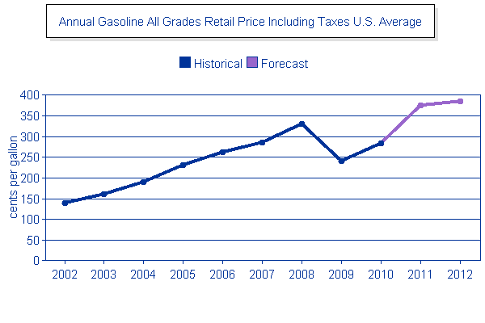
2002 actual through 2012 estimated
R²=0.82; 9.7% annual Δ; 3⁺X faster than inflation; 2020 = $8+/gallon
Source: Adapted from Energy Information Administration (2012).

Slide 6
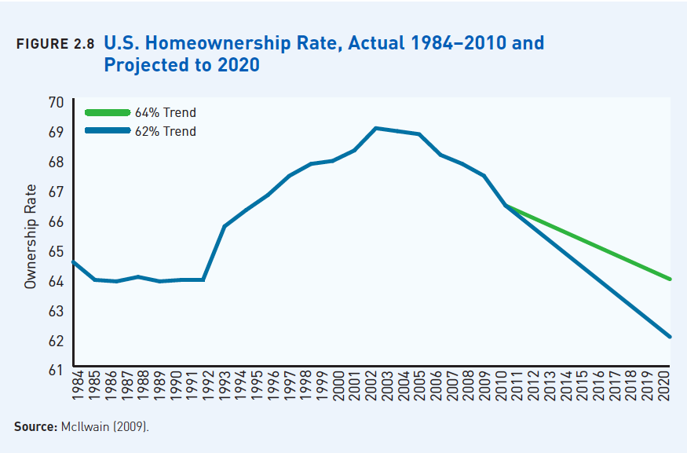

Slide 7
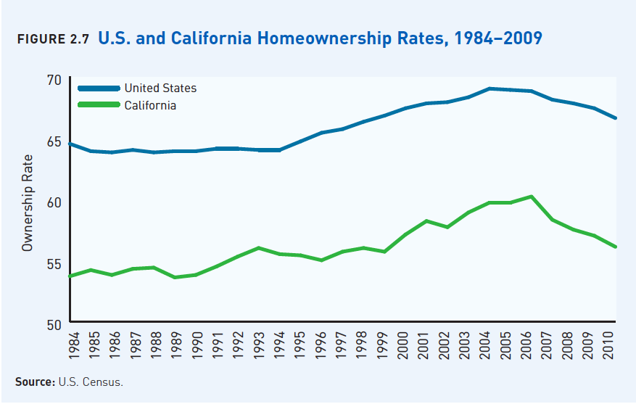

Slide 8
California Homeowner Share 2000-2010
HH Growth | 1,081
Owner Growth | 490
Owner Share | 45%
Source: Myers (2011) and Census

Slide 9
National and California Housing Demand by Type
House Type | NAR National Demand 2011 | NAR California Demand 2011
Attached | 39% | 42%
Small Lot | 37% | 36%
Conventional Lot | 24% | 22%
Source: Adapted from National Association of Realtors (2011).

Slide 10
NAR 2011 Survey Highlights
Question | US | CA
Prefer houses are smaller on smaller lots, and have a shorter commute to work, 20 minutes | 59% | 55%
Prefer to own or rent an apartment or townhouse with easy walk to shops and restaurants and have a shorter commute to work. | 38% | 42%
Prefer a neighborhood with a mix of single family detached houses, townhouses, apartments and condominiums on various sized lots; Almost all of the streets have sidewalks; Places such as shopping, restaurants, a library, and a school are within a few blocks of the home and can either walk or drive; Parking is limited when driving to local stores, restaurants and other places; Public transportation, such as bus, subway, light rail, or commuter rail, is nearby | 56% | 60%
In deciding where to live, public transit is very important or somewhat important. | 47% | 71%
Source: Adapted from National Association of Realtors (2011). (Questions paraphrased.)

Slide 11
Southern California Preferences
Source: Fairbank, Maslin, Maullin, Metz and Associates (October 2011)

Slide 12
Southern California Preferences
Source: Fairbank, Maslin, Maullin, Metz and Associates (October 2011)

Slide 13
Southern California Preferences
Source: Fairbank, Maslin, Maullin, Metz and Associates (October 2011)

Slide 14
MPO Demand by Housing Type 2010
Source: Arthur C. Nelson.

Slide 15
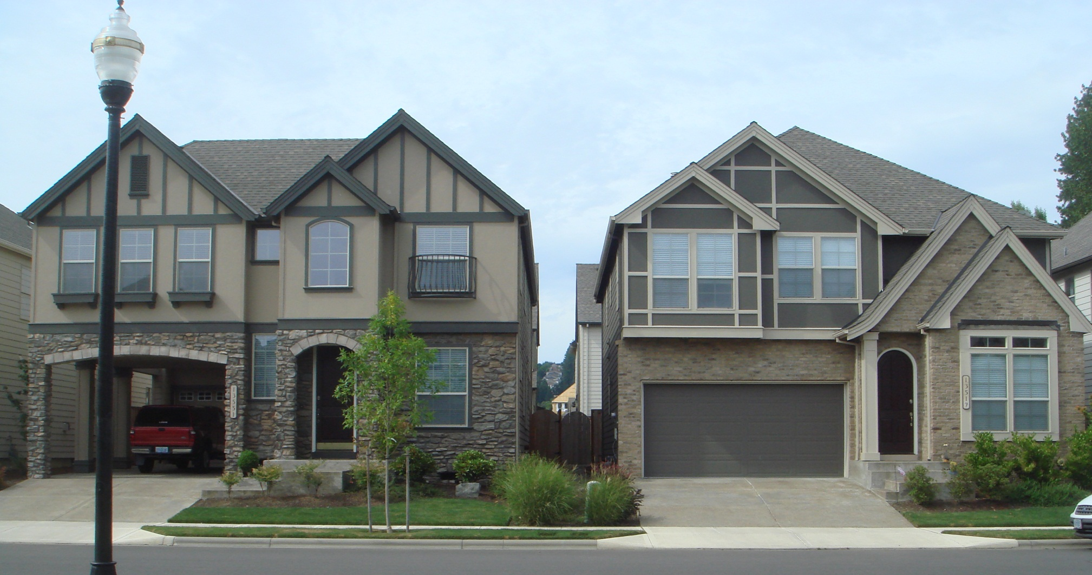
A small lot (<5,000 sq.ft.) does not
mean a small house

Slide 16
Residential Unit Preferences for Non-Hispanic White and Minority Households
Ethnicity | SCAG
Non-Hispanic White
Multi-Family (apartment, condo) | 27%
Townhouse | 13%
Small Lot (<5,000 sq.ft.) | 36%
Conventional Lot | 24%
TOD Demand | 52%
Minority
Multi-Family (apartment, condo) | 44%
Townhouse | 14%
Small Lot (<5,000 sq.ft.) | 23%
Conventional Lot | 19%
TOD Demand | 66%
Source: Adapted by Arthur C. Nelson from Baldasarre (2001, 2002, 2004).

Slide 17
MPO Housing Demand by Type to 2035
Source: Arthur C. Nelson.

Slide 18
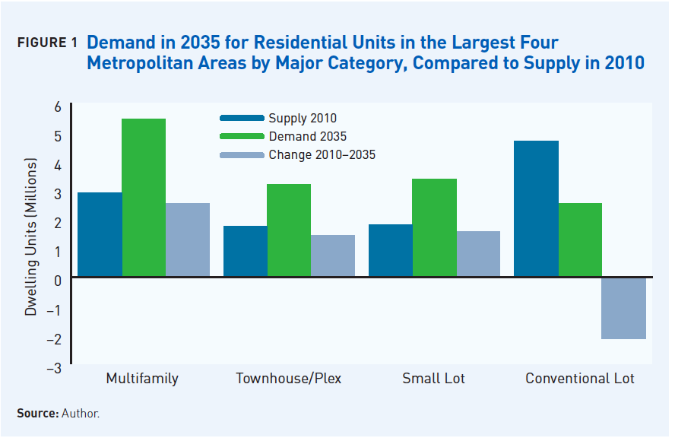

Slide 19
TSA Demand 2035, Big 4 MPOs
Source: Arthur C. Nelson.

Slide 20
Transit Station Area Demand, Big 4 MPOs
Source: Arthur C. Nelson.

Slide 21
Important to Walk/Bike to Work/Errands

Slide 22
Supply & Demand Comparison, US
Mode and Destination | Supply | Demand
Walk or Bike to Work | 4% | 23%
Walk or Bike for Errands | 10% | 22%
Source: Supply from NHTS 2009 (2011); demand from Porter-Novelli (2003, 2005)

Slide 23
Observed Walk/Bike Share Within 1-Mile, US
Year | Walk/Bike to Work Less than 1 Mile | Walk/Bike to Errands Less than 1 Mile
1995 | 25% | 26%
2001 | 34% | 35%
2009 | 37% | 42%
Change 1995-2009 | 45% | 59%
Source: National Household Travel Survey 2009 (2011).

Slide 24
Life-Spans of Major Uses
Source: Arthur C. Nelson.

Slide 25
Observations
First, while there are always exceptions and market niches will be different, adding generally to the current inventory of conventional lots exacerbates the current excess supply and erodes value of existing homes on those lots.
Second, surveys indicate that even if all new residential development were absorbed in existing and planned TODs by 2035 half or more of the demand for living in TODs would still not be met.
Third, there is sufficient developed land to absorb all new and recycled nonresidential development; this is because between 2010 and 2035 about half of all low-FAR structures will be redeveloped and/or repurposed.
Fourth, merely meeting the market demand for more attached products and accessibility to transit could bring California’s major metropolitan areas into compliance with SB 375.

