Slide 1
California Real Estate Market Update
Senate Transportation Committee
March 7, 2012
Leslie Appleton-Young, Chief Economist

Slide 2
California Housing Market

Slide 3
Sales Hit Bottom in 2007, Median Price in 2009
California Sales of Existing Homes and Median Price
UNITS/MEDIAN PRICE $
-44%
-61%
-25%
SOURCE: California Association of REALTORS®
Notes:
Peak to trough
1980s: -61%
1990s: -25%
2000s: -47%

Slide 4
Sales of Existing Detached Homes and Pacific West Consumer Confidence
California, January 2012 Sales: 517,740 Units, Down 5.7% YTD, Down 5.7% YTY
UNITS
INDEX
SOURCE: California Association of REALTORS®; The Conference Board
*Sales are seasonally adjusted and annualized
Notes:
4
Raw sales have averaged a 7.5% mtm drop in Sept since 1982, this month raw sales volume decreased 4.9%
Sales numbers revised from April 2008 to May 2009
Peak: 624,957 units in 2005
Valley: 189,345 units in 1982

Slide 5
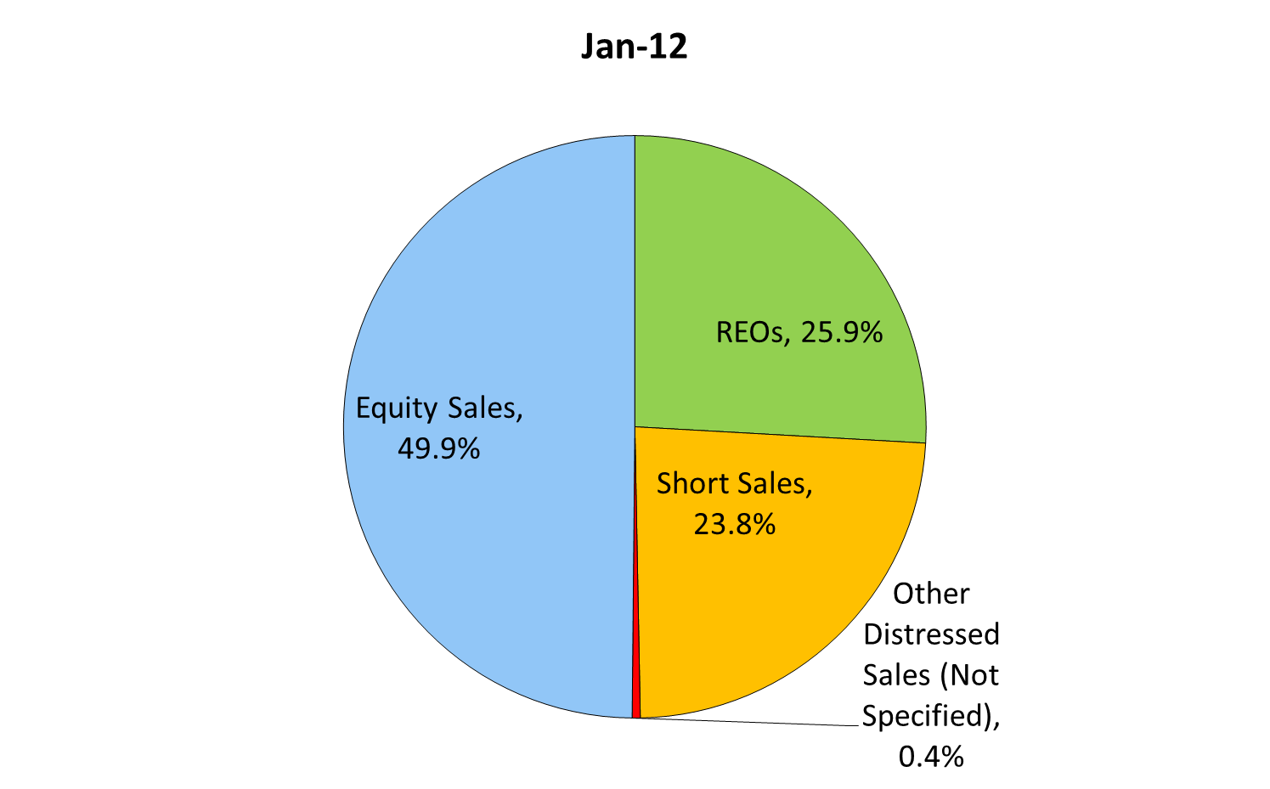
Share of Distressed Sales to Total Sales
SOURCE: California Association of REALTORS®

Slide 6
REO & Short Sales: Bay Area
(Percent of Total Sales)
SOURCE: California Association of REALTORS®

Slide 7
REO & Short Sales: Southern California
(Percent of Total Sales)
SOURCE: California Association of REALTORS®

Slide 8
REO & Short Sales: Central Valley
(Percent of Total Sales)
SOURCE: California Association of REALTORS®

Slide 9
REO & Short Sales: Rest of California
(Percent of Total Sales)
SOURCE: California Association of REALTORS®

Slide 10
Median Price of Existing Detached Homes
California, January 2012: $268,280, Down 3.9% YTY
SOURCE: California Association of REALTORS®
Notes:
10
The yty% decline was the 11th in a row
Now up 17% from trough in Feb-09

Slide 11
Trough vs. Current Price – January 2012
Bay Area
SOURCE: California Association of REALTORS®

Slide 12
Trough vs. Current Price – January 2012
Central Valley
SOURCE: California Association of REALTORS®

Slide 13
Trough vs. Current Price – January 2012
Southern California
SOURCE: California Association of REALTORS®

Slide 14
Unsold Inventory Index
California, January 2012: 5.5 Months
MONTHS
SOURCE: CALIFORNIA ASSOCIATION OF REALTORS®
Notes:
Please note that UII from 1990-1994 have been revised following an audit of our data.
Range since 1988:
Low: 1.3 months in April 2004
High: 18.8 months in Feb 1991
Long-run average: 7.2 months

Slide 15
Unsold Inventory Index (Months)
SOURCE: CALIFORNIA ASSOCIATION OF REALTORS®

Slide 16
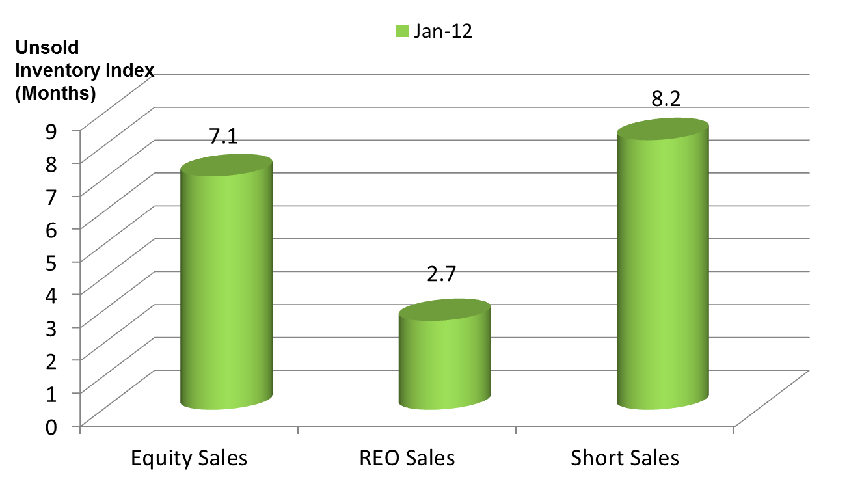
Tight Supply of Inventory for REO Sales
SOURCE: California Association of REALTORS®

Slide 17
Housing Affordability Index
California Vs. U.S.
% OF HOUSEHOLDS THAT CAN BUY
SOURCE: CALIFORNIA ASSOCIATION OF REALTORS®
Notes:
C.A.R.’s traditional Housing Affordability Index (HAI) was replaced with the First-Time Buyer Housing Affordability Index (FTB-HAI) in 2006.
Note this slide takes the average of the 3 months in each of the quarters.
C.A.R. began producing its Housing Affordability Index (HAI) in 1984. At that time, fixed-rate mortgages were the prevailing form of financing a home purchase, while the calculations used to produce the HAI reflected a 20 percent down payment. The methodology also assumed a monthly payment for principal, interest, taxes and insurance that was no more than 30 percent of a household’s income. In the more than two decades since the CALIFORNIA ASSOCIATION OF REALTORS® first conceived the HAI, the mortgage finance landscape has changed dramatically. The range of mortgage products available to buyers as well as underwriting criteria has changed. C.A.R. developed the new index measuring affordability for first-time home buyers to better reflect the realities of today’s real estate market.

Slide 18
CA Underwater Mortgages
Reverse Wealth Effect v. Squatter Economy
SOURCE: CoreLogic
Notes:
18
Note: Data is for CA Properties with a Mortgage
Near Negative Equity is defined as properties in negative equity or within 5% of being in a negative equity position

Slide 19
Distressed Market:
Issues and Overview

Slide 20
Mortgage Foreclosure & Delinquency Rates
California: Q4-2011
Delinquencies: Long Run Average: 4.5%
Foreclosure Rate: Long Run Average: 1.3%
SOURCE: Mortgage Bankers Association
Notes:
Foreclosure rate rising since the second half of 2005
Delinquency Rate, Low: 1.82% in Q1 2005, High: 11.34% in Q4 2009
Foreclosure Rate, Low: 0.12% in Q4 1979, High: 5.77% in Q2 2009

Slide 21
California Foreclosure Inventories, Jan. 2012
Preforeclosure: -30.1% YTD • Schedule for Sale: -34.3% YTD •
Bank Owned: -11.9% YTD
6 Month Average:
Preforeclosure: 104,364
Schedule for Sale: 87,112
Bank Owned: 98,851
SOURCE: ForeclosureRadar.com
Notes:
21

Slide 22
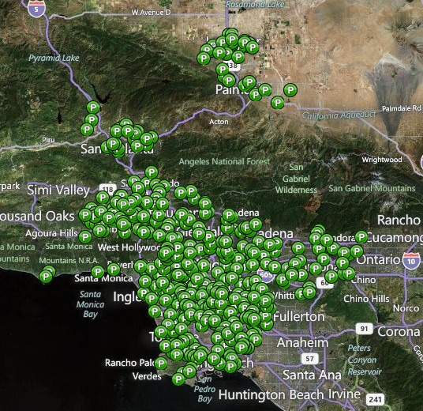

Los Angeles County
Preforeclosure: 13,793
Source: ForeclosureRadar.com as of 02/23/12.

Slide 23
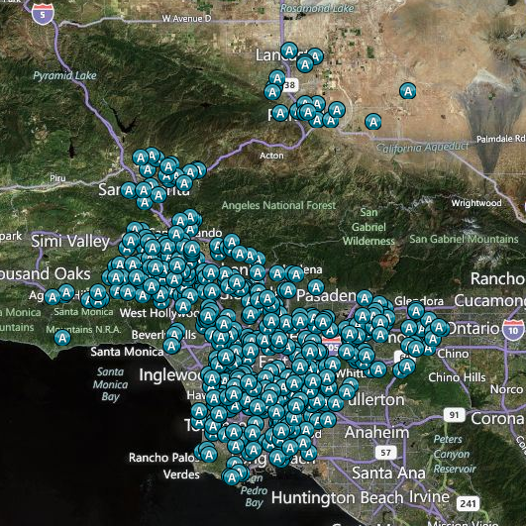
Los Angeles County
Auction: 19,444
Source: ForeclosureRadar.com as of 02/23/12.

Slide 24
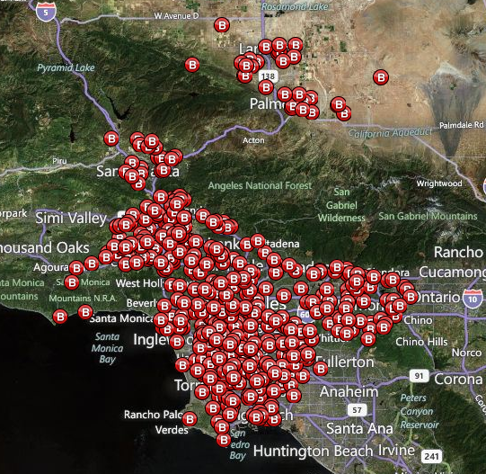
Los Angeles County
Bank Owned: 5,490
Source: ForeclosureRadar.com as of 02/23/12.

Slide 25
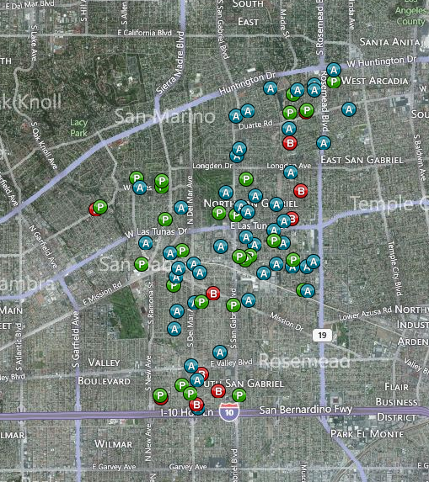
San Gabriel
Preforeclosure: 30 • Auction: 46 • Bank Owned: 10
Source: ForeclosureRadar.com as of 02/23/12.

Slide 26
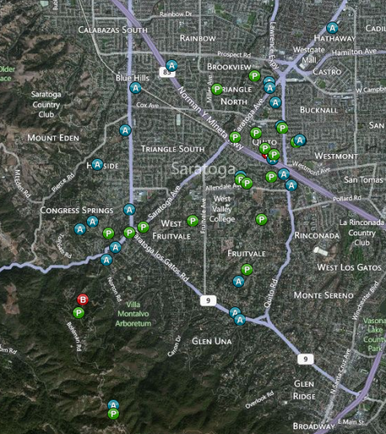
Saratoga
Preforeclosure: 19 • Auction: 25 • Bank Owned: 2
Source: ForeclosureRadar.com as of 01/30/2012.

Slide 27
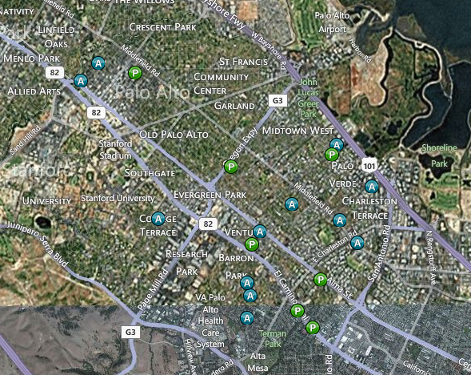
Palo Alto
Preforeclosure: 8 • Auction: 13 • Bank Owned: 0
Source: ForeclosureRadar.com as of 01/30/2012.

Slide 28
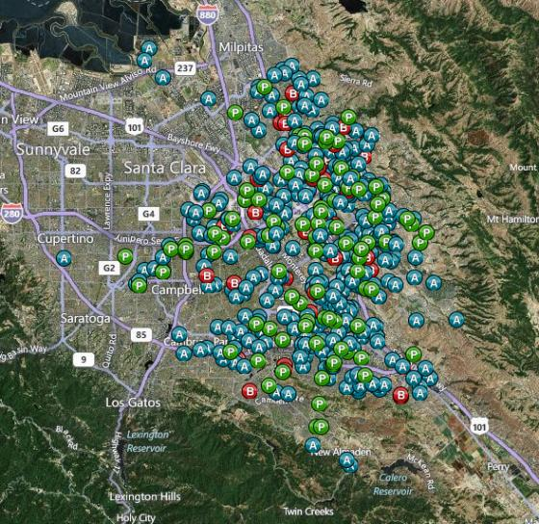
San Jose
Preforeclosure: 1,243 • Auction: 1,873 • Bank Owned: 441
Source: ForeclosureRadar.com as of 01/30/2012.

Slide 29
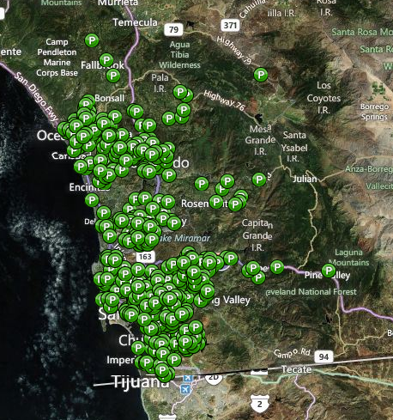
San Diego County
Preforeclosure: 4,916
Source: ForeclosureRadar.com as of 03/02/12.

Slide 30
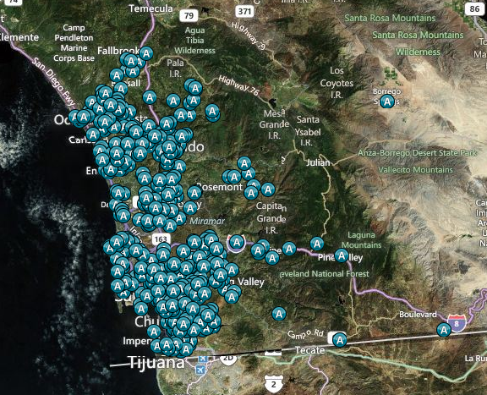
San Diego County
Auction: 5,921
Source: ForeclosureRadar.com as of 03/02/12.

Slide 31
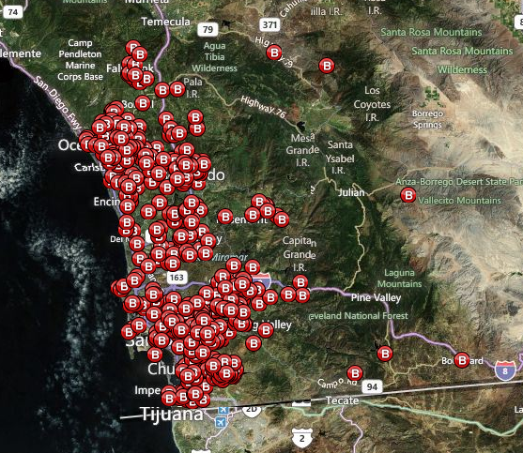
San Diego County
Bank Owned: 1,826
Source: ForeclosureRadar.com as of 03/02/12.

Slide 32
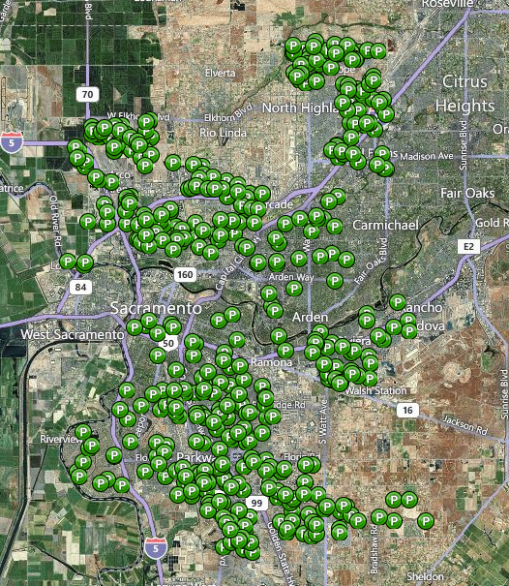
Sacramento
Preforeclosure: 2,216 • Auction: 1,905 • Bank Owned: 1,560
Source: ForeclosureRadar.com as of 08/19/11

Slide 33
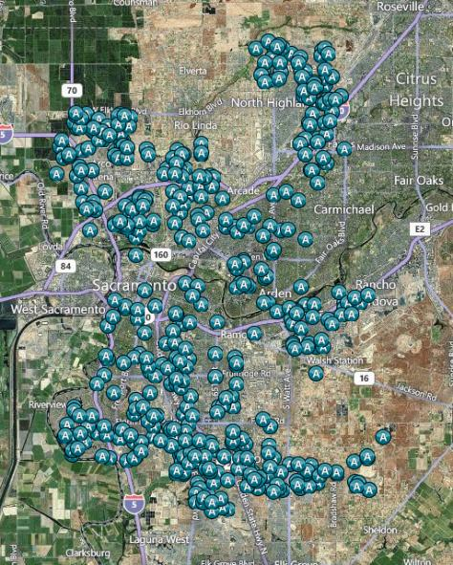
Sacramento
Preforeclosure: 2,216 • Auction: 1,905 • Bank Owned: 1,560
Source: ForeclosureRadar.com as of 08/19/11

Slide 34
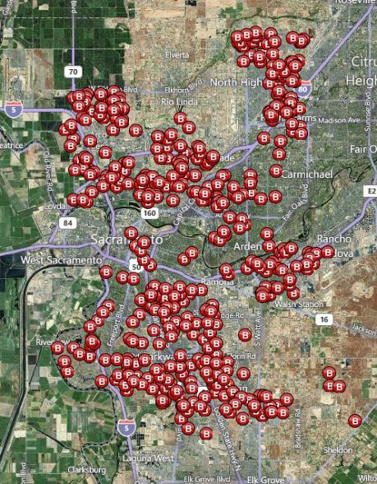
Sacramento
Preforeclosure: 2,216 • Auction: 1,905 • Bank Owned: 1,560
Source: ForeclosureRadar.com as of 08/19/11

Slide 35
2011 Annual Housing Market Survey

Slide 36
Equity vs. REO vs. Short Sales
 | Equity Sales | REO Sales | Short Sales
Share of Total Sales | 58.7% | 19.7% | 20.2%
Median Home Price | $431,000 | $240,000 | $287,000
Square Footage | 1,783 | 1,500 | 1,600
Price / SF | $250 | $112 | $175
Sales-to-List Price Ratio | 95.9% | 98.0% | 95.9%
% of Sales With Multiple Offers | 35.2% | 58.3% | 57.5%
Avg. Number of Offers | 3.0 | 3.0 | 3.6
% of All Cash Sales | 25.5% | 34.0% | 23.3%
Days on MLS | 67 | 50 | 141
Days in Escrow | 35 | 35 | 45

Slide 37
Proportion of Sellers Planning to Repurchase
Q. Is the seller planning on purchasing another home?

Slide 38
Reasons Sellers Not Planning to
Buy Another Home
Q. Why is the seller not planning to purchase another home?

Slide 39
Reasons For Selling
All Home Sellers
Q. What was the single most important reason for selling/buying the property?
Notes:
.

Slide 40
Investments & Second/
Vacation Homes

Slide 41
Foreign Buyers
Q. Was the buyer a foreign buyer?

Slide 42
California Housing Market Forecast

Slide 43
California Housing Market Outlook
Forecast Date: February 2012
Source: CALIFORNIA ASSOCIATION OF REALTORS®

Slide 44
Thank You www.car.org/marketdata lesliea@car.org

