Slide 1
Senate Transportation and Housing Committee Informational Hearing March 19, 2013 AB 32 Implementation: Light Duty Vehicles and Their Fuels
Zero-Emission Vehicles for Meeting California’s Air Quality and Climate Change Goals
Alberto Ayala Richard Corey
Deputy Executive Officer Deputy Executive Officer

Slide 2
Impacts of Air and Climate Pollution
Air Pollution
90% of Californians continue to breathe dirty air
Over 9,000 premature deaths
Increase in asthma symptoms and hospitalizations
Climate Change
A warming climate will have multiple adverse impacts such as:
Poor air quality made worse
More severe heat
Decreasing snowpack
Increasing threats to agriculture
Increasing wildfires and rising sea levels

Slide 3
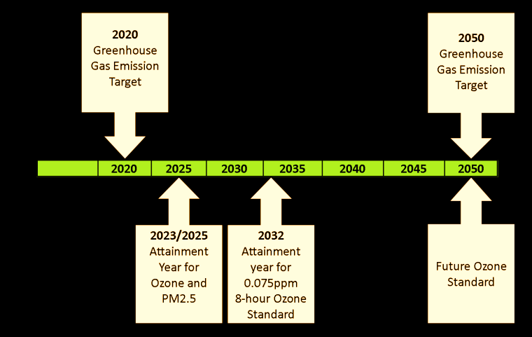
Air Pollution and Climate Milestones
Air Quality and Climate Milestones

Slide 4
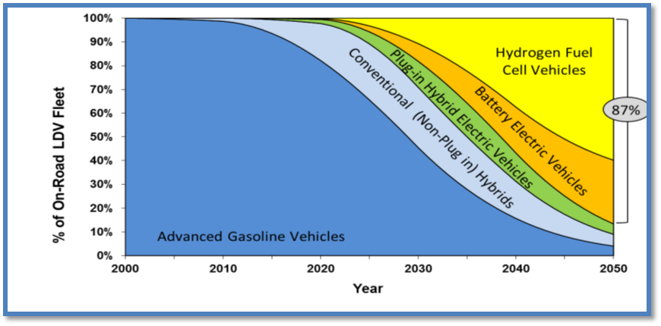
Nearly all vehicles need to be zero emission by 2050

Slide 5
Key Principles for Reducing Emissions
Policies focus on Vehicles and Fuels.
Vehicle and Fuel technologies need to: (a) use less energy and (b) use cleaner forms of energy. This requires a mix of fuels and a transition towards ZEVs.
Two sets of strategies: (a) cleaning up existing vehicles and fuels and (b) investing in advanced vehicle and fueling technologies.
Three opportunities for reductions within each strategy: fuel production, fuel composition, and fuel consumption.
Regulations and Incentives both needed.

Slide 6
Conclusions
Health-based air quality standards and GHG emission reduction targets drive ARB’s approach to addressing these problems
The transportation sector is the largest source of criteria pollution and GHG emissions in California
Need to achieve nearly 100% ZEVs powered by renewable, low-carbon fuels. The transition will require a mix of technologies as gasoline and diesel fuel will be part of the fuel mix for decades to come.
Reducing emissions from vehicles and fuels requires a two-pronged approach:
Turning over the existing vehicle fleet and cleaning up existing fuels to achieve near-term goals and
Incentivizing the investment in advanced technologies to achieve long-term goals.
Regulations alone cannot address the challenge; a complementary mix of regulations and incentives is needed.

