Slide 1
Fuels Of The Future: Pathways to 2050
Don Anair
Senate Transportation and Housing Committee
October 24, 2011

Slide 2
Meeting Our 2050 Climate Targets
Source: Based on UCS modeling for Climate 2030: A National Blueprint for a Clean Energy Economy

Slide 3
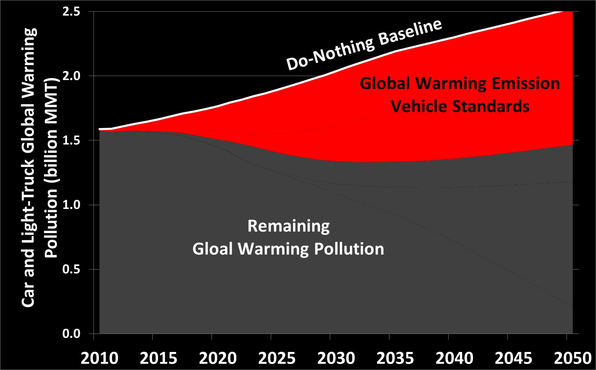
Meeting Our 2050 Climate Targets
Source: Based on UCS modeling for Climate 2030: A National Blueprint for a Clean Energy Economy

Slide 4
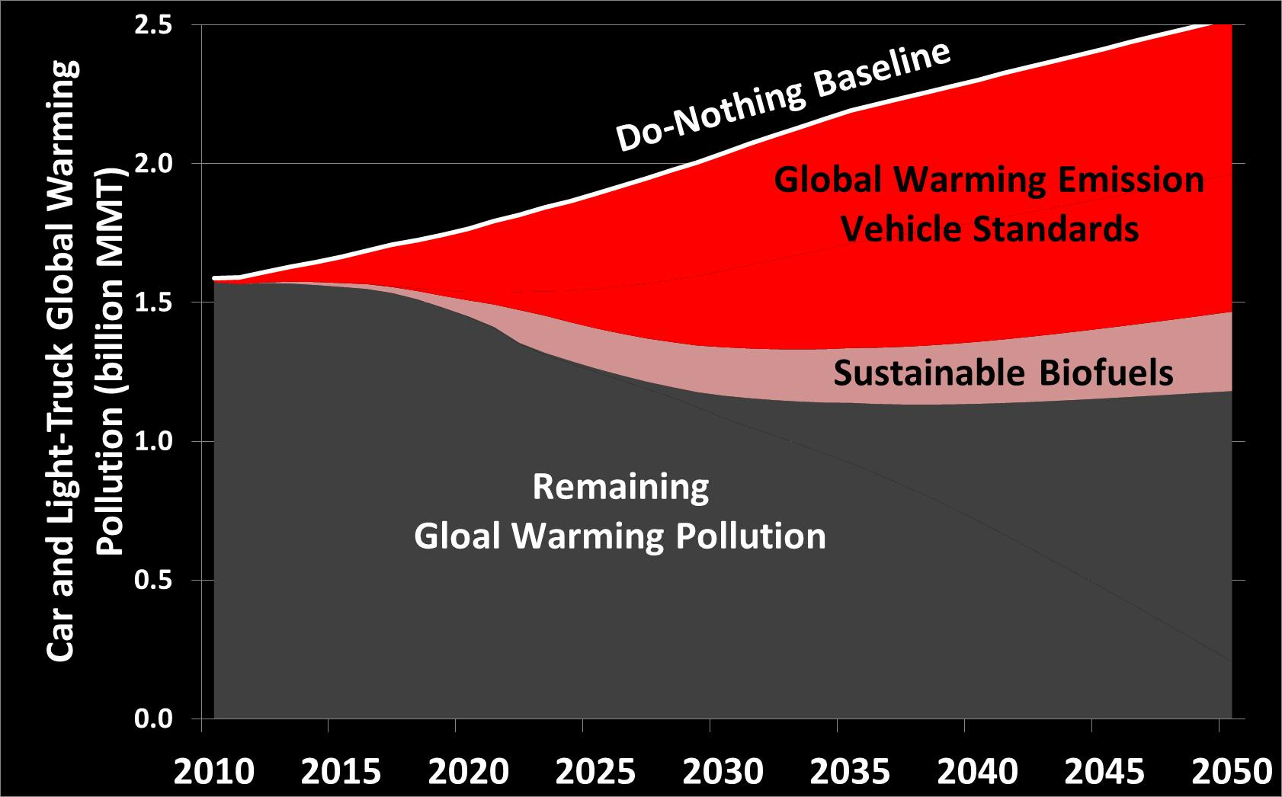
Meeting Our 2050 Climate Targets
Source: Based on UCS modeling for Climate 2030: A National Blueprint for a Clean Energy Economy

Slide 5
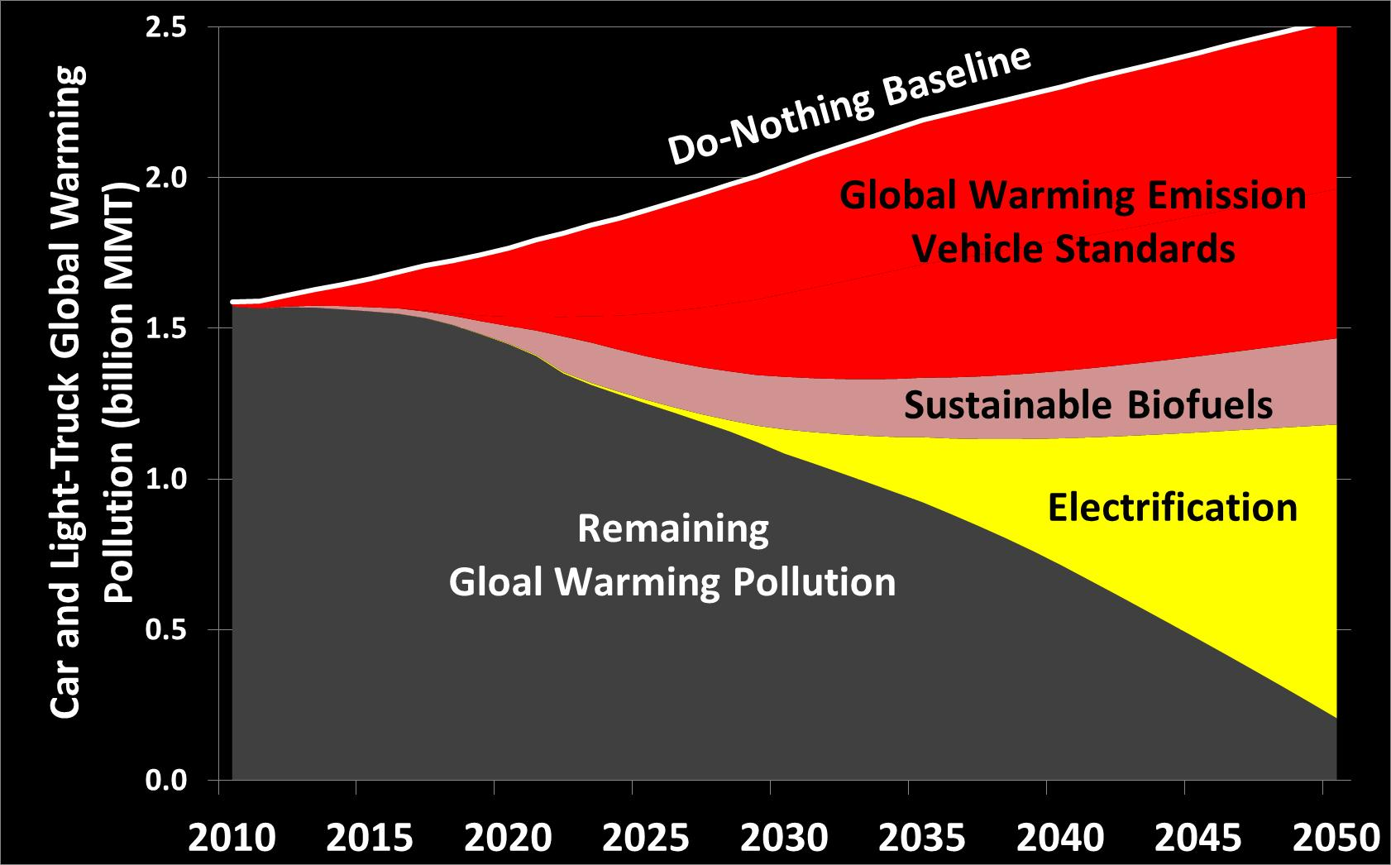
Meeting Our 2050 Climate Targets
Source: Based on UCS modeling for Climate 2030: A National Blueprint for a Clean Energy Economy

