Slide 1
CaFCP: Building Market Foundations
Catherine Dunwoody
Executive Director
Notes:
Thank you for the opportunity to speak today about the California Fuel Cell Partnership and our members’ work to build market foundations for hydrogen fuel cell vehicles.

Slide 2
From well to wheels
42% better
54% better
95% better
76% better
Data from CEC-600-2007-004-REV, August 2007
GHG data confirmed by DOE Record #: 10001, October 2010, Well-to-Wheels Greenhouse Gas Emissions and Petroleum Use for Mid-Size LDVs
Notes:
Like the other fuels and vehicles that you’re hearing about today, fuel cell vehicles reduce GHGs and pollutants when compared to conventional gasoline vehicles. Today, most hydrogen comes from natural gas, reducing GHGs by about 50%. When the hydrogen comes from renewable sources, it reduces GHGs by nearly 100%.
It’s one thing to see it in a chart, and another to see it in action…..

Slide 3
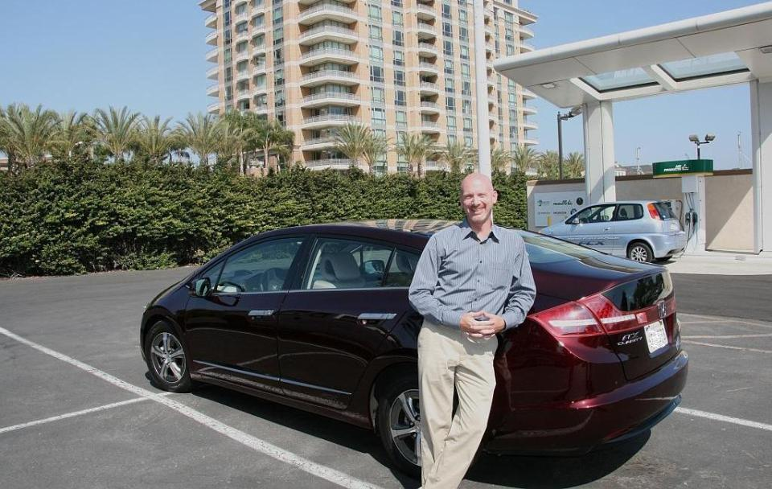
Honda
“We continue to believe that a fuel cell electric vehicle is the ultimate solution to reduce CO₂ emissions.”
Notes:
Honda has been leasing the FCX Clarity to customers for more than a year. Honda President & CEO said, “We continue to believe that a fuel cell electric vehicle is the ultimate solution to reduce CO2 emissions. A fuel cell car IS a full electric vehicle.”

Slide 4
Mercedes
“The entire 20,000-mile journey is the carbon equivalent to three and half minutes of German traffic.”
Notes:
Mercedes has just starting leasing their new B-class to customers in California and Germany. As a show of durability and range, they drove three of the cars around the world. Mercedes said that the entire 20,000-mile journey was the carbon equivalent to three and half minutes of German traffic.

Slide 5
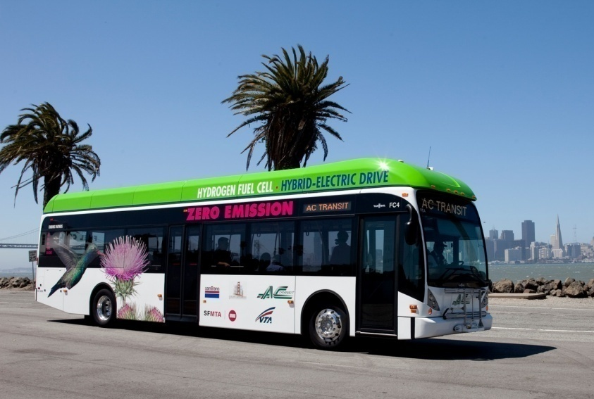
AC Transit
“Our first generation bus reduced GHGs by 43% using hydrogen from natural gas.”
Notes:
AC Transit demonstrated GHG reductions with it’s first-generation bus using hydrogen made at an on-site station. Now they are deploying a fleet of 12 third-generation buses using hydrogen made from renewable and conventional sources.

Slide 6
December 2010 automaker survey
Number of FCVs on road in CA
Notes:
Fuel cell vehicles are coming. We survey our automaker members every year, and they have consistently reported by 2017, more than 50,000 passenger fuel cell vehicles will be on California roads. Hydrogen fuel stations must be available in advance of vehicles so that customers have confidence they can get fuel when and where they need it.

Slide 7
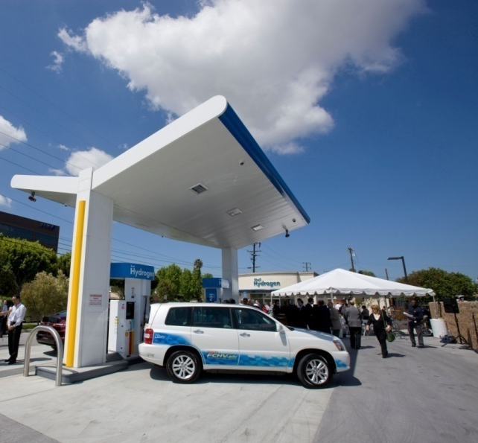
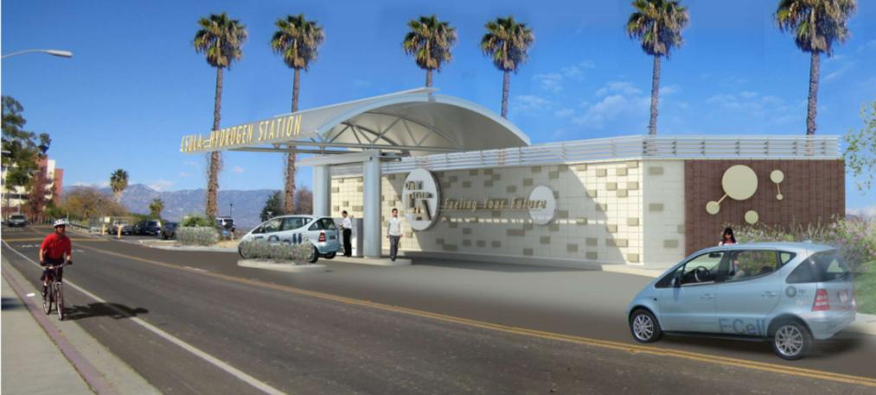
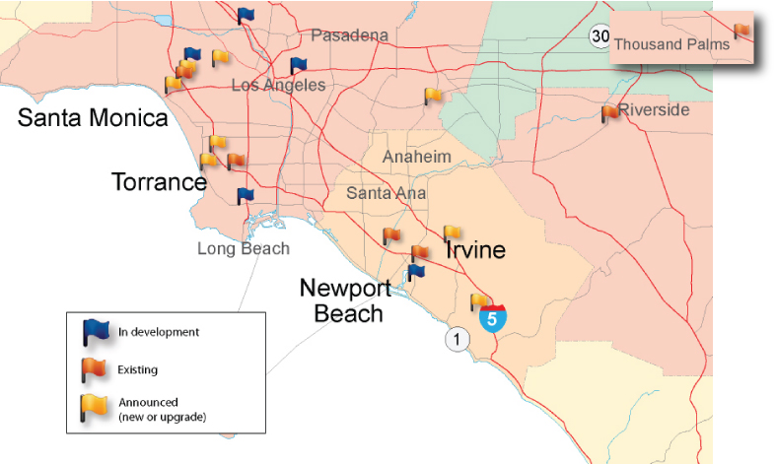
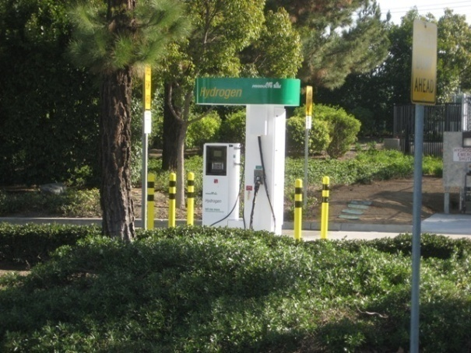
Cluster deployment in early years
Notes:
CaFCP works with automakers to identify priority early market communities where stations are needed first. With 6 stations currently open, four more poised to open in the coming months and 11 new or upgraded stations announced for funding, California is on track to have about 20 stations in Southern and Northern California by early 2013. These stations will provide the foundation for market growth.

Slide 8
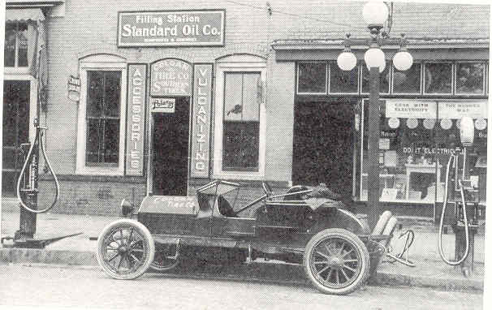
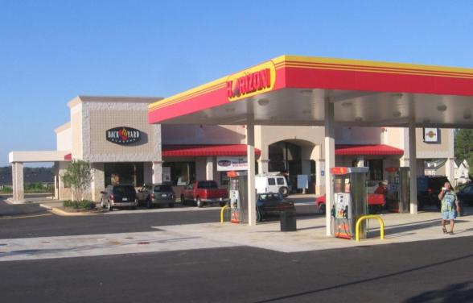
Growing the market
Government support to:
Provide early market coverage
Support retailers as fuel demand grows
Investments to:
Reduce cost
Reduce footprint
Develop new supply
Notes:
We need to expand the number of fuel stations as vehicle sales ramp up. Today, we are in a similar place as when horseless carriages were first widely introduced about 100 years ago. At that time, filling stations were small and people needed to plan their travel and know exactly where to go to get their fuel. Businesses took risks in selling a new product - gasoline - to a small but growing group of customers.
Growing the hydrogen fuel market will require a partnership between government and industry. Hydrogen suppliers are investing to reduce station equipment costs, reduce station size and develop new sources of hydrogen from renewable and waste feedstocks. Government incentives help build customer confidence, assuring FCV drivers that hydrogen will be available in their community. Incentives also support fuel retailers, most of whom are small businesses, during the period when vehicle volumes (and therefore fuel sales) are still growing.

Slide 9
Designed with the world in mind
Catherine Dunwoody
cdunwoody@cafcp.org
www.cafcp.org
Notes:
California’s work to build markets for hydrogen fuel cell vehicles is part of a global endeavor to reduce petroleum dependency, reduce greenhouse gas emissions and improve air quality while offering vehicles that meet customer needs and spur innovation. Together with Germany, Japan, Korea, China and other US states such as New York and Hawaii we are sharing learnings, growing business and building new solutions that will advance hydrogen fuel for transportation.

