Slide 1
High Deductible Health Plans
Neeraj Sood
Associate Professor and Director of Research

Slide 2
Acknowledgement
My studies were funded in part by a grant from the National Institute of Aging (NIA) and the NIH Common Fund for Health Economics (Grant R01-AG043850) and a grant from the California Health Care Foundation. Initial data collection was also funded by the Robert Wood Johnson Foundation.

Slide 3
Overview
What are high deductible health plans (HDHPs)?
How do HDHPs affect health care costs?
Who selects HDHPs & what are the implications for plan offerings?
What are the effects on consumer behavior?
Preventive care
Prescription drug use
Emergency room and inpatient costs
Price shopping

Slide 4
What are High Deductible Health Plans (HDHPs)?
Health insurance plans with a high deductible and are typically associated with a tax free health savings account
Both enrollees and employers can make contributions to the account
Implications for out of pocket costs
Consumers have to pay more out of pocket for health care before insurance begins covering costs
Lower premiums
Attractive for healthy consumers who have low expected health care use

Slide 5
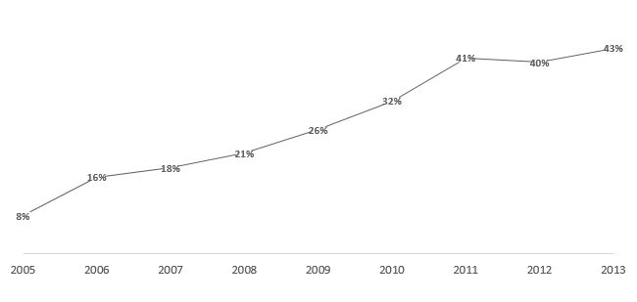
HDHPs are becoming increasingly popular
Fraction of large employers offering HDHP’s has increased rapidly
5x growth from 2005 to 2013
Source: Kaiser/HRET Survey of Employer Sponsored Health Benefits

Slide 6
5x increase in enrollment too
5x growth
2006 4% of employees had HDHPs
2013 20% of employees have HDHPs
Source: Kaiser/HRET Survey of Employer Sponsored Health Benefits

Slide 7
HDHPs reduce health care costs

Slide 8
Healthier patients select HDHPs which could raise traditional plan premiums
HDHPs have lower premiums but higher out of pocket costs at point of service
This makes HDHPs more favorable for healthy people
Research has shown that people who choose HDHPs had about 25% lower costs before switching
This favorable selection into HDHPs could cause traditional plan premiums to rise
Traditional plan premiums are predicted to rise by roughly 5%
Favorable selection in HDHPs could be mitigated by:
Higher employer contributions to health saving accounts
Increasing premium savings from enrolling in HDHPs

Slide 9
HDHPs do not reduce preventive care use
HDHPs typically carve out preventive care such as cancer screenings
Previous research showed modest decline in use of preventive care one year after enrollment in HDHPs
But our study of long term effects shows little or no difference in cancer screening rates between HDHP and traditional plan enrollees

Slide 10
HDHPs reduce use of medications for chronic illness
HDHP enrollees can lower prescription drug costs by:
Stocking up before switching,
Using lower cost alternatives such as generics
Reducing use or days supply
We find that reduced use accounts for majority of cost savings
HDHP enrollees reduce use of statins, antihypertensive and diabetes drugs by about 7.5%
When prescriptions are exempt from the deductible, drug utilization is also reduced but not by as much
Reduction in use was roughly half for Rx exempt HDHPs than HDHPs that were not exempt
Source: Huckfeldt, PJ., Haviland, A., Mehrotra, A., Wagner, Z., Sood, N. (2015) Patient Responses to Incentives in Consumer-directed Health Plans: Evidence from Pharmaceuticals. NBER Working Paper No. 20927

Slide 11
HDHPs do not increase ER visits and inpatient costs
Higher deductibles might mean that people forgo needed care increasing ER and inpatient costs
We find evidence that outpatient and drug costs decreased in the first three years after switching to HDHP
However, we find little evidence of increase in inpatient costs and ER visit costs

Slide 12
HDHPs are not associated with price shopping
Price shopping is when consumers search for lower cost health care providers
There is little to no evidence of increased price shopping for HDHP enrollees
Source: Neeraj Sood, Zachary Wagner, Peter Huckfeldt and Amelia Haviland (2013) “Price Shopping in Consumer Directed Health Plans,” Forum for Health Economics and Policy, 16(1) pp 1-19.
Low-cost provider is defined as a provider whose price was in the lowest tercile of prices available to employees in market.

Slide 13
Use of price transparency tools leads to lower claims payments
We find that when consumers have access to prices, they choose lower cost services
Whaley C, Schneider Chafen J, Pinkard S, et al. Association Between Availability of Health Service Prices and Payments for These Services. JAMA. 2014;312(16):1670-1676. doi:10.1001/jama.2014.13373.

Slide 14
Conclusions…
Pros
Several large employers offer HDHPs
Evidence that HDHPs lower health care costs
Little or no evidence of increase in ER or inpatient costs
Little or no evidence of decline in use of preventive care
Cons
Modest increase in premiums for traditional plans due to favorable selection
Reduction in use of medications for chronic illness
Little or no evidence of price shopping
The cons can be mitigated by:
Higher employer contributions to health saving accounts
Higher premium savings of enrolling in HDHPs
Carving out Rx benefits
Offering online tools to engage consumers and enable value based decisions

