Slide 1
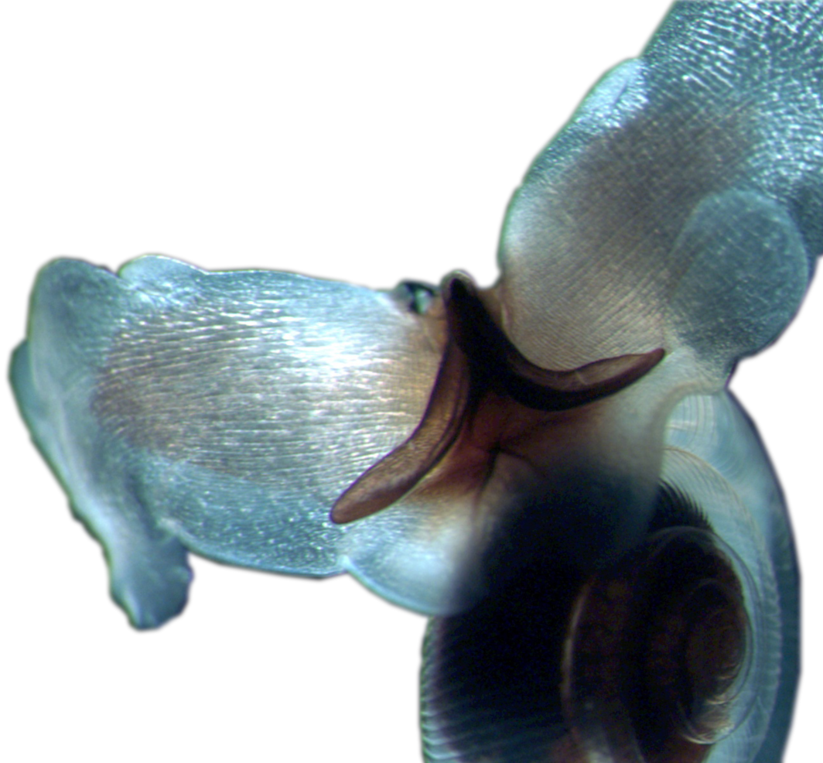
Ocean Acidification
Alexandria Boehm
Professor of Civil & Environmental Engineering
Senior Fellow Woods Institute of the Environment
Stanford University

Slide 2
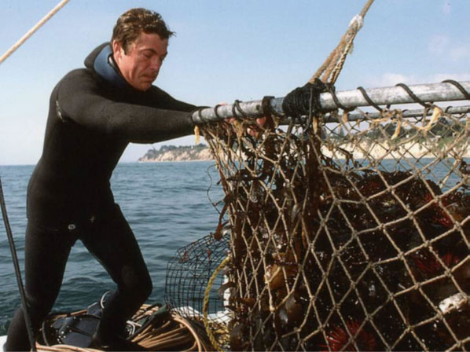
Bruce Steele, commercial sea urchin fisherman on ocean acidification:
“I really worry that by the time fishermen realize what's happening, it'll be too late," said Steele, who has been harvesting urchins for 37 years. "We could be unleashing an extinction event on the ocean. People tell me, 'You can't go around saying that,' but it's true."
One in every seven of us gets most of our protein from the sea. Because of that, food security is a major issue for our planet.
Dr. Richard Feely, Washington Post (August 2015)
Annual value of CA coastal and ocean resources: >$22 billion
  Commercial fisheries: > $250 million.
Ocean acidification has cost the oyster industry in the US Pacific Northwest nearly $110 million, and jeopardized about 3,200 jobs.

Slide 3
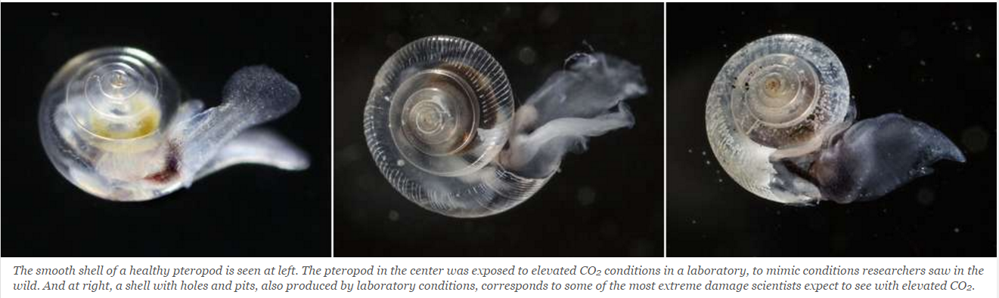
Changing ocean conditions and ocean acidification are likely to impact the seafood we harvest in California
Pteropods are the foundation of the marine food chain for key California fisheries. The photos below show pteropods under increasing CO₂ conditions:
Herring, mackerel and seabirds eat pteropods, as do other pteropod species. In the open ocean, some small fishes, squids and large shrimp eat them. Some of those animals then become important in the diet of Dungeness crab, rockfish, other groundfish, and Humboldt squid.
Ocean acidification’s harmful effects on pteropods are likely to reverberate up the food chain and impact commercial fisheries in California.
SeaChange, The Seattle Times

Slide 4
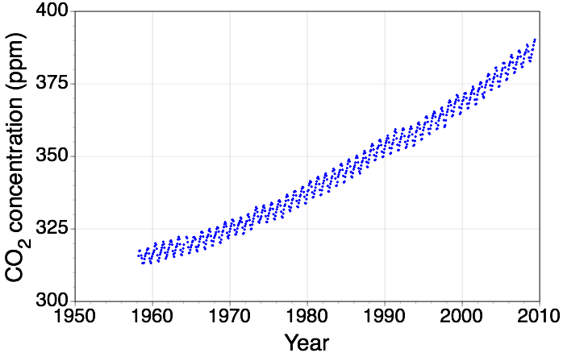
What is Ocean Acidification?
CO₂ story you’ve already heard:
  Atmospheric CO₂ concentrations are rising
Atmospheric CO2 data from Mauna Loa Observatory, Hawaii
Atmospheric CO2 concentration
Notes:
Oceans absorb CO₂ from the atmosphere.
CO₂ levels are rising rapidly due to fossil fuel burning and land use changes.
The excess CO₂ being absorbed by the oceans is changing ocean chemistry.

Slide 5
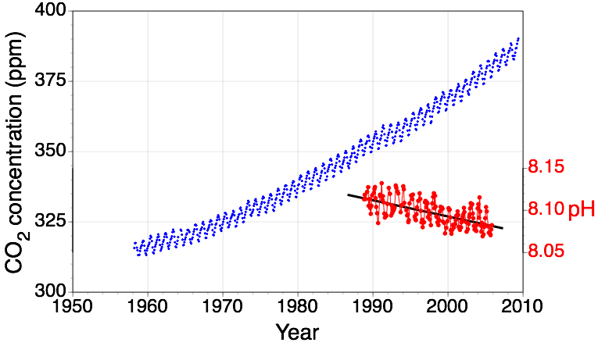
What is Ocean Acidification?
Ocean Acidification is the “other CO₂ problem”:
  Ocean pH decreases when CO₂ dissolves in seawater
Atmospheric CO2 data from Mauna Loa Observatory, Hawaii
Atmospheric CO2 concentration
Ocean pH
pH data from the Hawaii Ocean Time Series Station (HOTS)
Notes:
Current pH of the ocean, what pH is a measure of…
Units of change we will or have seen
The ocean will never be “acidic”
However, most ocean biota live within a narrow pH range

Slide 6
It’s not just pH that we care about…
O
C
O
CO₂
1. Dissolves in the ocean
HCO₃⁻
H
O
O
2. Reacts with water
to form bicarbonate ion
H₂O
C
H
H
O
O
and hydrogen ion
H⁺
HCO₃⁻
H⁺
3. Most of the hydrogen ions react with carbonate ions to form bicarbonate ion
CO₃²⁻
O
O
C
C
H
O
O
O
O
Courtesy of A. Dickson
Notes:
The process:
CO2 lowers pH
Binds carbonate ions that play an important biological role
We care about carbonate ion concentration because building blocks for shelled organisms, etc….

Slide 7
…It’s the change in carbonate chemistry that is the real concern
The change in carbonate chemistry affects shell-forming organisms
Scientists use aragonite saturation to quantify carbonate availability:
  Ω > 1 : Shells form
  Ω < 1 : Difficult to form shells
photos: David Littschwager/National Geographic Society
Notes:
Ph is the measure people know and hear about…

Slide 8
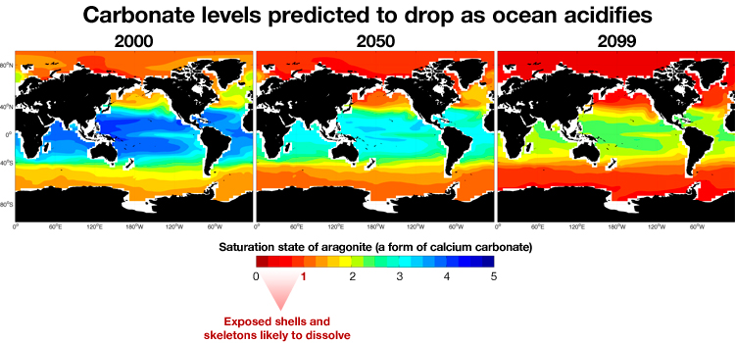
Ocean Acidification is Occurring Rapidly
Feely et al. (2009)
Notes:
Approximately 25% of the CO₂ generated by human activities since the mid-1700s has been absorbed by the oceans
Ocean acidity has increased 30% since the start of the industrial age
Ocean acidity is projected to increase 100-150% percent by 2100
*Note for 2nd bullet point: Given the current rate of global carbon dioxide emissions, the average acidity of the global surface ocean is on pace to increase by about 150 percent (relative to pre-industrial levels) by the latter half of this century.
Current rate of acidification is nearly 10x faster than any period over the past 50 million years
http://www.globalwarmingart.com/wiki/File:Carbon_History_and_Flux_Rev_png

Slide 9
Why Should We Care About Ocean Acidification on the West Coast?

Slide 10
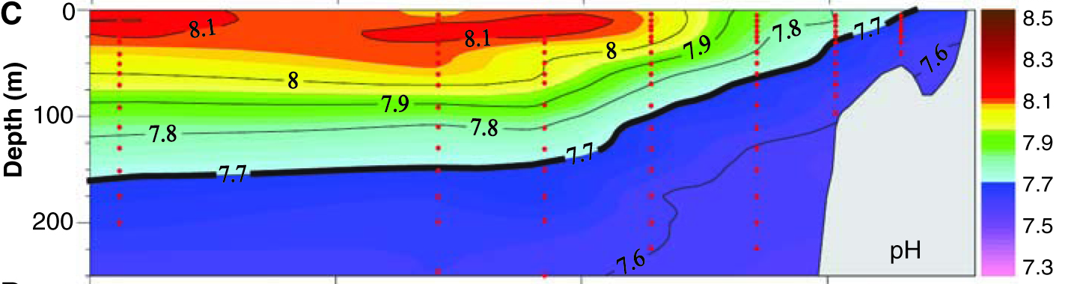
The West Coast Is Particularly Vulnerable
Our winds stimulate upwelling
  Brings deep ocean CO₂ waters to the surface
We have a narrow continental shelf
  Upwelling occurs close to shore
Corrosive water is already being seen close to shore
Feely et al. (2008)

Slide 11
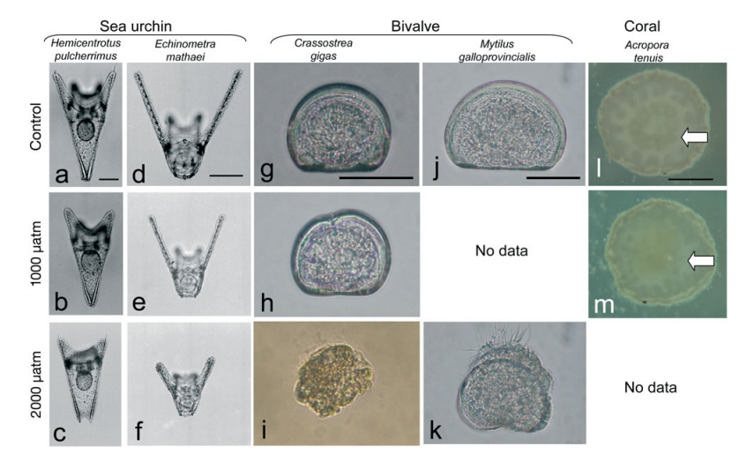
Already seeing effects of ocean acidification on the marine food web
Oyster Larva
Under ocean acidification there will be winners and losers, but there likely will be far more losers and a shift in ecosystem structure overall
Decrease in aragonite saturation affects shell formation
  Larval forms are most vulnerable
4 hatcheries provide >90% of farmed seed and 3 have suffered acidification-related failures
  Ability to produce oyster seed is presently throttling the industry
Kurihara 2008
Notes:
As I mentioned at the beginning, ocean acidification is likely to impact the marine food webs and the seafood we harvest and eat in California.

Slide 12



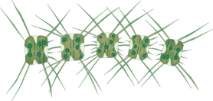
What is the Role of Nutrients?
N
P
Nutrients
1. Discharge to coastal waters
Algal Bloom
N
P
2. Taken up by algae;
fueling algal blooms
Algae
3. Algae die and sink
4. Dead Algae are respired at depth; consuming O₂ and producing CO₂
O
CO₂
C
O
Heterotrophs
Notes:
Roll through this slide quickly (?)

Slide 13

Nutrient Inputs May Exacerbate OA
What is the relative effect of global versus local inputs?
Nutrients
Runoff
Phytoplankton Blooms
Senesce and Sink
U
Nutrients
Respiration: Hypoxia and decreased pH
Outfall Pipe
High Nutrients High CO₂
Low O₂
Low pH
Upwelling
Notes:
Roll through this slide relatively quickly as well (?)

Slide 14
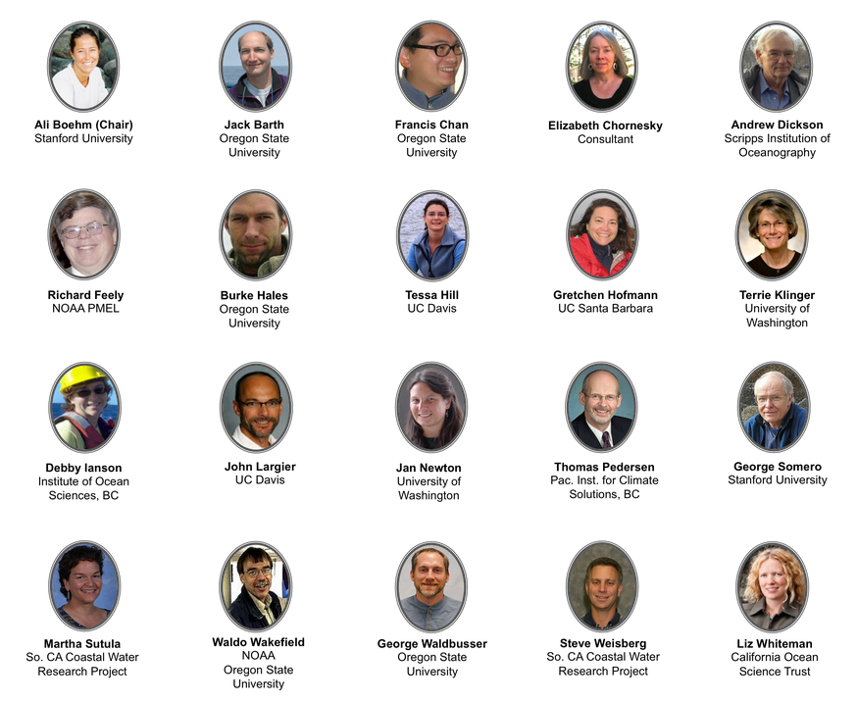
The West Coast Ocean Acidification and Hypoxia Science Panel
20 leading scientists appointed to address the science needs of decision-makers
Convened in 2013 at the request of the California Ocean Protection Council
  Expanded to a multi-state effort linking governments of California, Oregon, Washington, and British Columbia

Slide 15
