Slide 1
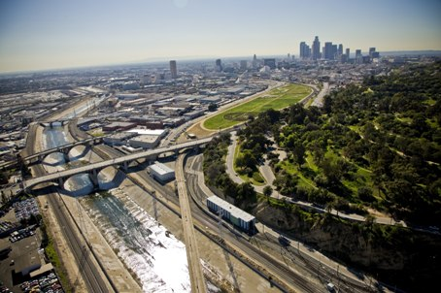
Los Angeles River Watershed
Terri Grant
Principal Engineer
Los Angeles County Flood Control District

Slide 2
LACFCD Map
LACFCD Map

Slide 3
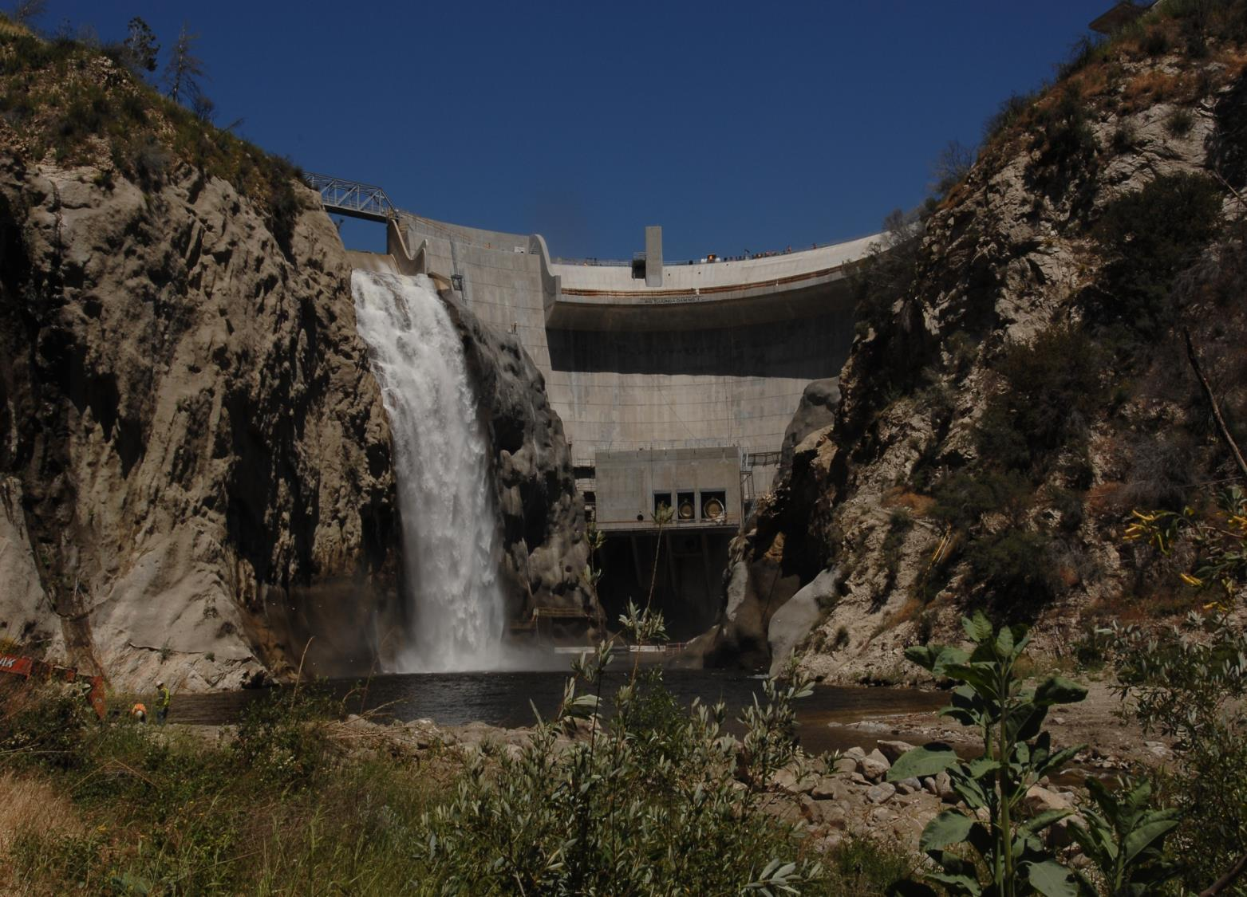
Big Tujunga Dam

Slide 4
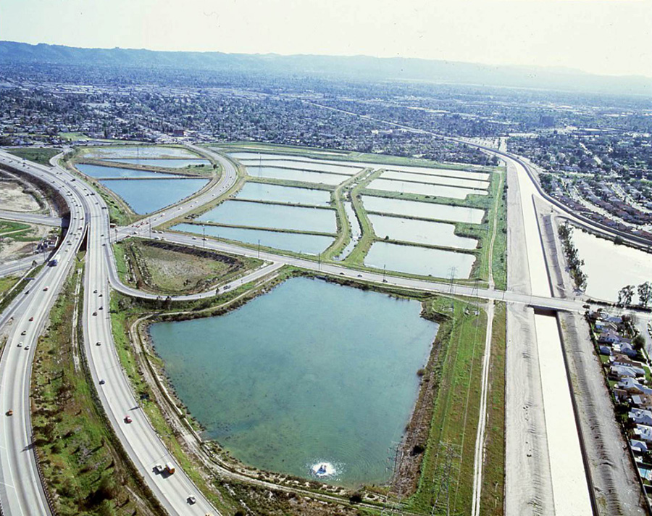
Tujunga Spreading Grounds

Slide 5
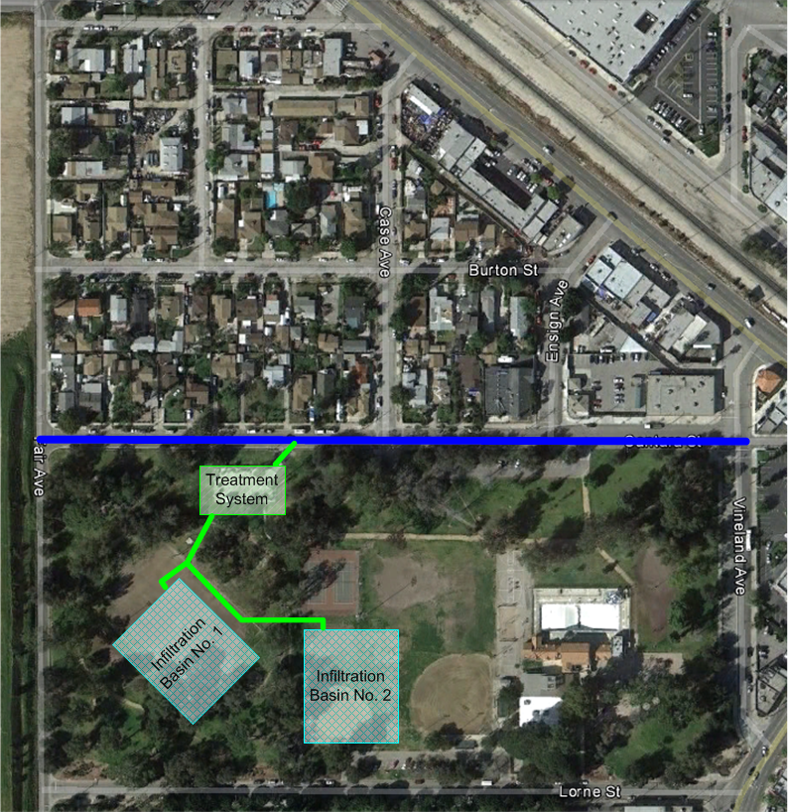
Sun Valley Park

Slide 6
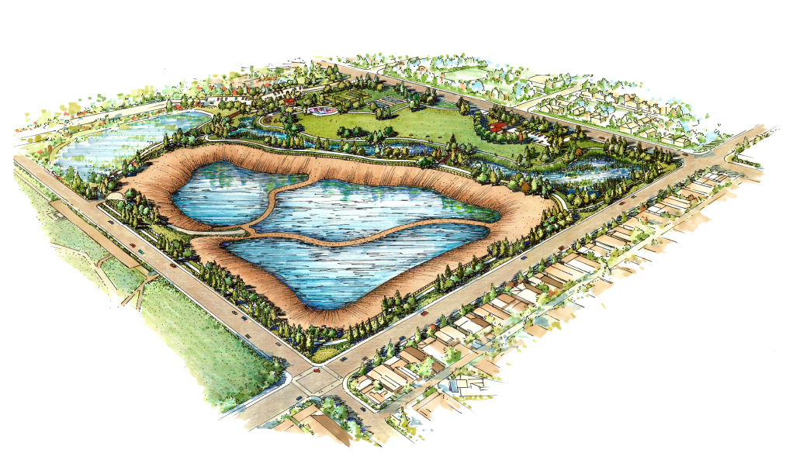
IN DESIGN
Rory M. Shaw Wetlands Park

Slide 7
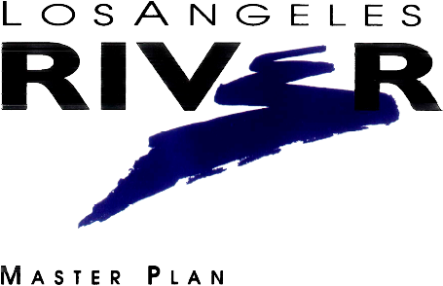
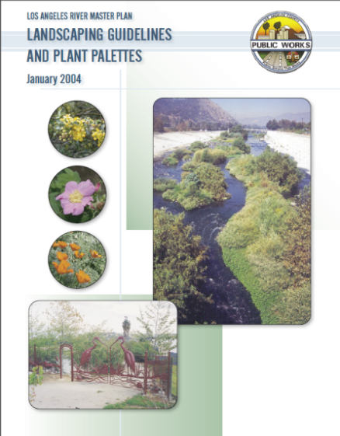
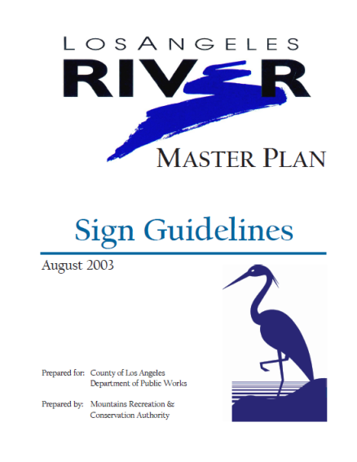
1996
Los Angeles River Master Plan

Slide 8
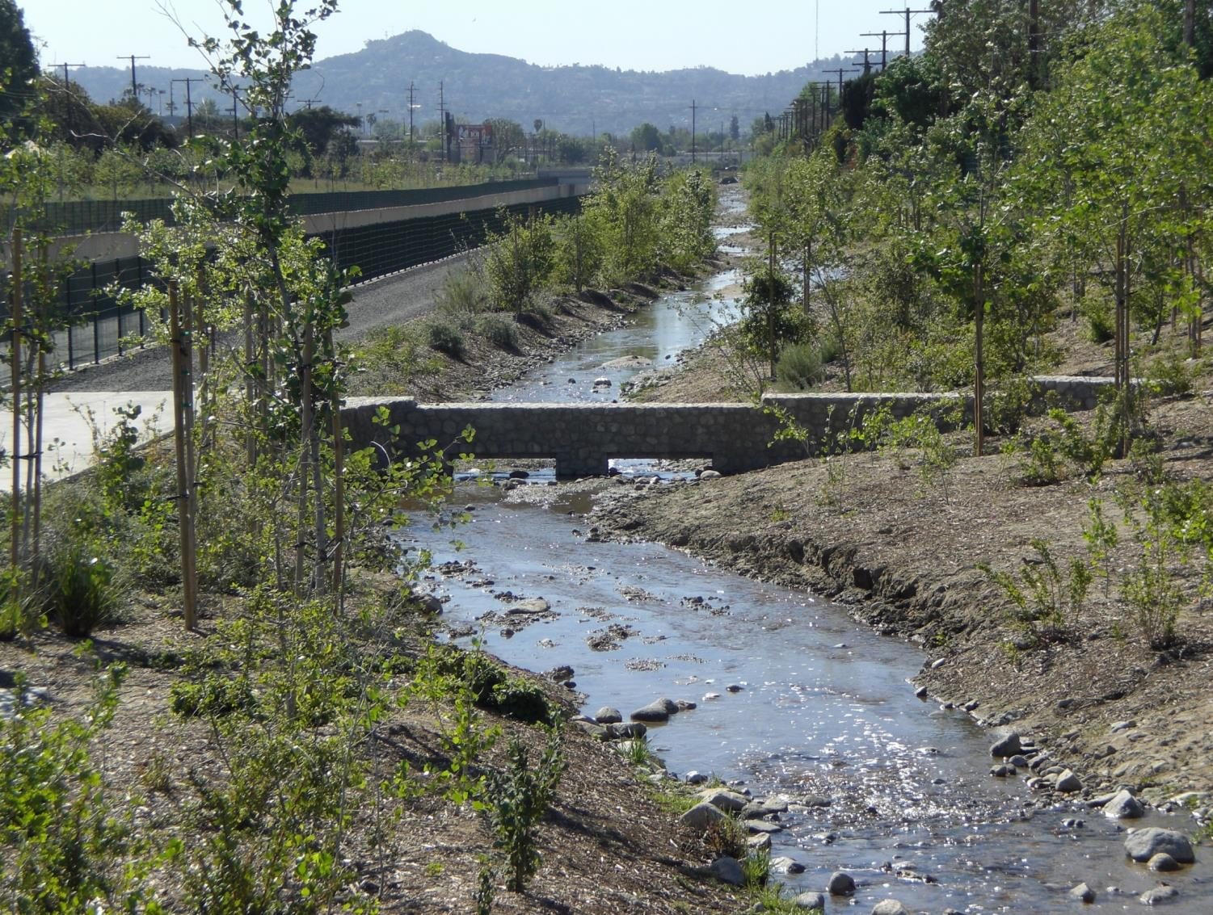
Tujunga Wash Greenway

Slide 9
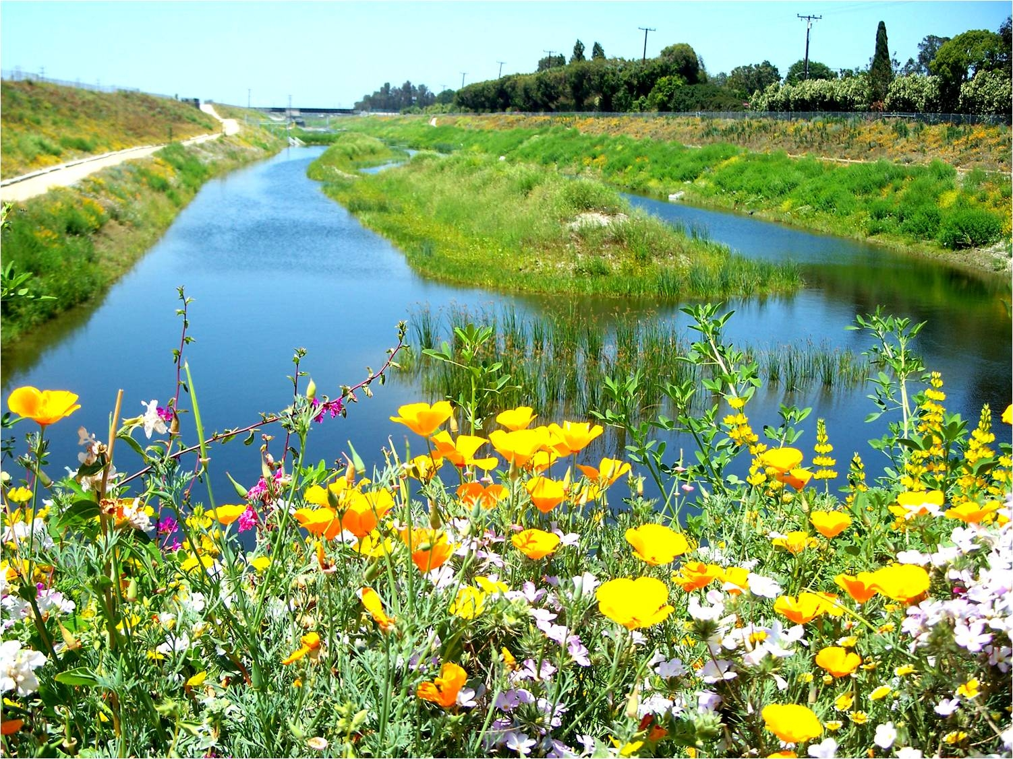
Dominguez Gap Wetlands

Slide 10
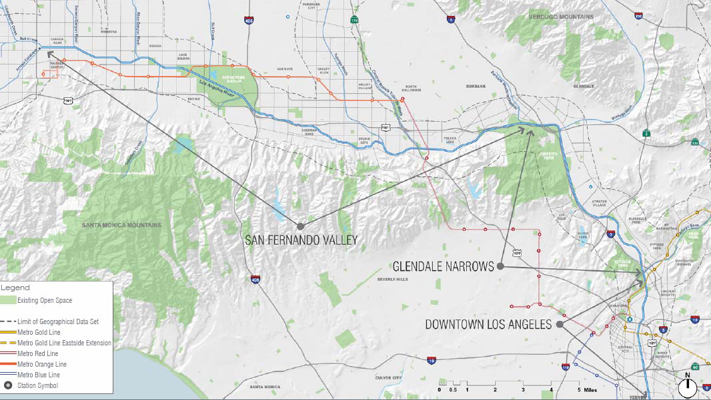
Los Angeles River Cooperation Committee

Slide 11
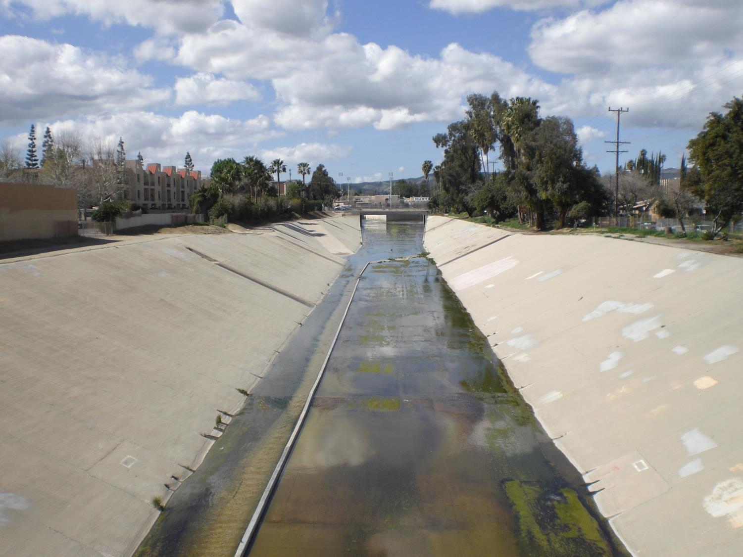
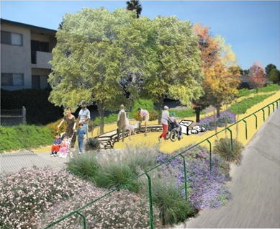
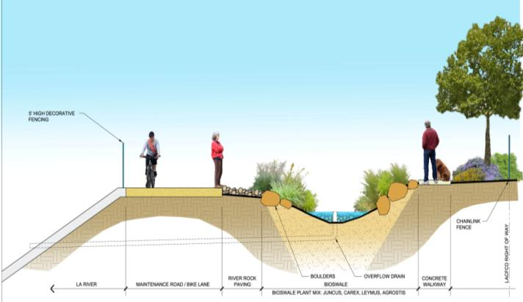
IN CONSTRUCTION
Los Angeles River Headwaters Project

Slide 12
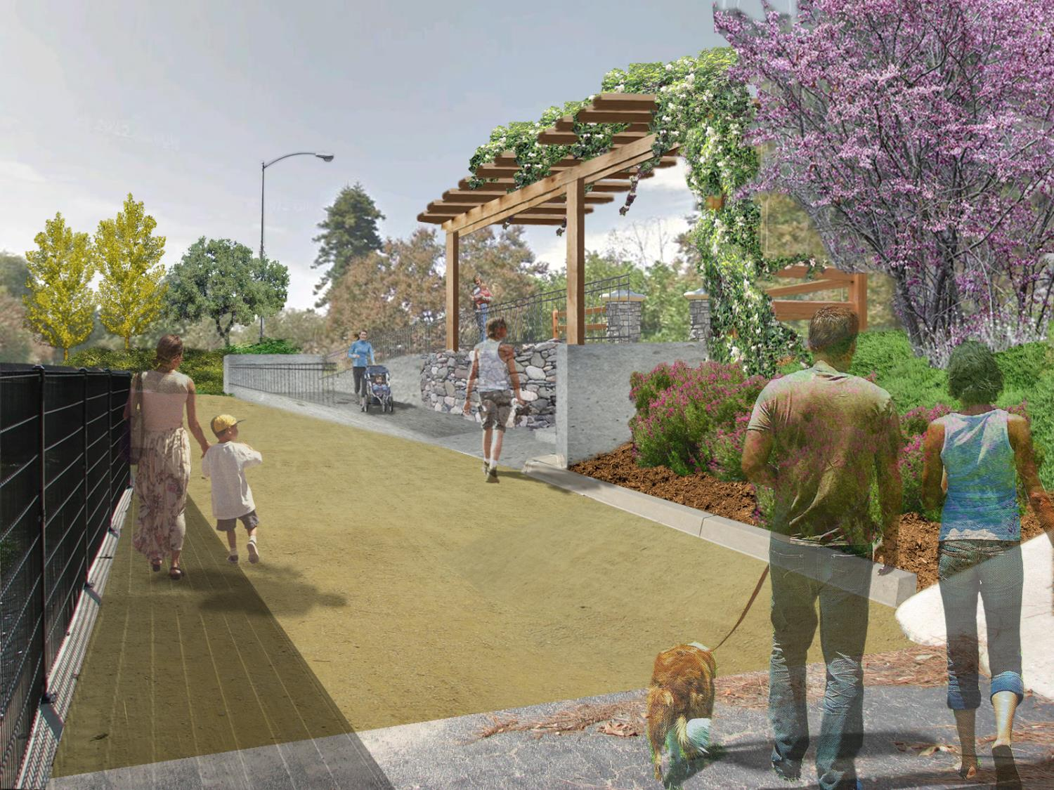
IN CONSTRUCTION
Los Angeles River North Valleyheart Riverwalk Project

Slide 13
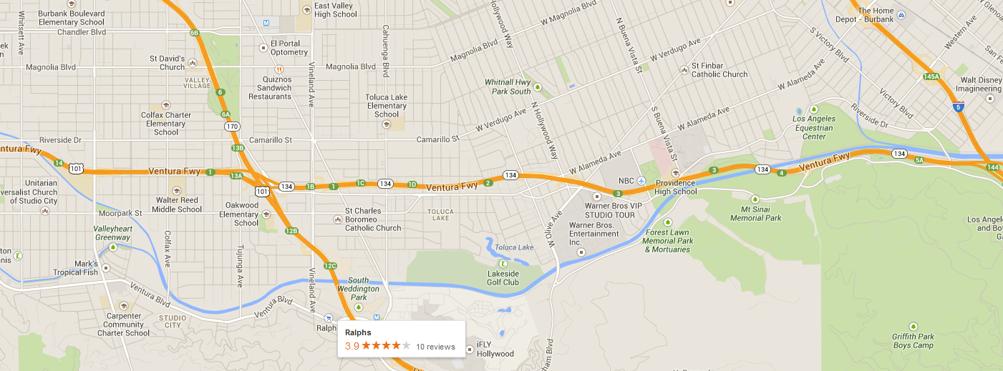
IN PLANNING
Project Limits
Whitsett Av to Riverside Dr
Universal Studios Bike Path

Slide 14

LA Basin Study Objectives
  Evaluate existing water conservation system
  Evaluate potential for new facilities and operational changes for increased capture and recharge to address future conditions
Key Considerations
  Account for projected climate change
  Population growth
LA Basin Study

Slide 15
Proposed New Parcel Fee To Finance
  Stormwater Quality and Water Supply Projects
New Revenue of ~$300 million annually
Public Hearing Held January – March 2013
  No majority protest (5.16% of properties protested)
  Strong concerns from schools, businesses, and some municipalities
  Board of Supervisors Decided to not move forward at this time
Next Steps
    Investigating opportunities for partnership with sanitation agencies (dry weather flow)
    League of Cities & California Contract Cities developing recommendations report
Clean Water, Clean Beaches Measure

Slide 16
Questions?
Terri Grant
Principal Engineer
Los Angeles County Flood Control District

