Slide 1

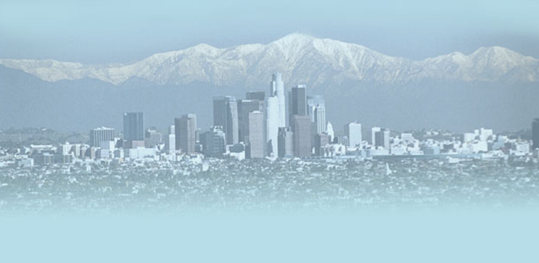
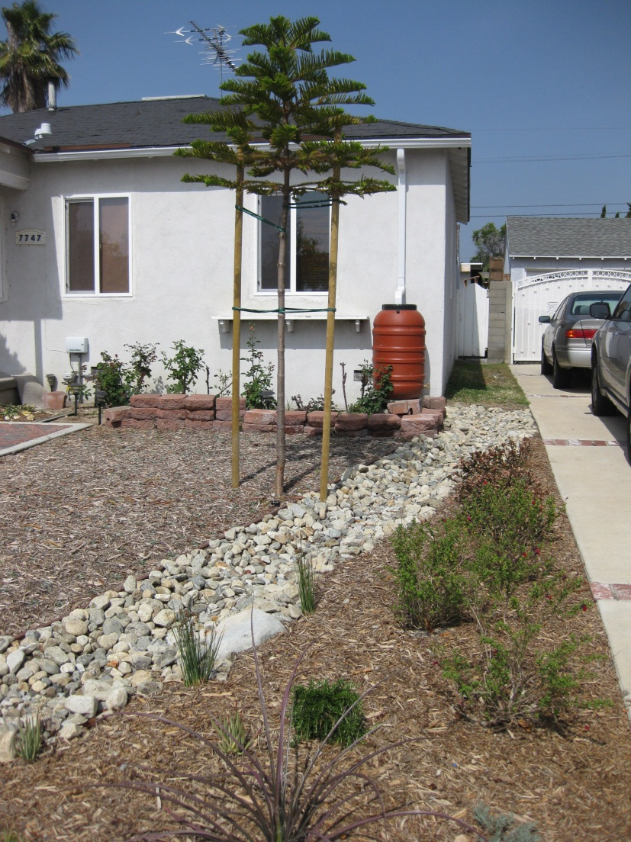
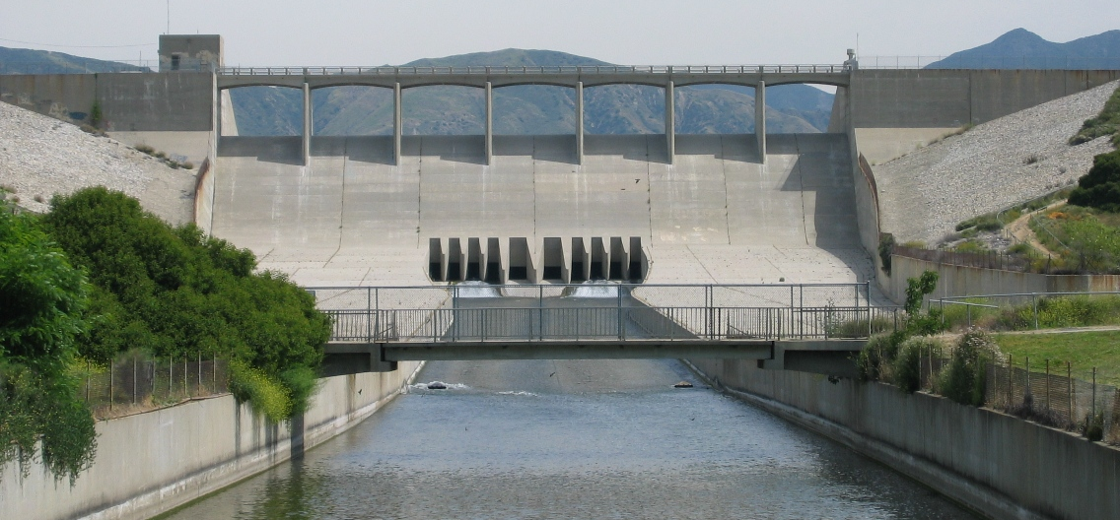
LADWP’s STORMWATER PROGRAM
May 10, 2013
Notes:
0
Picture on the left is one residence included in the Elmer Ave. retrofit project, highlighting a rainbarrel, a rain garden, bio-swales, and L.A. friendly landscape.
Photo on right is the Hansen Dam, which feeds the Hansen Spreading grounds.

Slide 2
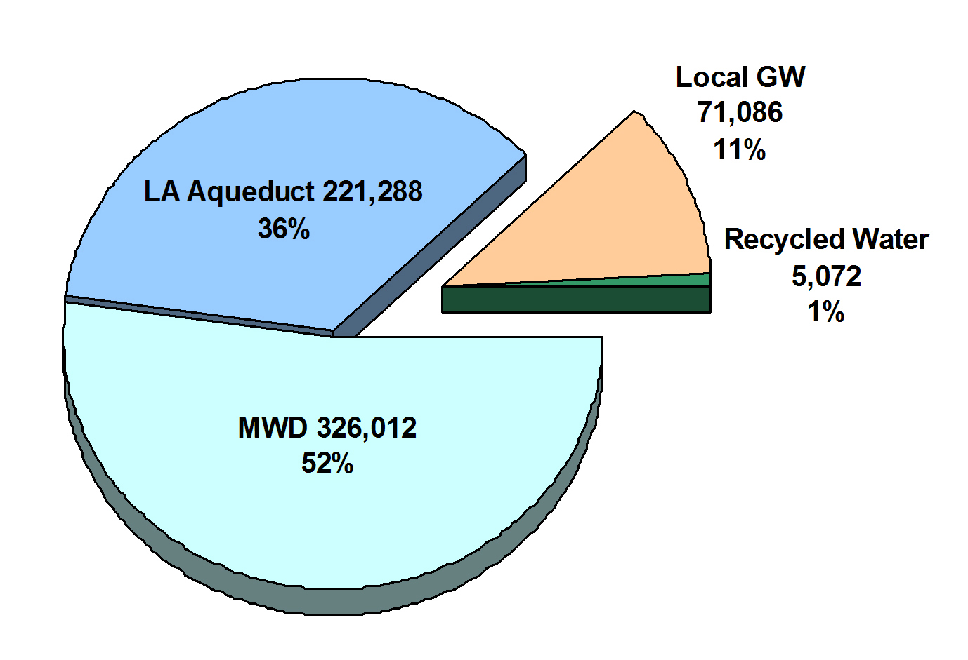
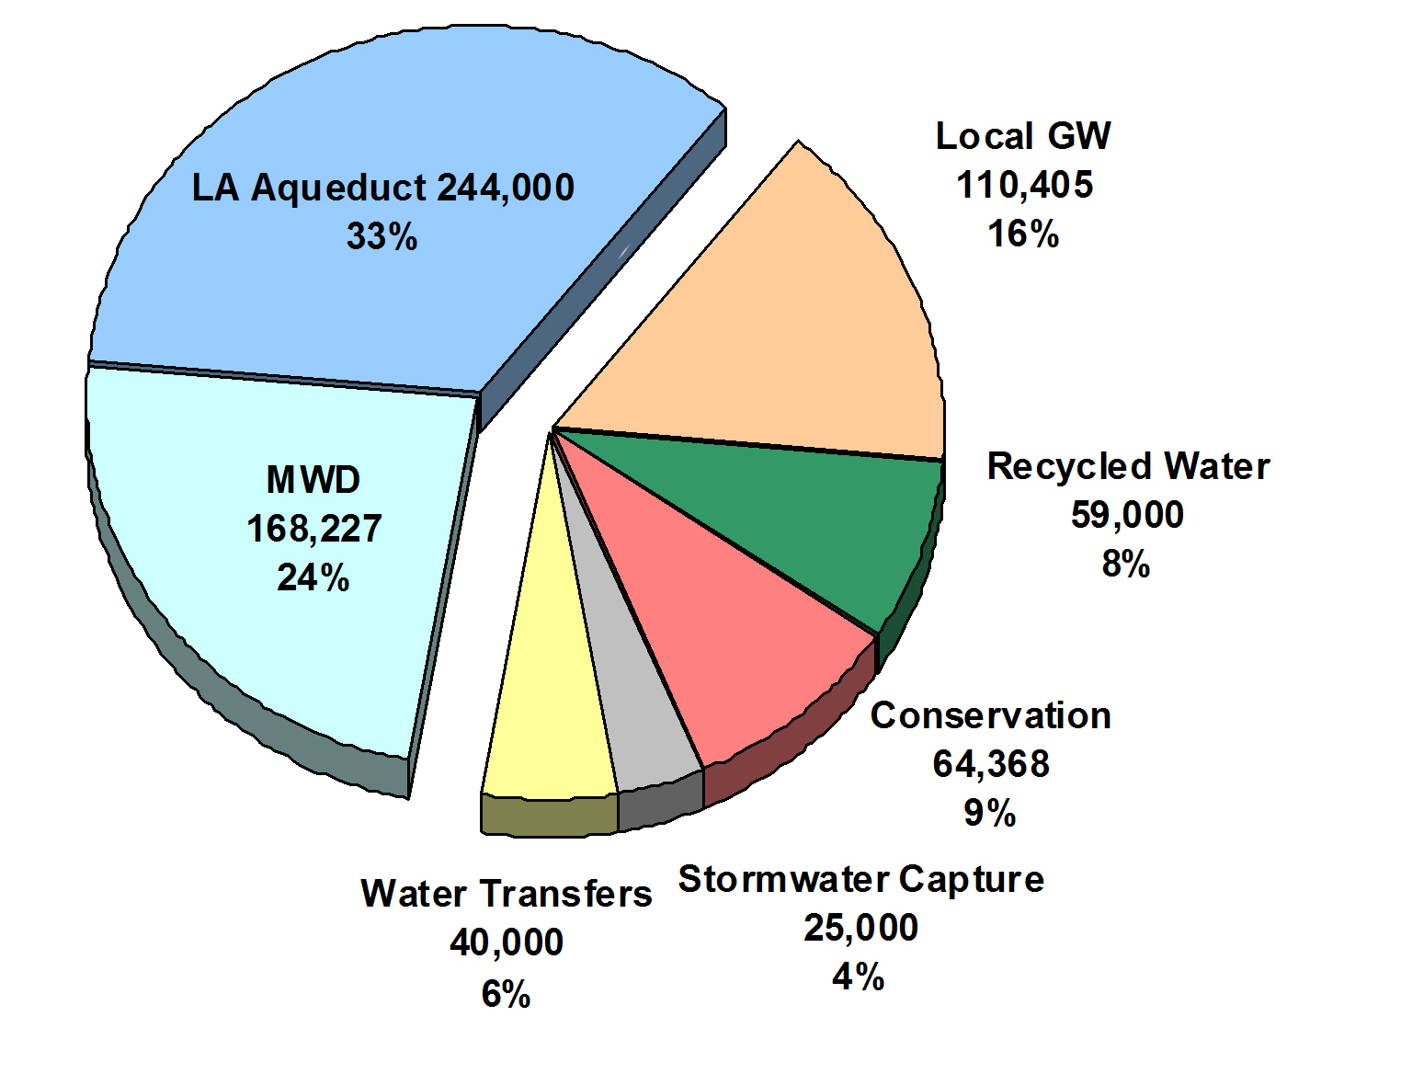
Comparison of Existing and 2035 Projected Water Supply Sources
Five Year Average Total: 621,700 AFY
Fiscal Year 2034 – 35 Total: 711,000 AFY
Stormwater Capture efforts are designed to alleviate 1 of 2 problems in the San Fernando Basin: Groundwater Contamination and lack of natural recharge.
Note: Charts do not reflect 100,000 AF of existing conservation
Notes:
Natural recharge in the SFB has been in a long term decline due to urbanization in the Valley, which once was full of agriculture (primarily orange groves) is now almost completely paved over.
The 5-year average shown on the left pie chart is based on FY 2006-2010.

Slide 3
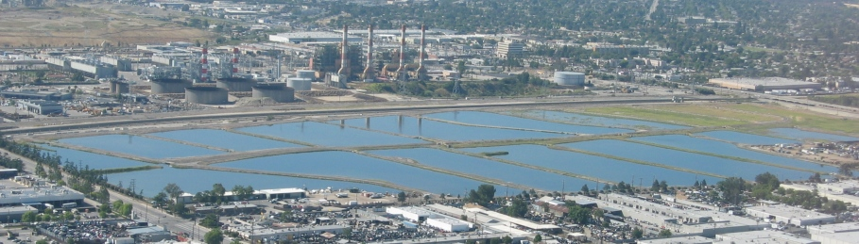
MAIN STORMWATER CAPTURE PROJECT CATEGORIES
Centralized Stormwater Capture
  Larger scale projects designed to facilitate groundwater recharge through spreading grounds
Distributed (Decentralized) Stormwater Capture
  Smaller scale projects, collecting runoff in local neighborhoods or on an individual residential level
Hansen Spreading Grounds
Notes:
Hansen Spreading Grounds (SG) – Working with LACFCD we propose to modernize this 156-acre facility to increase intake and storage capacity thereby improving groundwater recharge, flood protection and water quality while providing passive recreation and native habitat improvements.
Phase 1A will deepen and combine 20 existing basins into 6 larger basins; Phase 1B will improve the intake capacity with a new rubber dam in the L.A. River, and telemetry system; and Phase 2 will develop other compatible uses such as recreational trails and native habitat for the community.
A telemetry system introduces automated control to the rubber dam system. Existing radial gates will remain intact.

Slide 4
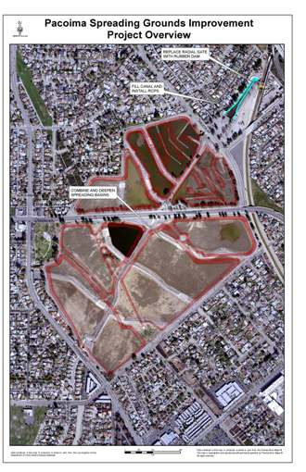
IMPORTANCE OF STORMWATER
Sustain and increase groundwater levels
Offset potable uses
Environmental benefits
  Flood control
  Reduced local runoff
  Water quality improvements in local streams, rivers, and beaches
  Habitat Restoration
Other societal benefits
  Open and green space for recreational use
  Neighborhood beautification
  Local job creation
Pacoima Spreading Grounds
Notes:
The Pacoima Spreading Grounds is a 169-acre parcel located adjacent to the Pacoima Wash Channel downstream from the Pacoima Dam. The LACFCD and LADWP propose to improve the existing intake structure by replacing the intake canal with four 54-inch diameter reinforced concrete pipes, adding an inflatable rubber dam, and deepening and reconfiguring the recharge basins to better capture and infiltrate stormwater.
Phase 1 will relocate and automate the intake structure, enhance infiltration rates by removing 1.37 million cubic yards of excavated material, and reconfigure the spreading basins from 9 basins to 6 basins with 2 settling basins. Phase 2 will develop other compatible uses, such as passive recreation and native habitat improvements.

Slide 5
DECENTRALIZED STORMWATER CAPTURE
Project Category | Description
Implement BMP’s & LID Ordinance at all Water System Facilities | Provides potential strategies to increase stormwater capture. Implementation of BMP’s and LID will increase stormwater capture potential at all LADWP owned facilities.
Residential Level Stormwater Projects | Planned rebates to incentivize residential customers to implement stormwater capture projects, programs, policies, and ordinances throughout the entire City.
Neighborhood Level Stormwater Projects | Stormwater capture projects intercept street runoff to recharge the San Fernando Groundwater Basin, improve water quality, and alleviate local flooding. Projects Include: Woodman Avenue and Elmer Avenue stormwater capture projects.
Notes:
LID Ordinance – Amends and expands on the existing Standard Urban Stormwater Mitigation Plan (SUSMP) requirements of capturing the first ¾” of a storm event by incorporating LID practices and standards. Effective on May 12, 2012, it expands SUSMP to include small projects greater than 500 sf of impervious area,
BMP’s - Best Management Practices are effective, practical, structural or nonstructural methods which prevent or reduce the movement of sediment, nutrients, pesticides and other pollutants from the land to surface or ground water, or which otherwise protect water quality from potential adverse effects of environmentally irresponsible activities. These practices are developed to achieve a balance between water quality protection and the production of wood crops within natural and economic limitations.
Neighborhood Distributed Projects
Woodman Avenue and Elmer Ave. stormwater capture improvement Projects are shown on slides 5 & 6.
Other Example Projects:
Laurel Canyon Parkway Infiltration Swale – The Project will collect storm water runoff from a drainage area and infiltrate the storm water into the ground below.
Van Nuys Boulevard Median - This project will direct surface runoff flows through pre-treatment devices and into a vegetated swale.
LA River Natural Park – The Project will be able to divert and treat runoff from surrounding tributary area. There will be a cumulative storage area. In addition, during the dry season the project would draw up to 5,000 gallons per day of water from the LA river to sustain constructed wetlands, which provide settlement, filtration and cleaning before discharging the treated water back into the LA River.
Residential level projects include rainbarrels, cisterns, rain gardens, and other systems applied at the residential level.
Water System Facilities Example (note: this is a centralized project) – A pipeline (aprox. 8,100-ft of 48” pipe) from the Van Norman Complex to the Pacoima Spreading Grounds will be constructed. It will allow for stored and captured stormwater at the VNC to be conveyed to the Pacoima Spreading Grounds and other downstream recharge facilities (Tujunga & Branford Spreading Grounds) via the Pacoima Diversion Channel for recharge into the SFB. The project will provide up to 4,200 AFY of additional recharge. Estimated Cost = $8.6 million.

Slide 6
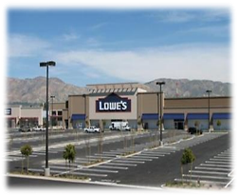
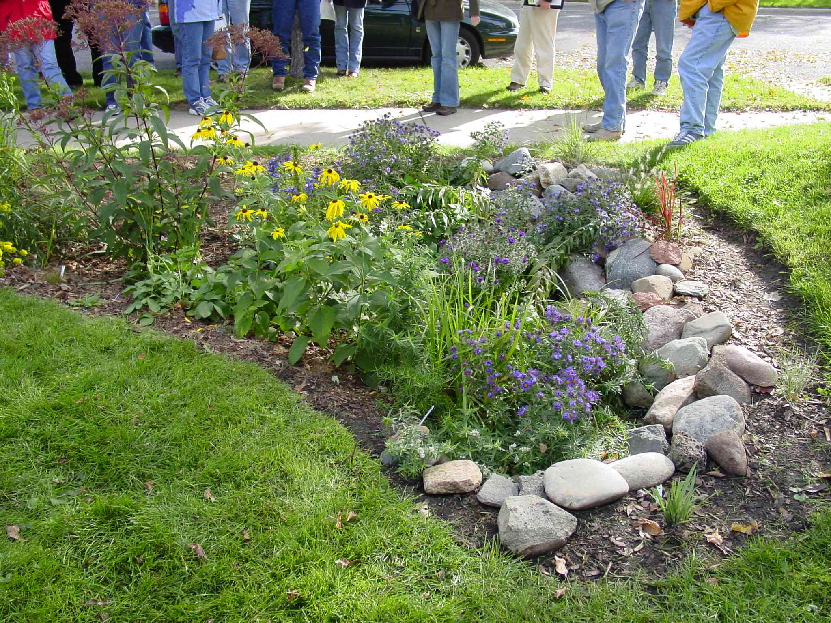
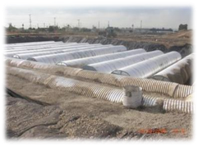
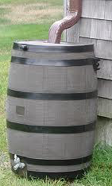
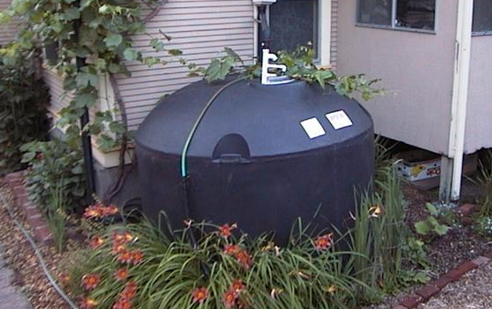
RAIN BARREL/CISTERN/ RAIN GARDEN RAINWATER HARVESTING PROJECTS
Rain Gardens
Cisterns - Lowe’s
Rainbarrel
Cistern
5
Notes:
Rainbarrel - The City of L.A. Bureau of Sanitation in conjunction with Santa Monica Bay Restoration Commission and the California Coastal Conservancy began a rainbarrel pilot program in 2009. Designed to conserve potable water and reduce the amount of polluted rainwater that runs untreated into the ocean, the $1-million pilot plan has enough funds to install 600 residential rain barrels, provide consultation on rain gardens, and provide one custom-made commercial planter box for each of ten businesses. It is estimated to save 584,100 gallons of water each year.
Water System Facilities BMP and LID Projects
Begin in FY 2014/15 and on-going
Costs: $5 million per year
Rain Barrel / Cistern Rebates & LID Incentives
Begin in FY 2014/15 and on-going
Costs: $10 million per year
Rain Garden Pilot Project – The pilot project offered technical and financial assistance to homeowners in high infiltration areas within the City that installed a rain garden on their property. The goal of the project was installation of 310 rain gardens. Homeowners received a rebate of up to $1000 in labor and materials to create a rain garden by either of the following options:
Do-It-Yourself
Direct Installation by the LADWP’s contractor Generation Water.

Slide 7
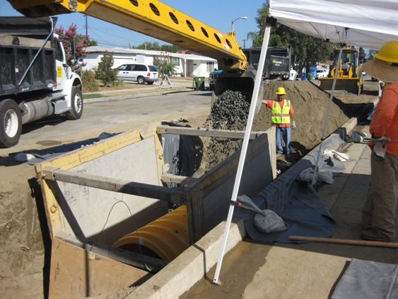
WOODMAN AVE. MULTI-BENEFICIAL STORMWATER CAPTURE PROJECT
65 AF of annual recharge.
Collects water from 130 acres of a “Disadvantaged Community” in the San Fernando Basin.
Vegetated swales and underground infiltration galleries to replace 16 ft by 3,500 ft concrete median.
Construction to be completed in August 2013.
Total estimated cost is $3.4M of which LADWP will fund $1.0M.
Collaborative effort with the City of Los Angeles Bureau of Sanitation (LABOS), Bureau of Street Services (LABSS), and The River Project.
Notes:
This project will intercept street runoff prior to entering Woodman Ave. and it’s storm drain system. This captured stormwater will be diverted into a vegetated swale and into underground infiltration galleries where it will percolate into the San Fernando Basin aquifer. Other project benefits include:
Improved local river, stream, and coastal water quality
Alleviate local flooding
Community open space enhancements
Improved aesthetics and pedestrian access near schools
Passive recreation
Educational opportunities
Restoration of native habitat

Slide 8
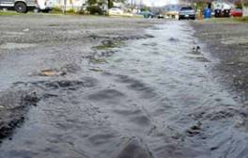
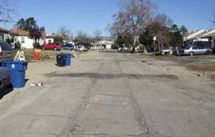
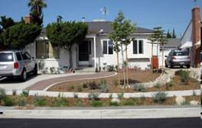
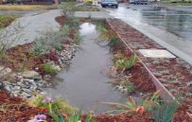
ELMER AVE. RETROFIT PROJECT
Before
16 AF of annual recharge.
Captures and treats runoff from 40 acres of residential land use.
Construction Complete in June 2010.
Features:
  Infiltration gallery
  Bio-swales
  Drought tolerant landscaping
  Permeable surfaces
  Rainwater collection for irrigation
Project partners:
  TreePeople
  Council for Watershed Health
  L.A. City Bureau of Sanitation
Project Constructed on public and private lands
Multiple funding parties with total cost of $2.5M.
After
Notes:
Similar to Woodman Avenue in function, this project implemented various stormwater capture BMP’s in the public right of way and private property using a different strategies to provide multiple benefits – reduced flooding and water pollution, increased local groundwater supplies. The project included the construction of an infiltration gallery under Elmer Avenue to collect storm water for infiltration and recharge, as well as several Bio-swales. Drought tolerant landscaping, permeable surfaces and rainwater collection for irrigation were also included.
PROJECT COST
Funding Source Amount
State Department of Water Resources Prop 50 Grant $859,952
City of LA In-Kind Support $522,500
Federal Appropriations $492,000
Water Augmentation Partners Support $510,000
U.S. Bureau of Reclamation Support $153,000
Total $2,537,452
LADWP contributed main line relocation $300,000

Slide 9
CENTRALIZED STORMWATER RECHARGE PROJECT CATEGORIES
Project Category | Description
Spreading Grounds Upgrades | Enhancement of spreading grounds to increase yields. Projects include Tujunga Spreading Grounds, Pacoima Spreading Grounds, Hansen Spreading Grounds, Lopez Spreading Grounds, and Branford Spreading Basin.
Dam Improvement Projects | Sustain and protect local groundwater supplies in the San Fernando Groundwater Basin, maintains ability to impound stormwater and make water available to spreading grounds. Projects include Pacoima Dam Sediment Removal, Big Tujunga Dam Sediment Removal and Big Tujunga Dam Rehabilitation.
Construction of New Spreading Grounds | Reduce peak flows and improve water quality in the Tujunga and Los Angeles River channels. Projects include Sheldon Pit Multiuse, Boulevard Pit Multiuse, and Old Pacoima Wash.
Notes:
Major Centralized Projects: Both large spreading grounds and dam sediment (Tujunga and Pacoima) projects are similar in form and function.
Tujunga Spreading Grounds Upgrade (See slide 9)
Tujunga Dam Sediment Removal
Project began in FY 2012-13 & to complete in FY 2017-18
Increase in recharge: 2,730 AFY, costs: $10 million
Pacoima Spreading Grounds Upgrade
Project began in FY 2011-12 & to complete in FY2014-15
Increase in recharge: 10,500 AFY, costs: $15 million
Pacoima Dam Sediment Removal (See slide 10)
Big Tujunga Dam Rehabilitation – Completed in July 2011, it constructed a thickened concrete arch buttress with central overtopping spillway, and installed new valves and control systems to manage storm water flows. Annual GW recharge benefit of 4,500 AF. Benefits also include habitat enhancement, flood prevention, and improved stream water quality. LADWP contributed $9M of $106M total cost.
Hansen Spreading Grounds – Working with LACFCD we propose to modernize this 156-acre facility to increase intake and storage capacity. Phase 1A will deepen and combine 20 existing basins into 6 larger basins; Phase 1B will improve the intake capacity by replacing a radial gate with a new rubber dam and telemetry system, and develop other compatible uses such as recreational trails and native habitat for the community.
Lopez Spreading Grounds – Consolidates the six existing spreading basins into two deeper basins that would increase storage capacity from 24 acre-feet to a total of 175 AF, increasing annual recharge by approximately 750 AF.
Brandford Spreading Basins – Most of the water tributary to the spreading basin is urban runoff from Branford Street Channel. The total wetted area of the spreading grounds is 7 acres with an expected annual recharge of 1,049 AFY.
New Spreading Grounds projects will also have these multi-benefits: GW recharge, flood control, water quality improvements in receiving waters, habitat enhancement and both active and passive recreational opportunities.
New Spreading Grounds
Sheldon Pit Multiuse – The pit was an active aggregate mine and is now operated by Vulcan Materials for fine sediment placement. If acquired and enhanced with stormwater capture facilities along with multi-use attributes, the available capacity of storage for stormwater would be approximately 6,000 acre-feet.
Boulevard Pit Multiuse – Very similar to Sheldon Pit. An active aggregate mine operated by Vulcan Materials Company (Vulcan). If acquired, recharge capacity would be approximately 15,000 acre-feet.
Old Pacoima Wash – Before the Pacoima Diversion Channel and the Pacoima Spreading Grounds were built, the Old Pacoima Wash was the natural waterway for stormwater flows emanating from the upper Tujunga Watershed. Approximately 3,000 feet long, the existing concrete lining of the channel will be removed, thus exposing natural gravel and sandy soils for infiltration.

Slide 10
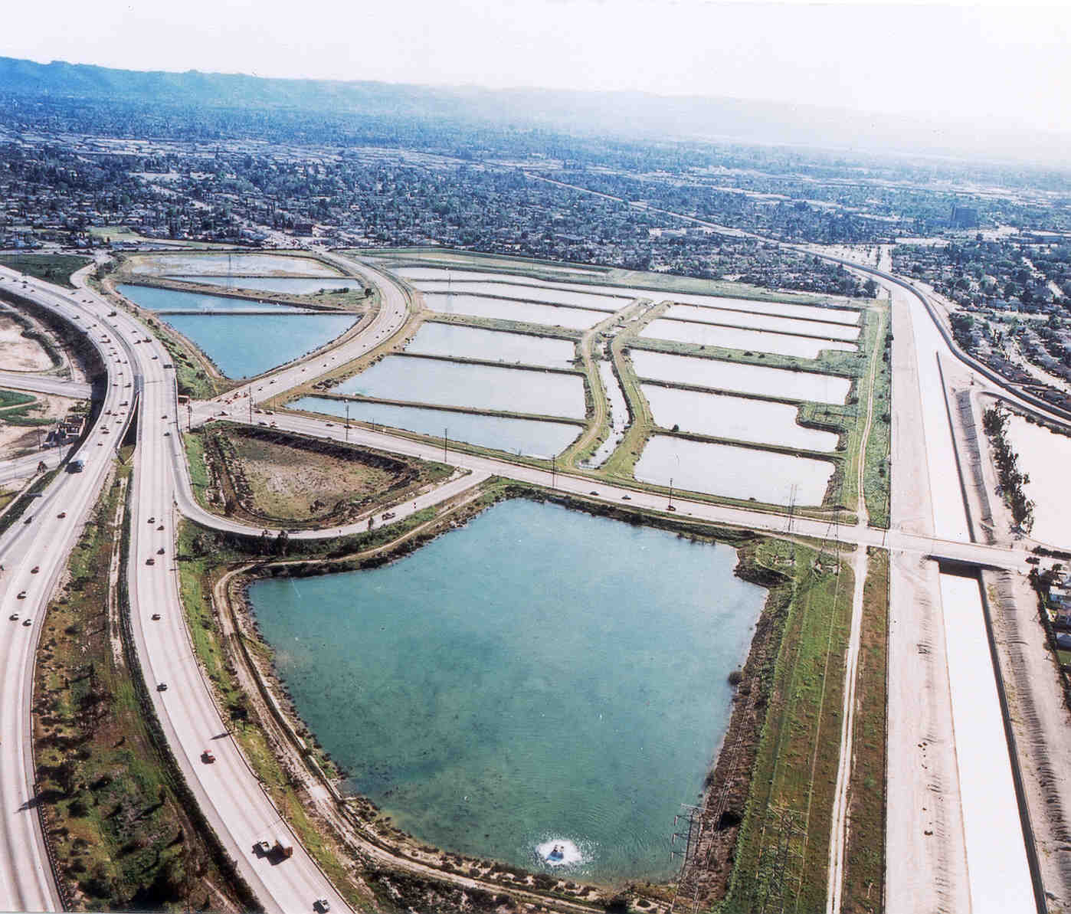
Tujunga Spreading Grounds Enhancement Project
Involves deepening and consolidation of multiple basins
Doubles recharge volume from 8,000 to 16,000 AF per year
150 acres of spreading grounds
Installation of two 60-foot inflatable dams to divert water from Tujunga and Pacoima Washes
Currently 90% design, Construction complete in 2016
Construction Cost – $20M
Project partners include USACE, LACFCD, LARAP, and LABOS.
Notes:
Working with the Los Angeles County Flood Control District (LACFCD) to enhance the Spreading Grounds which include; deepening and consolidating the existing twenty basins into nine large spreading basins, installing two high flow intakes with 60-foot inflatable rubber dams, and modifying the existing intake to improve water quality and remove sediments. Other equipment to be installed includes; control houses, slide gates and spillways, and a remote control telemetry system. The project plan incorporates community access and open space for passive recreation, limited to operational constraints. The City Department of Recreation and Parks will maintain the open space attributes of the project and the LACFCD will continue to operate and maintain the operating recharge facilities.
PROJECT COSTS (Paid for by LADWP)
Design/Specifications – $1,000,000
Construction – $20,000,000

Slide 11
Pacoima dam sediment removal project
Adds nearly 3,000 AF of capacity through removal of 2.4-5.2 million cubic yards of accumulated sediment.
Annual average recharge at downstream spreading grounds is 27,000 AFY – water that would otherwise be wasted to the Ocean.
Construction anticipated for 2014.
5-year project duration.
LADWP’s contribution $10M of $85M total cost.
LADWP partnering with Los Angeles County Flood Control District.
Notes:
The Pacoima Dam Sediment Removal Project will remove accumulated sediment and restore reservoir capacity to 6,060 acre-feet for continued flood control and water conservation operations. This project will remove a minimum of 2.4-5.2 million cubic yards of accumulated sediment.

Slide 12
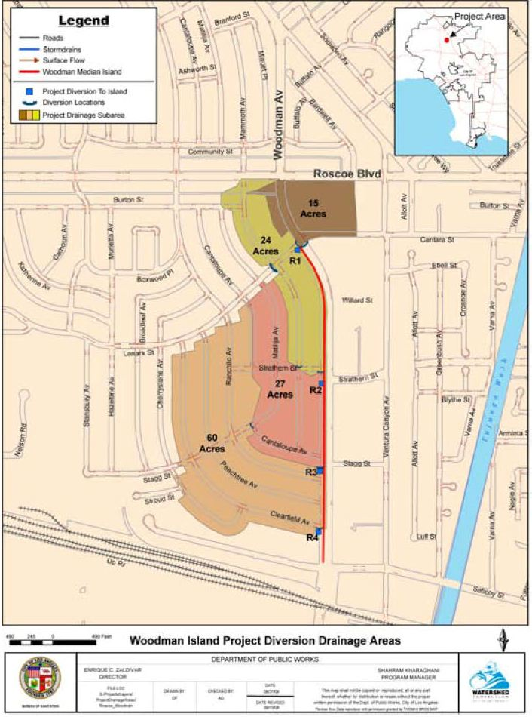
Stormwater Capture master plan
The LADWP’s Stormwater Capture Master Plan (Master Plan) will investigate and create potential strategies for implementation of stormwater and watershed management programs and projects throughout the City of Los Angeles.
Guides decision makers in setting project priorities.
To evaluate existing/potential projects, water supply benefits, water quality, open space, and flood reduction impacts.
Estimated completion 2015.
Estimated cost of Master Plan - $830k.
Project partners:
  Tree People
  LA City Dept. of Public Works
  LA County Dept. of Public Works
Notes:
Map shown is the plot plan for Woodman Ave. Similar documents will be created for Stormwater Capture Master Plan projects throughout the City.

Slide 13
L.A.’s WATER RELIABILITY 2025
The stormwater capture master plan will be incorporated into our current effort to accelerate the goals established in our 2010 Urban Water Management Plan – L.A.’s Water Reliability 2025.
L.A’s Water Reliability 2025 Program | Water Generated (AFY)
Centralized Capture | 54,800
Distributed Harvesting (Decentralized) | 7,600
Total | 62,400
2010 Urban Water Management Plan
Centralized Capture | 15,000
Distributed Harvesting (Decentralized) | 10,000
Total | 25,000
The 37,400 AF of additional stormwater generated by the L.A.’s Water Reliability 2025 Program will be used to mitigate groundwater basin overdraft.
Passage of AB850 will assist in financing these stormwater projects at a lower cost to ratepayers.
Notes:
LA’s Water Reliability 2025 Program is a combination of our Local Water Supply Program and the Clean-up of our San Fernando Groundwater Basin.

Slide 14
QUESTIONS/COMMENTS
13

