Slide 1


State Prescription Drug Purchases. Pricing Standards. Initiative Statute.
JOINT INFORMATIONAL HEARING
SENATE HEALTH AND ASSEMBLY HEALTH
SENATOR HERNANDEZ AND ASSEMBLY MEMBER WOOD, Chairs 1:30 p.m. - Room 4202
Jeffrey S. Hoch, PhD
Professor, Department of Public Health Sciences
Associate Director, Center for Healthcare Policy and Research
University of California, Davis
Dominique Ritley, MPH
Senior Health Policy Analyst, Center for Healthcare Policy and Research
University of California, Davis
The opinions expressed here are not necessarily representative of the official positions of UC Davis or our research partners.

Slide 2
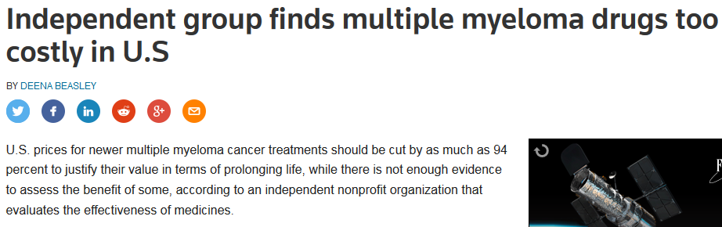
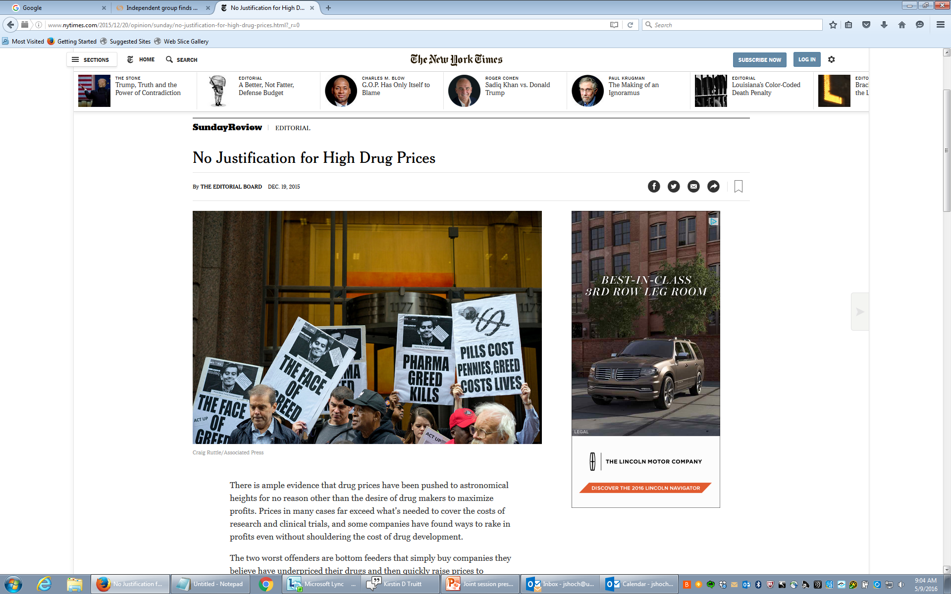
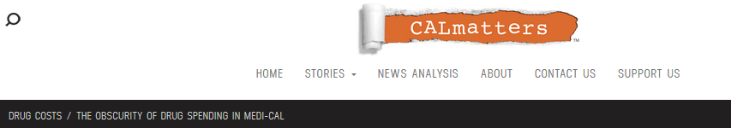
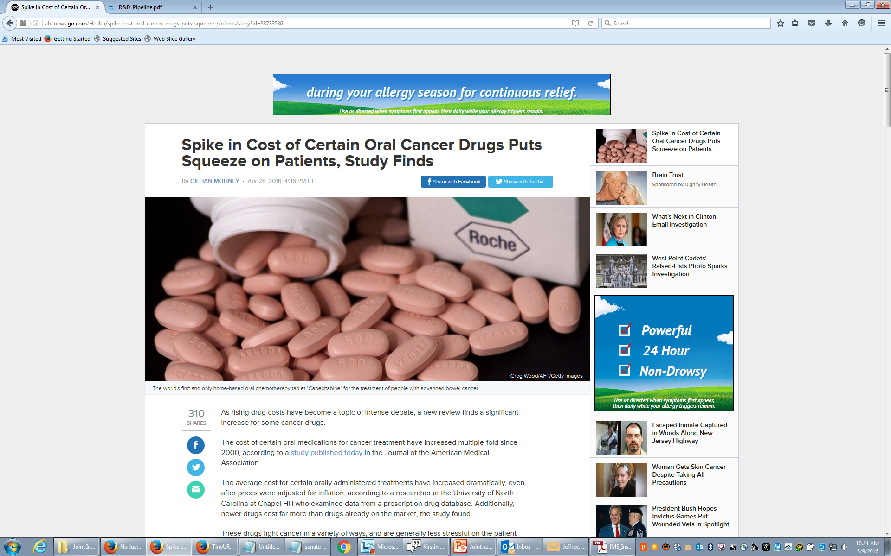
Drug costs are of concern…
There’s reason to believe the state is feeling the cost pressure of new Hepatitis C drugs like Sovaldi, drugs which California says cost $85,000 per course of treatment.
“It’s a very serious problem,” said California Health and Human Services Secretary Diana Dooley about the high cost of prescription drugs.
Dooley says drug prices are a problem for many health care payers; CalPERS, Medi-Cal and private insurers, too. The state is addressing the issue “in every way (it) can.”
http://www.reuters.com/article/us-health-cancer-costs-idUSKCN0XX21H
http://tinyurl.com/jtuawmf
http://www.nytimes.com/2015/12/20/opinion/sunday/no-justification-for-high-drug-prices.html?_r=0

Slide 3
Prescription drug costs
Price x Quantity – Rebate = Total Cost

Slide 4
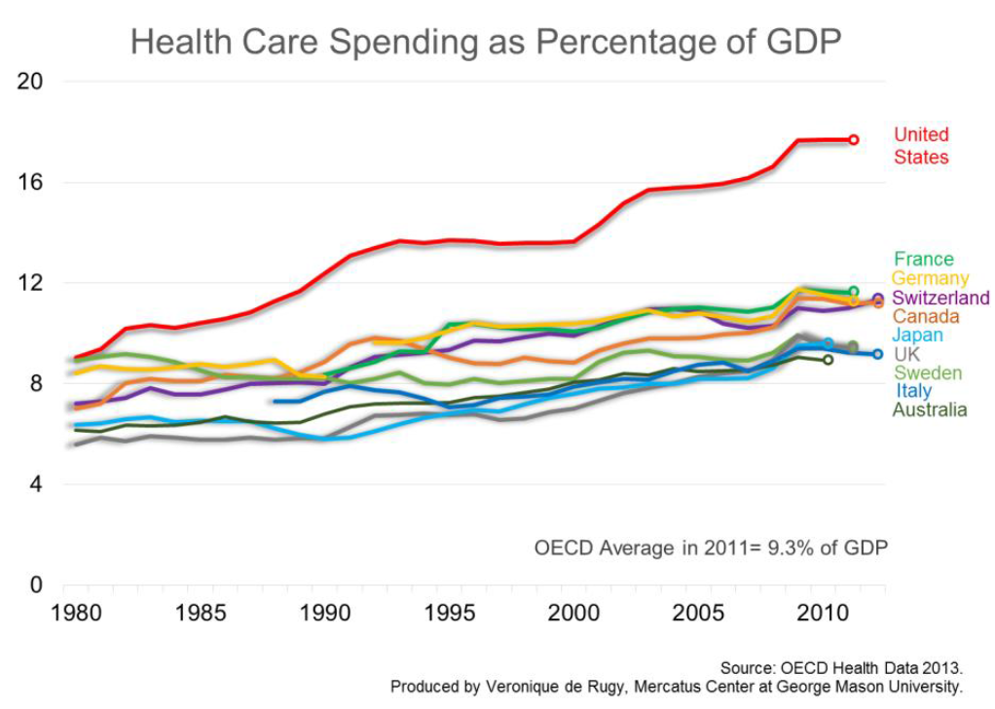
In 2011, the US spent 17.7 percent of its GDP on health care; no other OECD country reported > 11.9%.

Slide 5
US Health Care Spending More Than 2x the Average for Developed Countries
http://tinyurl.com/zkh7qv6

Slide 6
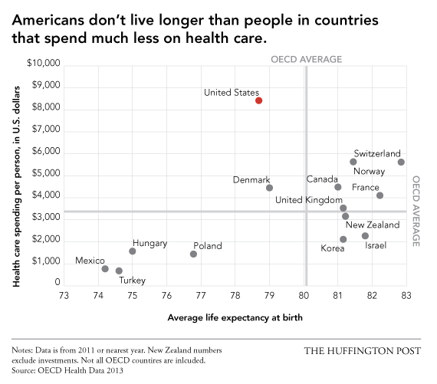
http://tinyurl.com/kl38vt4

Slide 7
Growth in prescription spending had slowed, but increased rapidly in 2014 and 2015
Average annual growth rate of prescription drug spending per capita for 1970’s – 1990’s;
Annual change in actual prescription drug spending per capita 2000 – 2014 and projected prescription drug spending per capita 2015 - 2024
Source: Kaiser Family Foundation analysis of National Health Expenditure (NHE) Historical (1960-2014) and Projected (2014-2024) data from Centers for Medicare and Medicaid Services, Office of the Actuary, National Health Statistics Group (Accessed on December 7, 2015) Note: 2014 to 2015 percent changes are calculated using 2014 and 2015 projected amounts.
http://tinyurl.com/zg256ug

Slide 8
Costly new specialty drugs are a major driver of increased health spending
Express Scripts drug spending growth trend by therapy class, 2006 -2014
Source: Express Scripts 2014 Drug Trend Report and Year in Review. Available at http://lab.express-scripts.com/drug-trend-report/
and http://lab.express-scripts.com/drug-trend-report/introduction/year-in-review
http://tinyurl.com/go8hwhb

Slide 9
Recent spending on specialty medicines increased 21.5% to $150.8Bn on an invoice price basis (2015)
http://tinyurl.com/z9vbw6z

Slide 10
http://tinyurl.com/hqdxgwl

Slide 11
How are prices determined?
Power sources and distribution of power among purchasers
Pharmaceutical manufacturers set “List Price”
Patents and exclusivity rights affect price setting
Laws and regulations alter all the marketplace
Medicaid and VA wield the most power to negotiate lowest prices (federal laws and regulations)
Medicare and private sector are limited in negotiations via formularies

Slide 12
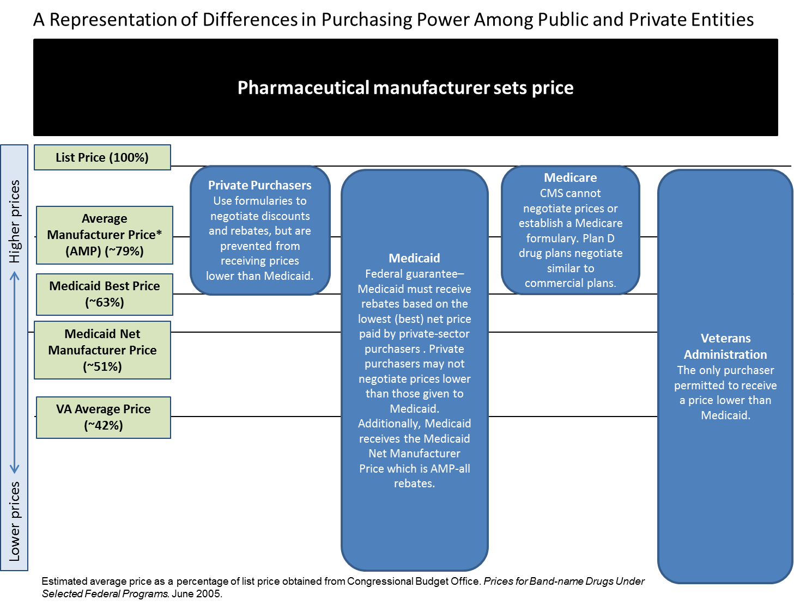
An explanation of cost uncertainty
?
Ginsburg, Ritley, Durbin, Perez and Hoch, (2016)

Slide 13
Concluding thoughts
U.S. pharmaceutical prices are among the highest worldwide.
Of particular concern are specialty drugs.
No one (except the manufacturer) knows both what the VA pays and what Medi-Cal pays.

Slide 14
State Prescription Drug Purchases. Pricing Standards. Initiative Statute.
JOINT INFORMATIONAL HEARING
SENATE HEALTH AND ASSEMBLY HEALTH
SENATOR HERNANDEZ AND ASSEMBLY MEMBER WOOD, Chairs 1:30 p.m. - Room 4202
Jeffrey S. Hoch, PhD
Professor, Department of Public Health Sciences
Associate Director, Center for Healthcare Policy and Research
University of California, Davis
Dominique Ritley, MPH
Senior Health Policy Analyst, Center for Healthcare Policy and Research
University of California, Davis
The opinions expressed here are not necessarily representative of the official positions of UC Davis or our research partners.

