Slide 1
Overview of Primary Care Workforce Needs
Increasing Access to Care under the
Affordable Care Act:
Utilizing the Health Care Continuum to Increase Access
Joint Informational Hearing of the
Senate Committee on Health
and the
Senate Committee on Business and Professions
Wednesday, March 21, 2012
1:00 – 4:00 p.m., Room 112

Slide 2
Central Issue
Expansion in primary care physician workforce is a partial solution at best. Problems include:
Geo concentration of training programs and residency placements
Insufficient emphasis on FP in HPEIs
PC pipeline will not yield numbers within ACA time frame
Maldistribution is problem not easily solved
PC physicians only one member of team

Slide 3
1st in retention of those who did residency in CA
1st in retention of those who went to med school in CA
Bad News
28th in # of residents/fellows per capita
41st in # of MD/DO students enrolled per capita
2nd oldest MDs in nation (30% over 60)
Good News
Capacity Trends
California ranks 40th in expanding its residency capacity and 25th in increasing MD/DO school capacity over 2000-2010.
Growing a California pipeline means growing a California workforce
Source: 2011 State Physician Workforce Data Book. AAMC Center for Workforce Studies.
Notes:
All data from NOVEMBER 2011. Source: 2011 State Physician Workforce Data Book. AAMC Center for Workforce Studies.
-California ranks 28th in # of residents/fellows per capita.

Slide 4
Notes:
First, explain the map. Size of the circles. Color of the circles. Healthcare designated areas.
Understand our definition of primary care: IM; FM; Peds. AAMC’s is more expansive/inclusive (includes med-peds).
Understand that it may be wrong: IM’s don’t often stay in generalist careers these days.
2003 JAMA study (Newton et al): Nationally, 1987-2002, primary care matches represented 40-50% (44% in 2002) of all med school grads entering the Match.
2008 Annals of Internal Medicine: Over 22,000 PGY-3 IM residents surveyed from 2003 to 2007 (75% of all those eligible). US MD’s: 22.8% generalists, 8.4% hospitalists, 60.4% subspecialties, 2.0% other (not IM), undecided 6.4%.

Slide 5
School | % Family | % Peds | % IM | % Other
Western | 25% | 7% | 17% | 51%
Touro | 19% | 11% | 14% | 56%
UC Irvine | 17% | 5% | 16% | 62%
Loma Linda | 14% | 9% | 15% | 62%
UC Davis | 9% | 11% | 15% | 65%
USC | 9% | 9% | 14% | 68%
UCSF | 8% | 8% | 27% | 58%
UCSD | 5% | 12% | 22% | 61%
UCLA | 5% | 6% | 27% | 62%
Stanford | 2% | 16% | 13% | 69%
Charles Drew | 0% | 12% | 18% | 71%
UC Riverside, opening in 2013, projects 50 graduates per year, with 50% going into primary care (25) and 60% of those grads (15) staying in the Inland Empire for residency.
Proportion of Total Graduates Choosing Primary Care vs Other, 2010
Notes:
In 2010, USC followed by UCSF had the highest absolute #s of graduates going into Primary Care.
Western followed by Touro had the highest proportion of their total graduates (entering the match) match into a primary care field.
And despite having roughly 20 fewer graduates over all, Western still managed to have 70 primary care graduates compared to USC’s 52.
The rows add to 100%, meaning if you look at Western, 25/7/17=49% choosing primary care, whereas 51% choosing something else.
The highest of the allopathic schools was UCSF, with 42% of its graduates headed to primary care fields. Followed by UC San Diego at 39%, and three tied at 38%: Irvine, UCLA, and Loma Linda.

Slide 6
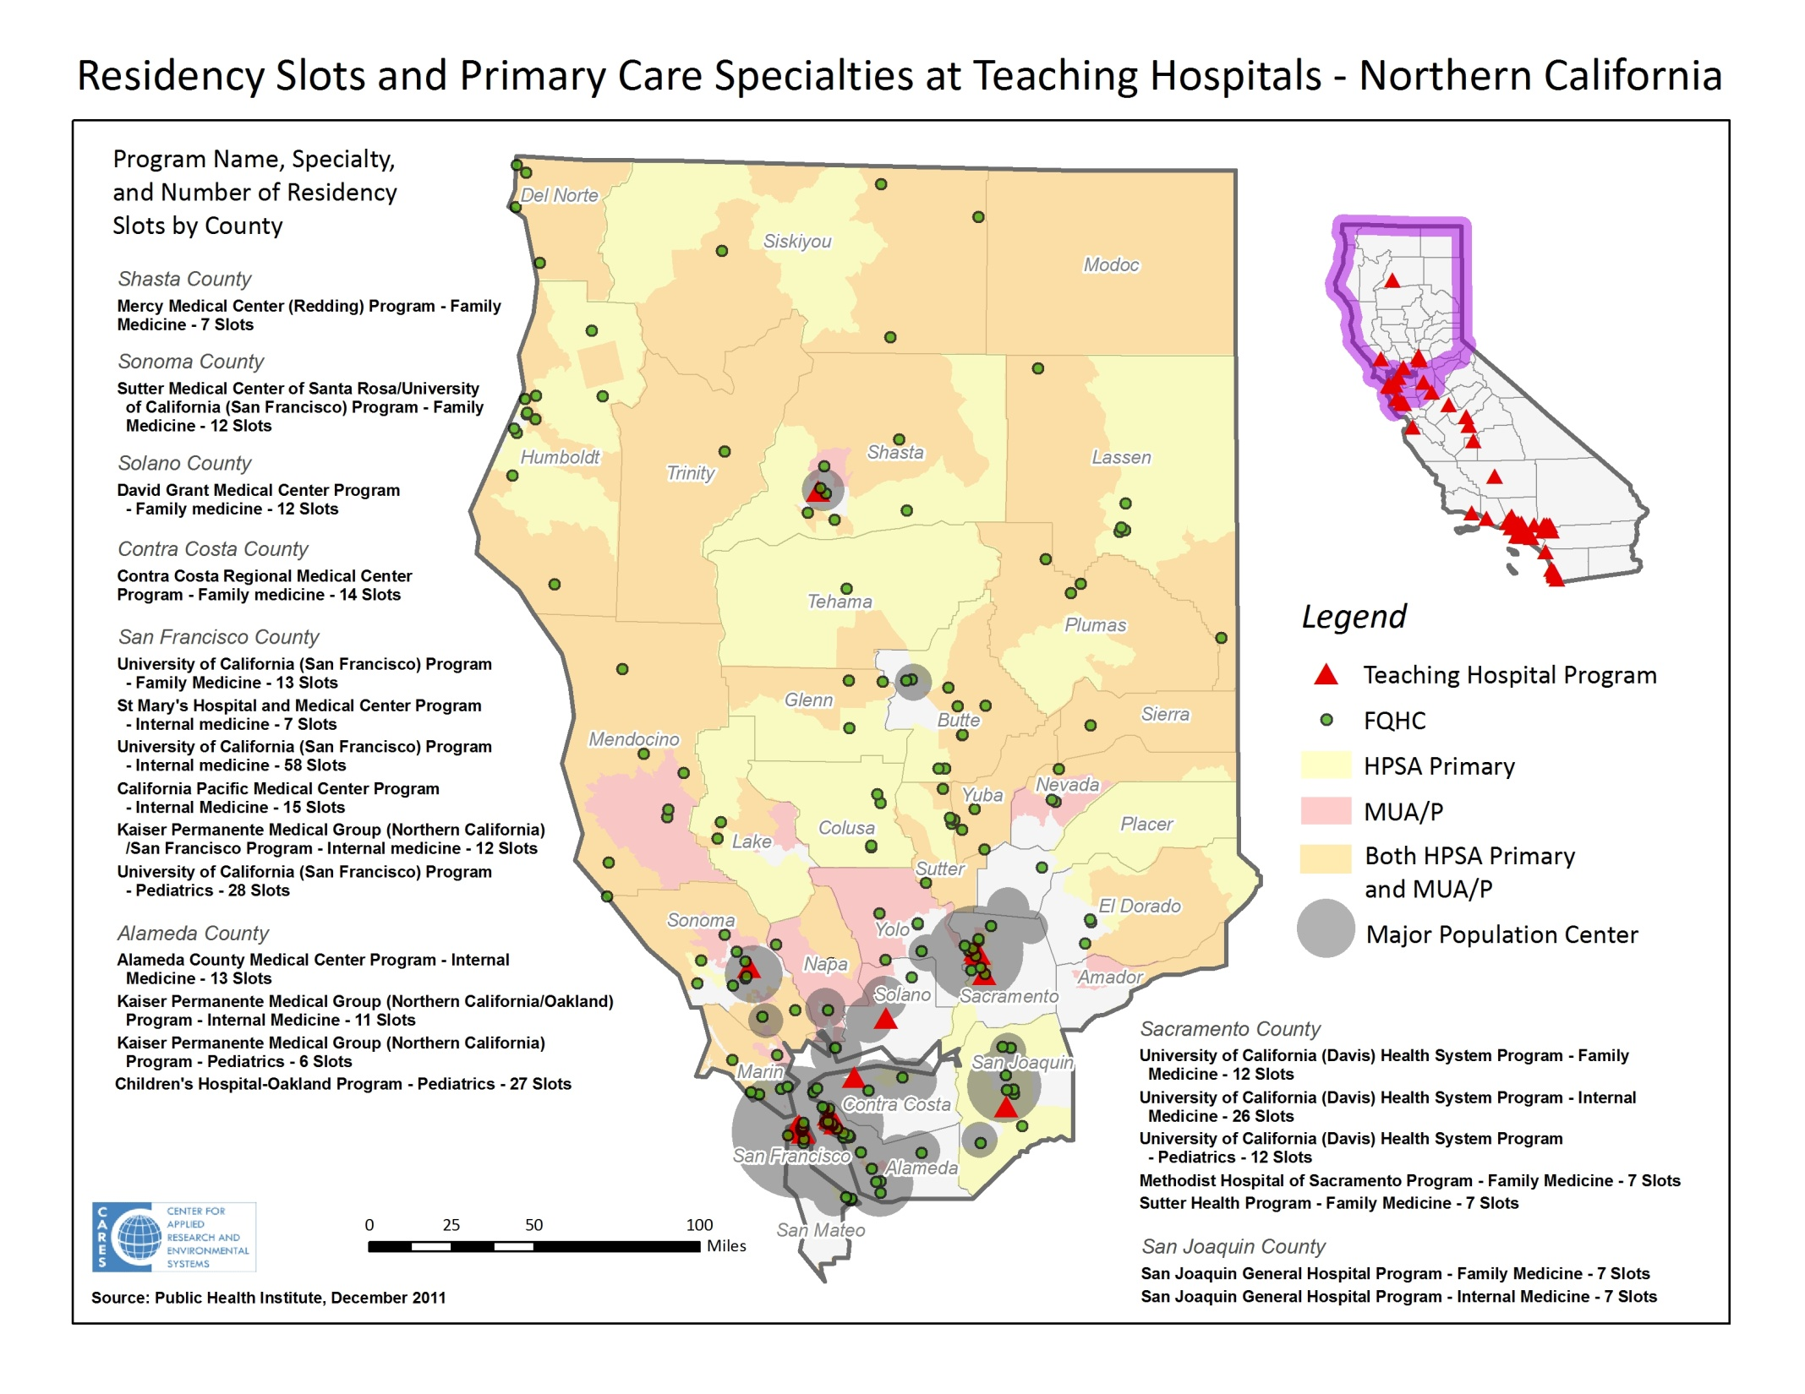

Slide 7
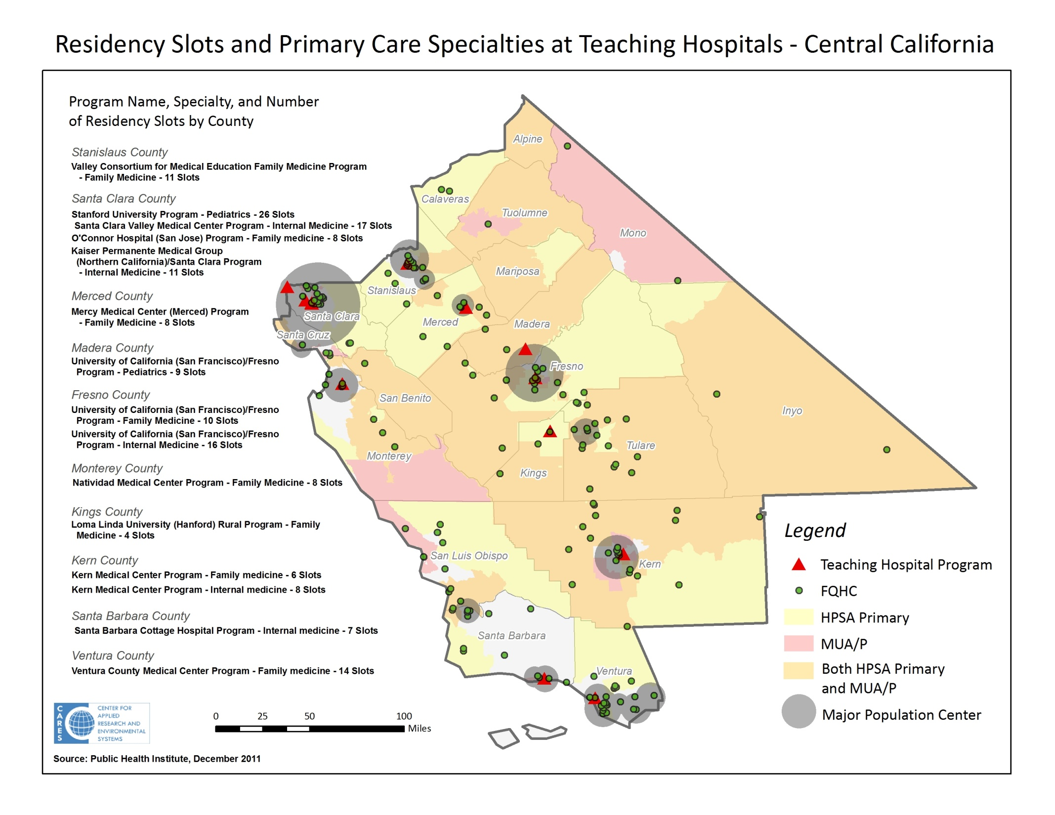
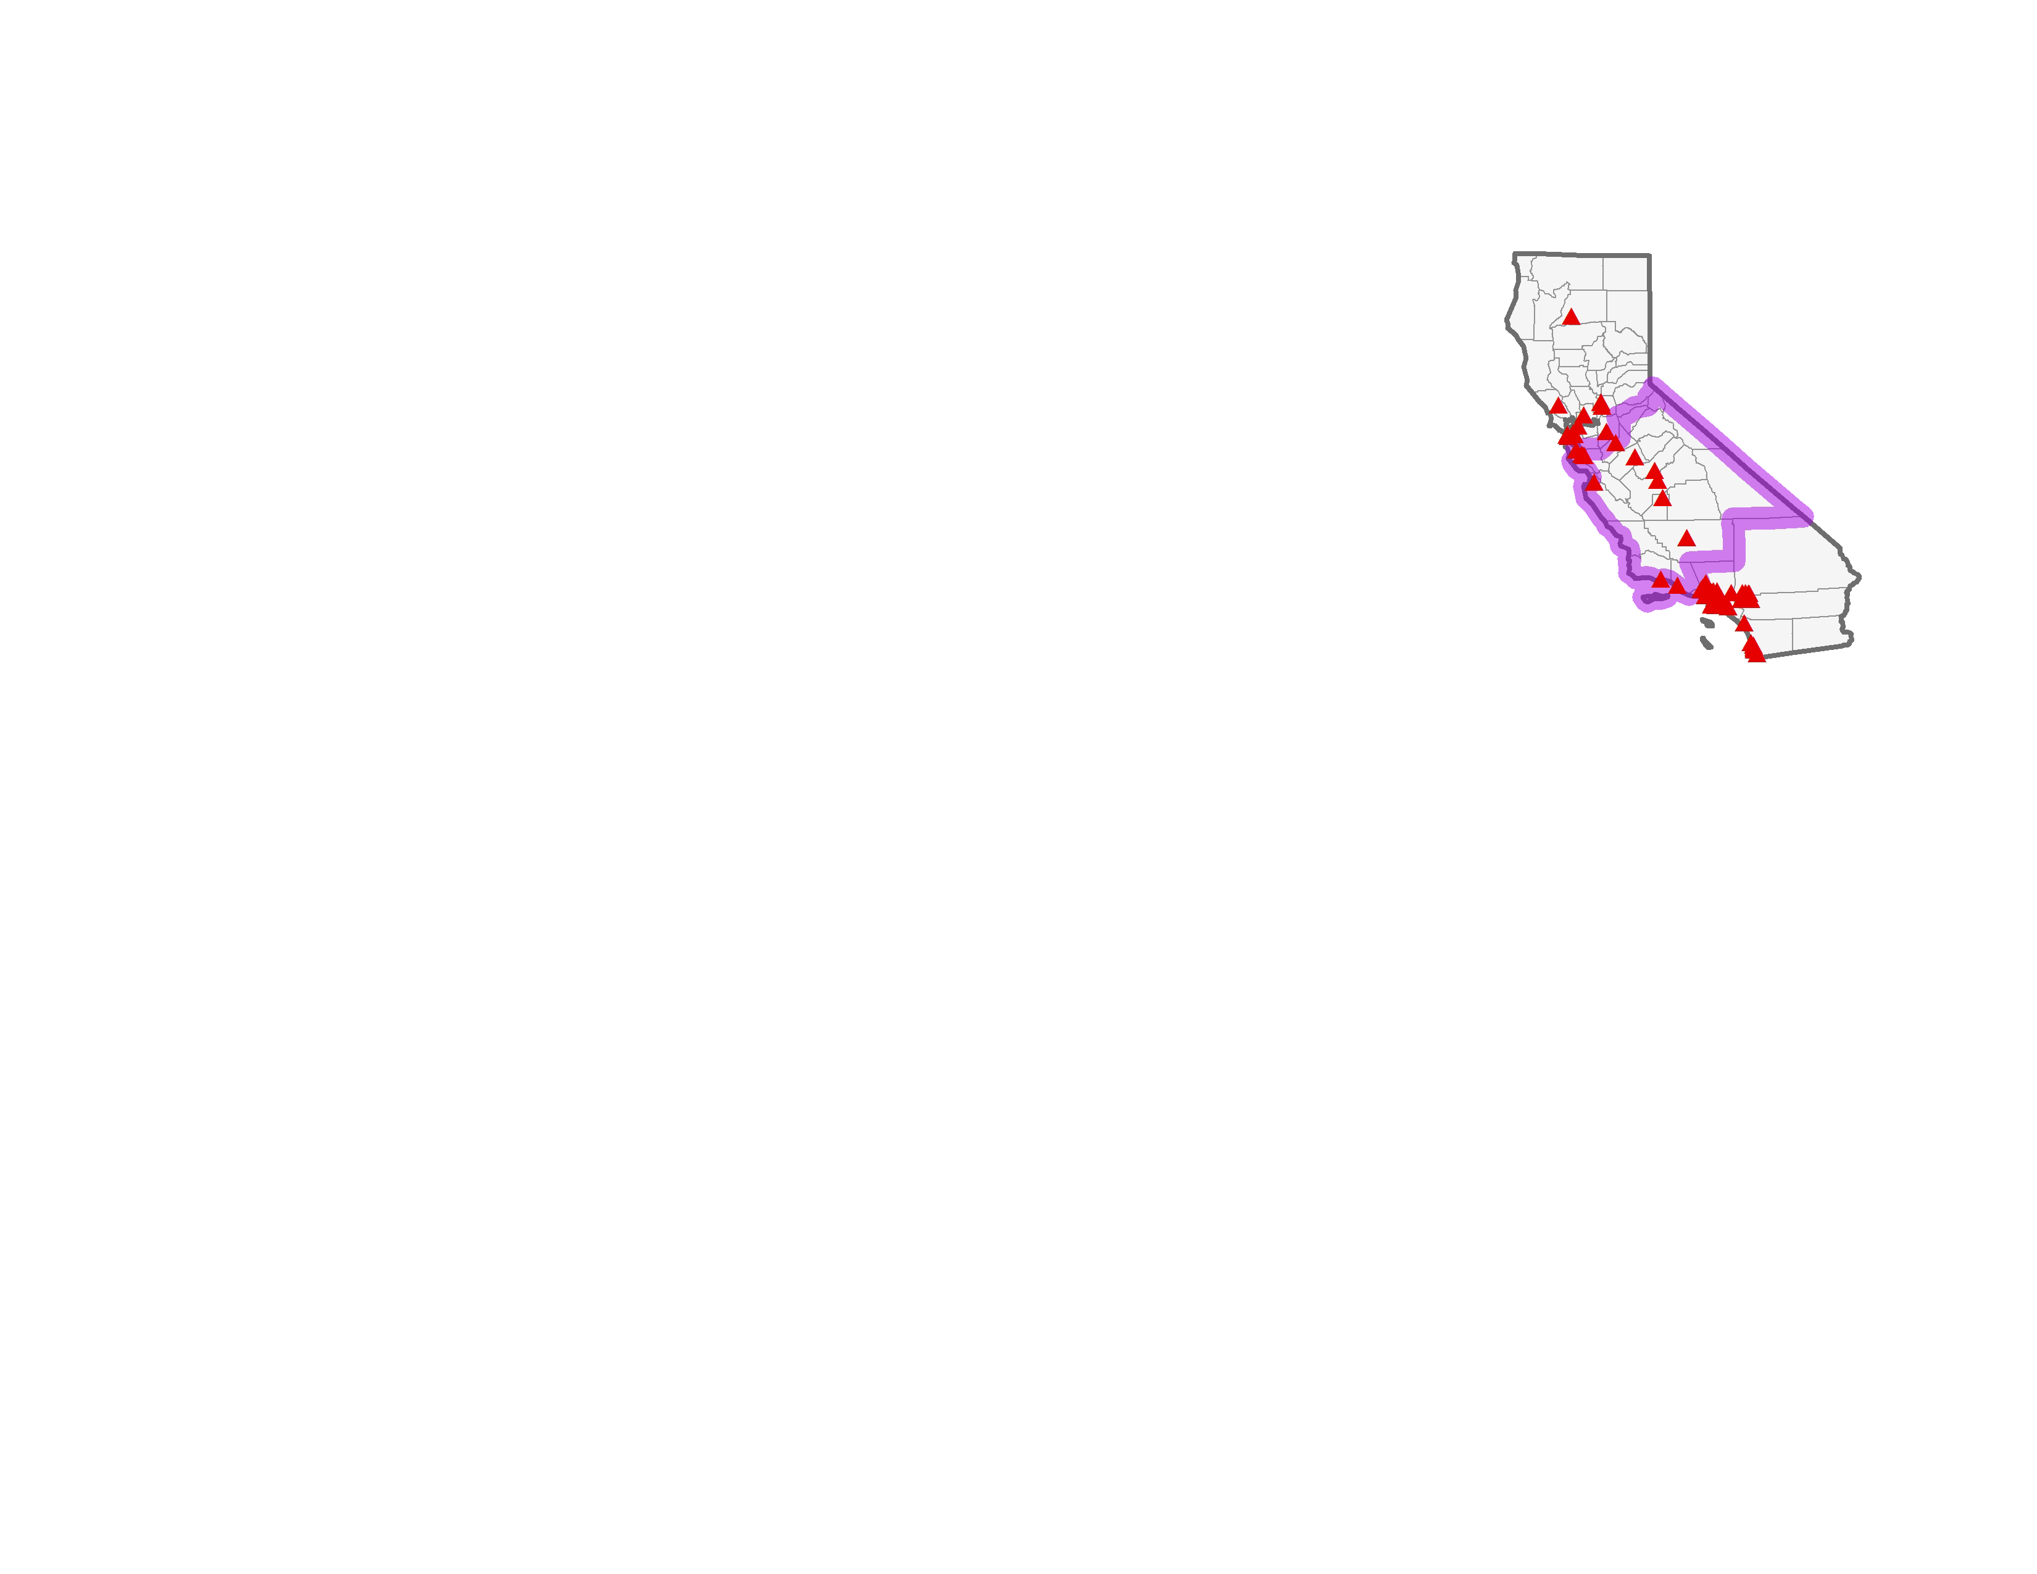

Slide 8
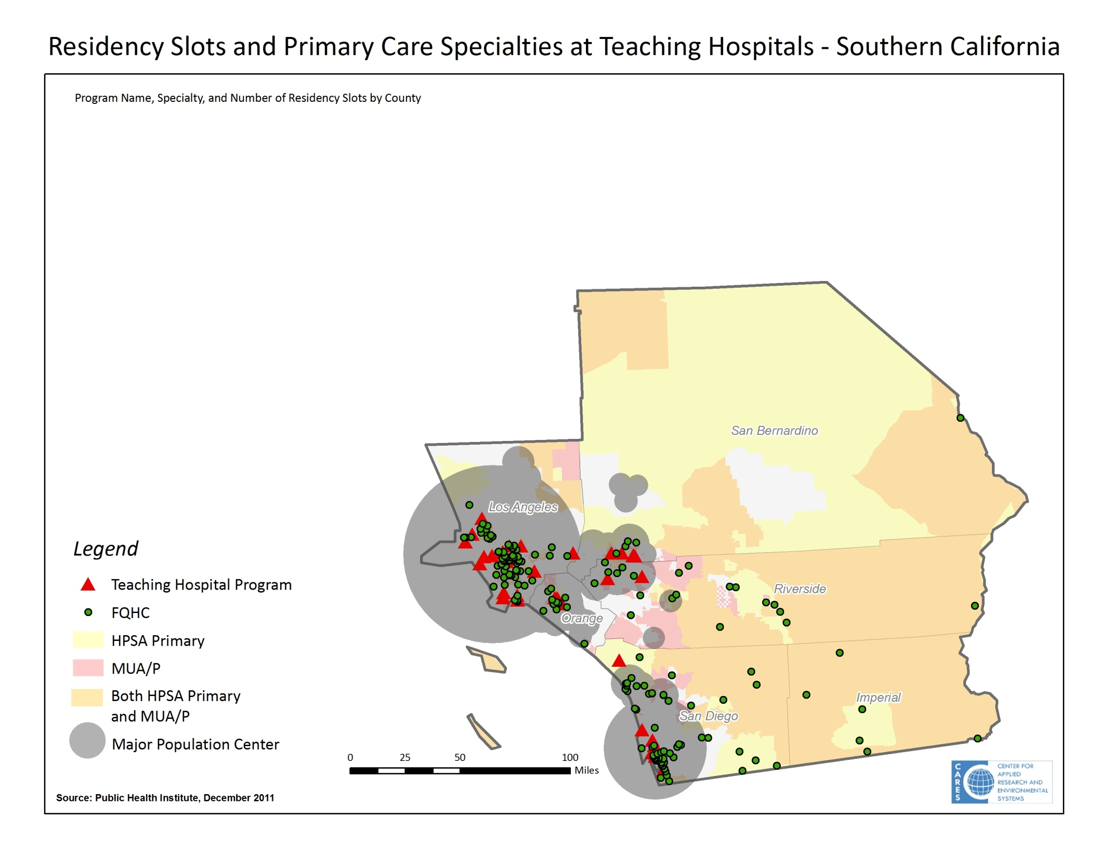
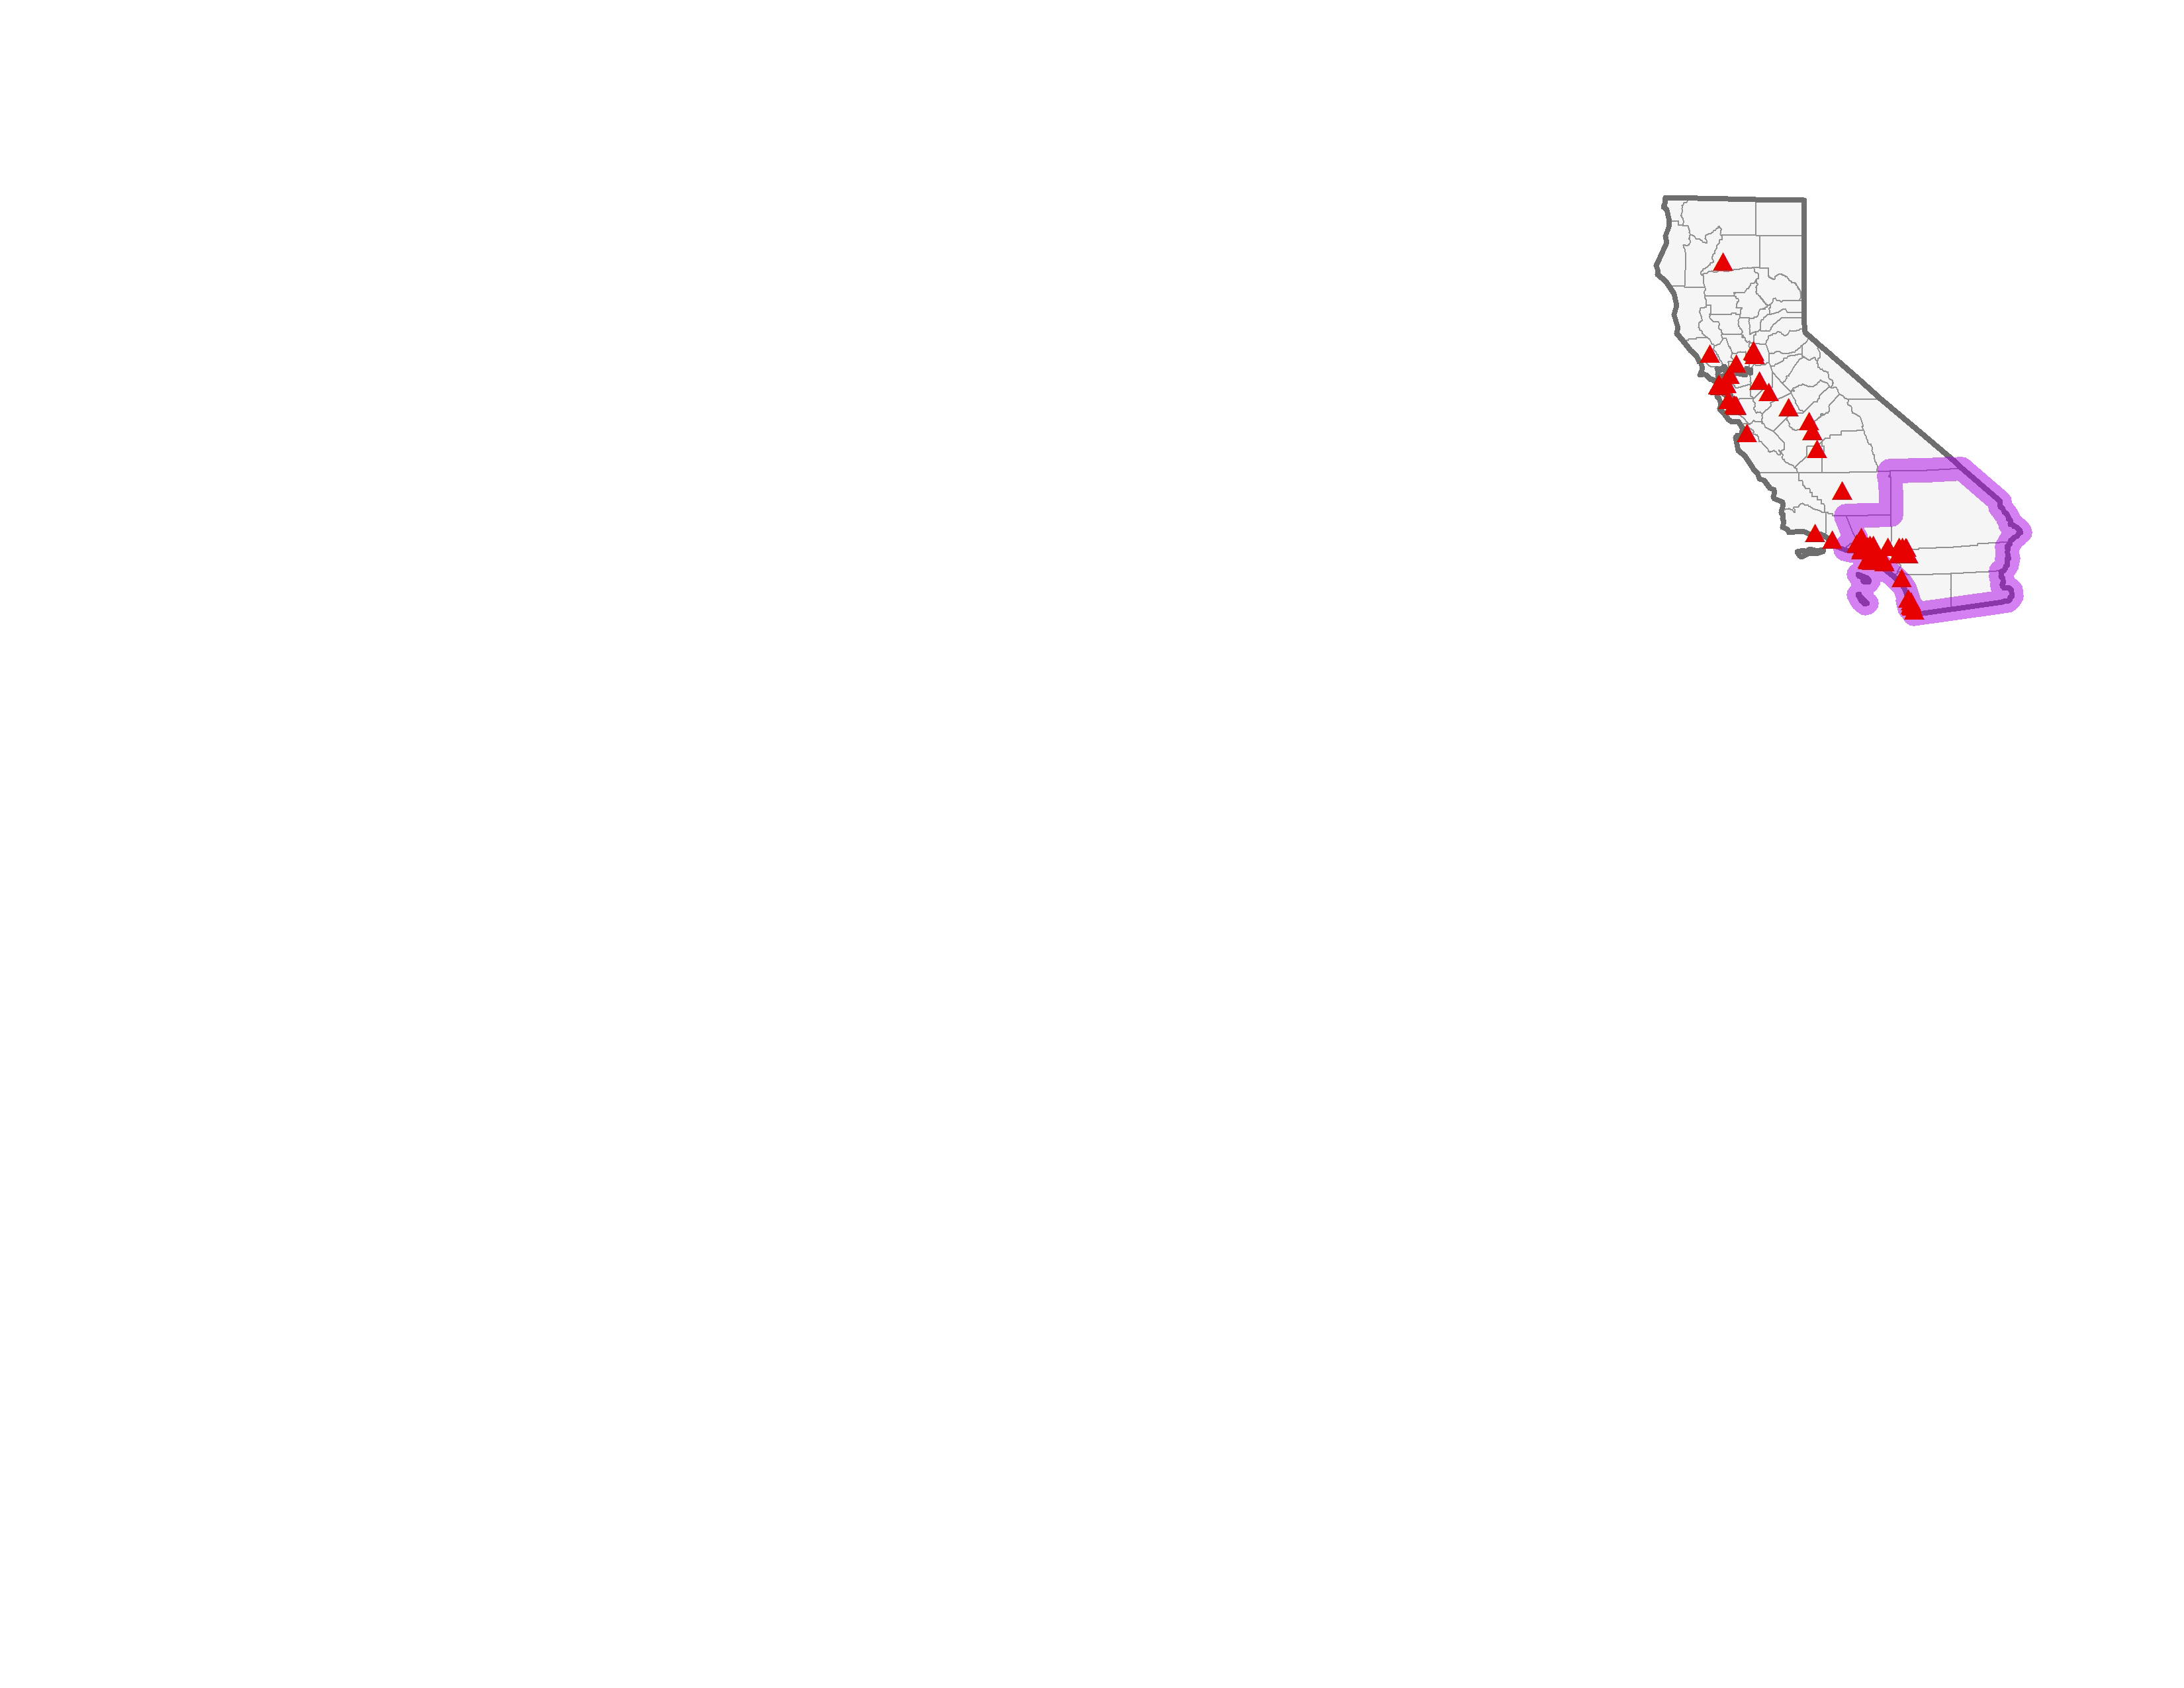
Los Angeles County
San Bernardino County
Orange County
St Mary Medical Center Program - Internal Medicine - 9 Slots
Los Angeles County-Harbor-UCLA Medical Center Program - Family Medicine - 12 Slots
Long Beach Memorial Medical Center Program - Family Medicine - 8 Slots
Los Angeles County-Harbor-UCLA Medical Center Program - Internal Medicine - 17 Slots
Los Angeles County-Harbor-UCLA Medical Center Program - Pediatrics - 11 Slots
Presbyterian Intercommunity Hospital Program - Family Medicine - 6 Slots
UCLA Medical Center Program - Family Medicine - 13 Slots
California Hospital Medical Center (Los Angeles)/University of Southern California Program - Family Medicine - 8 Slots
White Memorial Medical Center Program - Family Medicine - 6 Slots
White Memorial Medical Center Program - Internal Medicine - 5 Slots
White Memorial Medical Center Program - Pediatrics - 5 Slots
University of Southern California/LAC+USC Medical Center Program - Internal Medicine - 52 Slots
University of Southern California/LAC+USC Medical Center Program - Pediatrics - 10 Slots
UCLA Medical Center Program - Internal Medicine - 31 Slots
UCLA Medical Center Program - Pediatrics - 28 Slots
Cedars-Sinai Medical Center Program - Internal Medicine - 43 Slots
Pomona Valley Hospital Medical Center Program – Family Medicine - 5 Slots
Kaiser Permanente Southern California (Los Angeles) Program - Family Medicine - 9 Slots
Kaiser Permanente Southern California (Los Angeles) Program - Internal Medicine - 12 Slots
Children's Hospital of Los Angeles Program - Pediatrics - 26 Slots
Kaiser Permanente Southern California (Los Angeles) Program - Pediatrics - 6 Slots
Huntington Memorial Hospital Program - Internal Medicine - 6 Slots
Glendale Adventist Medical Center Program - Family Medicine - 8 Slots
Kaiser Permanente Southern California (Woodland Hills) Program - Family Medicine - 6 Slots
Northridge Hospital Medical Center Program - Family Medicine - 7 Slots
Olive View/UCLA Medical Center Program - Internal Medicine - 21 Slots
Loma Linda University Program – Family Medicine - 5 Slots
Loma Linda University Program - Pediatrics - 24 Slots
Loma Linda University Program – Internal Medicine - 26 Slots
Arrowhead Regional Medical Center Program – Family Medicine - 12 Slots
Kaiser Permanente Southern California (Fontana) Program - Family medicine - 9 Slots
Kaiser Permanente Southern California (Anaheim) Program - Family Medicine - 6 Slots
University of California (Irvine)/Children's Hospital of Orange County Program - Pediatrics - 29 Slots
University of California (Irvine) Program - Family Medicine - 9 Slots
University of California (Irvine) Program - Internal Medicine - 22 Slots
Riverside County
San Diego County
Kaiser Permanente Southern California (Riverside) Program – Family Medicine - 5 Slots
Riverside County Regional Medical Center Program – Family Medicine - 10 Slots
Scripps Mercy Hospital (Chula Vista) Program – Family Medicine - 7 Slots
Naval Medical Center (San Diego) Program - Pediatrics - 8 Slots
Naval Medical Center (San Diego) Program – Internal Medicine - 10 Slots
Scripps Mercy Hospital Program - Internal Medicine - 11 Slots
University of California (San Diego) Program – Family Medicine - 7 Slots
University of California (San Diego) Program – Internal Medicine - 27 Slots
University of California (San Diego) Program - Pediatrics - 14 Slots
Kaiser Permanente Southern California (San Diego) Program - Family Medicine - 6 Slots
Scripps Clinic/Scripps Green Hospital Program – Internal Medicine - 11 Slots
Naval Hospital (Camp Pendleton) Program – Family Medicine - 11 Slots

Slide 9
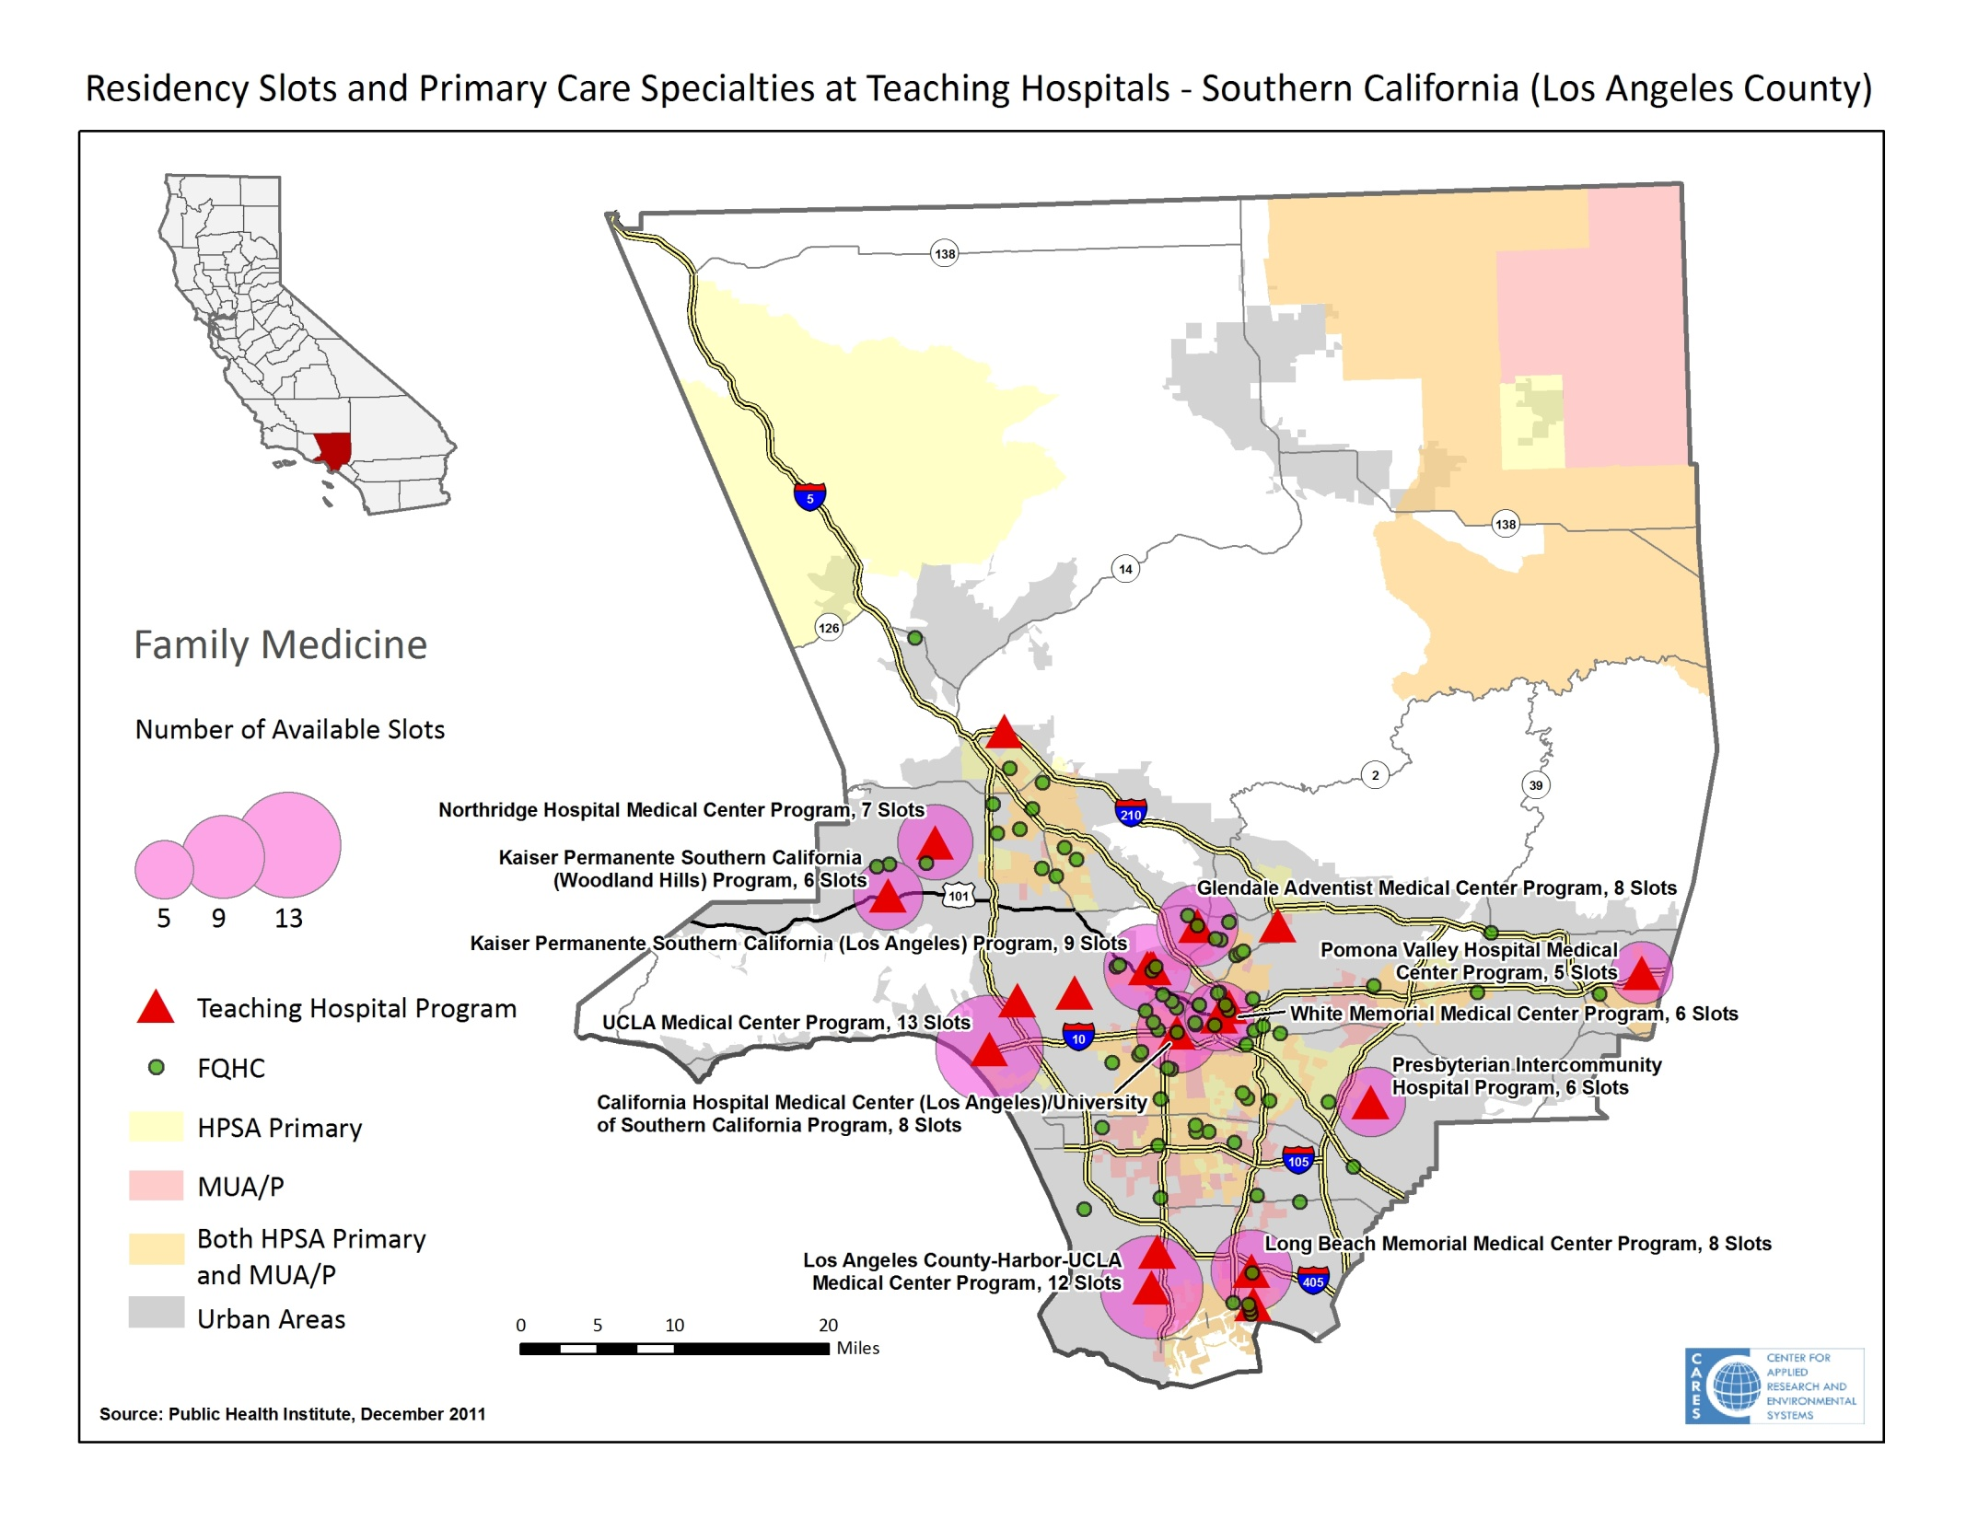

Slide 10
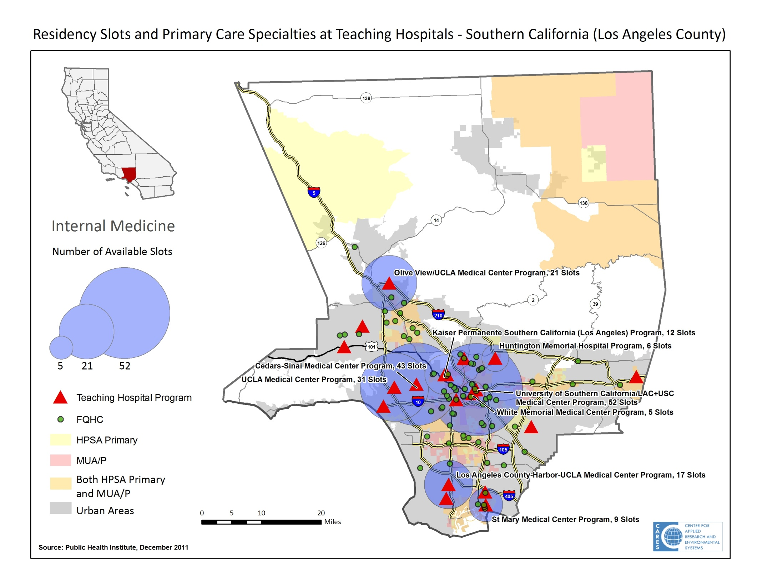

Slide 11
Do students stay?
Do they fill CA’s slots?
In 2010, 68% of CA medical school graduates matching into primary care specialities STAYED in CA.
But this means that CA medical school graduates filled only 30% of CA’s available primary care residency slots.
Notes:
The UC’s achieve a very high “stay in California” rate. Not sure if that is because of the way their student bodies are selected (focus on California residents).
Touro and Western have the lowest percentages of retaining trainees into California residency programs.
Even if every single PC grad from a CA med school stayed in California, it would still only fill 44% of the PC residency slots.

Slide 12
CHWA Primary Care Workforce Initiative Definition of Primary Care
AAFP Definition addresses diagnostic, treatment, prevention, and population health elements – interdisciplinary team, including:
Primary care physician
Advance practice and RNs
Physician Assistants
Allied HPs such as nutritionists, physical therapists
CHWs/Promotores
Oral health professionals
Mental/behavioral health professionals
Public Health professionals

Slide 13
CHWA Primary Care Workforce Initiative Overarching Goal
Ensure that CA has a well-trained, diverse PC workforce of sufficient size, geographic distribution, and capabilities to achieve health access, quality, affordability, and desired outcomes for our growing, aging, and increasingly diverse populations.

Slide 14
Goal 1
Increase primary care career awareness to expand the pool of qualified, diverse candidates available to meet projected needs
Develop comprehensive marketing plan that conveys a compelling case and vision for primary care.
Build educational capacity in K-12 to provide knowledge of the full spectrum of primary care-related health careers.
Public policies that increase support for ongoing education on the importance of primary care and prevention

Slide 15
Goal 2
Increase recruitment/retention of PC teams in underserved areas
Increase loan repayment and scholarships for PC, incl. Steven Thompson & State Loan Repayment Programs.
Streamline and simplify process for students and increasing awareness and participation by sites.
Reduce barriers to recruitment of PC team members in underserved areas.
Expand partnerships between training programs and employers to align education with workforce needs.

Slide 16
Goal 3
Increase access for UR students to in PC training programs with emphasis on emerging delivery models.
Assess PC training program capacity and geographic distribution to establish baseline relative to current and projected needs.
Assess cost-effectiveness of current programs(cost, time to degree) for all PC career tracks, and ID regulatory impediments to innovation.
Build support for programs that produce the most significant increase in primary care capacity and diversity.
Support increased mentorship and support systems to retain student interest in PC and practice in underserved communities.

Slide 17
Goal 4
Increase the number of CA PC residencies in non-acute settings and in areas of unmet need.
Develop incentives for residency programs to increase diversity and practice in underserved communities.
Increase residency opportunities and transition to practice programs for multiple provider types.
Increase funds for Song Brown and State Loan Repayment Program.
Incentivize and hold state-funded programs accountable to produce PC graduates. Use metrics for funding allocation.
Advocate for increased residencies and funding through allocation of residency slots unused by other states.

Slide 18
Goal 6
Develop new financing and delivery models that clarify the role and functions of team members, increase productivity, and meet access, quality, and outcome goals.
Convene stakeholders working on new models of PC care for ongoing dialogue and sharing of emerging lessons.
Develop, pilot and evaluate primary care practice transformation initiatives and demonstration projects, including:
Test new delivery models for team based PC; assess impact on team member roles, training needs. Ensure engagement at full scope of practice. Where appropriate, secure waivers to evaluate impact of expanded roles.
Pilot technologies that support team based care and enhanced payment to enhance attractiveness and primary care provider success and satisfaction.

Slide 19
A sampling of Findings & recommendations
HWDC Career Pathways Subcommittee

Slide 20
Physician Assistants
Barriers
Recommendations
Limited financial assistance
Limited options for rotations, preceptors, class size
Lower pay for PC, perception that not exciting
CMS ACO language limits ability to practice full scope
Financial incentives for PC, practice in MUAs, HPSAs
ID CHC-based residencies
Incentives for preceptors (e.g., CME credits)
Marketing strategy
Revise or secure waivers from ACO regulations

Slide 21
CHWs/Promotores
Barriers
Recommendations
No systematic knowledge of roles and contributions
Lack of defined roles and career pathways
Lack of infrastructure and dedicated funding
Lack of basic skills among applicant pool
Provider resistance; lack of understanding of pop health contributions
Statewide assessment and evaluation (CHWA planned)
Coordination and refinement of CCC and regional training program roles –certification
Increase DOL training support, incl. accel. ESL
Training needed for other members of PC team

Slide 22
Summary
Dramatic increase in enrollment will require substantial adjustments in delivery models.
Essential to integrate medical care and place-based, population health improvement.
Opportunity to link job creation and health care transformation, with focus in low income, diverse communities.
Policymakers can be helpful in
Establishing financial incentives
Ease regulatory obstacles to innovation
Investment in higher education

