Slide 1
Clinical Approaches to address the Obesity epidemic
Ken Fujioka, M.D.
Director of Nutrition and Metabolic Research
Director of The Center for Weight Management
Scripps Clinic
La Jolla, California

Slide 2
Pathophysiology of Obesity Why is it so hard to lose weight?
Need to know how humans regulate weight to understand the treatment options
Patient A
48 year old with a sedentary job
Weight 150 pounds
Develops lower back pain and is placed on prednisone (steroids) to decrease inflammation in compressed nerve causing severe pain
Patient on “the steroids” for 2 months and unable exercise for 6 months and gains 50 pounds
The patient is now a “pre-diabetic”
If the patient is Asian or Hispanic will see pre-diabetes emerge with less weight gain (20 to 30 pounds)

Slide 3
Motivated patient trying to lose weight
The patient recovers from the back injury and decides to lose weight
The patient begins a diet and exercise program
The patient loses about 20 pounds (over 3 mos)
200 down to 180
Despite staying on the diet and exercising 2 to 3 days a week the patient stops losing weight
A few months later the patient notes that the weight is starting to slowly go up

Slide 4
Weight regulation in Humans
The human body is hardwired to know how many fat cells are on board and to keep the body weight stable
At about 5% to 10% of weight loss the human body will respond by:
Lowering metabolic rate (more than 5%-10%)
Lower the hormones that signal satiety or fullness after eating
Increase thoughts and hormones to make humans seek out and eat more food
All part of a defense of body weight to survive
This does not get better with time (always trying to get back to that highest weight)
Sumithran P et al. N Engl J Med. 2011;365:1597-1604

Slide 5
The good news on 5% to 10% weight loss
Sustained weight loss of 3%-5% is likely to result in clinically meaningful reductions in triglycerides, blood glucose, HbA1C, and the risk of developing type 2 diabetes;
Greater amounts of weight loss will reduce BP, improve LDL–C and HDL–C, and reduce the need for medications to control BP, blood glucose and lipids as well as further reduce triglycerides and blood glucose.
Jensen MD, et al. 2013 AHA/ACC/TOS Obesity Guideline

Slide 6
Treatment options
Diet and lifestyle changes
This includes exercise
this applies to all overweight patients
Diet, lifestyle changes, and wt. loss medications
This applies to most overweight patients
(70% to 90%)
Bariatric surgery
This applies to less than 10% of the California population
7% ?

Slide 7
Diet and Lifestyle
Commercial programs
They work
Have low retention (22% at 26 weeks, 6.6% at 1 year)*
Smart phone applications
On line programs
Unusual fad diets
Meal replacements
Typical weight loss of 5% to 10%**
*CB Finley et al. Inter J of Obesity (2007)31,292-298
** NS Mitchel et al. Obesity (2011)19,568-573

Slide 8
Lifestyle Modification and Pharmacotherapy for Obesity
The hard part is combining diet and lifestyle
changes to weight loss medications
0
2
4
6
8
10
12
14
16
Sibutramine alone
Weight Loss (kg)
Lifestyle modification alone
Sibutramine + brief therapy
Combined therapy
0 3 6 10 18 40 52
Week
Wadden TA, et al. N Engl J Med. 2005;353(20):2111-2120.
Notes:
8

Slide 9
Older: Weight loss Medications
Phentermine approved for short term use
Approved for 12 weeks
From the stimulant class of weight loss agents
Inexpensive (10 to 20 dollars per month)
Orlistat over the counter
Approved for long term use
Fat blocker
Relatively weak weight loss agent with side effects most patients are not comfortable with
Very safe
50 to 70 dollars per month

Slide 10
Newer Weight loss Medications (approved 2012)
Phentermine-topiramate combination
Approved for long term weight maintenance
10 % or more weight loss in most patients
Significant side effects
Has REMs program
Can potentially harm the fetus in a pregnant woman
Lorcaserin
Approved for long term weight maintenance
10% weight loss in Responders (about 50% of pts respond)
Low number of side effects

Slide 11
Medications that may be approved in 2014 (both medications are available for other indications)
Bupropion-naltrexone
Combination depression medication with opiate blocker
5% to 10% weight loss
Will have safety data in high risk cardiovascular patients
Liraglutide –
approved for Diabetes
5% to 10% weight loss
Will be particularly useful in patients with pre-diabetes and diabetes

Slide 12
Medications: Risks and benefits
Responder rates (if they don’t respond stop the med)
New and helps ensure better weight loss
If a patient does not lose 5% of their weight by 3 months then the physician is to stop the medication
Improves outcome and lowers risk (because you stop the medication)
REMS (Risk Evaluation Management Strategy)
Ensures that only the correct patient gets the weight loss medication
Example: The weight loss medication is only available at Specialized pharmacies that make sure the patient is appropriate for the mediation. Say the medication causes birth defects then the pharmacy would alert the patient and make sure they do not get pregnant

Slide 13
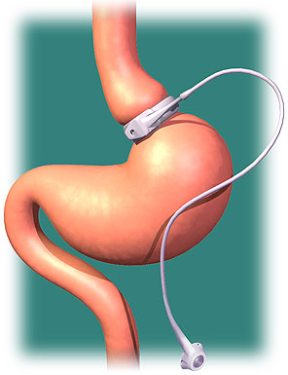
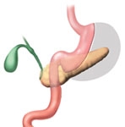
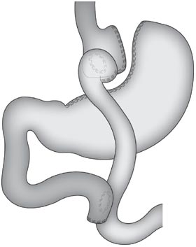
Current Surgical Options
Laparoscopic Gastric Bypass
Laparoscopic Gastric Band
Laparoscopic Sleeve Gastrectomy
25% to 30% weight loss
20% to 25% weight loss
Notes:
13

Slide 14
Does it pay to do bariatric surgery?
It is quiet clear that bariatric surgery will dramatically improve diabetes and related metabolic disease (and yes weight loss)
It does this by changing the hormones that control weight
Unfortunately these procedures carry a risk of surgical morbidity and mortality
When patients were followed for 6 years after surgery, overall health costs were not reduced #
There is a recommendation to limit surgery to patients with morbid obesity and a significant co-morbidity such as diabetes or severe orthopaedic problems *
#Weiner et al. JAMA Surg 2013; 1–8
*Livingston. JAMA. 2013. DOI: doi:10.1001/jamasurg.2013.1515

Slide 15
Summary
Treatments
Percent weight loss
Diet and Lifestyle
Long term weight loss maintenance*
Diet, Lifestyle, and Medications
Long term weight loss maintenance *
Bariatric surgery
Long term weight loss maintenance*
5% weight loss
20 percent
5% - 10% weight loss
Approximately 50 to 70%
25% weight loss
80%
Long term = 2 years
*Handbook of Obesity Fujioka chapter 37 2008 Editor George Bray

