Slide 1
Obesity : Implications for Hospitals Report to the Senate Health Committee Sacramento, CA February 12, 2014
Paveljit S. Bindra, MD, MBA, MSc, FACC
Chief Medical Officer & Chief Information Officer
Citrus Valley Health Partners

Slide 2
Agenda
Obesity—Perspectives
Medical Issues & Treatment
Hypertension
Diabetes
Surgical Costs
Physical Plant Issues
Beds
Diagnostic Imaging
Transport
Human Resources Issues
Workers’ Compensation
Injuries
Staffing Requirements
Community Interventions & Initiatives

Slide 3
Perspectives
Obesity is responsible for ~5-10% of total health expenditure in the US
Obesity = BMI >30 kg/m²
US Prevalence is 32%
Including production losses, accounts for >1% of GDP.
Obesity determinants
Industries supplying lifestyle commodities
Government policies : agriculture, transport, urban planning
Changing work conditions
Notes:
There is increased pvt transport use, scarce opportunity for physical activity, decreased physical activity at work, higher stress and job insecurity, longer working hours for some jobs

Slide 4
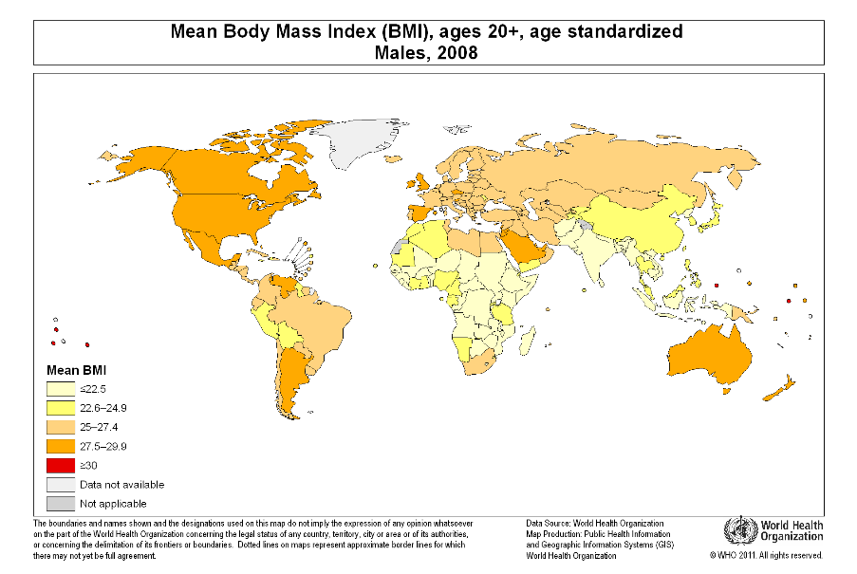
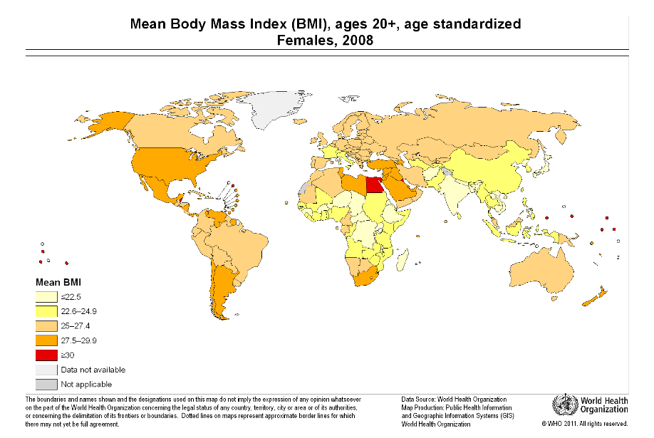
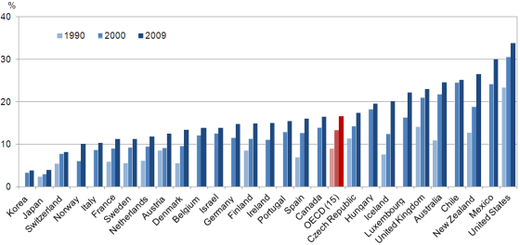
Trends in Obesity
http://www.downeyobesityreport.com/2012/06/the-global-obesity-picture/

Slide 5
Obesity Trends Among US Adults
CA Obesity Rate 24%
Source: Center for Disease Control (www.cdc.gov)

Slide 6
Medical Issues
Comorbidities include
Diabetes
Coronary Artery Disease
Hypertension
Dyslipidemia
Sleep apnea
Musculoskeletal problems

Slide 7
Treatment
Treatment goal : negative energy balance
Very low calorie diet
Physical activity > 250 min/wk
Behavior modification
Pharmacotherapy to target
Fat absorption (Orlistat)
Appetite suppression (Sibutramine)
Metabolic upregulation (Phentermine)
Bariatric Surgery
Reserved for BMI >35 with co-morbidities
Restrictive and malabsorptive procedures to decrease amount of food entering the stomach
Sustainable weight loss
Notes:
Behavior modification involves self monitoring, problem solving, stimulus control, relapse prevention, goal setting, social support, cognitive restructuring
Surgeries includeRoux-en-Y (gastric bypass), vertical band gastroplasty, adjustable gastric banding, biliopancreatic diversiion), etc

Slide 8
Physical Plant/Equipment Demands
Wider wheelchairs: 2x cost increase
Heavy-duty stretchers/beds: 3x cost increase
Larger blood pressure cuffs
Bigger beds with higher weight capacity
Larger CT scanners and MRI machines
Ambulances: Reinforced stretchers and winches
New toilets to accommodate 500 pounds
Equipment to Accommodate Obese Patients | Average Cost
Radiographic/Fluoro Unit | $ 650,000
Large Operating Table | $ 33,000
Bariatric Bed | $ 22,500
Motorized Bariatric W/C | $ 5,500
Extra Wide Stretcher | $ 4,300
http://www.hospitalmanagement.net/features/feature93179/
http://www.nyc.gov/html/hhc/html/newsletter/201207-bariatric-surgery-centers.shtml

Slide 9
Treating Patients of Size
Manual movement of patient by staff or
use of lift equipment
Delayed or adjusted treatment plan
Increased risk to move patient
Fees and non-reimbursement for
Bedside, commode, wheelchair
Overhead rail to transfer patient
30-40% patients at CVHP with a BMI >30
85% of the time there are patients between 400-500 lbs
46% of the time there are patients >500 lbs

Slide 10
Scope of Worker Injuries
Moving patients and related physical activity often results in MS injuries for healthcare workers
Increase in patient falls
Cost of workers compensation claims
Lost time from work
MS injuries often require surgery
PACA empowers employers to battle obesity
Premium increase of 30-50% to incentivize wellness programs*
* http://www.forbes.com/sites/rickungar/2012/04/30/obesity-now-costs-americans-more-in-healthcare-costs-than-smoking/

Slide 11
Injury Prevention Programs
California’s Hospital Patient and Health Care Worker Injury Protection Act requires hospitals to:
Develop and maintain a Safe Patient Handling Policy
Assess equipment needs and purchase equipment as necessary
Overhead lifts, transfer sheets, portable lifts
Conduct data analysis and respond accordingly
Conduct training for all employees who may be present in patient care units
Safe Patient Handling & Movement; Optimal Review, Spring 2012, Vol 9, Issue 1

Slide 12
Stepping Up To The Challenge
Hospitals as the locus of population health
Community Initiatives
Lighten Up San Gabriel Valley
Outreach/Coaches
Community Runs
Let’s Move.gov
School outreach to reduce childhood obesity

Slide 13
Questions and Comments

Slide 14
Back Up Slides

Slide 15
Obesity/Overweight
Rate of obesity/overweight in service area:
Overweight adults – 36.4% (Calif. 26.4%)
Adult males (21.5%) Adult females (21.3%)
Obese youth – 30.6% (Calif. 29.8%)
Hispanic/Latino youth – 35.2%
Overweight youth – 15.1% (Calif. 14.3%)
Significant youth obesity rates in Baldwin Park (40.7%) and South El Monte (44.6 to 45.3%)

Slide 16
Obesity/Overweight
Associated drivers/factors:
Cardiovascular Disease
Clinical Care (97.9 per 1,000 preventable hospital admissions
Access to Care (lack of primary care physicians)
Diabetes
Hypertension
Colorectal Cancer
Behavioral (physical activity)
Physical Environment (fast food restaurants, grocery stores)
Social/Economic (free or reduced price for school lunches)
Notes:
Note on lack of PCP in service area – lack 68 PCP in our service area (we are actively recruiting); in addition, most specialists are needed as well.

Slide 17
Healthy Community Resource Program
Began in 2012
Education, support, community resources for health living
Not a diet or meal plan
Comprehensive program with three components:
Education, Web, Weigh-in Event
Notes:
Offers education, support and resources to those living and working in the San Gabriel Valley who want to lose weight in a healthy way
NOT a diet or meal plan
Comprehensive program with 3 main components

