Slide 1
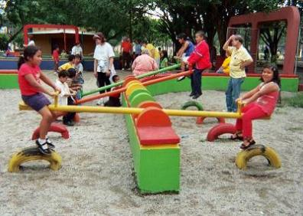

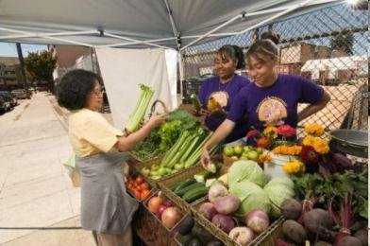

Building on What Works:
Prevention in California
Manal J. Aboelata, MPH
Managing Director
Prevention Institute
Prepared for the Senate Committee on Health Oversight Hearing
Wednesday, February 12, 2014
www.preventioninstitute.org

Slide 2

Reframing
the nutrition & physical activity debate
...to corporate
& government
responsibility
from simply a matter
of individual choice...
www.eatbettermovemore.org
NPA1038_Taking Action Show

Slide 3
Steering Committee
CANFIT: Communities, Adolescents, Nutrition, Fitness
California Center for Public Health Advocacy
California Food Policy Advocates
California Pan-Ethnic Health Network
Change Lab Solutions
California Parks and Recreation Society
California Project LEAN
California WIC Association
Child Care Food Program Roundtable
Latino Health Access
PolicyLink
Prevention Institute
The Samuels Center
PILM3020-12 11/02
Notes:
The Steering committee of the Strategic Alliance establishes the overall program & campaign directions for the Alliance. The Steering Committee is currently comprised of 10 organizations:
California Adolescent Nutrition and Fitness Program (CANFit) is a nonprofit organization that works throughout California to engage communities and build their capacity to improve nutrition and physical activity among multi-ethnic adolescents.
California Food Policy Advocates is a private nonprofit organization dedicated to improving the health and well-being of low-income Californians by increasing their access to nutritious and affordable food.
California Pan-Ethnic Health Network (CPEHN) is a statewide network of multicultural health organizations working together to improve health care access and eliminate health status disparities in California's communities of color.
California Project LEAN works with state and local physical activity and nutrition leaders to conduct statewide programs such as the Food on the Run program, which trains teens on healthy eating and physical activity and prepares leaders to serve as policy change agents in their schools and communities.
California WIC Association (CWA) is a nonprofit organization formed by directors of local WIC agencies to represent all parties interested in the operation of the Special Supplemental Nutrition Program for Women, Infants, and Children (WIC).
Center for Public Health Advocacy is a nonpartisan nonprofit organization dedicated to raising awareness about critical public health issues and mobilizing communities to support the establishment of needed policies and programs in California.
Child Care Food Program Roundtable promotes health and well-being of children in child care through providing leadership and advocating for an enhanced and expanded CCFP.
Latino Health Access (LHA) is a non-profit organization that takes a unique, holistic, and positive approach to working with medically under-served communities by promoting health, preventing disease, and improving access to safe health care.
Prevention Institute is a nonprofit, national center dedicated to improving community health and well-being by building momentum for effective primary prevention. Prevention Institute is currently coordinating and staffing the Strategic Alliance.
Samuels & Associates,Inc. is a health research, policy and evaluation consulting firm that specializes in strategic planning, program development and multi-site program evaluation in the areas of health promotion and disease prevention; specific areas of expertise span women's health, nutrition and fitness, community health, and policy issues in public health.
In addition to the steering committee, the Alliance has several ad hoc subcommittees that develop strategies in physical activity promotion, policy development and media outreach.

Slide 4
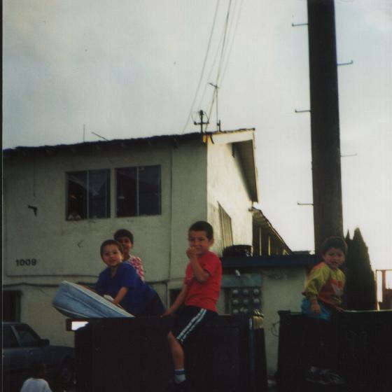
Santa Ana, CA: We need parks!
Photo Courtesy of Latino Health Access

Slide 5
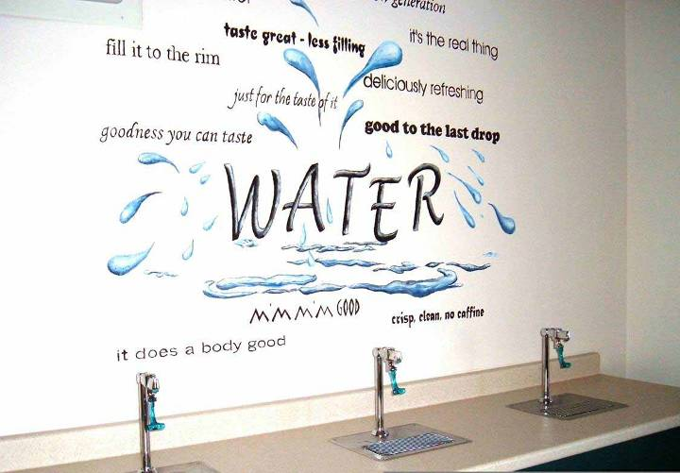
Central Valley: We want healthy water !
Photo Courtesy of Folsom-Cordova School District

Slide 6
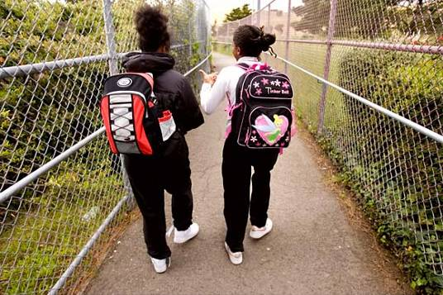
Chula Vista: We expect a safe community
“Reality and perception of violence causes justification for not being outside, letting children outside, and not walking to places that they normally would,”
-Community Leader

Slide 7
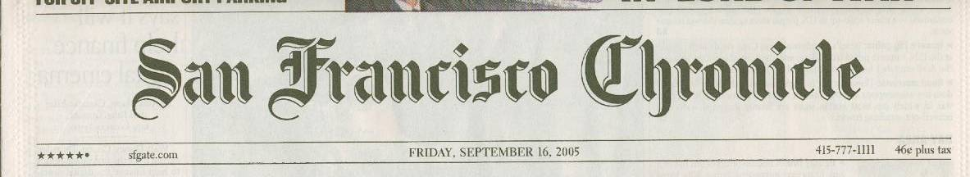
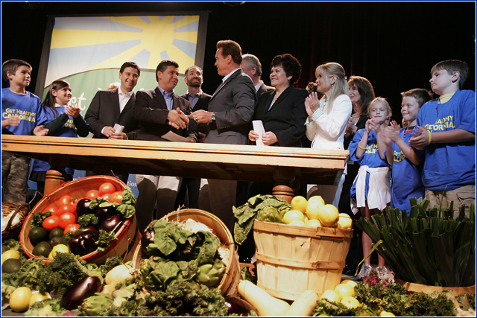
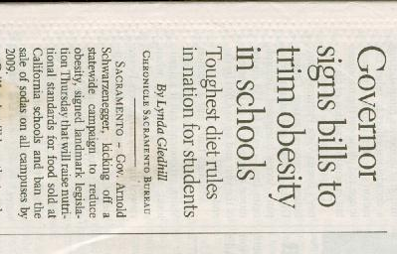
Notes:
Strategic Alliance, a statewide coalition of nutrition and physical activity advocates in California that Prevention Institute staffs, developed a Taking Action Platform
that Governor Shchwarzenegger adopted and turned into the state’s Obesity Action Plan to raise nutritional standards for food sold at California schools and ban the sale of sodas on school campuses.

Slide 8
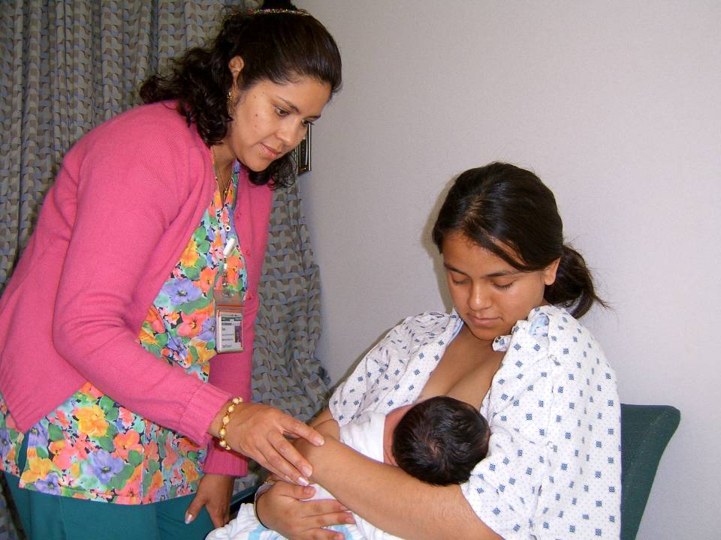
Baby Friendly Hospitals
Notes:
Level 1: Strengthening individual knowledge and skills
The Loving Support Breastfeeding Program provides support, encouragement and assistance to all new mothers in order to make breastfeeding successful.
Open to all Riverside County residents
EXAMPLE
Toll-free, bilingual helpline available 24 hours a day, seven days a week to provide support and assistance. Staffed by certified lactation educators and lactation consultants.

Slide 9
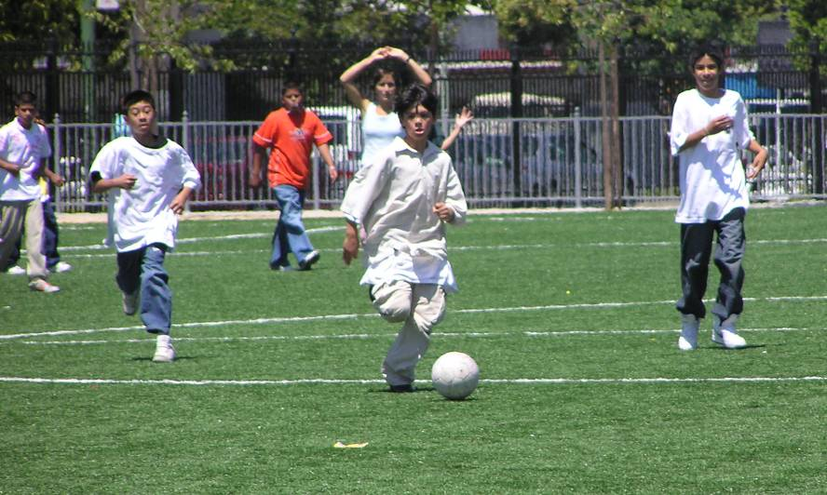
Everyone Deserves Safe Places to Play and Be Active

Slide 10
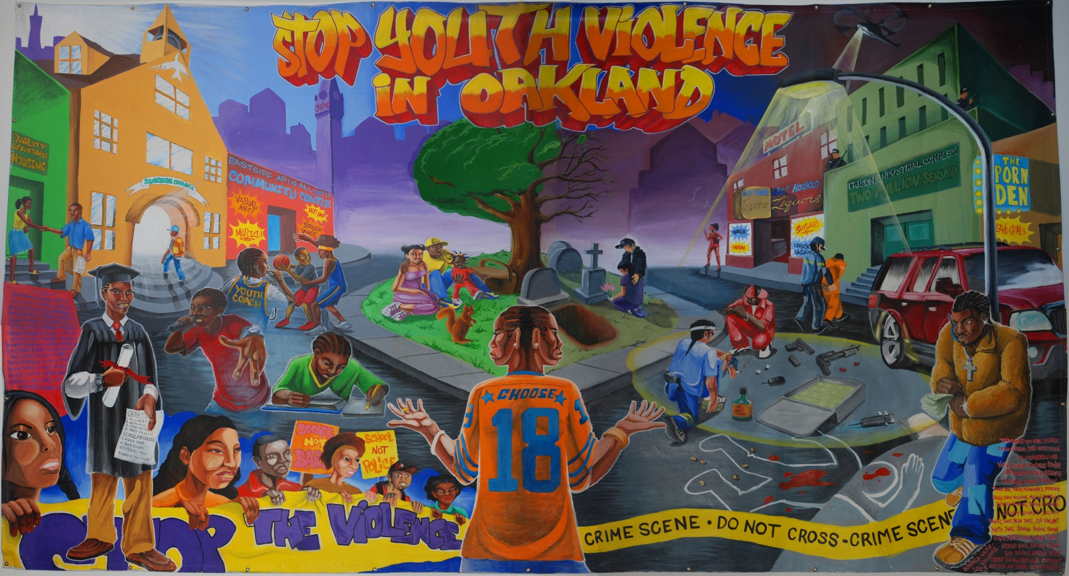
Focus on Safety
“Violence is not the problem of one neighborhood or group…Coming together and owning this problem and the solutions are central.”
-Dr. Deborah Prothrow-Stith, Harvard School of Public Health, UNITY Co-Chair
Notes:
Safety as an underlying approach connected to chronic illness. It is an essential component of equity: a potential strategy would be joint use.

Slide 11
ENVIRONMENT
EXPOSURES
HEALTH
BEHAVIOR
BEHAVIOR
Notes:
(mod 1 review)

Slide 12
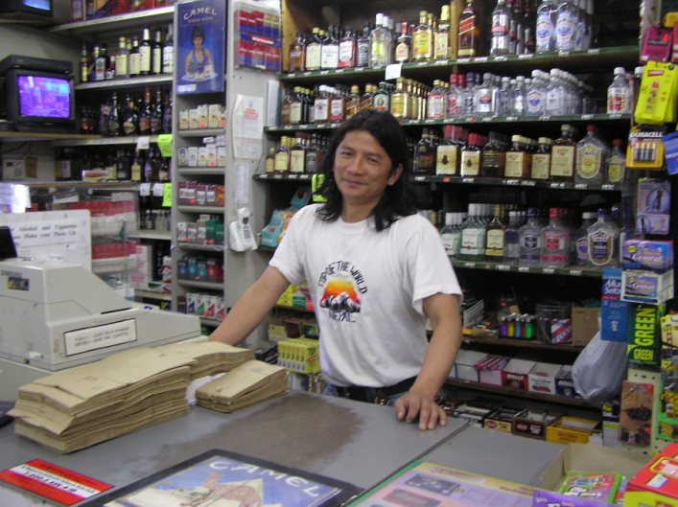
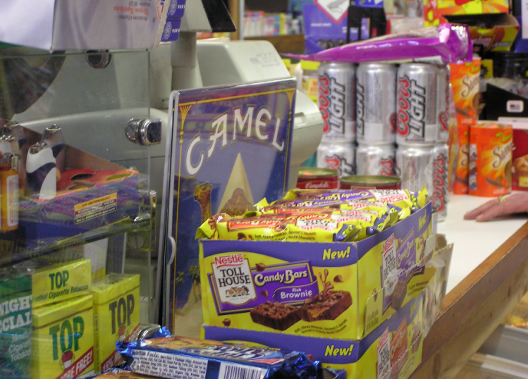
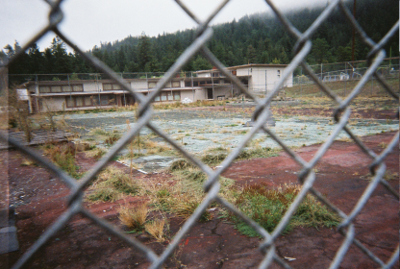
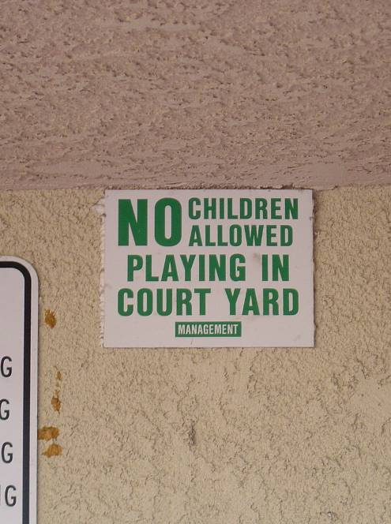
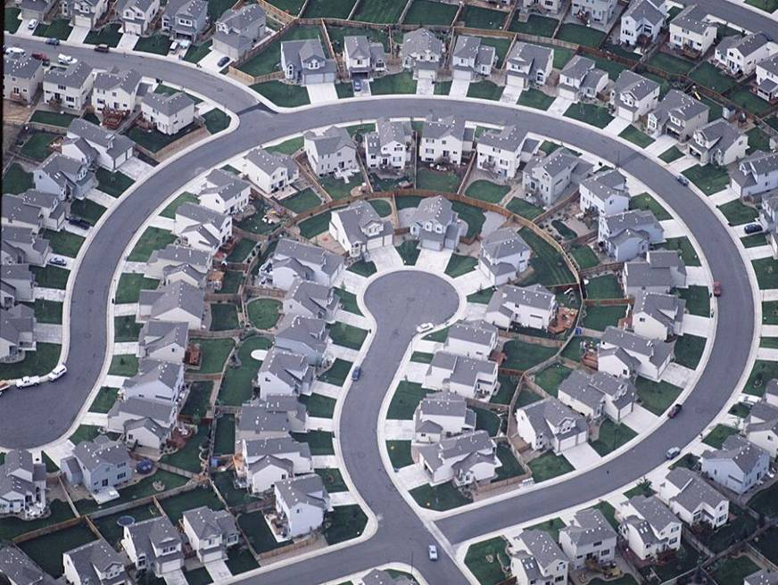
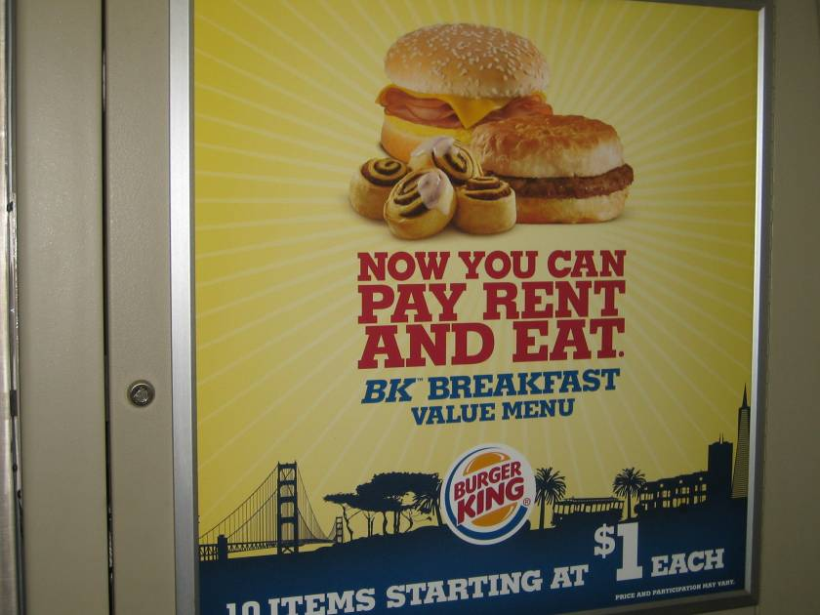
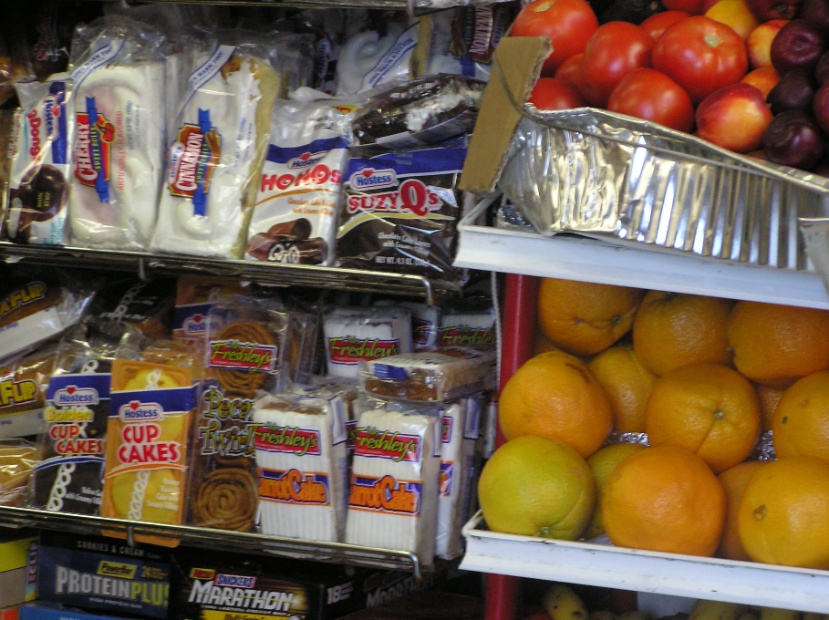
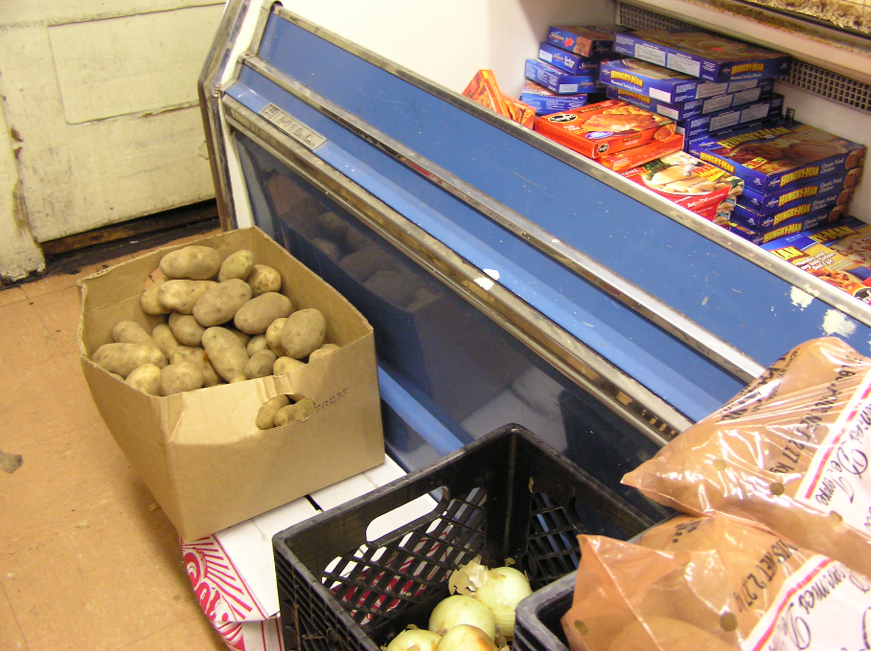

www.eatbettermovemore.org
NPA1038_Taking Action Show

Slide 13
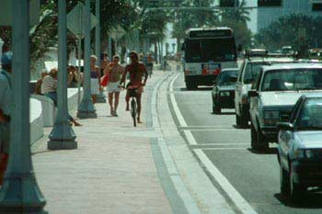


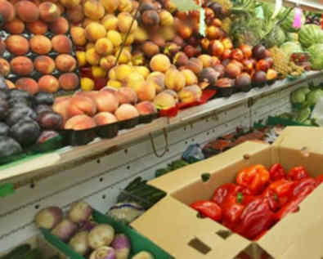
Health in all Policies
Notes:
Emphasize environmental and policy change

Slide 14
A good solution solves
multiple
problems.
Prevention Institute

Slide 15
Prevention
Prevention
a systematic process that reduces the frequency and/or severity of illness or injury.
Primary Prevention
Primary Prevention
Promotes healthy environments and behaviors to prevent problems from occurring before the onset of symptoms
Notes:
So what is prevention? What do we mean by primary prevention?

Slide 16
Return on Investment with Prevention
Savings at
5 years
$16 Billion
Annual Savings
In 5 Years
$5.60
Return on Investment
$1
Investment
SOURCE: Prevention for A Healthy America: Investments in Disease Prevention Yield Significant Savings, Stronger Communities, Trust for America’s Health, July 2008

Slide 17
“There is one unexpected long-term option that can help our stalling economy—reforming our health care system through enhanced prevention and wellness.”
Tommy Thompson
Former Secretary of Health and Human Services
September 2008

Slide 18
Field Poll: “CA Voters Support…
Nearly all voters support increasing the availability of
fresh drinking water in schools and other public areas
Strong support for providing incentives and enacting policies to increase the availability of fresh fruits and vegetables in low-income neighborhoods
Six in ten voters attach high importance to covering exercise and other organized physical activities (like the YMCA or YWCA) under the state’s Medi-Cal program
Data provided courtesy of The California Endowment
Field Poll data just released 2/12/14 conducted on behalf of The California Endowment

Slide 19
Priority Actions
Apply a “health in all policies” lens to state-level decisions
Prioritize funding in most impacted communities
Convene statewide listening sessions

Slide 20
“
People’s health is strongly influenced by the overall life odds of the neighborhood where they live.
Indeed, place matters. In many low-income urban and rural communities, whole populations are
consigned to shortened, sicker lives.
”
Source: Prevention Institute. A Time of Opportunity: Local Solutions to Reduce Inequities in Health and Safety. 2009.

Slide 21
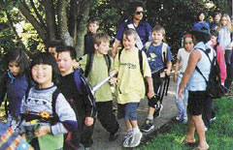
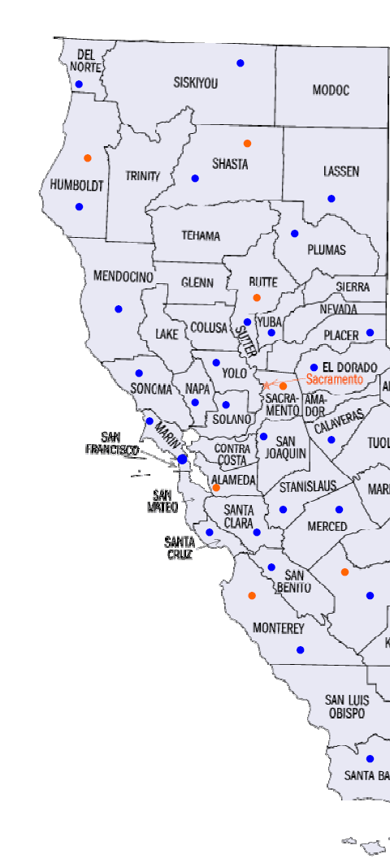
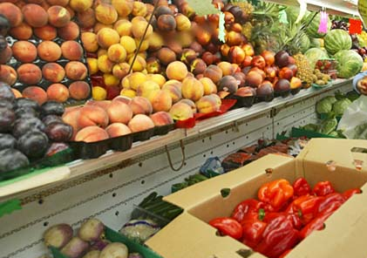
Local Efforts Making the Movement

Slide 22
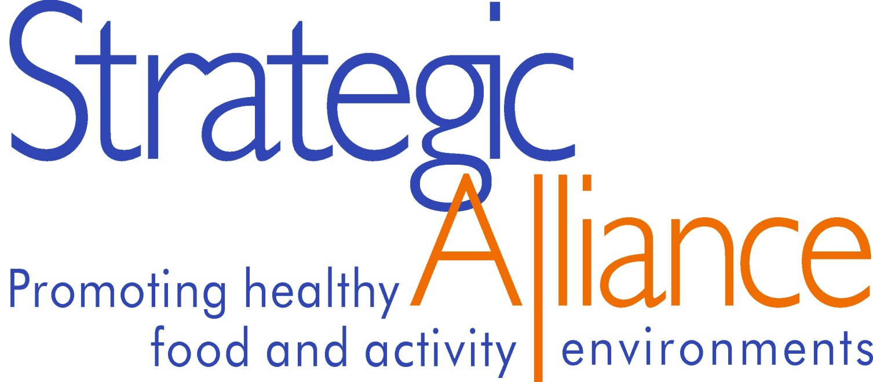
Visit us today at www.eatbettermovemore.org
www.eatbettermovemore.org
NPA1038_Taking Action Show
Notes:
Thanks for the opportunity to speak with you today

Slide 23





www.preventioninstitute.org
221 Oak Street
Oakland, CA 94607
Tel: (510) 444-7738
Follow us on:
Sign up for our media alerts:
http://www.preventioninstitute.org/alerts

