Slide 1

California Public Utilities Commission
Update to California State Senate
Michael R. Peevey, President
California Public Utilities Commission
March 18, 2014

Slide 2

Presentation Overview
CPUC’s Goal
2013 Overall Results
California Snapshot
Drought
2014 Look Ahead
Specific Industries
2
Notes:
2

Slide 3
The CPUC’s Goal
To ensure that Californians receive safe, reliable utility service and infrastructure at reasonable rates, with a commitment to environmental enhancement and a healthy California economy.

Slide 4
Safety Policies & Procedures
In 2013 the CPUC established requirements to incorporate safety considerations into every decision.
  In every proceeding, the Assigned Commissioner and the Administrative Law Judge seek comment on the specific safety impacts of any proposal under consideration.
In 2013 the CPUC opened a proceeding to begin integrating a risk-based decision-making process for utility rate requests.
  When a utility requests a rate adjustment the request must include testimony on how additional investment will mitigate risk.

Slide 5
Decision & Resolutions
In 2013, the CPUC issued 507 decisions and held 268 days of hearings.
In 2013, the Industry Divisions collectively received approximately 3,600 Advice Letters, and 181 Resolutions were drafted for CPUC consideration.
In 2013, 274 new proceedings were opened.

Slide 6
Consumer Outreach
In 2013, the CPUC participated in more than 540 events promoting consumer programs such as CARE, Medical Baseline, LifeLine, and offering information on senior fraud prevention and managing utility bills.
In 2013, the CPUC Consumer Affairs Branch assisted more than 50,000 Californians through direct contact via phone calls, written correspondence, and secure online interactions.

Slide 7
Supplier Diversity
In 2013, the utilities collectively reported more than $8 billion procured from diverse suppliers – that is 32.9% of their total procurement needs.
  The utilities conducted business with more than 3,800 diverse suppliers.
In 2013, the CPUC procured $18.5 Million (15.84%) from Small Businesses and $1.5 Million (1.28%) from Disabled Veteran Business Enterprises.

Slide 8
California Snapshot
According to the Edison Electric Institute and American Gas Association studies, California customers on average pay approximately $92 for their monthly electricity bills and $40 for their gas bills.
  California’s average monthly bill is the 15th lowest bill in the country.
  The average monthly gas bill for the country as a whole is approximately $60 while California is at $40.
The CPUC regulated water utilities on average charge water customers a monthly charge of $68.
Broadband service has reached more than 95% of California households.

Slide 9
Drought
  Dry 2013 / 2014
  50% of normal for rainfall, about 31% of normal for snowpack
  January 17, 2014 – Drought State of Emergency declared by Governor Brown
      Calling for a 20% voluntary reduction in water use
  January 31, 2014: State Water Project - no water deliveries
  February 21, 2014: Central Valley Project – 50% cut for urban
  Commission Actions
  February 27, 2014: 15 largest utilities ordered to put in place 20% voluntary conservation
  Member of Governor’s Drought Task Force
  Our utilities are expected to be fine this year
  Monitoring vulnerable water systems along with Dept. Public Health
  Mandatory Conservation
      Catalina Island
      California American Water Company– Sacramento region
9
Notes:
9

Slide 10
2014 Look Ahead
Electric Rate Reform (AB 327)
Ensuring Adequate Power Supply throughout California, Including Power Reliability in Light of the SONGS Retirement.
Improving Safety of California Gas Operations:
  The CPUC will continue its work on several cases involving natural gas pipeline safety, such as R.11-02-019 to establish new safety and reliability regulations for gas transmission and distribution pipelines, and several investigations, including a major investigation into the PG&E San Bruno pipeline rupture (I.12-01-007) and related investigations of PG&E’s practices concerning the operations of its natural gas transmission system in locations with higher population density (I.11-11-009) and PG&E’s
  gas transmission record-keeping (I.11-02-016).

Slide 11
2014 Look Ahead (cont.)
California Advanced Services Fund (R.12-10-012)
  The CPUC initiated this Rulemaking to revise the eligibility requirements for participation in the CASF.
Implementing Assembly Bill 136 (R.13-03-008)
  To implement the provisions of AB 136, which is to design and implement a program to provide access and to distribute a Speech Generating Device (SGD) device to any subscriber who is certified as having a speech disability requiring this device.
Hope for a Rainy 2014.

Slide 12
Specific Industries
Following is information on specific industries:
  Safety & Enforcement
  Implementation of Energy Priorities
  Telecommunication Matters
  Water

Slide 13


Safety and Enforcement
The CPUC oversees the safety of electric and communications facilities, power plants, natural gas and propane gas systems, railroads, light rail transit systems, and highway/rail crossings, licensing, consumer protection, motor carriers of passengers, household goods, and water vessels, and regulates hot air balloons and some air carriers.
13
13

Slide 14
Safety and Reliability: Gas Facilities
Extensive pipeline testing is underway throughout California.
  PG&E tested approximately 480 miles, replaced about 86 miles of gas transmission pipelines, and installed over 98 automated valves.
Updated CPUC Natural Gas Safety Action Plan.
Evaluated individualized plans filed by each jurisdictional gas utility pursuant to SB 705 (Hill, 2011).
Developing new rules for the safe and reliable operation of natural gas pipelines in California, including new performance metrics.
Safety staff published standard operating procedures for Gas Safety Citation Program; issued more than $8.5 million in fines in 2013.
Staff-sponsored audits within PG&E’s General Rate Case evaluated utility’s risk-based safety decisions, which introduced safety to the CPUC ratemaking process.
14
Notes:
14

Slide 15
Safety and Reliability: Electric, Communications, and Generator Facilities
Fire Safety: Adopted safety rules specific to communications companies’ aerial and overhead facilities.
Substation Security: Audited multiple PG&E, SCE, and SDG&E substations for compliance with new 2012 CPUC-adopted standards.
High Speed Rail Electrification: Opened a proceeding to establish uniform safety requirements for design, construction, operation, and maintenance of overhead 25 kV electrification systems.
Plant Outages: Inspected more than 300 generator outages, repairs, and return to service.
Citation Program: Considering measures to implement SB 291 (Hill), which requires the CPUC to develop a safety enforcement program for gas and electrical corporations, including a citation process, by
January 1, 2015.
15
Notes:
15

Slide 16
Safety: Railroad, Rail Transit, Rail Crossings
CPUC’s Rail Safety Programs:
    Railroad Safety: Joint jurisdiction with the Federal Railroad Administration
    Rail Transit Safety: State safety oversight agency with exclusive jurisdiction
    Rail Crossing Safety: Exclusive jurisdiction for authorization and safety
  Applying risk management to previously unknown risks in California’s rail system, including the increased crude oil rail traffic and lack of hazardous materials reporting threshold for transit agencies.
  Implementing Positive Train Control (PTC) to prevent collisions.
  Partnered with the NTSB to investigate incidents at Angel’s Flight and BART in 2013 to:
    Ensure that the rail agencies’ corrective action plans address all findings and recommendations resulting from accident investigations.
    Monitor the status and implementation of those plans.
16
Notes:
16
16

Slide 17
Safety: Transportation
CPUC adopted a new category of transportation charter party carriers called “Transportation Network Companies” (TNC).
  Determined TNCs are under CPUC jurisdiction.
  Developed an application process for TNCs.
  Next phase of the proceeding will consider how to encourage innovation in the transportation industry while ensuring public safety.
Issued a citation to the charter party carrier involved in the May 2013 limousine fire on the San Mateo-Hayward bridge for exceeding the seating capacity of the vehicle.
Now require carriers to file most insurance information in electronic format, which decreased document processing time.
New rules require electronic signatures and electronic retention of documents by carriers, in response to SB 838 (Hill).

Slide 18

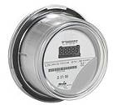

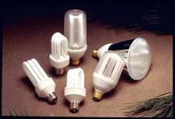

Energy Policies & Priorities
The CPUC regulates investor-owned electric and gas utilities (such as PG&E, SCE, SDG&E and SCG), which serve over two-thirds of electricity demand and over three-quarters of natural gas demand in the state.
18
Notes:
18

Slide 19
Ensuring Electric Reliability in Light of State OTC Policy and SONGS Retirement
Long-Term Procurement Planning reviews reliability need biennially and has been planning for OTC retirements.
  2010 Water Board Policy affects 19 power plants, 16 in ISO (17,500 MW), 8 have fully or partially retired (5,000 MW in ISO).
  2013 SONGS retirement was another 2,200 MW.
  3,000 MW of new power plants came online in 2013.
Three recent decisions have authorized 2,900-3,800 MW of new resources in Southern California.
  Authorizations include some preferred resources, storage, and all-source procurement.
  Energy Efficiency expected to provide more than 1,000 MW of additional load reduction.
  The authorization range provides flexibility on location and resource type (PV vs DR. vs peakers).

Slide 20
Ensuring Electric Reliability While Integrating Intermittent Renewables
Reviewing whether the future electric system fleet has sufficient flexibility requires complex modeling.
CPUC has developed joint modeling assumptions and study methods with the ISO, CEC, utilities, and other parties.
Evaluating flexibility modeling results is a key issue in the upcoming 2014 Long-Term Procurement Proceeding.

Slide 21
Resource Adequacy
In 2013, regulated load serving entities met electric system needs with no electric service loss because of insufficient generation.
In 2013, the CPUC approved a decision requiring load serving entities to start acquiring flexible capacity in 2015 to ensure reliable integration of variable energy resources (wind, solar, storage).
In early 2014, the CPUC initiated a new proceeding known as the “Joint Reliability Plan” to investigate the need for additional policies to ensure long-term reliability, including:
  Consideration of multiyear resource adequacy,
  Joint CPUC-Energy Commission-ISO planning assessments; and,
  Review of the proposed ISO market backstop mechanism.

Slide 22
Investigation on the San Onofre Nuclear Generating Station
The CPUC opened its investigation of the steam generator failures at SONGS in November 2012.
  In early 2012 the facility ceased operating due to leakage and excessive wear found in the recently installed steam generators. SCE permanently shut down the facility in June 2013.
  SONGS is owned by SCE (78.2%), SDG&E (20%), and the City of Riverside (1.8%). SCE operates the facility.
The CPUC’s investigation is reviewing:
  SCE’s response and costs following the shutdown.
  The appropriate amounts to be removed from rate base.
  The reasonableness of the costs of the replacement steam generators.
A Proposed Decision of the Administrative Law Judges regarding costs incurred at SONGS during 2012 is on the CPUC’s March 27, 2014. Voting Meeting agenda.
  The Proposed Decision requires that $93.5 million be returned to the customers of SCE and SDG&E for costs over-collected in 2012 ($74.2 million to SCE’s customers, $19.3 million to SDG&E’s customers).

Slide 23
Natural Gas Infrastructure
After extensive environmental review, in November 2013 CPUC approved new construction work at the Aliso Canyon storage field.
  In addition to replacing some obsolete facilities, the work will result in an increase in the injection capacity of the field.
In late 2013, SoCalGas requested recovery of costs for a proposed $628 million pipeline project.
  SoCalGas believes project is necessary to assure more reliable delivery of gas supplies into its southern system and into the SDG&E area.
  CPUC will examine SoCalGas’ request in 2014.

Slide 24
Key Developments in Rate Design
Net Energy Metering
Resolution E-4610 authorized NEM aggregation to go forward (SB 595). Implementation scheduled for 1st and 2nd quarters 2014.
Retail Rates Order Instituting Rulemaking (R.12-06-013)
8 of 13 parties filing rate design proposals favored default Time of Use (TOU) as the preferred default residential rate structure.
Energy Division Staff Proposal recommended default TOU starting in 2018.
Vast majority of commercial customers are now on default TOU rates.
Green Tariff/Shared Renewables (SB 43)
All three IOUs filed applications to implement Green Tariff/Shared Renewables programs pursuant to SB 43.
The proceeding is on track to reach a decision on the applications by the July 1, 2014, statutory deadline.

Slide 25
Key Development in Rate Design (cont’d)
PG&E Economic Development Rate
  Approved enhanced 35% discount for large C&I customers in California municipalities and counties with high unemployment rates.
SDG&E General Rate Case Phase 2
  SDG&E revenue allocation and rate design proposals evaluated; Decision adopted in January 2014.
  Issues regarding Non-CARE residential rate tier consolidation, Tier 3 CARE rate cap, basic service fee (fixed charge) moved to the Retail Rates OIR (R.12-06-013).
Smart Meter Opt Out
  Ongoing evaluation of non-participant and participant rate impacts associated with proposed Smart Meter opt-out tariffs.

Slide 26
General Rate Cases
Issued a Decision in SDG&E’s 2012 GRC.
  In May 2013 the CPUC authorized SDG&E an increase of $115 million (3.6% in total revenue requirements) in electric and $8 million (1.3%) in gas revenue requirements. The CPUC ensured that SDG&E would have the necessary funds to maintain and replace electric and gas delivery infrastructure to ensure safe and reliable service to customers, comply with state and federal environmental regulations, and allow SDG&E to install Smart Grid technologies to better monitor the electric grid to improve reliability.
  SDG&E will file its 2016 GRC application in the 4th quarter 2014.
The CPUC is reviewing PG&E’s 2014 GRC application.
  PG&E has requested an increase of $1.282 billion, consisting of $587 million for electric distribution, $486 for gas distribution, and $209 million for electric generation for its 2014 GRC revenue requirements. PG&E cites the need to make expenditures on safety and reliability related projects as major drivers of its request.
  The CPUC is expected to issue a decision in PG&E’s GRC in the 2nd quarter 2014.
SCE filed its 2015 GRC application in November 2013.
  SCE requests a $206 million increase in revenue requirements in 2015 (1.3% increase in total revenue requirements). SCE cites the need for electric distribution investments such as pole replacements as a major factor driving its GRC request.
  The CPUC will review SCE’s 2015 GRC request during 2014.

Slide 27
Electric Fuel and Purchase Power Costs
Electric fuel and purchased power costs are reviewed and approved in Energy Resource Recovery Account proceedings.
In November 2013 the CPUC authorized SDG&E $949 million to recover fuel and purchased power costs.
  The CPUC allowed SDG&E to recover an additional $149 million in fuel and power procurement expenses in February 2014; the CPUC is currently considering SDG&E’s request for its 2014 fuel and purchased power budget of $1.2 billion, and is expected to make a decision in the 2nd quarter 2014.
In November 2013 the CPUC authorized SCE $3.8 billion in revenue requirements to recover fuel and purchased power costs.
  The CPUC is currently considering SCE’s request for its 2014 fuel and purchased power budget of $5.2 billion, and is expected to make a decision in the 2nd quarter of 2014.
The CPUC authorized PG&E to recover $5.1 billion in fuel and purchased power costs for 2014.
  The CPUC issued a decision in December 2013.

Slide 28
The CPUC is Committed to Energy Efficiency as the New “Business as Usual” in California
Transitioning away from lighting focus and towards deep retrofits, peak reductions (i.e., A/C installation and maintenance) and market transformation.
Rolling out new statewide Energy Efficiency Financing initiative and water-energy marketing programs.
New “Regional Energy Network” and Community Choice Aggregators will act as EE Program Administrators.
New pilot to replace inefficient, but still-operational HVAC units in areas impacted by SONGS closure.

Slide 29
Low Income Energy Efficiency Programs
California statutes require utilities to administer two main programs to assist low income customers:
- California Alternative Rates for Energy (CARE)
CARE provides 30% – 35% discounts on electric and natural gas bills.
- Energy Savings Assistance Program (ESAP)
ESAP provides no-cost weatherization to low income households.
The CPUC authorized approximately $5 billion for utilities to continue the CARE and ESAP programs during the 2013-2014 program cycle.
Recent CARE program improvements:
  Changes to increase program participation.
  Energy Upgrade California pilots for low income multifamily sector.

Slide 30
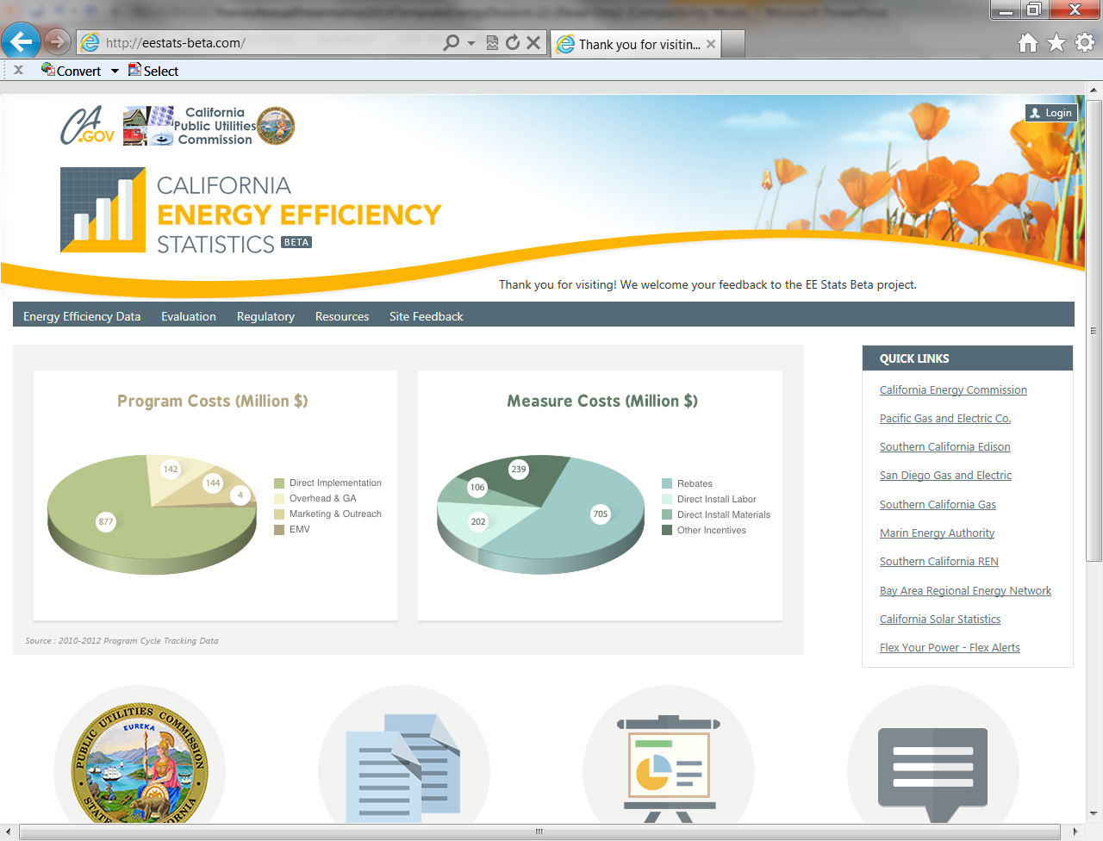
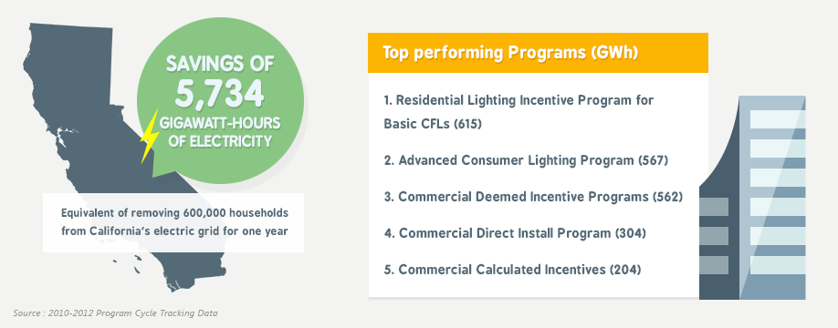
2013-14 Energy Efficiency Portfolio Savings Estimates
5,000 GWH of electricity
830 peak MW of capacity
120 million therms of natural gas
$600MM in net benefits for customers
Program Savings Data on the web: http://EEStats.cpuc.ca.gov

Slide 31
Demand Response
Strengthening DR in Southern California:
  In response to the outage (and eventual retirement) of SONGS, the CPUC approved changes to existing DR programs in Southern California to improve the effectiveness, reach, and reliability of DR programs with no significant costs to ratepayers.
Encouraging Greater Market Engagement in DR:
  In 2013, CPUC encouraged the participation of 3rd party DR providers in California in a number of ways:
    Approved 2-year contracts between PG&E and SCE and 3rd party DR providers for more than 500 MWs of DR.
    Developed new rules to enable 3rd party DR providers and large end-use customers to bid bundled load as DR in the state’s wholesale energy market (final approval February 2014).
Setting Directions for Future DR programs:
  In September, CPUC opened a new DR policy Rulemaking with the intention of making future DR more useful in meeting the state’s resource planning needs and operational requirements. This Rulemaking is anticipated to provide policy guidance for the design and procurement of future DR resources.

Slide 32
California Solar Initiative (CSI) Update
CSI Program is on target to reach its goal of 3,000 MW of distributed solar by 2017.
CSI has installed more than 1,400 MW at more than 125,000 sites.
Residential sector demand remains robust despite declining CSI incentives.
Third-party ownership models are driving demand in residential sector.
Total CSI system costs decreased 46% between 2007 and 2013.
Year | MW Installed | Per Watt Costs | Annual Cost Reductions (%)
2007 | 28 | $10.46 | -
2008 | 121 | $10.60 | -1%
2009 | 136 | $9.44 | 10%
2010 | 155 | $8.52 | 19%
2011 | 270 | $7.34 | 30%
2012 | 354 | $5.89 | 44%
2013 | 317 | $5. 67 | 46%

Slide 33
RPS Implementation and Major Trends
RPS is a market-based program that requires all California LSEs to procure increasing amounts of renewable energy through 2020 and beyond.
  Established in statute in 2002 for retail sellers only, current law sets statewide goal of 33% by 2020.
  RPS-obligated LSEs include: IOUs, ESPs, CCAs (CPUC regulates), and POUs (with Energy Commission oversight).
  Procurement to achieve 33% has largely been met.
In 2013, 139 contracts were approved by the CPUC including 946 MW of RPS Capacity.
Focus going forward will be to procure RPS resources for meeting need for grid reliability in conjunction with complying with various policy constraints including SONGS replacement and storage compliance requirement, etc.

Slide 34
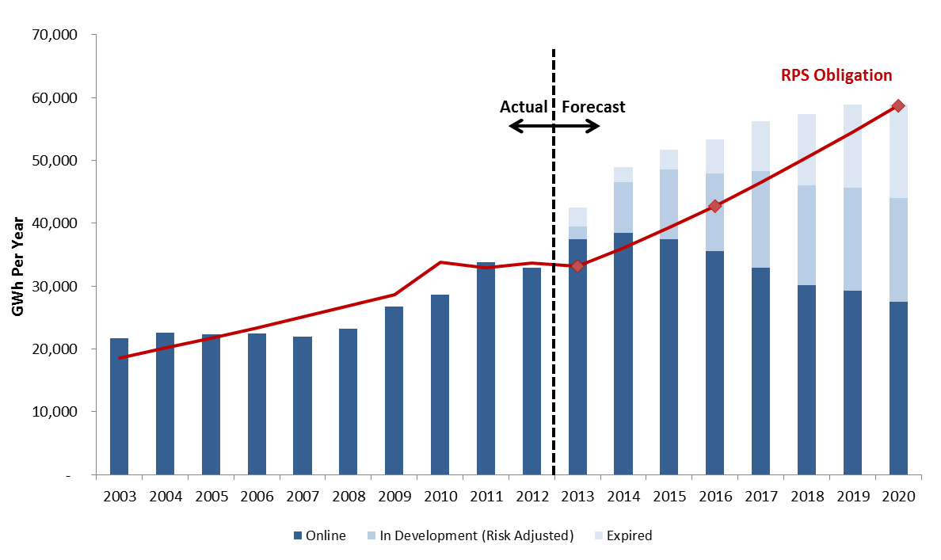
IOUs are on Track to Meet RPS Goals
California Public Utilities Commission, August 2013
For planning purposes, the Commission assumes that less than 100% of contracted projects will achieve commercial operation

Slide 35
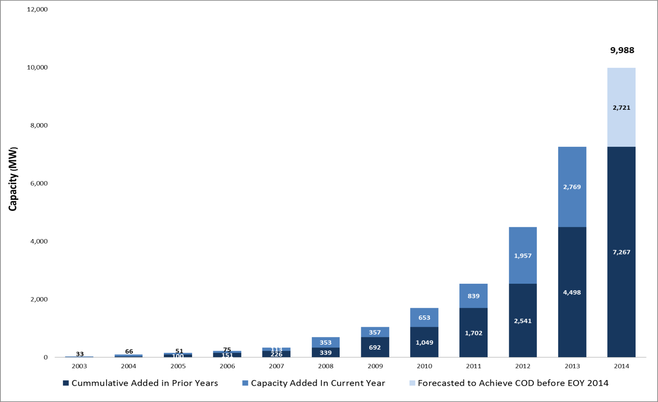
RPS Capacity Additions
California Public Utilities Commission, December 2013

Slide 36
Greenhouse Gas Emissions
Cap-and-Trade Implementation
  ARB gave allowances to protect IOU electric ratepayers, and all must be sold at ARB’s quarterly auctions.
  CPUC oversees use of revenues from these sales.
Carbon Price Signal
  Electricity rates will reflect a carbon price signal starting April 2014.
Allowance Revenue Use: Ratepayer Protection
  CPUC approved electric IOUs’ GHG allowance revenue forecasts for 2014.
  Customers will receive credits beginning in April 2014.

Slide 37
Electric Program Investment Charge
Funding Amounts (2013-2020)
  $162 million/year
  CPUC approved triennial investment plans
Research Areas
  Applied research and development
  Technology Demonstration and Deployment
  Market Facilitation

Slide 38
Transmission Line Permitting
CPUC issues permits, including conducting CEQA review, for transmission and substation projects that support renewable development and system reliability.
  Tehachapi Renewable Transmission Project (SCE) – expected online 2016
  Devers-Palo Verde 2 (SCE) – online 2013
  Eldorado Ivanpah Transmission Project (SCE) – online 2013
  Sunrise Powerlink (SDG&E) – online 2012
  Red Bluff Substation (SCE) – online in 2013
  Coolwater-Lugo Transmission (SCE) – application filed 2013
  West of Devers Upgrade (SCE) – application filed in 2013
  Sandlot Substation (SCE) – expected online 2014
  East County Transmission (SDG&E) – expected online 2014
  Embarcadero-Potrero (PG&E) – expected online in 2016
Status of 50+ other filed or approved projects available at: www.cpuc.ca.gov/PUC/energy/Environment/

Slide 39
Energy Storage
In October 2013, the CPUC set a target of 1,325 MW for the utilities and other load-serving entities to build, buy, or contract for energy storage by 2020.
  Utilities filed applications on March 1, 2014, describing parameters for their initial solicitations set to begin Dec. 1, 2014.
In February 2013, the CPUC ordered Southern California Edison to purchase at least 50 MW of energy storage to meet L.A. Basin local capacity requirements.
  Bids have been accepted and a short list will soon be announced.
Additional information on storage available at: www.cpuc.ca.gov/PUC/energy/electric/storage.htm

Slide 40
Distributed Generation Interconnection
In 2013, the CPUC worked on policies to reduce the cost and time for customers and small generators to interconnect to the utilities’ distribution system.
These included:
  Automated utility permitting practices;
  Standardized date gathering and reporting; and,
  Providing cost certainty.
A Proposed Decision was issued for comment in January 2014 that would adopt a group interconnection study process and standardized contracts.

Slide 41







Communications Industry
The CPUC manages universal telephone service programs, issues video franchises, monitors customer service and public safety standards for telephone services, regulates rates for basic phone service and rural carriers, licenses telephone corporations, and responds to federal telecommunications initiatives.
41
41

Slide 42
Telephone Corporations
696 unique telecommunication corporations are currently licensed or registered with the CPUC to offer various modes of telecommunication service (local, long-distance, wireless, etc.)
Telecommunications User Filing System (TUFFS) reports approximately $389 million in Public Purpose Program surcharges were collected in 2013.
Some of these corporations have multiple licenses or registrations to offer telecommunication service (i.e., wireline, wireless, and Voice over Internet). There are currently 1,052 total licenses and registrations.
The breakdown of services offered by these licensed entities is as follows:
Wireline service | 426
Wireless service | 91
VoIP service | 131
Multiple services | 42
Remote Telephone Unit (2 way radio and Paging) service | 6

Slide 43
Expanding LifeLine Service to Meet Changing Needs for Access
Through 8 statewide public hearings, clear messages from participants:
  Consumers need wireless to facilitate job search and to address temporary housing.
  Consumers want to choose plans that best meet needs.
  Consumers want access to wireless plans that include text and data options.
January 2014 - Adopted two tier subsidy mechanism for wireless
  Consumers receive $5.75 per month for plans that offer 501 minutes to 999 minutes.
  Consumers receive $12.65 per months for plans that offer 1,000 or more minutes.
California LifeLine program allows consumers to also receive Federal LifeLine subsidy

Slide 44
Public Safety and 9-1-1
In July 2013, issued Decision 13-07-019 to address the risk of inaccurate caller location information being delivered to Public Safety answering points from Multi-Line Telephone Systems (MLTS) users, such as hotels, hospitals, and buildings.
CPUC is participating in FCC network reliability proceedings.
  CPUC filed comments representing state interest in 9-1-1 network resiliency for key components of the 9-1-1 architecture, such as central offices and cell sites.
CASF Broadband infrastructure grants identify public safety entities that may benefit from improved broadband access.
In 2013, approved three additional applications for the use of 2-1-1 (Information and Referral services) for Butte, San Benito, and Tehama Counties.

Slide 45
Encouraging Broadband Deployment
California Advanced Services Fund (CASF)
  Implementing SB 740: Proceeding in progress to address requirements for non-telephone corporations to receive CASF grants (i.e., right-of-first refusal for existing providers prior to grant awards in underserved areas and applications from local government entities).
  Implementing AB 1299: Public housing broadband projects:
    Public workshops and meetings with public housing representatives initiated.
    Target issuing grants by end of 2014.
  Implementing solicitation for new Consortia in unrepresented counties in CA to promote deployment and adoption.
Identifying priorities areas:
  Establish CASF priority areas where broadband infrastructure is inadequate in unserved and underserved areas of the State.
  Consortia and unrepresented counties of San Luis Obispo, Santa Barbara, and Ventura provided regional priorities to CPUC staff at CASF Summit in March 2014.
45

Slide 46
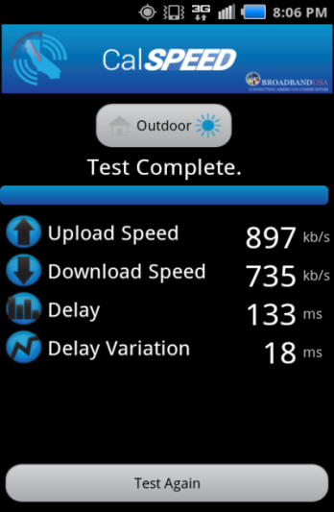
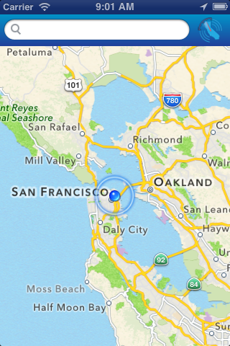
Broadband Data Analysis and Public Feedback
Consumers can provide feedback via a paper survey (English & Spanish), wireless phone app or through website availability mapping tool
  hwww.cpuc.ca.gov/PUC/Telco/bbpubfeedback.htm
April 2013 – Broadband testing app CalSPEED was created.
Consumer supplied data included in availability map results.
Public feedback used in CASF grant application review process.

Slide 47
Speech Generating Devices Added to Deaf and Disabled Telecommunications Program
AB 136 (Beall, 2011, Ch. 404) added speech generating devices (SGDs) to existing equipment distribution program.
CPUC adopted program rules on December 16, 2013.
Application process rolled-out in January 2014.
Application process relies upon speech language pathologist assessment.
First recipient received equipment on February 25, 2014.
Continue to work with vendors, speech language pathologist, non-profit organizations and sister state agencies to increase access to SGDs.

Slide 48




The Water Industry
The CPUC is responsible for ensuring that investor-owned water utilities deliver clean, safe, and reliable water service at reasonable rates.
48
Notes:
48

Slide 49
Water Utility Regulation
CPUC Charter: Clean, safe, and reliable water service at just and reasonable rates.
115 water utilities
  $1.4 Billion in revenues
  Serving more than 6 million Californians – 16% of the state’s population
Challenges and Cost Drivers
  More stringent water quality standards
  Aging infrastructure
  Declining water use
    Recession
    Conservation mandates
    Drought

Slide 50
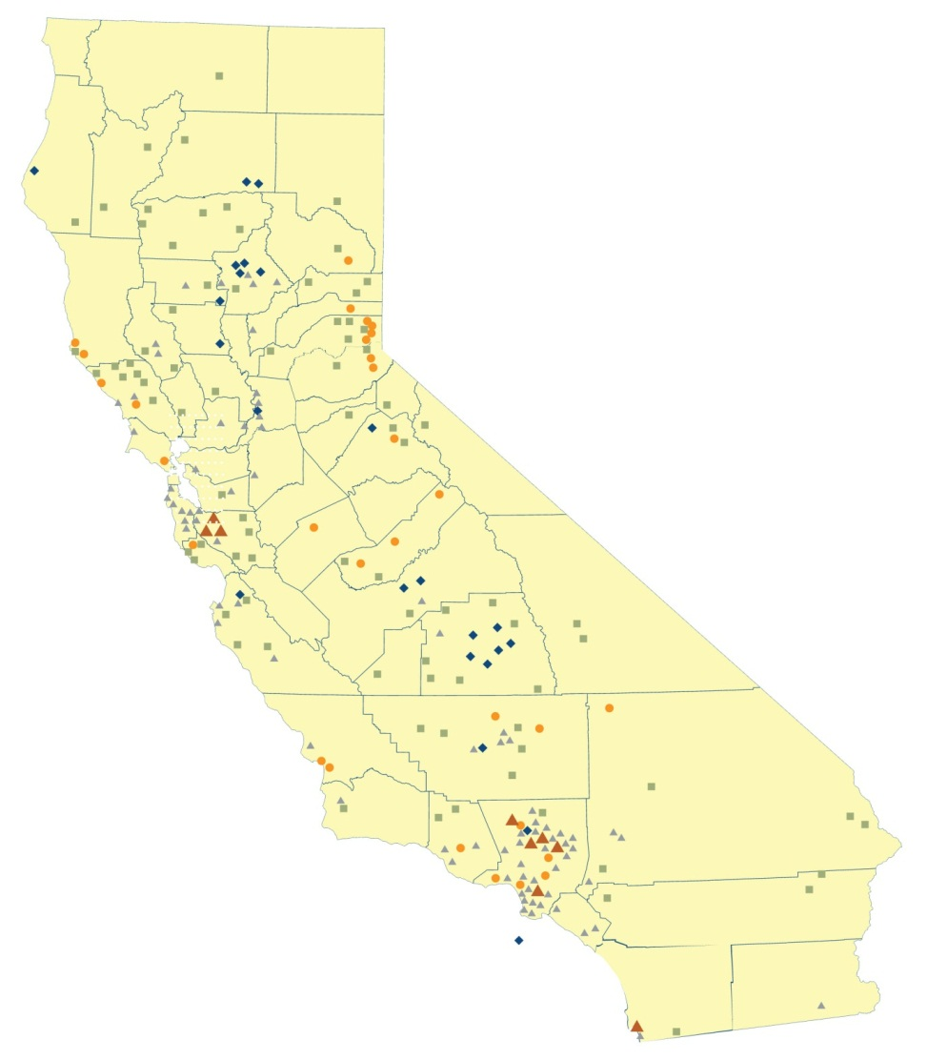
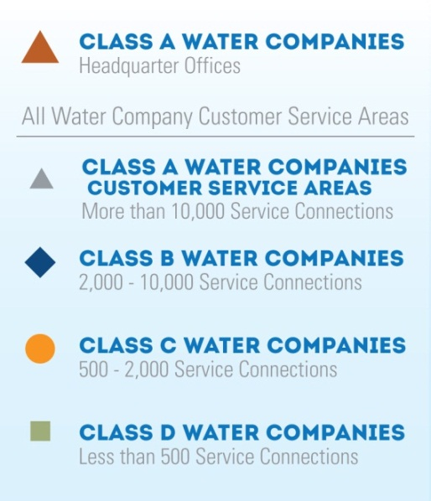
Water Utility Geographic Reach

Slide 51
Low Income Ratepayer Assistance
All large water utilities offer low income bill assistance programs.
251,914 residential water customers participate in these programs.
Income criteria similar to that applied by the energy low income programs.
Huge increase in participation rates in 2013.
  Auto enrollment program with data exchange between the energy and water utilities.
Low-income programs for water started in 2006.

Slide 52
Thank you.
Questions?
www.cpuc.ca.gov

