Slide 1
The US NRC’s Power Reactor Decommissioning Process Michael F. Weber Deputy Executive Director for Materials, Waste, Research, State, Tribal and Compliance Programs U.S. Nuclear Regulatory Commission Office of the Executive Director for Operations

Slide 2
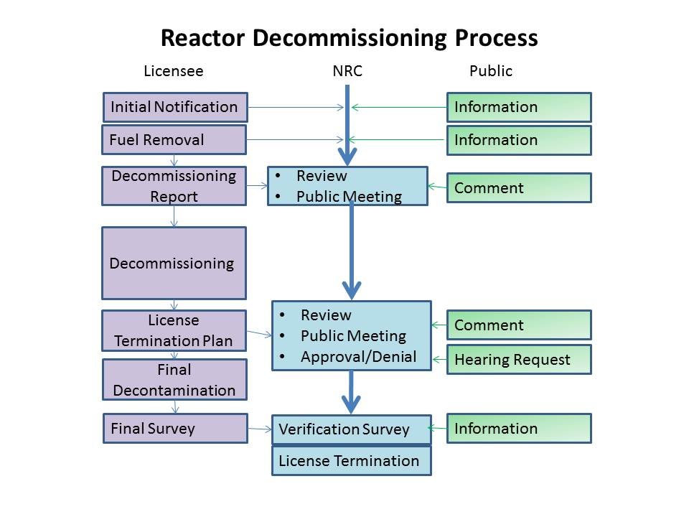
Reactor Decommissioning Process Summary
2

Slide 3
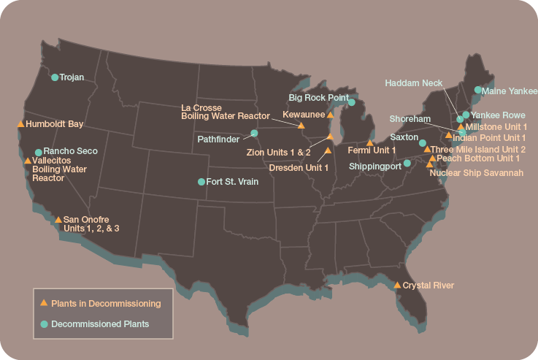
Power Reactors in Decommissioning

Slide 4
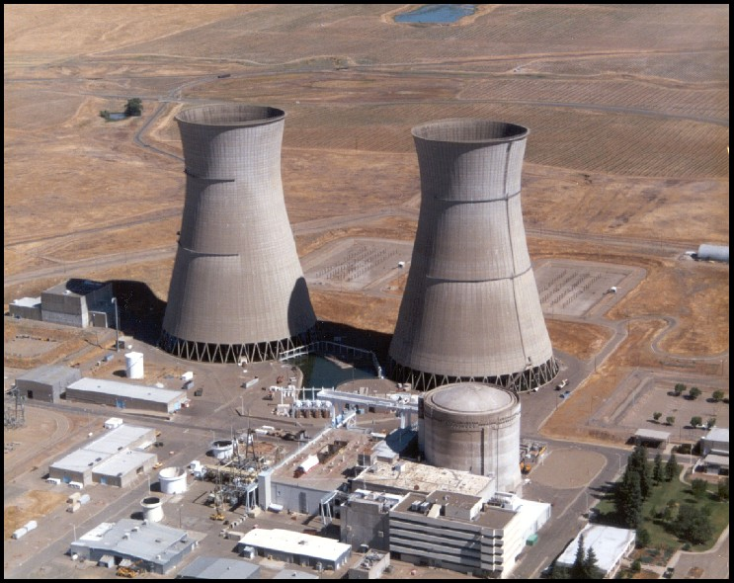
Rancho Seco - 2009

Slide 5
Maine Yankee - 2005

Slide 6
Big Rock Point - 2007

Slide 7
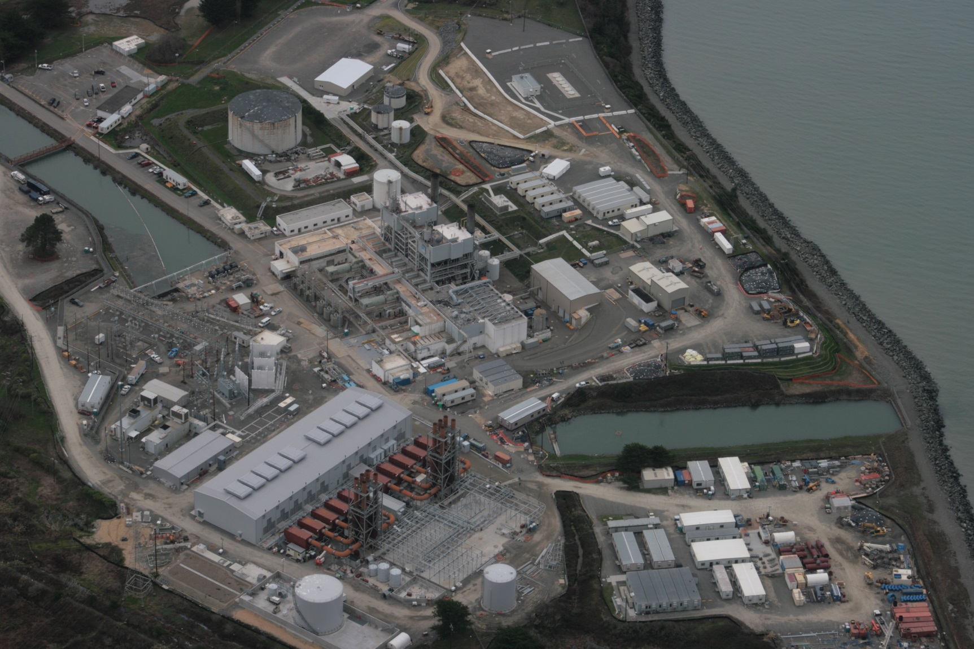
Humboldt Bay

Slide 8
San Onofre Nuclear Generating Station

