Slide 1
Gas Safety and Reliability Branch Management and Operations Review
Report and Recommendations

Slide 2
GSRB Management and Operations Review
Project Charter
Project Methodology and Timeline
Report and Recommendations
Report Structure and Contents
Report Key Findings
GSRB Challenges, Opportunities, and Progress To Date
Recommendations, Implementation Steps, and Performance Metrics

Slide 3
Project Charter
CPUC’s Independent Review Panel (IRP) recommendation:
“Undertake an independent management audit of the USRB [now GSRB] organization, including a staffing and skills assessment, to determine the future training requirements and technical qualifications to provide effective risk-based regulatory oversight of pipeline safety and integrity management, focused on outcomes rather than process.”
Project objectives in Spring 2014:
“The goals of the proposed audit will be to
Analyze and evaluate GSRB activities in the context of their effectiveness in adhering to existing safety regulations;
Provide the CPUC with new ideas, insights, and practical, implementable recommendations; and
Develop implementation plans designed to evolve the program into one that is more proactive in addressing gas safety issues.”

Slide 4
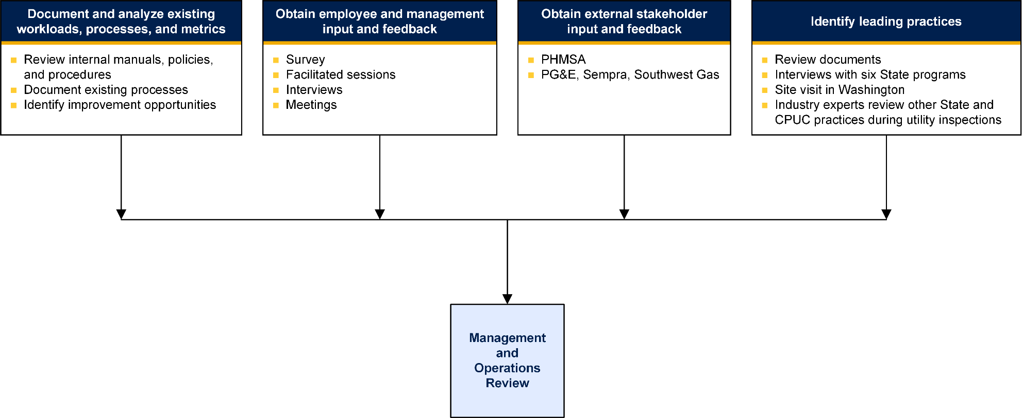
Project Methodology and Timeline
April 2014-March 2015

Slide 5
Report and Recommendations
Executive Summary
Introduction and Approach
GSRB Challenges, Opportunities, and Progress To Date
Recommendations, Implementation Steps, and Performance Metrics
Utility Inspection Recommendations
Incident Investigation Recommendations
Work Prioritization, Staffing, and Training Recommendations
Technology and Tools Recommendations
Communication and Change Management Recommendations
Risk Assessment Approach Recommendations

Slide 6
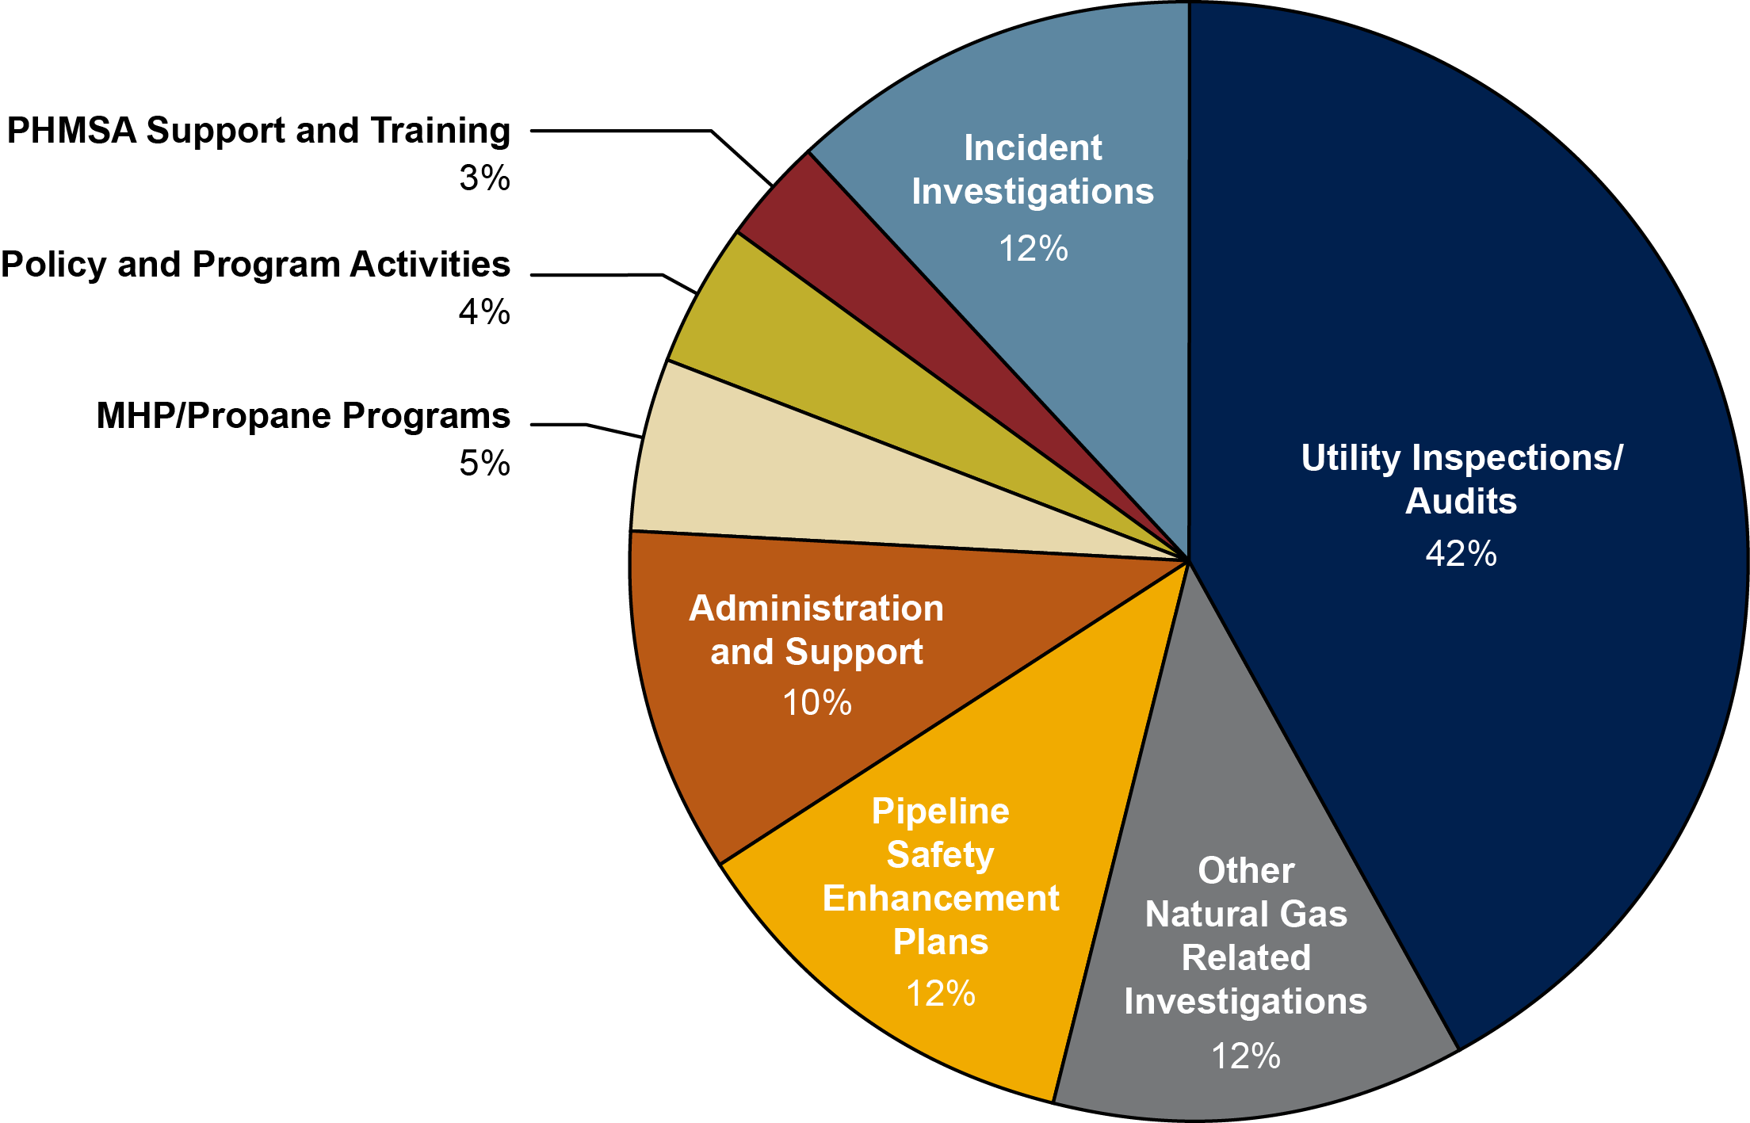
GSRB Roles and Responsibilities

Slide 7
GSRB Challenges and Opportunities
Challenge/Opportunity
❶ | Frequent management changes, shifting priorities, and reactive responses to internal and external recommendations post-San Bruno led to a loss of focus, lack of clear direction, loss of trust in leadership, and unacceptable work backlogs.
❷ | Disparate, cumbersome, and inadequate database systems that are challenging to use and not conducive to organized recordkeeping, identifying and responding to higher risk areas, monitoring progress, or tracking performance.
❸ | Lack of consistency, focus, organization, depth and rigor, adequate recordkeeping, clear expectations, and follow-through in utility inspection practices.
❹ | Delays in completion of utility inspection reports and lack of follow-through on violations, recommendations, observations, and concerns.
❺ | Delays in completion of incident investigation reports and lack of follow-through on violations, recommendations, observations, and concerns.
❻ | Inability to analyze trends, risks, and other safety-related concerns across incidents, utility inspection findings, self-reported violations, and complaints.
❼ | Assignment of staff to multiple tasks without clear prioritization of activities to those with the greatest impact on safety.
❽ | Lack of communication.
❾ | Lack of performance measures, clear expectations, and accountability.
❿ | Mix of staff experience and training does not provide a balance of regulatory, policy, or industry expertise to best support GSRB activities.
⓫ | Implementation of new citation program is challenging due to concerns on precedent, legal issues, and lack of clarity and specificity in applying penalties.
⓬ | Lack of integration of newly formed Risk Assessment and Enforcement Section.

Slide 8
GSRB Progress To Date
Year | Activities
2011 | Split Utility Safety and Reliability Branch (USRB) into Gas and Electric branches Initiated rulemaking proceeding R-11-02-019 to strengthen natural gas safety rules Closed NTSB recommendation P-10-7 on notifications to utilities Required CPUC voting meetings to include safety presentation | Added Utility Engineers Created Risk Assessment and Enforcement Section (RAS) Required utility pressure testing plans Authorized citations by GSRB engineers
2012 | Developed hazard report (RAS) Required utilities to prepare PSEPs Monitored PSEP activities (ongoing) Added Utility Engineers | CPUC established Safety Council Initiated specialized utility inspections/audits Increased flexibility in MHP/Propane inspections Increased whistleblower protections
2013 | Reorganized CPUC to create Safety and Enforcement Division (SED) Developed Audit (Utility Inspection) best practices Initiated rulemaking proceeding R-13-11-006 to incorporate risk assessment into general rate cases | Developed a Standard Operating Procedure for Gas Safety Citation Audits Issued over $8 million in citations Established bi-weekly coordination meetings with Energy Division
2014 | Prepared Utility Office of Safety and Reliability Annual Plan with goals and metrics Added Supervisor positions Reorganized GSRB to improve reporting and supervisory roles Adopted CPUC Safety Policy Statement Conducted 15 integrity management audits of utilities as of August 2014 | Closed NTSB recommendation P-10-5 on PG&E Maximum Allowable Operating Pressure Closed NTSB recommendation P-11-22 to conduct audits of PG&E with PHMSA Evaluated, with RAS, PG&E’s risk assessment approach in cost of service proposal Developed improved incident process Developed Self-Identified Violation process Revised approach to utility inspections

Slide 9
Recommendations and Implementation Steps

Slide 10
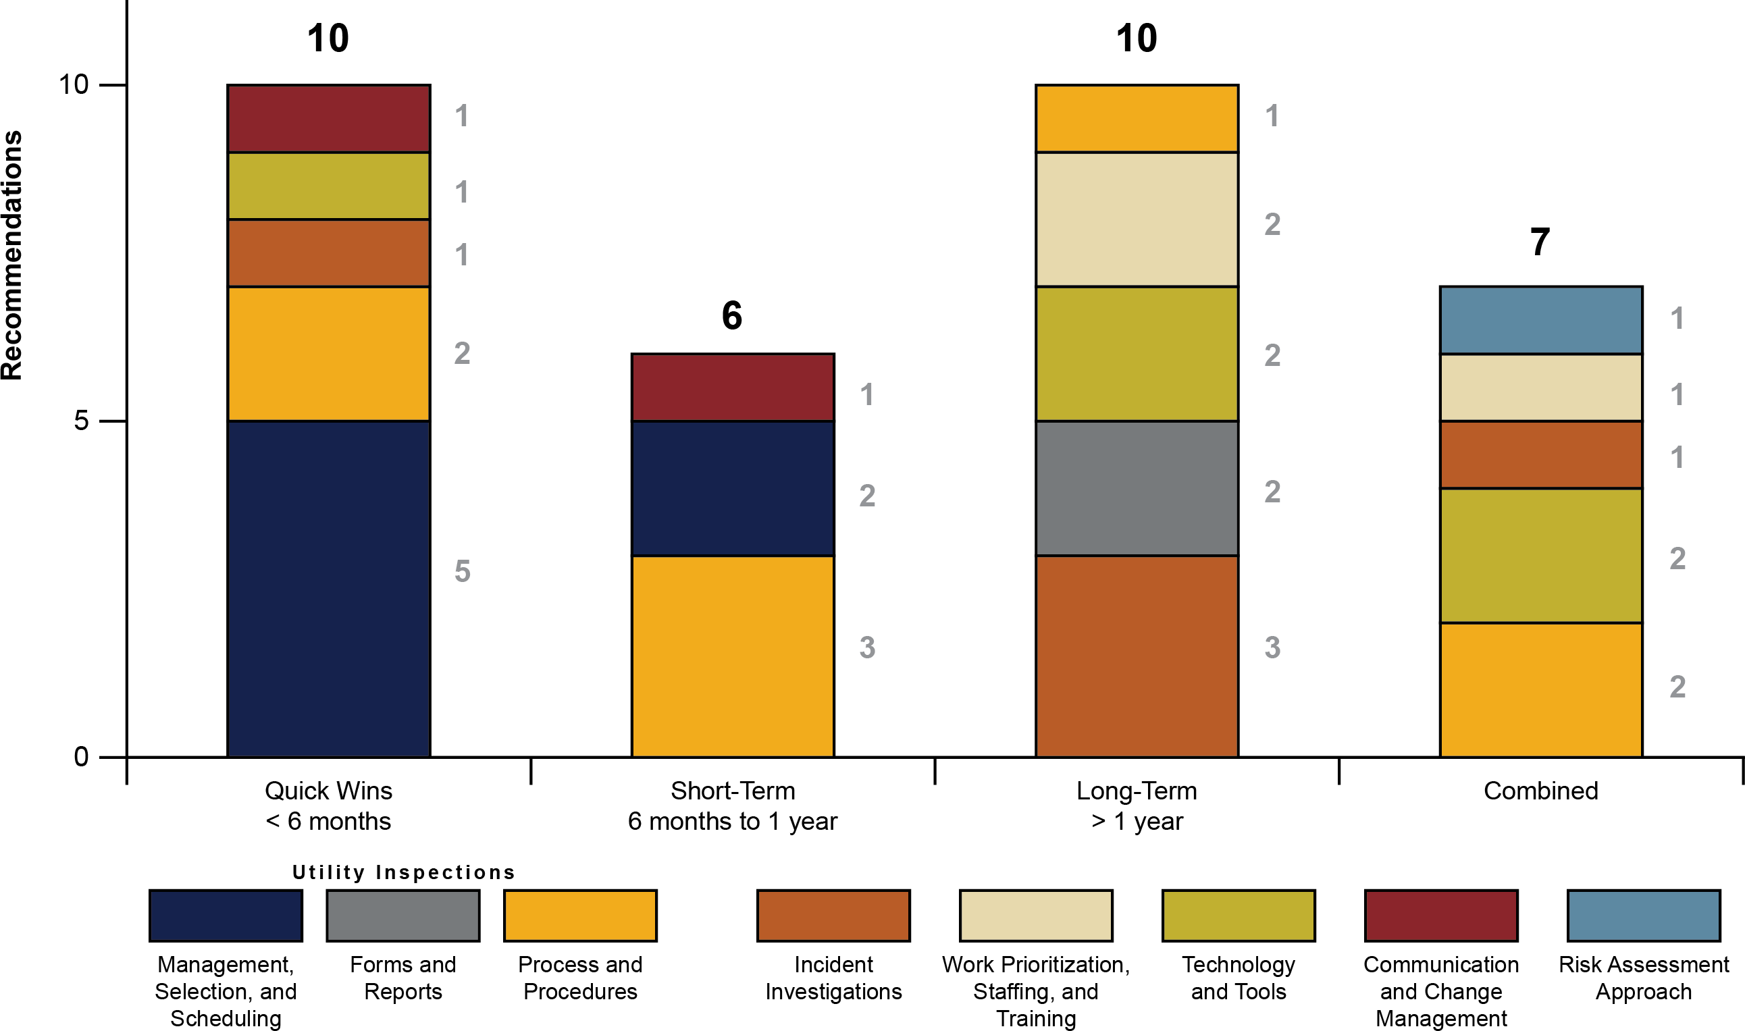
Recommendations and Implementation Steps
Timing

Slide 11
Recommendations and Implementation Steps
Priorities
Improving utility inspection performance
Upgrading outdated technology
Providing risk assessment
Addressing backlogs
Prioritizing and focusing work
Communicating activities, processes, and goals
Increasing PHMSA evaluation score

Slide 12
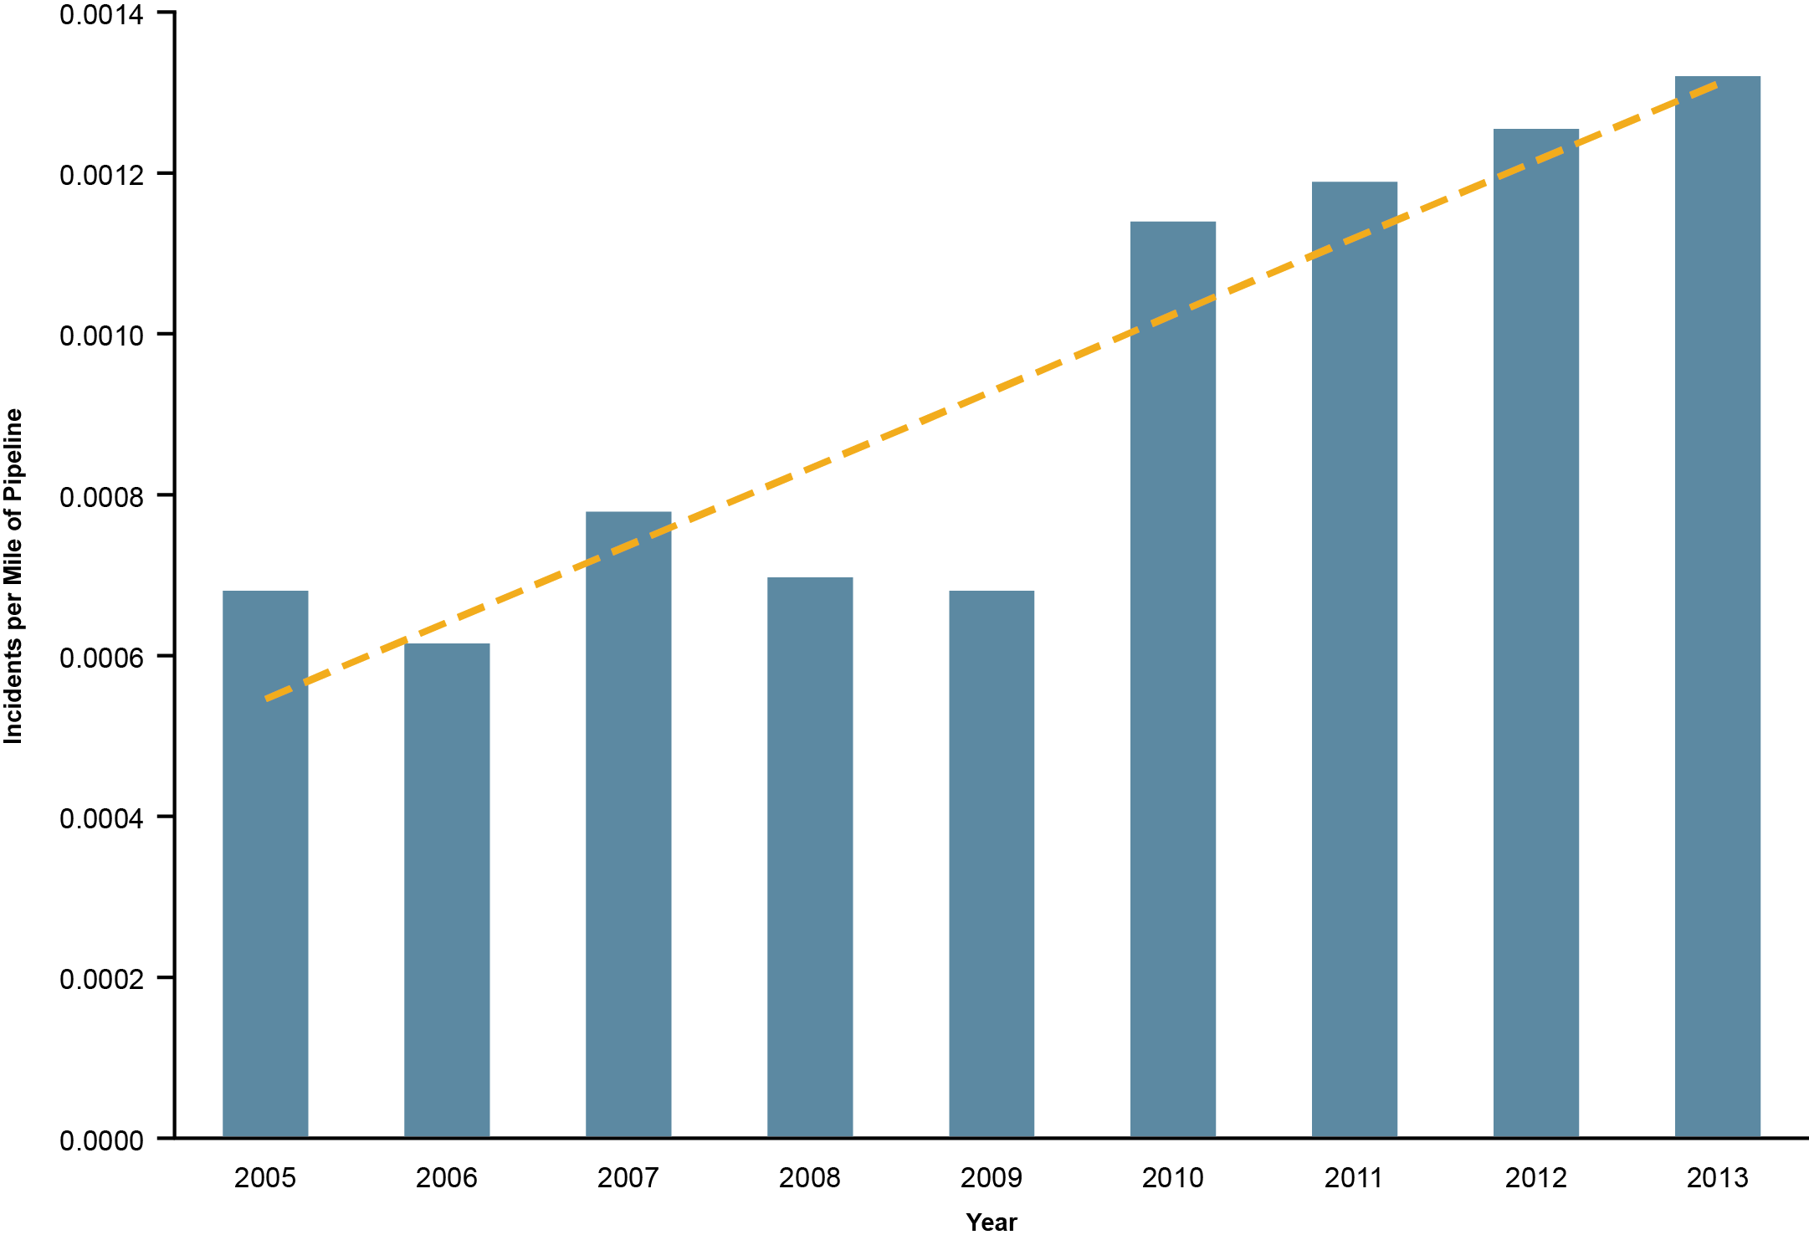
Performance Metrics
Recommended 19 performance metrics to track and measures progress
Example: incidents per mile of natural gas pipeline (2005 to 2013)

Slide 13
Thank you
The report will be available at:
http://www.cpuc.ca.gov/PUC/safety/Pipeline/
Wendy Pratt
wendy.pratt@crowehorwath.com
www.crowehorwath.com

