Slide 1
California Shortlines and Regional Railroads Kennan H. Beard III, Senior VP Modesto Empire Traction Company and President CSLRA David Buccolo, General Manger Central California Traction Company and Member of the National TRANSCARE Working Group
Not as long as our CLASS one PARTNERS but our TRACKS ARE JUST AS WIDE

Slide 2
A little History of the CCT, M&ET and Shortlines in California
Central California Traction Company (CCT)
Incorporated in 1905 to operate from Stockton to Sacramento
Began serving the Port of Stockton, California’s fourth largest port, in 2000
Handles cars for the food and wine industry as well as bulk minerals, ethanol and other hazardous materials
Equipped with a two mobile training railcars that travel the state to provide HAZMAT and emergency response training to First Responders
Modesto and Empire Traction Company (M&ET)
Founded in 1911 and has been owned and operated by the Beard family since it’s inception
Serves the communities of Modesto and Empire
Handles cars for over 50 local companies including the food, wine and agricultural industries
Participates yearly in TRANSCARE training of First Responders
Other CSLRA members railroads were leased or purchased from ATSF (now BNSF) Southern Pacific and Union Pacific. At Least 4 Shortlines have been in California for over 100 years.

Slide 3
Safety and the California Shortlines
Every member of the CSLRA is dedicated to SAFETY first, and providing safe, reliable transportation to our customers, class one partners and ports each and every day.
Many members have been sponsors of TRANSCARE in the past and will again in 2014
In 2013 CSLRA members sponsored ethanol response training at five stops in the state, 3
general railroad emergency response seminars and 1 chlorine response seminar.
In 2014, members are sponsoring training in 4 locations for chlorine first response and four railroad emergency response training classes around the sate

Slide 4
CSLRA Members
25 members from San Diego to the Oregon Border Serving the Ports Of San Diego, LA and Long Beach, Stockton and Richmond and San Francisco and rural areas of the Coast and the Central Valley, San Joaquin Valley and Sacramento Valley
Arizona and California Railroad
California Northern Railroad
Central Oregon and Pacific
Central California Traction Company
Fillmore and Western Railroad
Los Angeles Junction Railway
Modesto Empire Traction Company
Napa Valley Railroad
Northwest Pacific Railroad
Pacific Sun Railroad
Pacific Harbor Line
Richmond Pacific Railroad
Sacramento Valley Railroad
Santa Cruz and Big Trees Railway
San Diego and Imperial Valley Railroad
Sierra Northern and Sierra Railroads
San Francisco Bay Railway
Santa Cruz and Monterey Bay Railway
San Joaquin Valley Railroad
Santa Maria Valley Railroad
Stockton Terminal and Eastern
Trona Railway
Ventura County Railway
West Isle Line
Connecting with the BNSF and Union Pacific to complete the first or last mile of service to customers all over California and keeping rail as a vital link in the transportation network for large and small communities

Slide 5
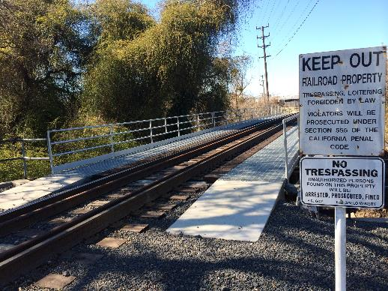
TRACK AND BRIDGE MAINTAINANCE
All Railroads are Required to maintain track to Federal Railroad Administration Regulations
49 CFR part 213, which mandates the minimum requirements for Class I, 2, 3, and 4 track.
Based on the Class of track it is inspected at a minimum once a week on the shortlines
Comply with FRA CFR 49 Part 237 Bridge Safety Standards and all bridges inspected at a minimum of yearly but when doing regular track inspections bridges are looked over each week.
Most shortlines use Ultra-sonic Testing at least once per year.
All Railroads must also comply with CPUC regulations and General Orders which do not conflict with FRA Regulations many of which place a hardship on small railroad operations with no benefit to safety.

Slide 6
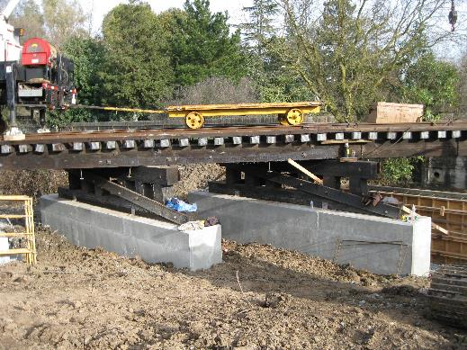
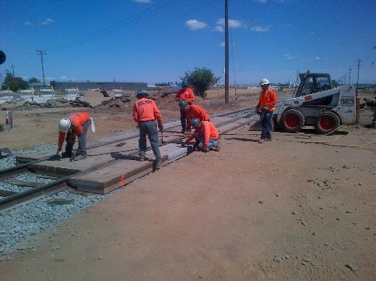
CSLRA Railroad members inspect bridges with both in-house employees and major bridge engineering firms using professional engineers who are certified in California. When defects are noted, repairs are made. Members maintain tracks to FRA Class 1 ,2,and 3 requirements and Inspect tracks to meet all FRA requirements.

Slide 7
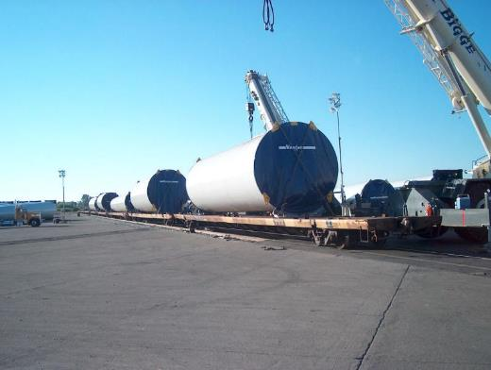
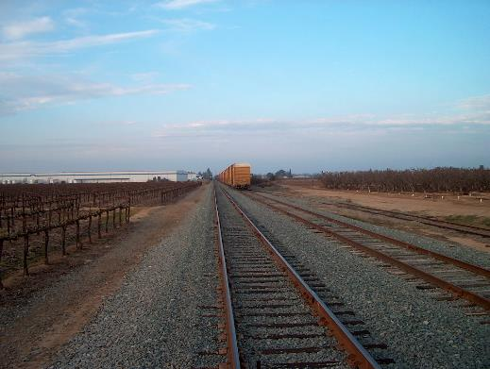
Infrastructure of the California Shortlines California Shortlines all have Capital budget projects to maintain and upgrade the infrastructure of the properties they own and lease

Slide 8
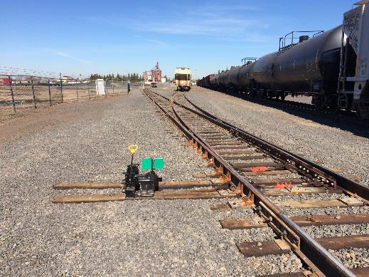
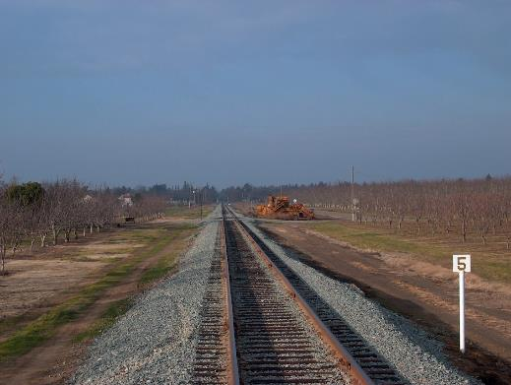
Tracks of the M&ET and the CCT

Slide 9
THANK YOU FOR YOUR TIME TODAY
Any Questions ?

