Slide 1
Treatment for Addiction in the Community Reduces Drug Use, Crime and Recidivism
Richard A. Rawson, Ph.D, Professor
Semel Institute for Neuroscience and Human Behavior
David Geffen School of Medicine
University of California at Los Angeles
www.uclaisap.org
rrawson@mednet.ucla.edu

Slide 2
“The takeaway from the CDCR report should be that the public and leaders at all levels of government should get past doomsday rhetoric about realignment and work with counties to attack the link between drugs and crime. “ Editorial: Realignment hasn't caused a crime wave Sac Bee, May 28, 2013

Slide 3
Individuals involved in the criminal justice system have very high rates of alcohol and drug use.

Slide 4
Severity of Substance Abuse Disorders Among Inmates
70-80% inmates have used illegal drugs
Adults--31% Males, 52% Females need intensive tx services
53% meet criteria for abuse/dependence
Juveniles—50% need services
Percent
Belenko & Peugh (2005)
Notes:
Absent treatment, most released inmates with drug use histories return to drug use and crime (Martin et al., 1999; Langan & Levin, 2002)

Slide 5
Justice-Involved 4 Times More Likely to Have SUD Than General Population
National Household Survey on Drug Use and Health, 2005.

Slide 6
Co-Occurring Disorders Common among State Inmates
 | NO PROBLEMS | DRUG ABUSE/ DEPENDENCE ONLY | MENTAL HEALTH DISORDER ONLY | DRUG ABUSE/ DEPENDENCE & MENTAL HEALTH DISORDER
TOTAL INMATE POPULATION | 29.6% | 22.0% | 17.8% | 30.6%
OFFENSE TYPE
VIOLENT | 32.9% | 18.8% | 21.0% | 27.3%
DRUG | 26.1% | 28.5% | 11.7% | 33.7%
NON-VIOLENT NON-DRUG | 26.3% | 22.9% | 16.7% | 34.1%

Slide 7
A Focus on Opiate Use

Slide 8
Opioid Dependence is a Growing Public Health Concern in the US
65% of jail and prison population meet criteria for a substance use disorder
23% have a history of opioid use (heroin and prescription painkillers)
People age 12 or older dependent on or abusing heroin or pain relievers. Growing Incidence of Opioid Dependence in the US, 2002-2008. SAMHSA NSDUH 2008, p. 268

Slide 9
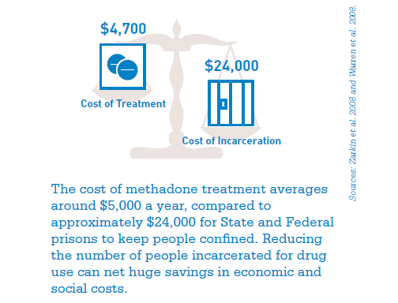
Treating Addiction in the Criminal Justice Population is Cost-Effective
Principles of Drug Abuse Treatment for Criminal Justice Populations. (2012). NIDA. NIH Publication No. 11-5316

Slide 10
Treatment Approaches for Offenders Need to Use Contemporary Evidence-Based Practices

Slide 11
Addiction Treatment in 2013
What do the following things have in common:
Audio Cassette Tapes
Telephone Answering Machines
Electric Typewriters
TV Shows: The Love Boat and Fantasy Island
Addiction treatments currently used in the California criminal justice system

Slide 12
Answer:
They all belong to the 1970s

Slide 13
Addiction Treatment Model 1975 “Put them in a box and cure them”
Drug User
Treatment
NTOMS Sample of 250 Programs
Non- Drug User

Slide 14
Addiction Treatment Model 2013 “Maximize Effectiveness using a Continuum of Care”
Detox
Residential Treatment
Outpatient Behavioral and Medication Treatment
Continuing Care/Recovery Support Services
Notes:
Continuity of care is extending treatment beyond acute care. It is step down care for higher-intensity to lower-intensity services, or stepping up to higher intensity if necessesary.
It is basically a fluid system of transfer for clients within and outside of the system to make sure their needs are met.

Slide 15
Standardized Assessment and Patient Placement
Standardized Assessment
Standardized Patient Placement
Detox
Residential
Outpatient
Continuing Care/Recovery Support Services

Slide 16
The Role of Medication Assisted Treatment (MAT)

Slide 17
Major Advancements in SUD Treatment
Methadone treatment has been acknowledged by the UN and WHO as an essential medication and the most effective treatment for opiate dependence currently available.
Over the last decade, the FDA has approved two new medication for the treatment of substance use disorders:
Buprenorphine (Suboxone)
Extended-release Naltrexone (Vivitrol)
The vast majority of scientific evidence documents the effectiveness of MAT in treating opioid addiction
Medication-Assisted Treatment For Opioid Addiction in Opioid Treatment Programs. (2008). SAMHSA

Slide 18
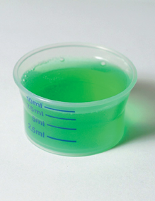
Methadone
Orally active synthetic μ agonist which blocks euphoria.
Long half-life, slow elimination
Effects last 24 hours; once-daily dosing maintains constant blood level
Prevents withdrawal, reduces craving and use
Clinic dispensing limits availability

Slide 19
Crime Among 491 Patients Before And During MMT at 6 Programs
Crime Days Per Year
Adapted from Ball & Ross - The Effectiveness of Methadone Maintenance Treatment, 1991
Opioid Agonist Treatment of Addiction - Payte - 1998

Slide 20
Methadone Experiment: 6 Mo Post Release (N=201)
In-Custody Methadone Induction Improves Treatment Effectiveness
-- signif. diff from referral
-- signif. diff from treatment only on release
Gordon, M.S., Kinlock, T.W., Schwartz, R.P., O’Grady, K.E. (2008).
Notes:
Stat sig: Tx days: A vs. B. vs. C sig; Crime days A vs C.
heroin days, opiod UA: A vs. C. Cocaine; UA ns (days: A vs. B): cell ns=63, 68, 70; N=201.

Slide 21
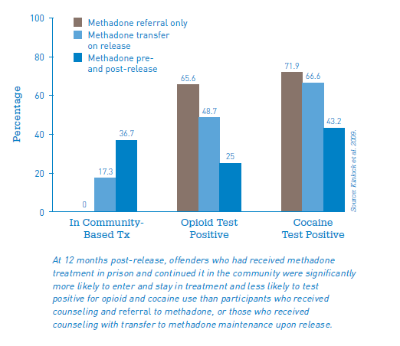
In-Custody Enrollment in Methadone Treatment
Principles of Drug Abuse Treatment for Criminal Justice Populations. (2012). NIDA. NIH Publication No. 11-5316

Slide 22
Buprenorphine
Partial opioid agonist with limited potential for overdose
Minimal subjective effects (e.g., sedation) following a dose
Available for use in office settings
Lower level of physical dependence
Suboxone ® limits diversion by causing severe withdrawal symptoms in addicted users who inject it to get “high.”

Slide 23
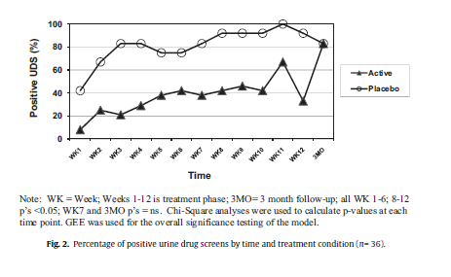
Buprenorphine For Women in the Criminal Justice System
Opioid-dependent women who were given active buprenorphine over a 12-week intervention period had lower relapse rates after returning to the community than those who did not receive medication.
Cropsey, et al. (2011). Results of a pilot randomized controlled trial of buprenorphine for opioid dependent women in the criminal justice system. Drug and Alcohol Dependence, 119, 172-178

Slide 24
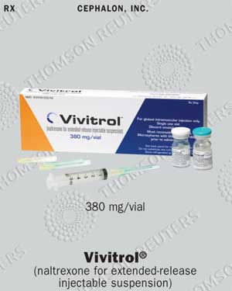
Extended Release Naltrexone
Opiate antagonist available in tablet or extended-release injection form (Vivitrol ®).
This medication is an effective opioid treatment with few side effects
Naltrexone treatments are an especially promising therapy for opiate dependence with correctional populations because of the low abuse liability and lack of euphoria associated with this treatment.
Cropsey, et al. (2005). Pharmacotherapy Treatment in Substance-Dependent Correctional Populations: A Review. Substance Use & Misuse, 40, 1983-1999.

Slide 25
Six Month Treatment Outcomes All Sites
p =.003
p = .011
p = .311
Coviello et al., In Press

Slide 26
Comparative Evidence Base of MAT for Opioid Dependence
Despite the success of agonist treatments such as methadone and buprenorphine, few offenders receive these treatments
Criminal justice system has not been favorable to agonist treatments
 | Efficacy | Community Effectiveness | CJS Feasibility | CJS Effective | CJS Adoption
Methadone | ++++ | +++ | +++ | ++ | +
BUP-NX (buprenorphine) | ++++ | +++ | ++ | + | +
XR-NTX | ++ | ++ | +++ | ++ | ?
Lee, et al. (2013) Presentation: Extended-Release Naltrexone for Opioid Relapse Prevention at Jail Re-entry.

Slide 27
Recommendations
Make all Addiction Medications Pharmacy Benefits
Include Methadone Maintenance as a benefit for all individuals with opioid addiction (in the exchange plans)
Have CDC and county jails employ proactive enrollment of patients in MAT before release

Slide 28
Recommendations
Support AB Bills:
AB 395 – To allow residential SUD treatment programs licensed by the department to include on-staff physicians knowledgeable of addiction medicine as part of a multidisciplinary healthcare team
AB 720 – To require counties to designate an individual or agency to enroll into Medi-Cal certain individuals held in county jail, consistent with federal requirements
AB 889 – Would require a plan or insurer to have an expeditious process in place to authorize exceptions to step therapy when medically necessary, and to conform effectively and efficiently to continuity of care

