Slide 1
“Coming Home” Recovery, Treatment, & Funding Strategies for successful reintegration of incarcerated persons who have a Serious Mental Illness
June 1, 2013
Presented by
Ross C Peterson
Vice President,
Telecare Corporation

Slide 2
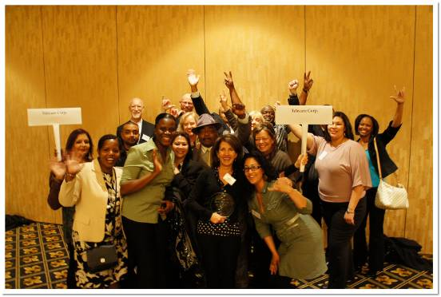
About Telecare
Headquartered in Alameda, CA
Family, woman, employee-owned
80+ programs & 2, 500 employees in 8 states
Specialize in services for people with SMI and SA,DD,CJ, involvement

Slide 3
Celebrating the Value of Partnerships
1965:
1 program
1 state
1 county
3 payers
1985:
5 programs
1 state
3 counties
5 payers
2013:
80 programs
8 states
22+ counties
40+ payers

Slide 4
Our Early Experiences Working with Forensic Consumers
1998 Con Rep
Solano subcontract Day Treatment
2000 Psych Inpatient Alameda / Oakland County Jail
Oregon PSRB
16 bed Secure Residential
Woodburn (2006)
Bend (2010)
2001 -2005 MIOCGA
Solano
Alameda

Slide 5
AB34/2034 Homeless Outreach
These programs changed the face of California
Outcome driven ACT /FSP Model
Reduce homeless, ER, inpatient, in-jail days and return to prison rates
Include large number of Parolees and Probationers
Telecare provided services, LA, San Diego, San Mateo, Santa Barbara, Stanislaus and Ventura
Lead to Prop 63 and statewide Full Service Partnership approach. Has leveraged millions of dollars of FFP via County Specialty Mental Health Medi-Cal program

Slide 6
MHSA Funded Forensic Services
Prop 63 substantially expanded the system of care but did not include Parolees (viewed as a State responsibility)
MHSA does fund Court Collaborative and specialized FACT programs for Probationers
Telecare currently operates programs in Orange, San Diego and San Bernardino Counties

Slide 7
San Bernardino FACT

Slide 8
Criminogenic Risk & Need Factors
Static (can’t be changed)
Age
History of Antisocial Behavior
Dynamic ( can change behaviors, attitudes, choices)
Criminal personality (anti-social behavior)
Antisocial attitudes, values and beliefs
Antisocial associates (criminal peers)
Poor self control and problem solving skills
Substance Abuse
Dysfunctional family (marital and family relations)
Employment and Employment Skills

Slide 9
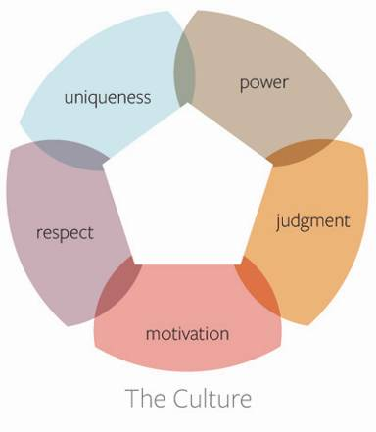
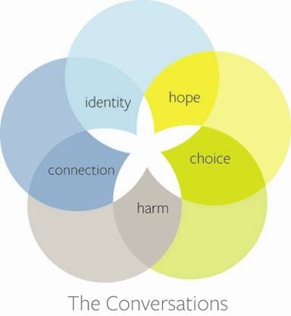
Recovery Center Clinical System(RCCS): Culture, Conversations
Notes:
Speaker TBD: Marc/Amy/Jim

Slide 10
California Prison and Parole Populations
In 2009 California had 167,832 persons in State Prisons and 111,202 on parole
Persons with mental illness are disproportionately represented:
4 to 8 times higher than in general population
As high as almost 20% of prison population
Higher rates of parolee violations
Some studies have shown as high as 95% (dual dx)
70% to 80% with serious mental illness compared 50 to 60% for persons with criminal behaviors.
Parolee expanded services through the development of Integrated Services for Mentally Ill Parolees

Slide 11
Integrated Services for Mentally Ill Parolees (ISMIP)
Telecare was awarded 4 of these 8 pilot programs:
San Diego County
San Bernardino County
Two in LA County
Other programs include:
Kern County
Sacramento County
San Francisco County
Santa Clara County

Slide 12
Telecare CORE Programs Los Angeles, San Bernardino San Diego
Corrections Outpatient Recovery Enhancements (CORE)
Multidisciplinary Team (ACT) approach
Integrated services
Team approach
Low client-staff ratios
Locus of contact in the community
Medication management (Medi-Cal)
Focus on everyday problems in living

Slide 13
The ISIMP Challenges
Identifying eligible parolee
Medi-Cal and SSI benefits
Housing Options / Homelessness
Access to Health Care
Access to Medications
Need for pre-employment and vocational services
High levels of co-occurring substance abuse
Lack of access to Specialty Mental Health Funding

Slide 14
Recommendations
Allow CDCR to contract with CAMHSA as a Specialty Mental Health Provider for ISMIP services or via the Counties
It is estimated 30% -40% current cost of services for Medi-Cal eligible consumers could be funded via FFP
With proposed expansion of ISMIP from its current 400 to 5,000 members this could save millions of State General Fund dollars

Slide 15
Recommendations (Continued)
2. Allow smaller Parolee specialized case loads for consumers with serious mental illness.
3. Begin Benefit Application process as soon as allowable while persons are still in Prison.
4. Where “injectables” are clinically indicated begin process while still in Prison.

Slide 16
Recommendations (Continued)
5. Promote Evidence-Based Practices and Programs *
Assertive Community Treatment
Integrated Mental Health and Substance Abuse
Supported Employment
Supported Housing
Cognitive Behavioral Treatment
* (Checklist of SAMSHA Gains Center for Behavioral Health and Justice Transformation)

