Slide 1
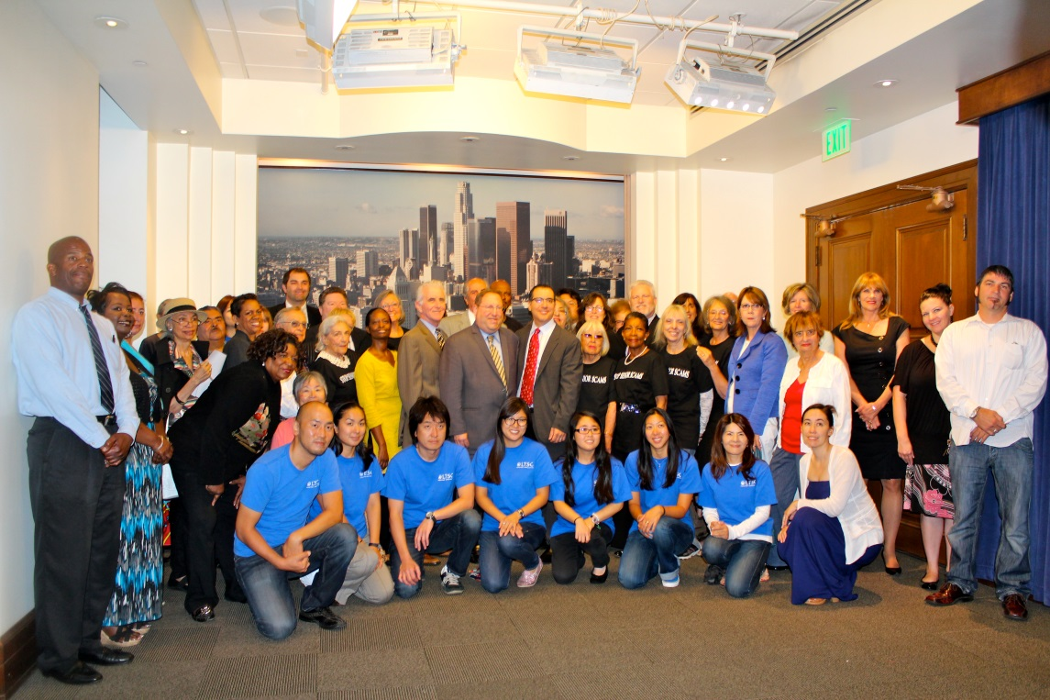
Inform ~ Educate ~ Engage

Slide 2
MISSION:
The Los Angeles Aging Advocacy Coalition seeks to build a formal and united alliance to:
To advocate on issues affecting the well-being of older adults and their caregivers
To provide information on issues affecting aging adults
To engage in the planning, designing and implementation of service delivery and coordination model
To offer educationally enriched opportunities for members and the community
To provide a forum to promote professional networking

Slide 3
Inform ~ Educate ~ Engage
Policy Agenda
Policy Briefs
Weekly E-Newsletter
Monthly Meetings Via Webinar
Legislative meetings & roundtables with policy makers
Annual Summit

Slide 4
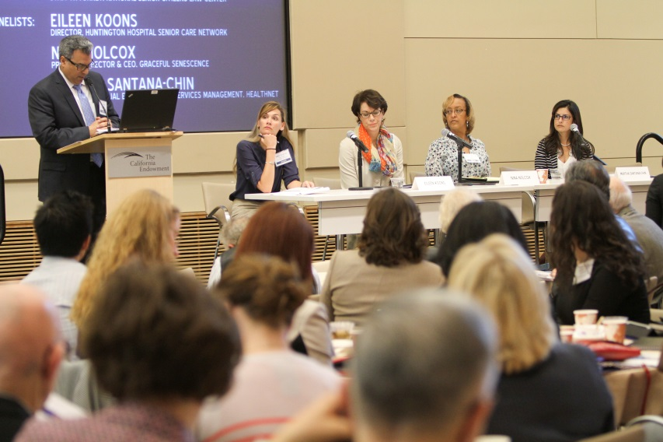
Annual Aging Summit

Slide 5
2014 HIGHLIGHTS AT-A-GLANCE
60 Member Organizations
27 Summit Sponsors
$72,000.00: 2014 Summit Revenue

Slide 6
Successful Initiatives
Influenced preservation of funding for evidence-based programs that keep older adults out of hospital beds and emergency rooms
Educated elected and appointed officials on impact of federal budget sequestration that threatened meal programs and other critical services for older adults; led to elected officials at the local level finding funds to offset budget cuts
Prevented the dismantling of the City of Los Angeles Department of Aging and stopped the elimination of the Long Beach Senior Center
Strengthened relationships between community based social service organizations and the healthcare sector to improve the integration of and access to coordinated services among older adults

