Slide 1
What is the Affordable Care Act’s Impact on Medi-Cal and California?
Ken Jacobs
UC Berkeley Center for Labor Research and Education
February 2013

Slide 2
California Simulation of Insurance Markets (CalSIM)
Developed by UC Berkeley Center for Labor Research and Education and UCLA Center for Health Policy Research with support from The California Endowment
Enrollment estimates produced for Covered California
Predicts the impact of the Affordable Care Act (ACA) on employer decisions to offer coverage and individual decisions to obtain coverage in California
Uses public data sources—mostly state-specific, including California Health Interview Survey

Slide 3
Medi-Cal Expansion (Newly Eligible)
Adults under age 65 with income below 138% Federal Poverty Level (~$15,000 single individual, ~$32,000 for a family of four)
More than 1.4 million eligible in 2014-2019
Roughly 75% adults without children living at home
750,000-910,000 expected to enroll by 2019

Slide 4
1.46 million Californians Will Be Newly Eligible for Medi-Cal
Newly Eligible for Medi-Cal
by Source of Insurance without the ACA, 2019
Total Eligible: 1,460,000
Source: UC Berkeley-UCLA CalSIM model, version 1.8

Slide 5
Nearly half of the newly eligible will be Latino
Californians under Age 65 Newly Eligible for Medi-Cal, Base Scenario, 2019
Race/Ethnicity
English Proficiency
Source: UC Berkeley-UCLA CalSIM model, version 1.8

Slide 6
The Majority of Those Eligible for Medi-Cal, but Not Enrolled, Have Another Source of Coverage
Eligible for Medi-Cal but Not Enrolled
by Source of Insurance without the ACA, 2019
Total Eligible: 2,530,000
Source: UC Berkeley-UCLA CalSIM model, version 1.8

Slide 7
Medi-Cal Enrollment Increase Among Those Already Eligible
240,000-510,000 expected to enroll by 2019
71% of those eligible are children, remainder are parents
Most of increase will happen regardless of the Expansion due to mandatory provisions of ACA:
minimum coverage requirement for individuals;
simplified eligibility, enrollment & renewal processes; and
improved awareness of coverage.

Slide 8
In total Medi-Cal predicted to grow by 1 million or more by 2019.
Californians under Age 65 Predicted to Take Up in the
Subsidized Exchange and Medi-Cal, 2014-2019 (in millions)
Enhanced
Enhanced
Base
Base
Source: UC Berkeley-UCLA CalSIM model, version 1.8

Slide 9
Expanding Medi-Cal will Benefit Economy
100,000 new jobs per year in California due to ACA provisions including the Medi-Cal Expansion, according to Bay Area Council Economic Institute
Research suggests that health insurance coverage can improve educational outcomes and worker productivity
Sources: Haveman and Weinberg 2012; Levine and Schanzenbach 2009; Pitard, Hulsey, Laditka and Laditka 2009; Dizioli and Pinheiro 2012; Nguyen and Zawacki 2009.

Slide 10
Expanding Medi-Cal Improves Health Outcomes
Previous Medicaid expansions associated with reduced mortality
Adults with Medicaid in Oregon were more likely to have regular place of care, usual doctor and use preventive care
Sources: Sommers, Baicker and Epstein 2012; Baicker and Finkelstein 2011.

Slide 11
Federal Government will Pay:
100% of health care costs for newly eligible in 2014 through 2016, phasing down to 90%in 2020 and future years;
50% for parents and children who are already eligible for Medi-Cal;
88% for Healthy Families children in 2015 to 2019, and 65% in 2014; and
50% of administrative costs for all Medi-Cal enrollees and 65% for those eligible under Healthy Families.

Slide 12
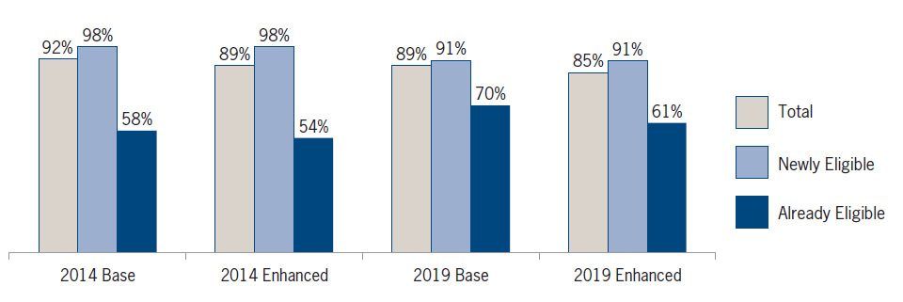
Federal Government Will Pay for At Least 85% of New Medi-Cal Spending
Share of New Medi-Cal Spending Federally-Paid with Expansion
Source: Lucia L, Jacobs K, Watson G, Dietz M and Roby DH. Medi-Cal Expansion under the ACA: Significant Increase in Coverage with Minimal Cost to the State. January 2013.

Slide 13
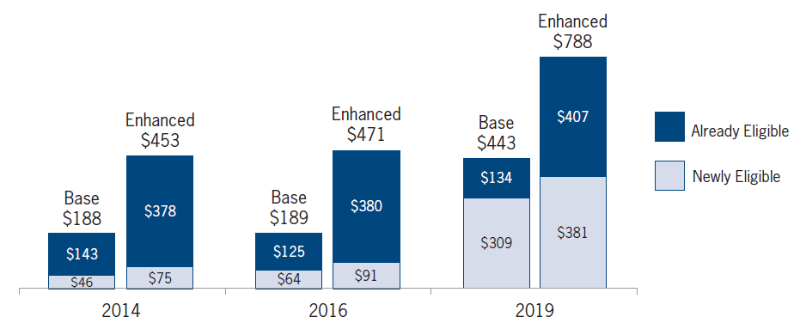
Most New State Spending Not Due to Expansion in 2014-2016
New State General Fund Spending with Expansion ($ millions)
Source: Lucia L, Jacobs K, Watson G, Dietz M and Roby DH. Medi-Cal Expansion under the ACA: Significant Increase in Coverage with Minimal Cost to the State. January 2013.

Slide 14
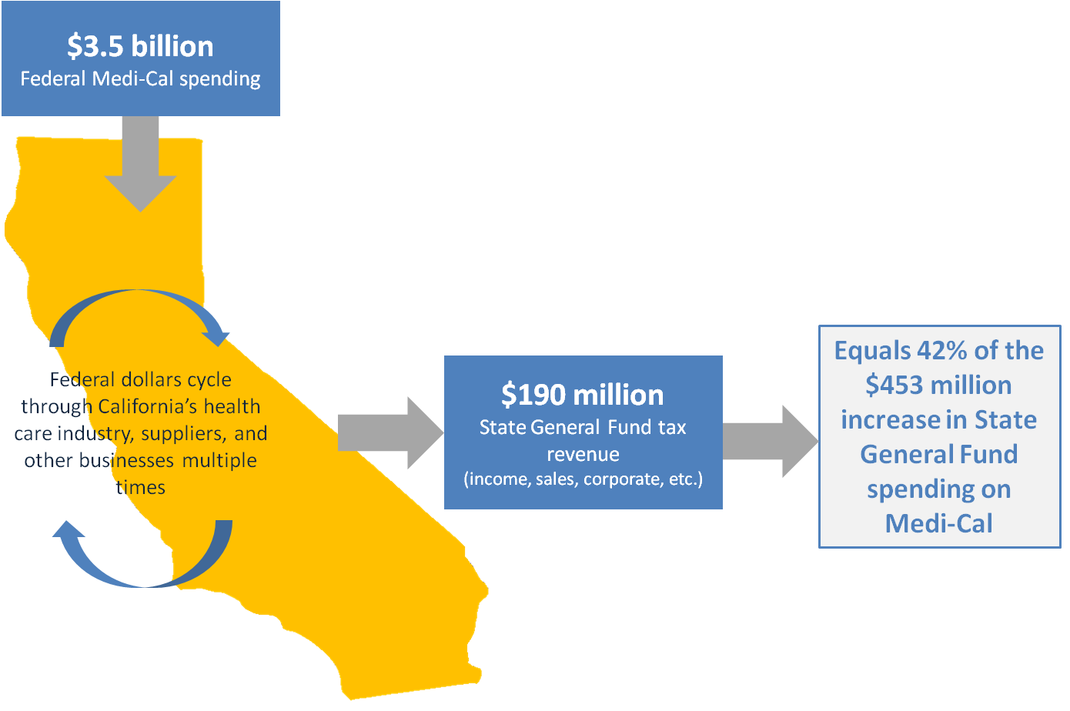
New Federal Medi-Cal Spending will Generate New State Tax Revenue
Source: Lucia L, Jacobs K, Watson G, Dietz M and Roby DH. Medi-Cal Expansion under the ACA: Significant Increase in Coverage with Minimal Cost to the State. January 2013.

Slide 15
Medi-Cal Expansion will Result in other State Savings
Movement of some individuals from partial- to full-scope Medi-Cal with higher match rate
State prison costs
Higher reimbursement for hospital services outside of the correctional system
Increased mental health and substance use coverage could reduce incarceration over time
County savings harder to quantify

Slide 16
3-4 Million Californians are Predicted to Remain Uninsured in 2019
Uninsured Californians under age 65, 2019
Source: UC Berkeley-UCLA CalSIM model, v1.8
Notes:
Describe how Medi-Cal eligibles can sign up at provider, but Exchange eligible have to wait for open enrollment unless qualifying for a special enrollment period based on life transition
Important for Medi-Cal eligibles to sign up in advance of needing care. Oregon Medicaid experiment showed that people with Medicaid coverage were 70% more likely to have a regular place of care, 55% more likely to have a usual doctor, increased use of preventive care (by 60%) and cholesterol monitoring (by 20%)

Slide 17
For More Information
UC Berkeley Center for Labor Research and Education:
http://laborcenter.berkeley.edu/healthcare/
Ken Jacobs (kjacobs9@berkeley.edu)
UCLA Center for Health Policy Research
http://healthpolicy.ucla.edu/Pages/home.aspx
Jerry Kominski (kominski@ucla.edu)
Dylan Roby (droby@ucla.edu)

