Slide 1
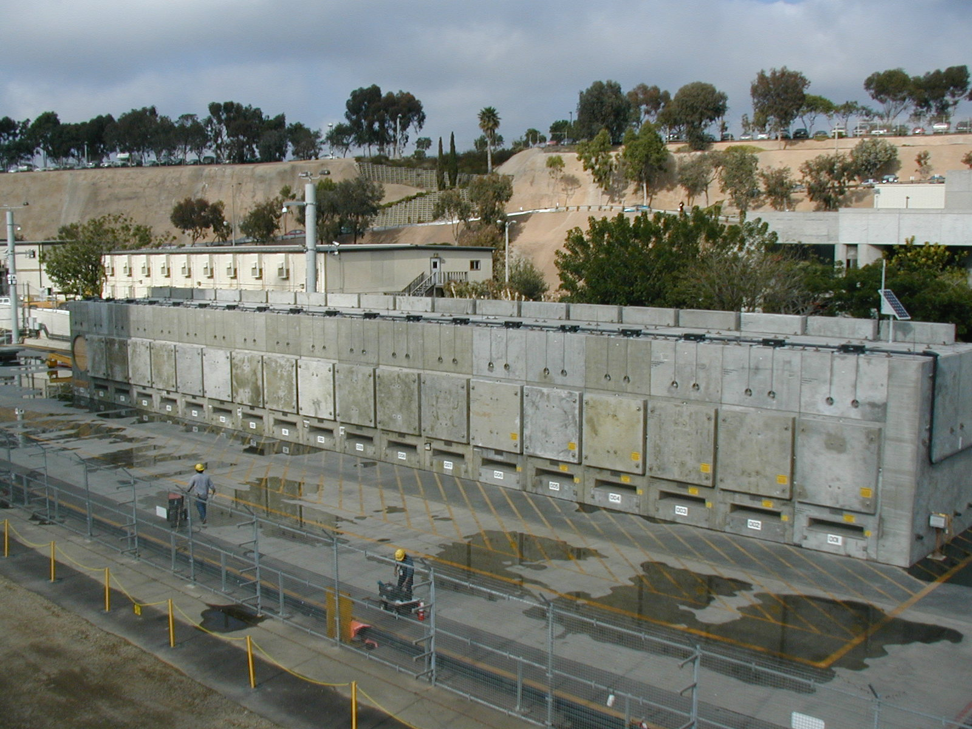
San Onofre Nuclear Generating Station ISFSI

Slide 2
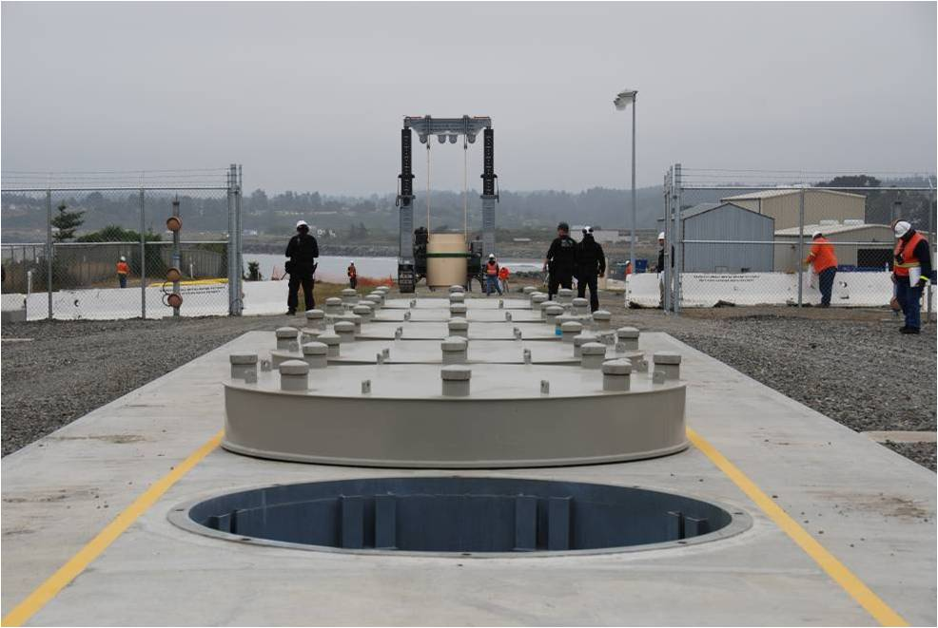
Humboldt Bay ISFSI

Slide 3
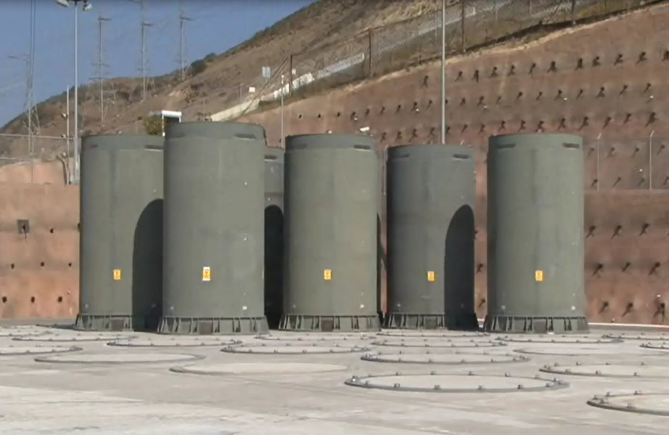
Diablo Canyon ISFSI

Slide 4
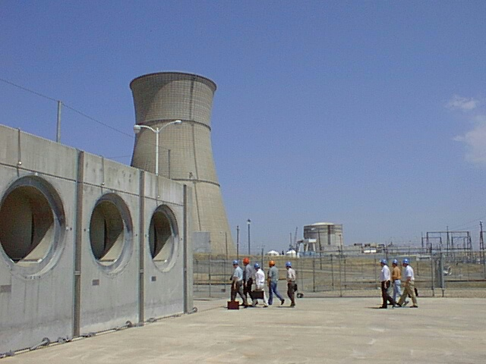
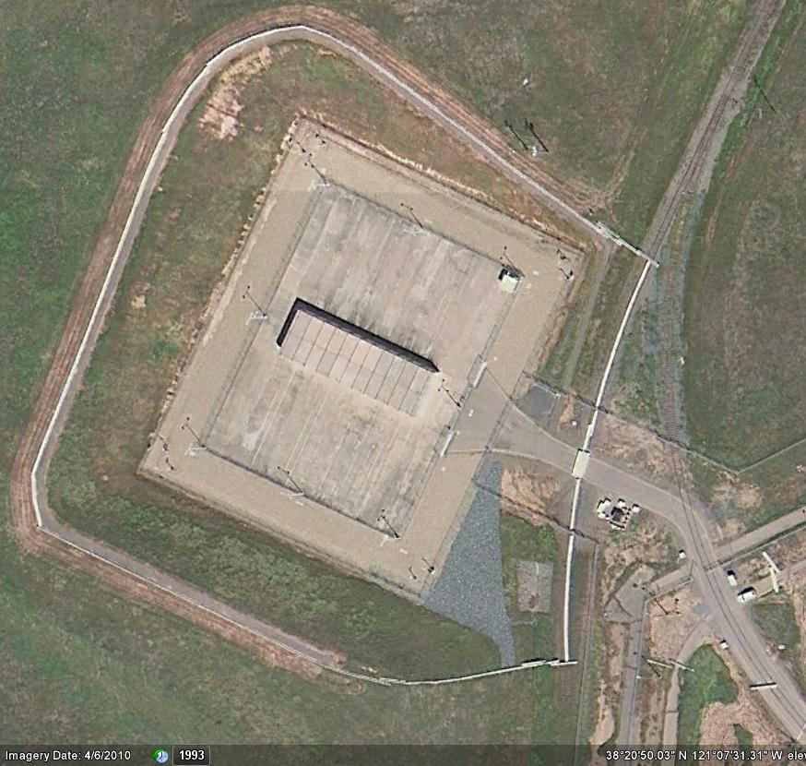
Rancho Seco ISFSI

Slide 5
Trojan - 2005

