Slide 1
UCLA Climate Research Lounge

Slide 2
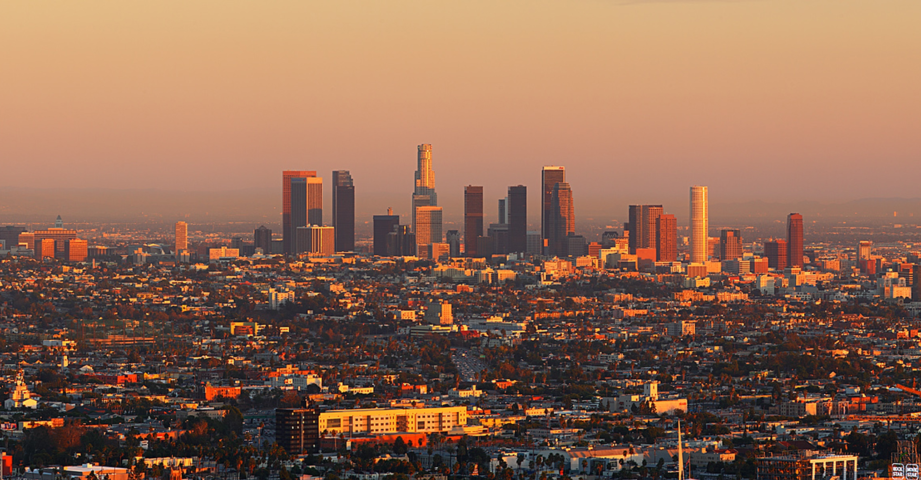
What Climate Change Means for Southern California:
Results From the Climate Change in the Los Angeles Region Project
Alex Hall
December 3, 2013

Slide 3
Notes:
Figure SPM.6 | Comparison of observed and simulated climate change based on three large-scale indicators in the atmosphere, the cryosphere and the ocean: change in continental land surface air temperatures (yellow panels), Arctic and Antarctic September sea ice extent (white panels), and upper ocean heat content in the major ocean basins (blue panels). Global average changes are also given. Anomalies are given relative to 1880–1919 for surface temperatures, 1960–1980 for ocean heat content and 1979–1999 for sea ice. All time-series are decadal averages, plotted at the centre of the decade. For temperature panels, observations are dashed lines if the spatial coverage of areas being examined is below 50%. For ocean heat content and sea ice panels the solid line is where the coverage of data is good and higher in quality, and the dashed line is where the data coverage is only adequate, and thus, uncertainty is larger. Model results shown are Coupled Model Intercomparison Project Phase 5 (CMIP5) multi-model ensemble ranges, with shaded bands indicating the 5 to 95% confidence intervals. For further technical details, including region definitions see the Technical Summary Supplementary Material. {Figure 10.21; Figure TS.12}

Slide 4
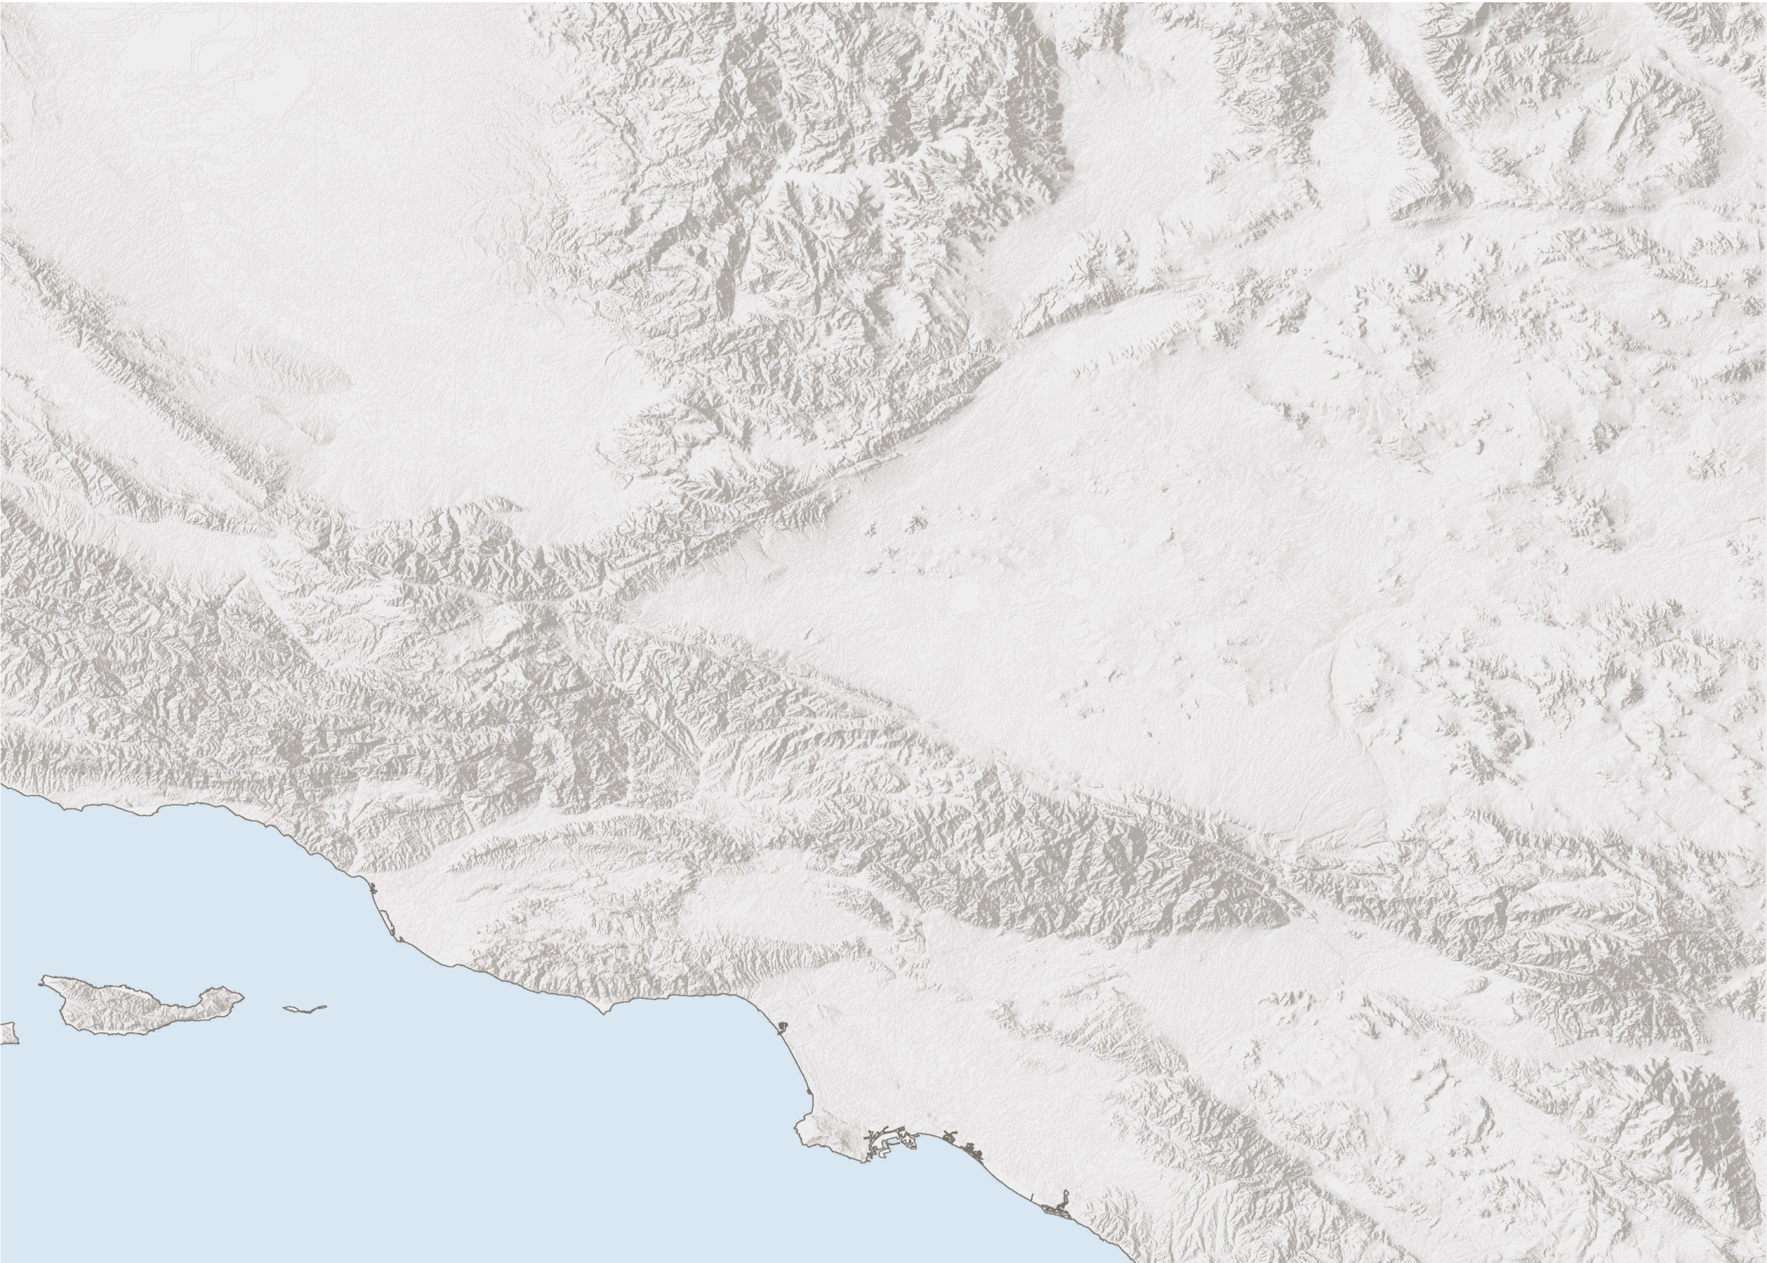
Palmdale
San Fernando Valley
Ventura
San Bernardino
Downtown LA
Santa Monica
Long Beach
Notes:
Delete

Slide 5
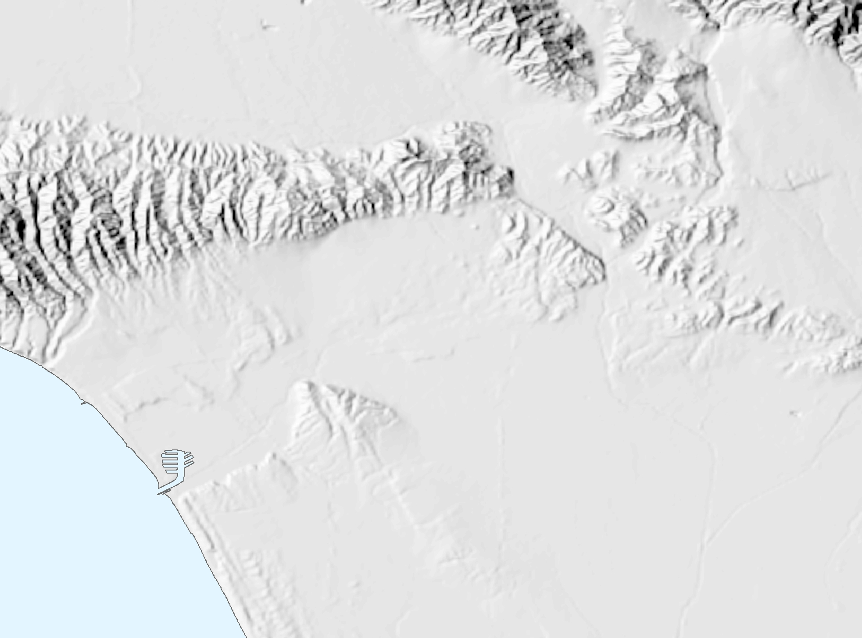
Burbank
Sherman Oaks
Glendale
Pasadena
Hollywood
Downtown LA
Santa Monica
Culver City
South
Los Angeles
Inglewood
Downey

Slide 6
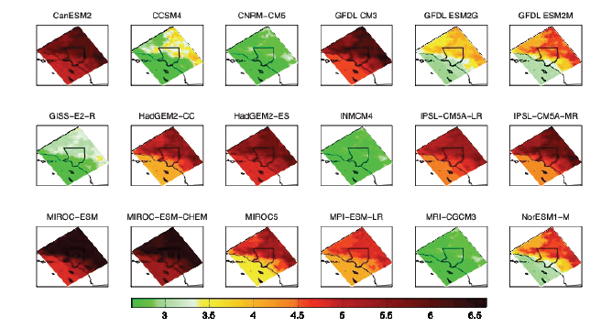
We applied ~30 global climate models to the Los Angeles region

Slide 7
We projected future climate for 2 scenarios
ppm
Baseline
Mid-Century
End-Century
1400
1200
Business As Usual
400
Mitigation
Observed
200
1880
1960
2000
2040
2080

Slide 8

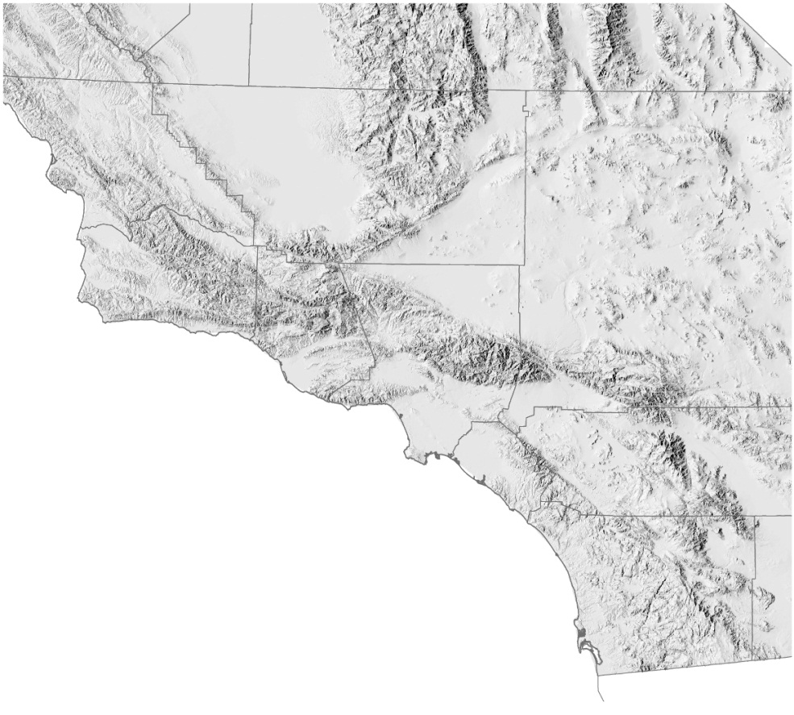
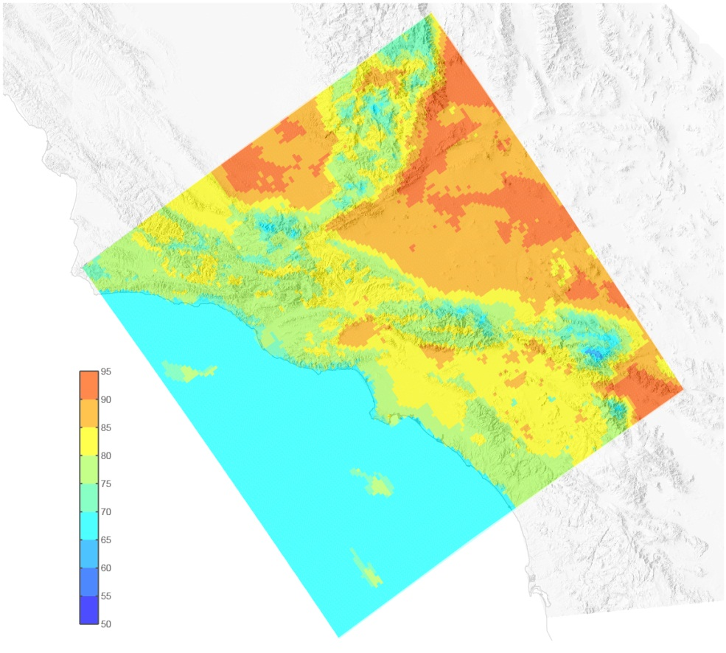
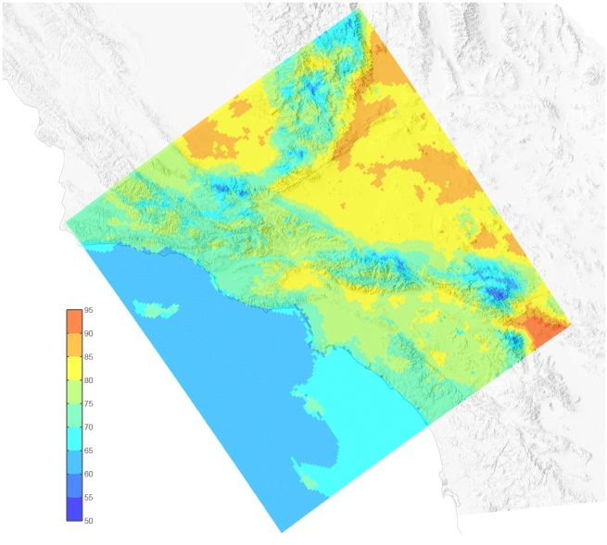
Temperature
Average August Temperature 1981–2000
Average August Temperature
2041–2060: Business As Usual
Bakersfield
Santa
Barbara
Los Angeles
San
Bernardino
Palm
Springs
San Diego

Slide 9
Temperature
Average August Temperature
Business As Usual
Mitigation
90
85
80
At least 70% of Business-As-Usual warming is inevitable
75
1981–2000
2041–2060

Slide 10
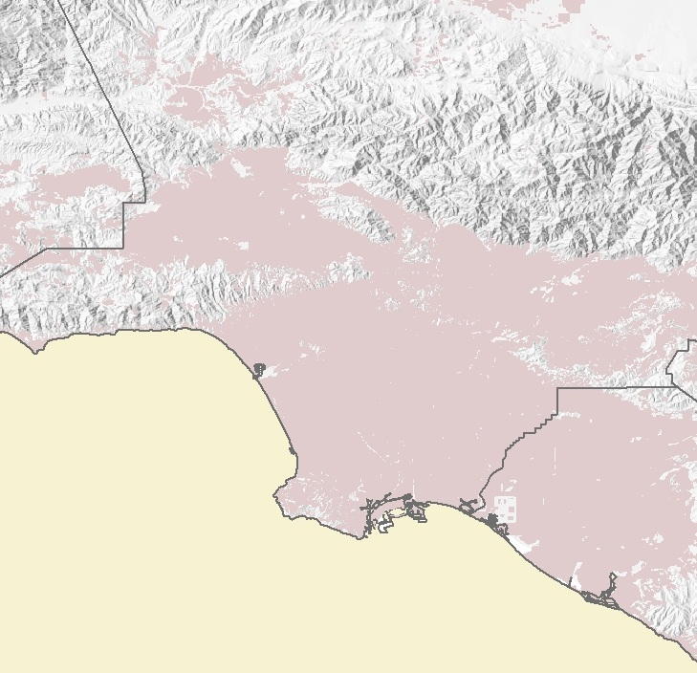
Days Hotter Than 95⁰F Per Year
Santa
Clarita
Porter
Ranch
San Fernando
Sunland
Pasadena
Woodland
Hills
Studio City
El Sereno
Hollywood
Westwood
Downtown LA
Santa Monica
Baldwin Hills
Venice
100 days >
Watts
2041–2060
Business As Usual
Long Beach
Santa Ana
60 days >
1981–2000

Slide 11
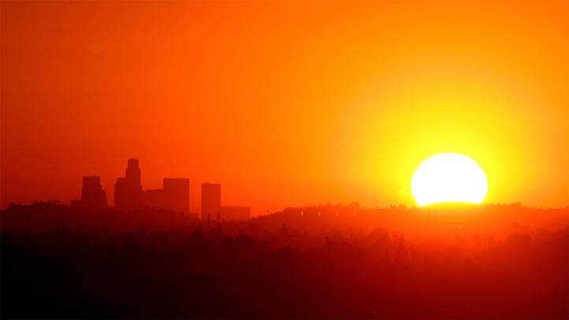
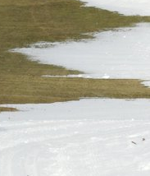
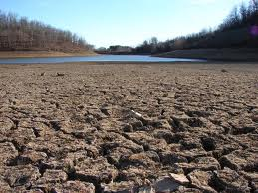
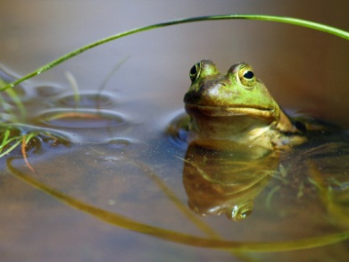
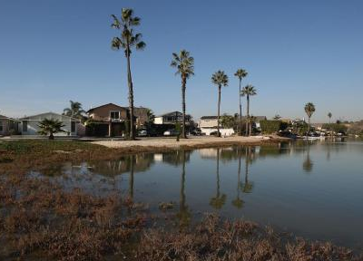
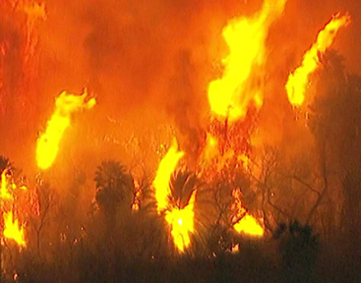
Adaptation is inevitable.
Temperatures
Snow
Water resources
Ecosystem effects
Sea level rise
Fire
But is it enough?

Slide 12
Temperature
Average August temperature
Business As Usual
Mitigation
90
85
80
75
1981–2000
2041–2060
2081–2100

Slide 13
California Climate Change Projections
Notes:
9-km domain

Slide 14
UCLA Climate Research Lounge
For more on the Climate Change in LA Project:
C-CHANGE.LA

Slide 15
UCLA Climate Research Lounge
Thank You
Special Thanks to:
Department of Energy
National Science Foundation
Los Angeles Mayor’s Office
Los Angeles Regional Collaborative
Climate Resolve
UCLA Dept. of Atmospheric and Oceanic Sciences
UCLA Institute of the Environment and Sustainability
Beth Jines
Jonathan Parfrey
Paul Bunje
Madelyn Glickfeld
Mark Gold
Glen MacDonald
Stephanie Pincetl

Slide 16

UCLA Climate Research Lounge
Credits
Presentation design, maps and illustrations by www.greeninfo.org
Photography/Images:
California Geological Survey
Los Angeles Times
Orange County Register
Mark A. Johnson
Accuweather.com
IPCC
Newser.com
Associated Press/Huffington Post
NASA Goddard Institute for Space Studies
Xweather.org

Slide 17

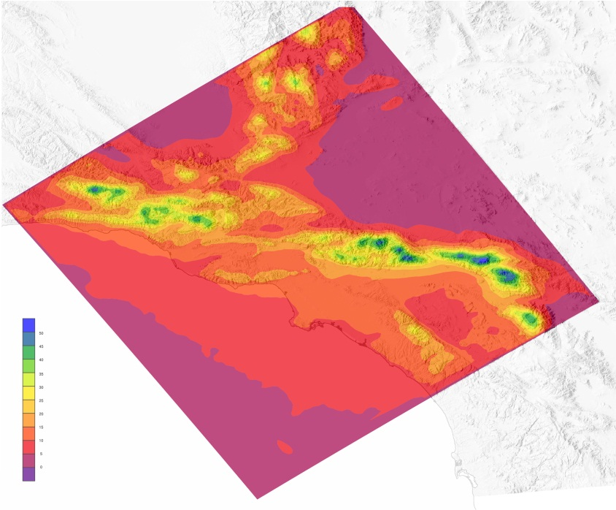
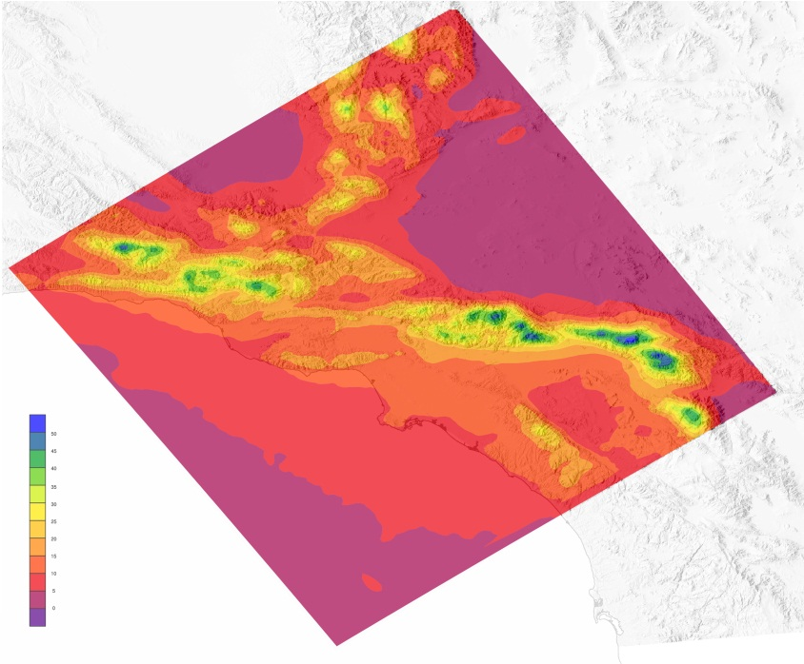
Precipitation
Little change in precipitation by mid-century*
Average Dec–Mar Precipitation
1981–2000
Average Dec–Mar Precipitation
2041–2060: Business As Usual
*Results are preliminary

Slide 18
Precipitation
But other factors affect water resources
Snowpack
Evaporation
Streamflow

Slide 19


Snowfall
Baseline Annual Snowfall
87”
40”
Wrightwood
87”
Lake Arrowhead
Idyllwild

Slide 20
Snowfall
Mid-Century
Business As Usual
52”
22”
Wrightwood
Lake Arrowhead
53”
Idyllwild

Slide 21
Snowfall
Mid-Century
Mitigation
62”
27”
Wrightwood
Lake Arrowhead
63”
Idyllwild

Slide 22
Fire
1981–2000
Acres Burned by Wildfires*
2041–2060
Business As Usual
45000
35000
25000
15000
5000
May
June
July
Aug
Sept
Oct
Nov
Dec
*Preliminary results from fire study conducted in collaboration with Yufang Jin and Jim Randerson at UC Irvine

Slide 23
UCLA Climate Research Lounge

